Slide 1
2D Z-string: A new spatial knowledge representation for image databases
Anthony J.T. Lee , Han-Pang Chiu
Department of Information Management, National Taiwan University, No. 1, Section 4, Roosevelt Road, Taipei 106, Taiwan, ROC Received 18 February 2003
Presenter : Yu-Ju Liao
Date :Apr. 12, 2022

Slide 2
Abstract
The knowledge structure called the 2D C⁺-string, proposed by Huang et al., to represent symbolic pictures allows a natural way to construct iconic indexes for images. According to the cutting mechanism of the 2D C⁺-string, an object may be partitioned into several subparts. The number of partitioned subparts is bounded to O(n²), where n is the number of objects in the image. Hence, the string length is also bounded to O(n²). In this paper, we propose a new spatial knowledge representation called the 2D Z-string. Since there are no cuttings between objects in the 2D Z-string, the integrity of objects is preserved and the string length is bounded to O(n). Finally, some experiments are conducted to compare the performance of both approaches.

Slide 3
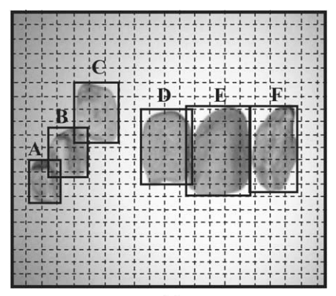

Spatial knowledge representation
u-string
v-string

Slide 4
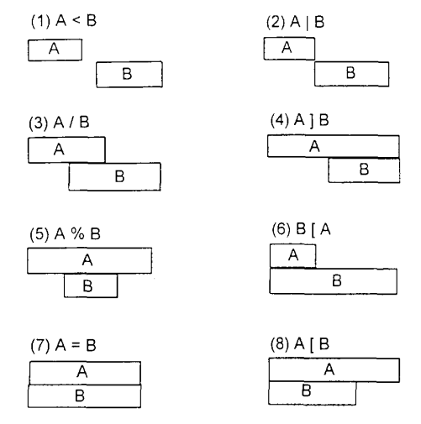
Metric measurements

Slide 5
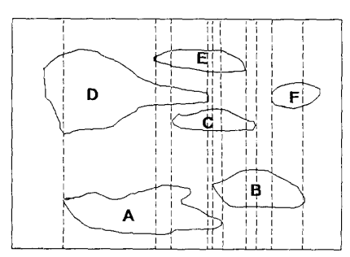
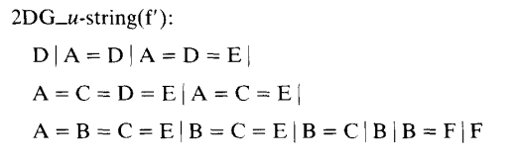
2D G-string
2D string (2D G-string) representation with a cutting mechanism to describe the objects of an image. G_{op} = {"<", "=", “|"} is the set of generalized relational operators.

Slide 6
2D G-string
2D string (2D G-string) representation with a cutting mechanism to describe the objects of an image. G_{op} = {"<", "=", “|"} is the set of generalized relational operators.

Slide 7
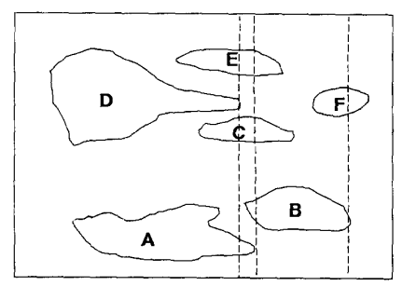

2D C-string
2D string (2D C-string) representation with a cutting mechanism to describe the objects of an image. R_{g} = {"<", “|"} is the set of global relational operators, R_{i} = {"=", "[", "]", "%"} is the set of local relational operators;

Slide 8
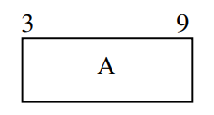
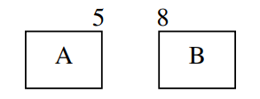
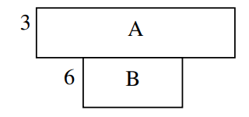
2D Z-string: Metric measurements
(1) The size of an object: A₆
(2) The distance associated with operator ‘‘<’’: A <₃ B
(3) The distance associated with operator ‘‘%’’: A%₃ B

Slide 9
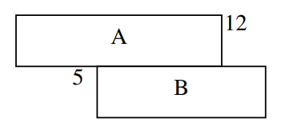
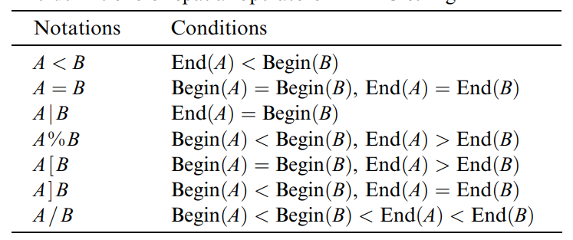
2D Z-string: Metric measurements
(4) The distance associated with operator ‘‘/’’: A/₇ B

Slide 10
2D Z-string
u-string
v-string

Slide 11
2D Z-string
u-string
v-string

Slide 12
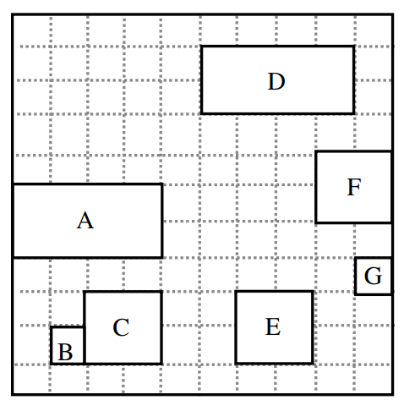
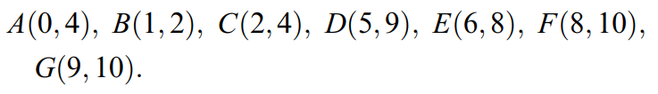
2D Z-string
(1)dominating point: B
(2) former objects
A former object of object O is an object with smaller begin-bound than that of object O or an object with equal begin-bound and bigger end-bound than that of object O.
(3) nearest former object
The former object with the biggest begin-bound.

Slide 13
2D Z-string
(1)dominating point: B
(2) former objects
A former object of object O is an object with smaller begin-bound than that of object O or an object with equal begin-bound and bigger end-bound than that of object O.
(3) nearest former object
The former object with the biggest begin-bound.

Slide 14
2D Z-string
(1)Dominating point: B
overlapping: x, cover: x
(2)Dominating point: A
cover: B, C
(A, B, C):
not any objects former objects: C
nearest former object: B
=> (B₁ | C₂)
not any objects former objects: (B₁ | C₂)
nearest former object: A
=> (A₄ ] (B₁ | C₂))

Slide 15
2D Z-string
(1)Dominating point: B
overlapping: x, cover: x
(2)Dominating point: A
cover: B, C
(A, B, C):
not any objects former objects: C
nearest former object: B
=> (B₁ | C₂)
not any objects former objects: (B₁ | C₂)
nearest former object: A
=> (A₄ ] (B₁ | C₂))

Slide 16
2D Z-string
(1)Dominating point: B
overlapping: x, cover: x
(2)Dominating point: A
cover: B, C
(A, B, C):
not any objects former objects: C
nearest former object: B
=> (B₁ | C₂)
not any objects former objects: (B₁ | C₂)
nearest former object: A
=> (A₄ ] (B₁ | C₂))

Slide 17
2D Z-string
(3)Dominating point: E
overlapping: x, cover: x
(4)Dominating point: D
overlapping: F
(5)Object covered by F : G
=> (F₂ ] G₁)
(6) Objects covered by the dominating object but not by object F:D, E
=> (D₄ %₁ E₂)
(7)Merge
=> ((D₄ %₁ E₂) /₁ (F₂ ] G₁))
(8)Merge
=> (A₄ ] (B₁ | C₂)) <₁ ((D₄ %₁ E₂) /₁ (F₂ ] G₁))

Slide 18
2D Z-string
(3)Dominating point: E
overlapping: x, cover: x
(4)Dominating point: D
overlapping: F
(D, F)
(5)Object covered by F(smallest end-bound) : G
=> (F₂ ] G₁)
(6) Objects covered by the dominating object but not by object F:D, E
=> (D₄ %₁ E₂)
(7)Merge
=> ((D₄ %₁ E₂) /₁ (F₂ ] G₁))
(8)Merge
=> (A₄ ] (B₁ | C₂)) <₁ ((D₄ %₁ E₂) /₁ (F₂ ] G₁))

Slide 19
2D Z-string
(3)Dominating point: E
overlapping: x, cover: x
(4)Dominating point: D
overlapping: F
(D, F)
(5)Object covered by F(smallest end-bound) : G
=> (F₂ ] G₁)
(6) Objects covered by the dominating object but not by object F:D, E
=> (D₄ %₁ E₂)
(7)Merge
=> ((D₄ %₁ E₂) /₁ (F₂ ] G₁))
(8)Merge
=> (A₄ ] (B₁ | C₂)) <₁ ((D₄ %₁ E₂) /₁ (F₂ ] G₁))

Slide 20
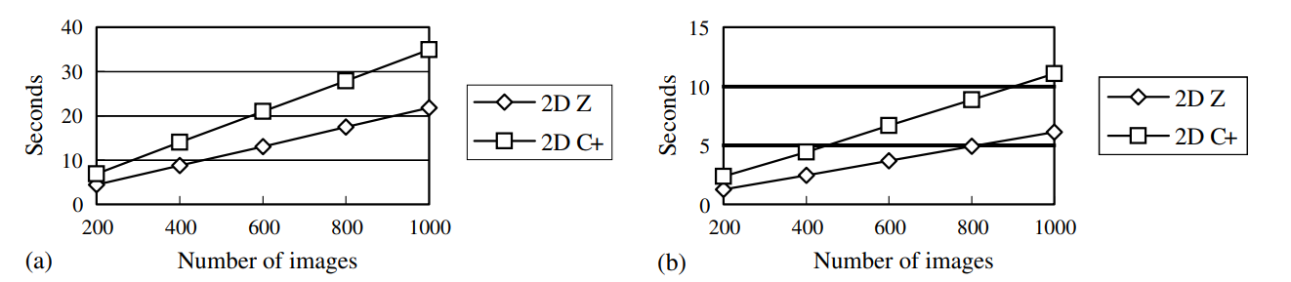
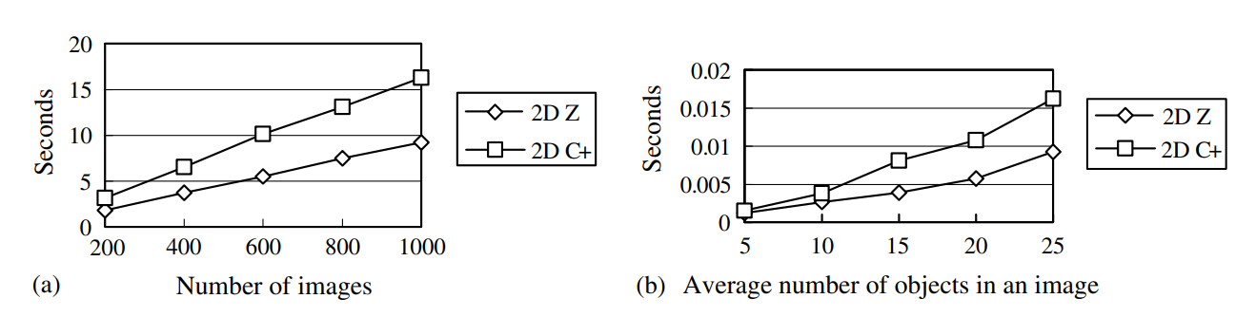
Result

Slide 22
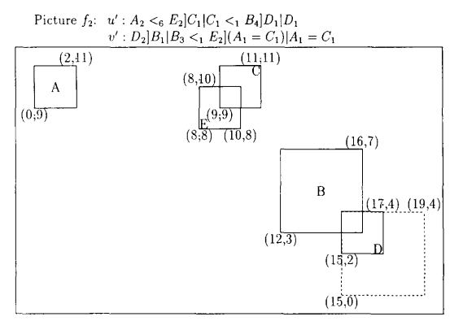
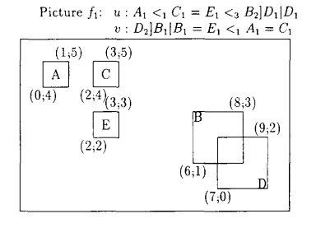
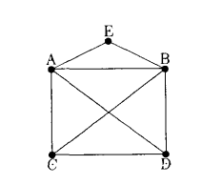
Maximal complete subgraph problem

Slide 23
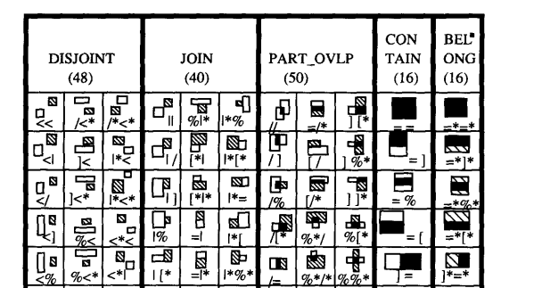
Five categories of relations
A disjoins B. All parts of A are separated from all parts of B.
A is edge to edge with B. The bound of A is edge to edge with the bound of B, and no part of A overlaps with any part of B.
A contains B. All parts of B are completely overlapped with some parts of A.
A belongs to B, All parts of A are completely overlapped with some parts of B.
A is partly overlapped with B.

