Slide 1
An Optimal Algorithm for Finding the Longest Increasing Subsequence of Every Substring
C. T. Tseng, S. H. Shiau, C. B. Yang
Proc. of the 5th Conference on Information Technology and Applications in Outlying Islands, Kinmen, Taiwan, June 2, 2006.
Presenter: Guan-Ting Chen
Date: June 7, 2022

Slide 2
Abstract
Given a string S = {a 1 , a 2 , a 3 , · · · , a n }, the longest increasing subsequence (LIS) problem is to ﬁnd a subsequence of the given string such that the subsequence is increasing and its length is maximal.
In a previous result, to ﬁnd the longest increasing subsequences of each sliding windows with a ﬁxed size w of a given string can be solved in O(wloglogn+OUTPUT) time, where O(wloglogn) is taken for preprocessing.
In this paper, we solve the problem for ﬁnding the longest increasing subsequence of every substring of S. With the straightforward implementation of the previous result, the time required for the preprocessing would be O(n²loglogn). With the modiﬁcation of the data structure used in the algorithm, our algorithm needs only O(n²) preprocessing time. Since there are O(n²) substrings totally in a given string with length n, our algorithm is optimal. The time required for the reporting stage is linear to the size of the output. In other words, our algorithm can ﬁnd the LIS of every substring in O(n²+OUTPUT) time, where OUTPUT is the sum of the lengths of the outputs.

Slide 3
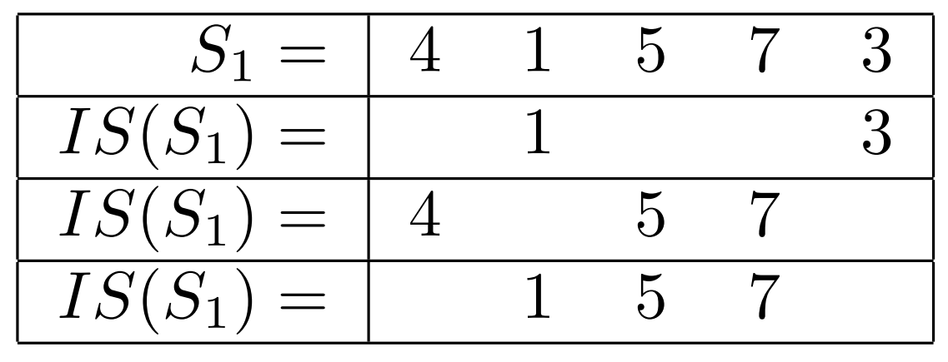
Longest Increasing Subsequence

Slide 4
LIS of Every Substring
Sequence: 4 1 5 7 3
Sequence [ i, j ] | LIS
4 1 5 7 3 | 4 5 7, 1 5 7
4 1 5 7 | 4 5 7, 1 5 7
1 5 7 3 | 1 5 7
5 7 3 | 5 7
7 3 | 7, 3
3 | 3

Slide 5
Patience Sorting
Sequence 415736
Principle Row
i | S[i]
1 | 4 | 4
2 | 1 | 1
3 | 5 | 1 5
4 | 7 | 1 5 7
5 | 3 | 1 3 7
6 | 6 | 1 3 6

Slide 6
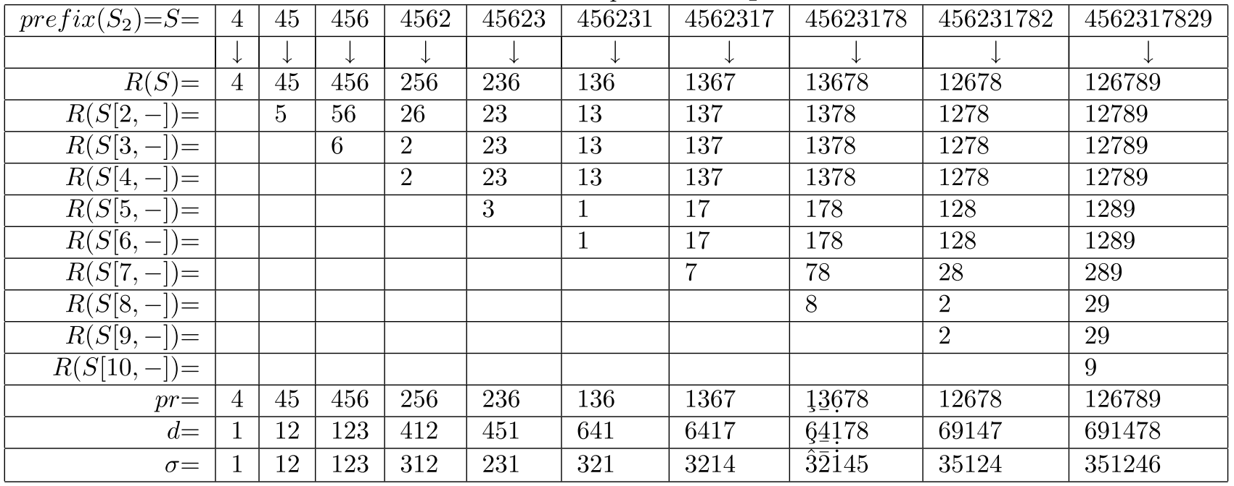

Slide 7
S | R(S)
45623178 | 13678
5623178 | 1378
623178 | 1378
23178 | 1378
3178 | 178
178 | 178
78 | 78
8 | 8
pr | 1 | 3 | 6 | 7 | 8
d | 6 | 4 | 1 | 7 | 8
σ | 3 | 2 | 1 | 4 | 5

Slide 8
ADD
Get the position that the new element 2 should be ADD
Find Successor
Chain
p = 2 4 5
i | 1 | 2 | 3 | 4 | 5
pr | 1 | 3 | 6 | 7 | 8
σ | 3 | 2 | 1 | 4 | 5

Slide 9
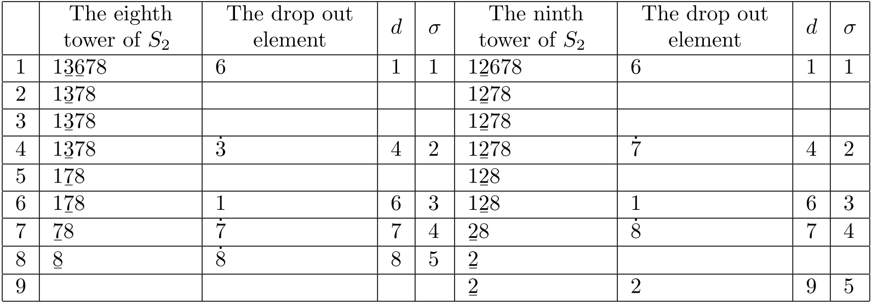
ADD (cont.)
S = 45623178 ADD 2

Slide 10
ADD (cont.)

Slide 11
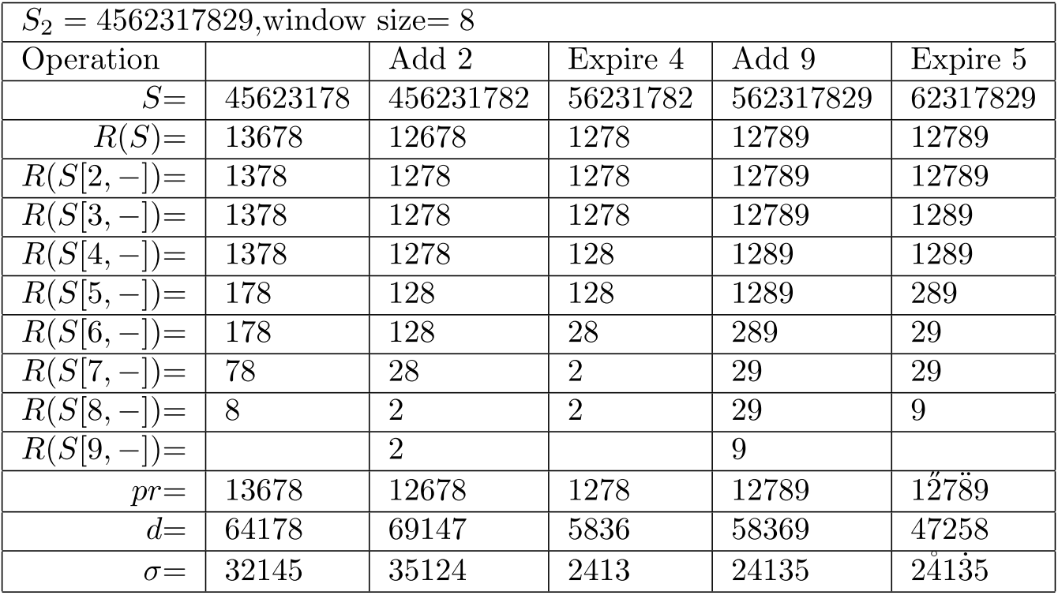
EXPIRE

Slide 12
Trace
Find predecessor
S | 4 | 45 | 456 | 4562 | 45623 | 456231 | 4562317 | 45623178
R | 4 | 45 | 456 | 256 | 236 | 136 | 1367 | 13678
σ | 1 | 12 | 123 | 312 | 231 | 321 | 3214 | 32145

Slide 13
Trace
Find predecessor
S | 45623178
pr | 13678
σ | 32145
S | 4562317
pr | 1367
σ | 3214
S | pr | σ
45623 | 236 | 231
5623 | 23 | 12
S | 456
pr | 456
σ | 123
Output: 45678

Slide 14

Time Complexity
$O\left(n^{2}+ OUTPUT\right)$
ADD, EXPIRE
$O(l)$
l is the LIS length in the window

