Slide 1
Fuzzy Deep Learning based Urban Traffic Incident Detection
Chaimae El Hatri, Jaouad Boumhidi
Cognitive Systems Research, Volume 50, August 2018, Pages 206-213
Presenter: Ying-Yu Lin
Date: Jun.7, 2022

Slide 2
Abstract (1/2)
Traffic incident detection (TID) is an important part of any modern traffic control because it offers an opportunity to maximise road system performance. For the complexity and the nonlinear characteristics of traffic incidents, this paper proposes a novel fuzzy deep learning based TID method which considers the spatial and temporal correlations of traffic flow inherently. Parameters of the deep network are initialized using a Stacked Auto-Encoder (SAE) model following a layer by layer pre-training procedure. To conduct the fine tuning step, the back-propagation algorithm is used to precisely adjust the parameters in the deep network.

Slide 3
Abstract (2/2)
Fuzzy logic is employed to control the learning parameters where the objective is to reduce the possibility of overshooting during the learning process, increase the convergence speed and minimize the error. To find the best architecture of the deep network, we used a separate validation set to evaluate different architectures generated randomly based on the Mean Squared Error (MSE). Simulation results show that the proposed incident detection method has many advantages such as higher detection rate and lower false alarm rate.

Slide 4
Automatic incident detection techniques
Support Vector Machine (SVM)
- limitation : choice of kernel function
Fuzzy Logic (FL)
- affected by subjective decisions
Back-Propagation Neural Network (BPNN)
- slow convergence, possibility of getting caught in the local minimum

Slide 5
Traffic incident detection(TID)
Artificial Neural Networks (ANNs)
- pattern recognition problem
- no mathematical model or explicit rules.
deep learning algorithm
- represent traffic features without prior knowledge

Slide 6
Fuzzy deep learning
Initialize the parameters:
- stacked auto-encoder (SAE)
Adjust the parameters:
- back-propagation algorithm
Adaptively vary the learning parameters:
- fuzzy logic control

Slide 7
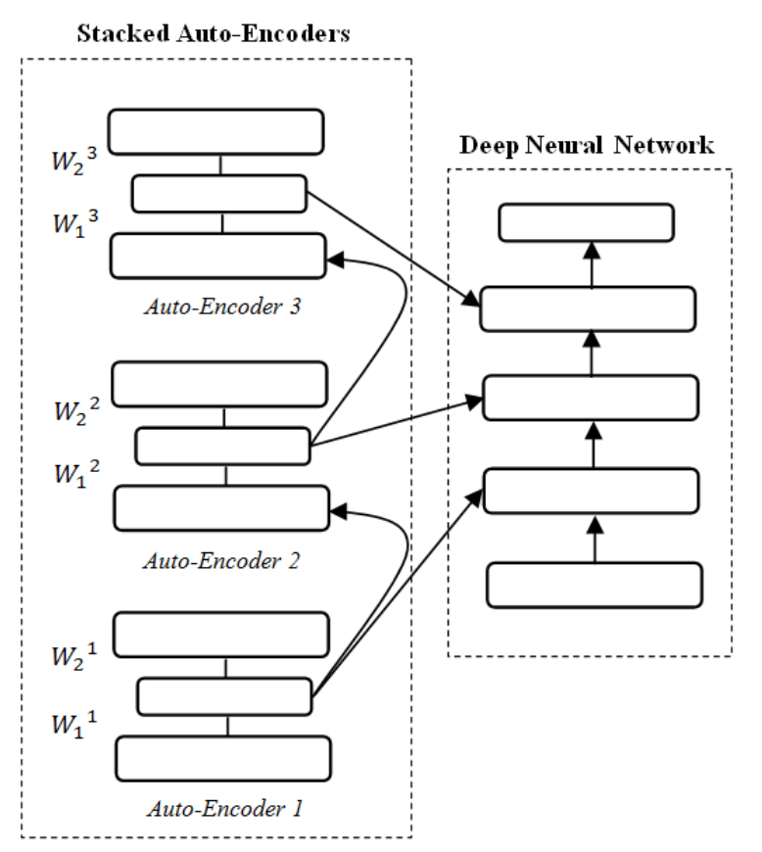
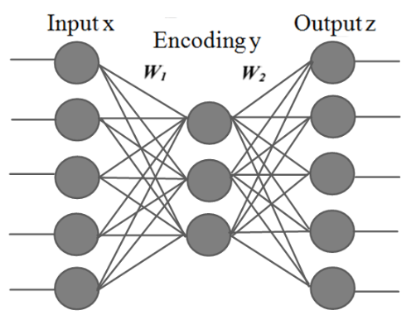
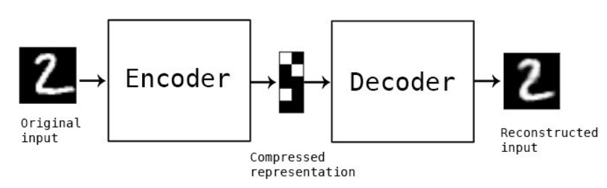
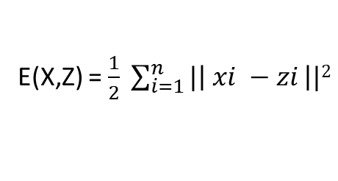
Stacked Auto-Encoders (SAE)
E(X,Z) = $\frac{1}{2} \sum_{i=1}^{n}{|\left| xi −zi \right||2}$

Slide 8
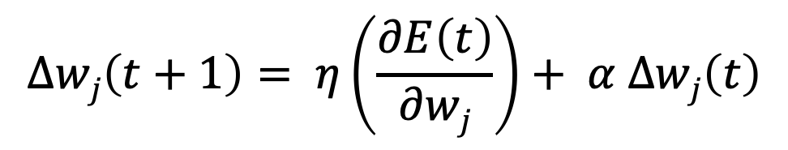

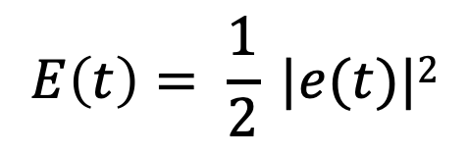
Back-Propagation Algorithm
$$∆wj\left(t+1\right)= η\left(\frac{∂E\left(t\right)}{∂wj}\right)+ α ∆wj\left(t\right)$$
$η :learning rate , α :momentum factor$
$$E\left(t\right)= \frac{1}{2} |e(t)|2$$

Slide 9
Fuzzy Logic Controlled Deep Neural Network
Consists of four components:
- fuzzifier
- fuzzy rule base
- fuzzy inference process
- defuzzifier

Slide 10
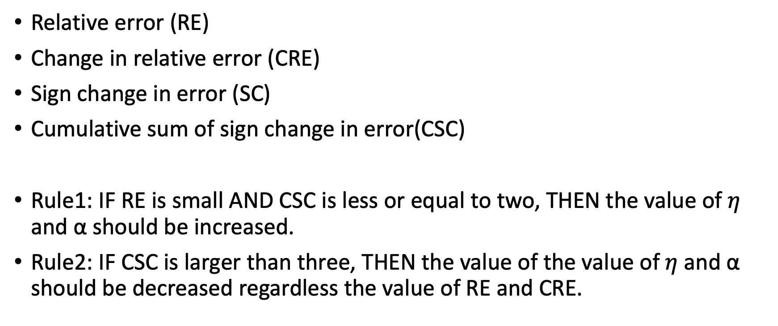
Fuzzy Logic Control System
Relative error (RE)
Change in relative error (CRE)
Sign change in error (SC)
Cumulative sum of sign change in error(CSC)
Rule1: IF RE is small AND CSC is less or equal to two, THEN the value of $η$ and α should be increased.
Rule2: IF CSC is larger than three, THEN the value of the value of$η$ and α should be decreased regardless the value of RE and CRE.

Slide 11
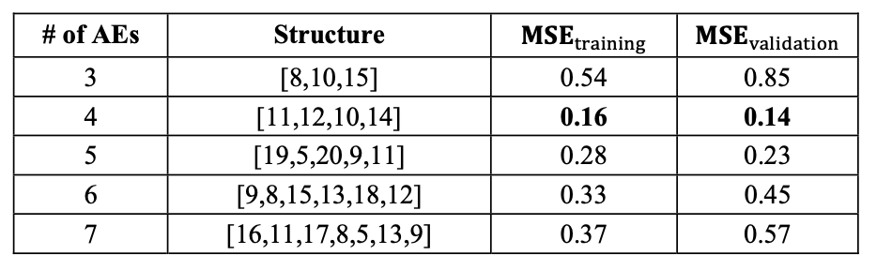
Experiment
determine the optimal structure of the deep network

Slide 12
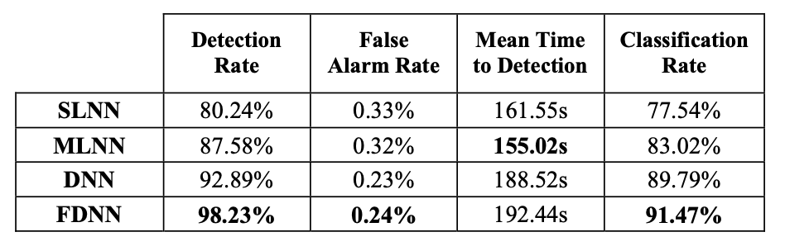
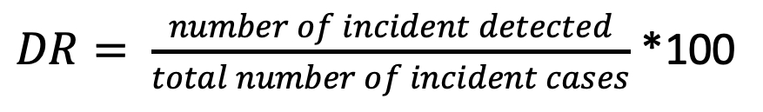
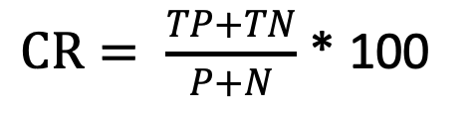
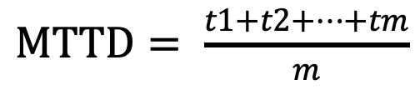

Experiment
$DR= \frac{number of incident detected}{total number of incident cases}$ *100
FA$R= \frac{number of false alarm cases}{total number of non−incident instances}$ *100
$MTTD= \frac{t1+t2+…+tm}{m}$
$CR= \frac{TP+TN}{P+N}$ * 100

Slide 13
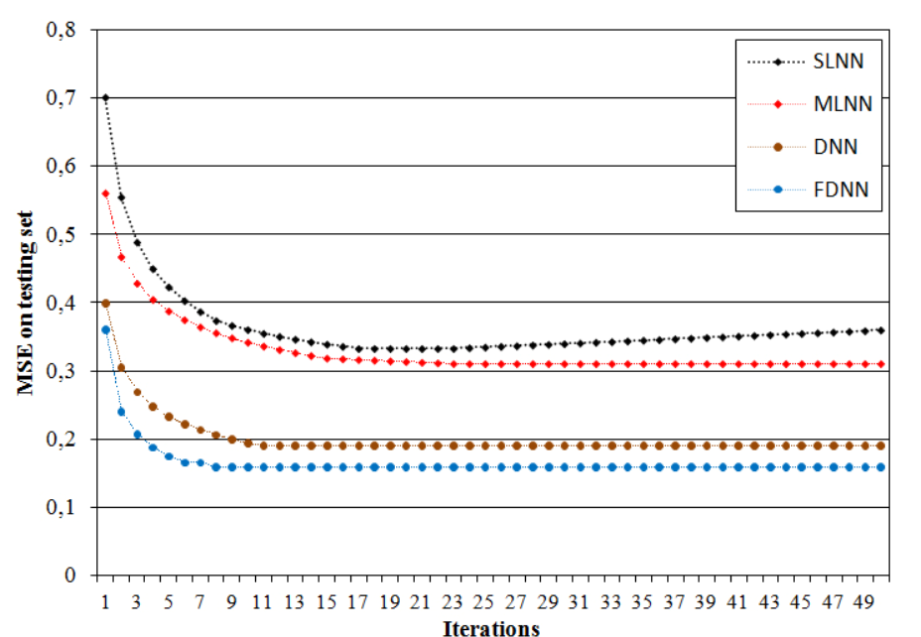
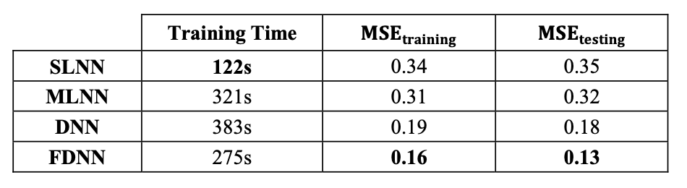
Experiment

Slide 14
Conclusion
unsupervised learning algorithm to pre-train the deep network
FDNN minimize the error and reduce the training time by 28.19%

