Slide 1
Finding the gapped longest common subsequence by incremental suﬃx maximum queries
Yung-Hsing Peng, Chang-Biau Yang
Information and Computation 237 (2014) 95–100
Presenter: Cheng-Han Ho
Date: Jun. 14, 2022

Slide 2
Abstract (1/2)
The longest common subsequence (LCS) problem with gap constraints (or the gapped LCS), which has applications to genetics and molecular biology, is an interesting and useful variant to the LCS problem. In previous work, this problem is solved in O(nm) time when the gap constraints are ﬁxed to a single integer, where n and m denote the lengths of the two input sequences A and B, respectively. In this paper, we ﬁrst generalize the problem from ﬁxed gaps to variable gap constraints.

Slide 3
Abstract (2/2)
Then, we devise an optimal approach for the incremental suﬃx maximum query (ISMQ), which helps us obtain an eﬃcient algorithm with O(nm) time for ﬁnding LCS with variable gap constraints. In addition, our technique for ISMQ can be applied to solve one of the block edit problems on strings, reducing the time complexity from O(nm logm + m²) to O(nm + m²). Hence, the result of this paper is beneﬁcial to related research on sequence analysis and stringology.

Slide 4
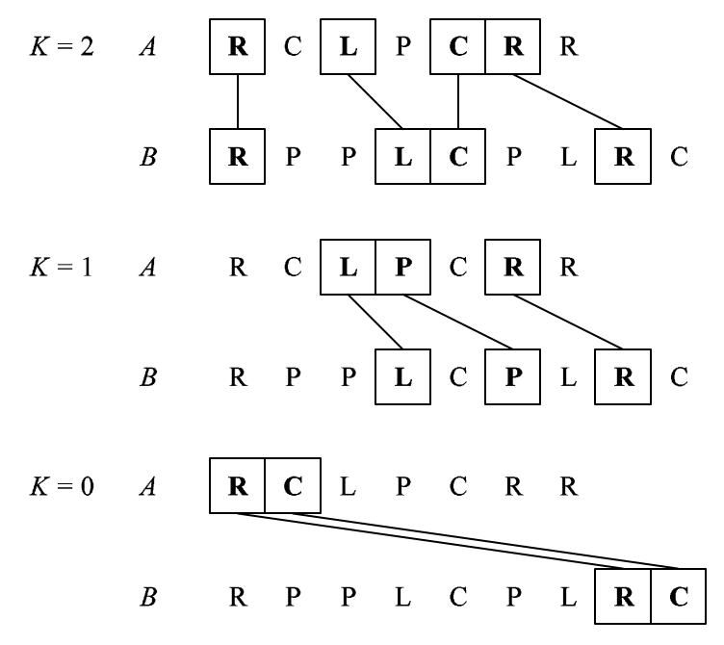
FIG (fixed gap LCS)
i_{x} − i_{x−1} ≤ K + 1, for 2 ≤ x ≤ p.

Slide 5
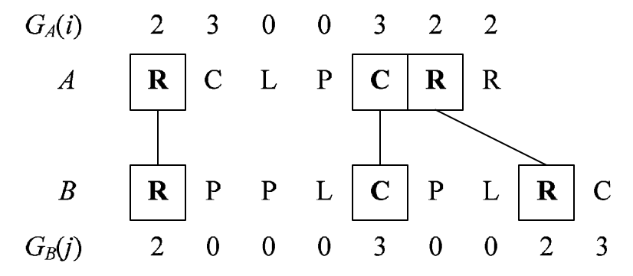
VGLCS (variable gap LCS )
i_{x} − i_{x−1} ≤ G_{s}(i_{x}), for 2 ≤ x ≤ p.

Slide 6
VGLCS
G_{Y}(j)+1
 |  | Y₁ | Y₂ | ... | Y_{j-1-K} | … | Y_{j-1} | Y_{j} | … | Y_{n}
X₁
X₂
⋮
X_{i-1-K}
⋮
X_{i-1}
X_{i} |  |  |  |  |  |  |  | ●
⋮
X_{n}
每個 match 需檢查
(G_{X}(i)+1 * (G_{Y}(j)+1)
使用 ISMQ 找到最大值
G_{X}(i)+1

Slide 7
ISMQ (Incremental Suﬃx Maximum Query)
D = 10, 3, 7, 2
SMQ_{D} = 10, 7, 7, 2
D = 10, 3, 7, 2, 5
SMQ_{D} = 10, 7, 7, 5, 5
D = 10, 3, 7, 2, 5, 8
SMQ_{D} = 10, 8, 8, 8, 8, 8

Slide 8
VGLCS
Step.1 更新這行的 ISMQ 序列
Step.2 更新前一列的 ISMQ 序列
Step.3 如果 match，設為這列的ISMQ 找到之最大值 + 1
 |  | Y₁ | Y₂ | ... | Y_{j-1-K} | … | Y_{j-1} | Y_{j} | … | Y_{n}
X₁
X₂
⋮
X_{i-1-K}
⋮
X_{i-1}
X_{i} |  |  |  |  |  |  |  | ●
⋮
X_{n}

Slide 9
VGLCS
Step.1 更新這行的 ISMQ 序列
Step.2 更新前一列的 ISMQ 序列
Step.3 如果 match，設為這列的ISMQ 找到之最大值 + 1
 |  | Y₁ | Y₂ | ... | Y_{j-1-K} | … | Y_{j-1} | Y_{j} | … | Y_{n}
X₁
X₂
⋮
X_{i-1-K}
⋮
X_{i-1}
X_{i} |  |  |  |  |  |  |  | ●
⋮
X_{n}

Slide 10
VGLCS
Step.1 更新這行的 ISMQ 序列
Step.2 更新前一列的 ISMQ 序列
Step.3 如果 match，設為這列的ISMQ 找到之最大值 + 1
 |  | Y₁ | Y₂ | ... | Y_{j-1-K} | … | Y_{j-1} | Y_{j} | … | Y_{n}
X₁
X₂
⋮
X_{i-1-K}
⋮
X_{i-1}
X_{i} |  |  |  |  |  |  |  | ●
⋮
X_{n}

Slide 11
Union and Find
又稱為 disjoint set union problem
ISMQ problem reduce to union-ﬁnd problem.
operations :
make(x, C)
ﬁnd(x):
unite(x, y, C)

Slide 12
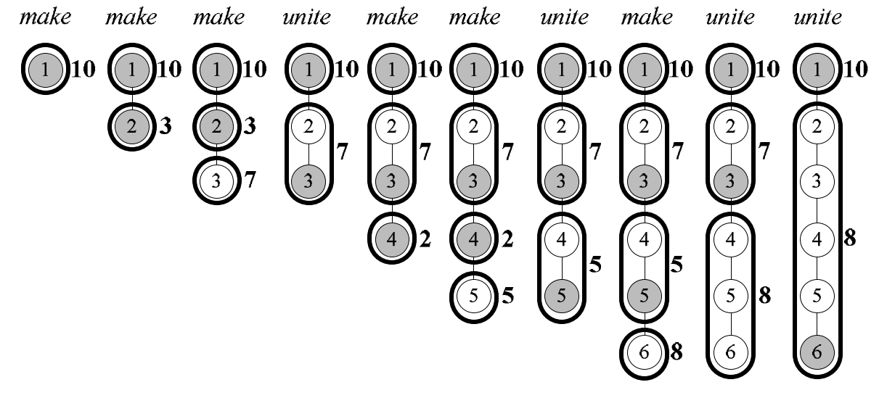
Union and Find
D = 10, 3, 7, 2, 5, 8

Slide 13
Time complexity
使用 incremental tree set union，把 union-ﬁnd operations 降成 O(1)
union-ﬁnd : O(mn)
VGLCS: O(mn)

