Slide 1
A Branch and Bound Irredundant Graph Algorithm for Large-Scale MLCS Problems ​
Chunyang Wang, Yuping Wang and Yiuming Cheung
Pattern Recognition, Volume 119, November 2021, 108059
Presenter:Chien-Ting Lee
Date: Jun. 14, 2022

Slide 2
Abstract(1/2)
Finding the multiple longest common subsequences (MLCS) among many long sequences (i.e., the large scale MLCS problem) has many important applications, such as gene alignment, disease diagnosis, and documents similarity check, etc. It is an NP-hard problem (Maier et al., 1978). The key bottle neck of this problem is that the existing state-of-the-art algorithms must construct a huge graph (called direct acyclic graph, briefly DAG), and the computer usually has no enough space to store and handle this graph. Thus the existing algorithms cannot solve the large scale MLCS problem.
Notes:
et cetera

Slide 3
Abstract(2/2)
In order to quickly solve the large-scale MLCS problem within limited computer resources, this paper therefore proposes a branch and bound irredundant graph algorithm called Big-MLCS, which constructs a much smaller DAG (called SmallDAG) than the existing algorithms do by a branch and bound method, and designs a new data structure to efficiently store and handle Small-DAG. By these schemes, Big-MLCS is more efficient than the existing algorithms. Also, we compare the proposed algorithm with two state-of-the-art algorithms through the experiments, and the results show that the proposed algorithm outperforms the compared algorithms and is more suitable to large-scale MLCS problems.
Notes:
1呂當鄧
skins

Slide 4
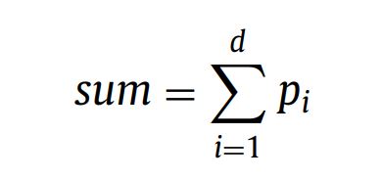
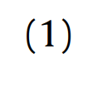
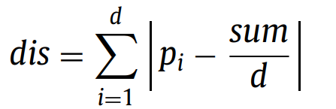

Branch and bound
EX: P(1,2,3)
sum=1+2+3=6
EX: P(1,2,3)
sum/d=6/3=2
dis=|1-2|+|2-2|+|3-2|=2
Notes:
這有兩個公式用來挑選哪些點用來當作評估值，
公式(1)將所有的點的維度相加越小者越優先挑選
公式(2)各維度與平均值做相減後相加=>代表各個維度數值較相近，序列後面可能會有更多match point
我們會先看sum的值，越小越好 ，如果sum相等在看dis，一樣也是越小越好，如果皆相同，則隨機選取。

Slide 5
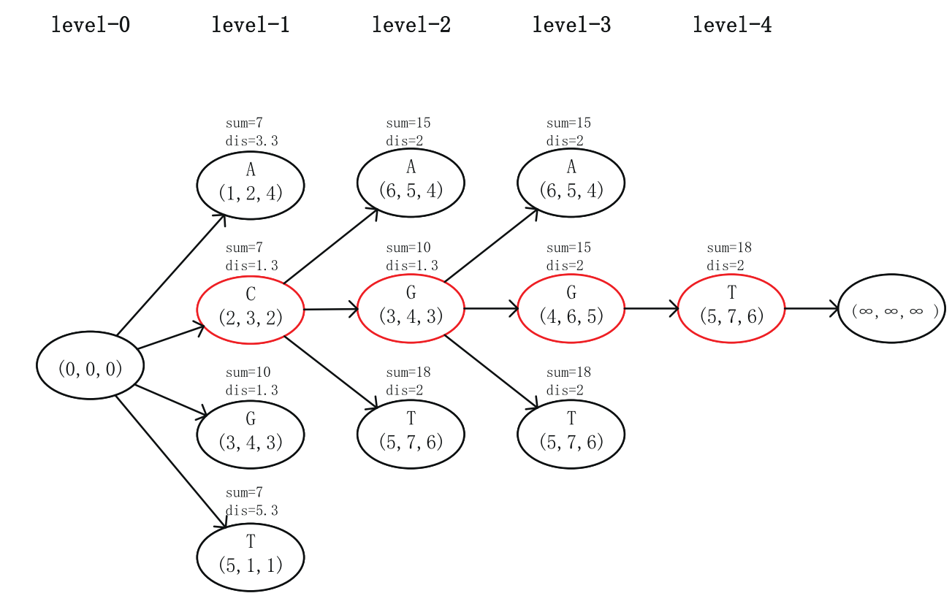
Branch and bound
Temporary Maximum Length=4
Notes:
下限

Slide 6
Branch and bound
衡量點公式:
Notes:
N條序列的lcs長度一定會小於 2條的lcs長度，故我們會從n條裡面挑選兩條

Slide 7



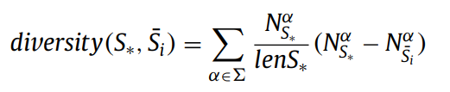
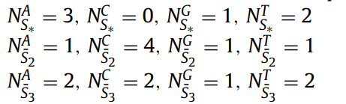
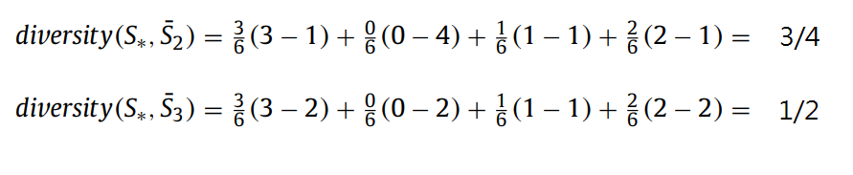
Branch and bound
挑選S1 S2做LCS當作upper bound

Slide 8
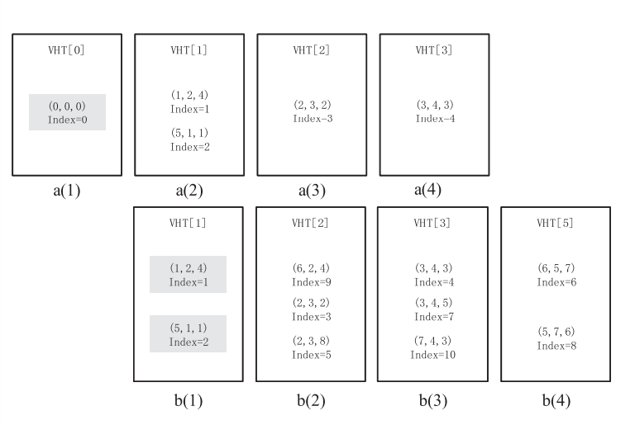
Vector Hash Table
Notes:
依照點裡面的維度的最小值來做紀錄

Slide 9



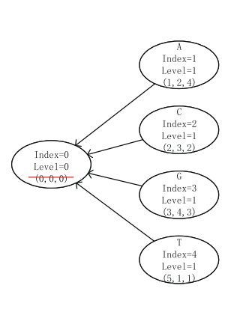
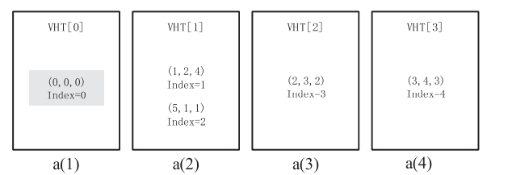
Small-DAG

Slide 10
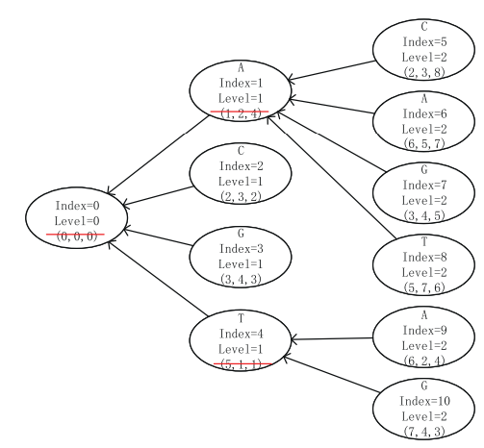
Small-DAG
|S1|=|S2|=|S3|=8

Slide 11
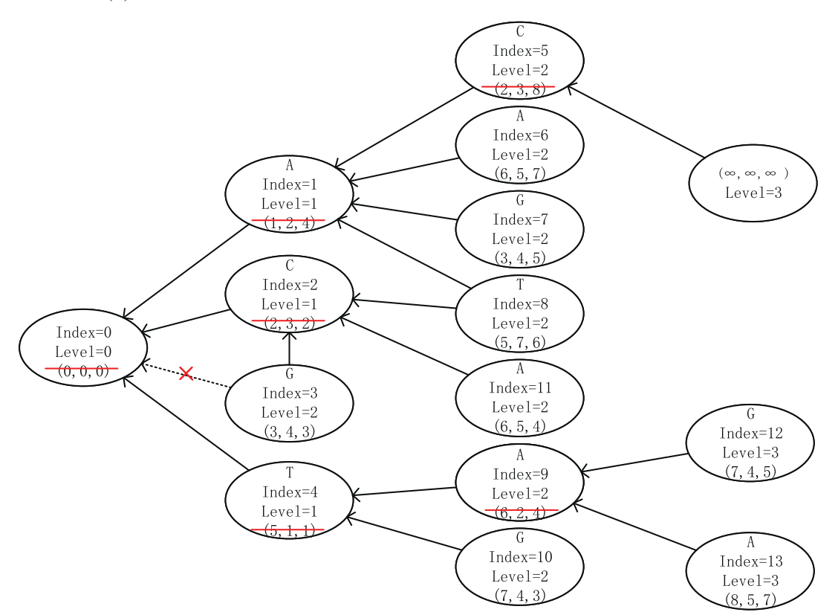
Small-DAG
|S1|=|S2|=|S3|=8
Notes:
7,4,3

Slide 12
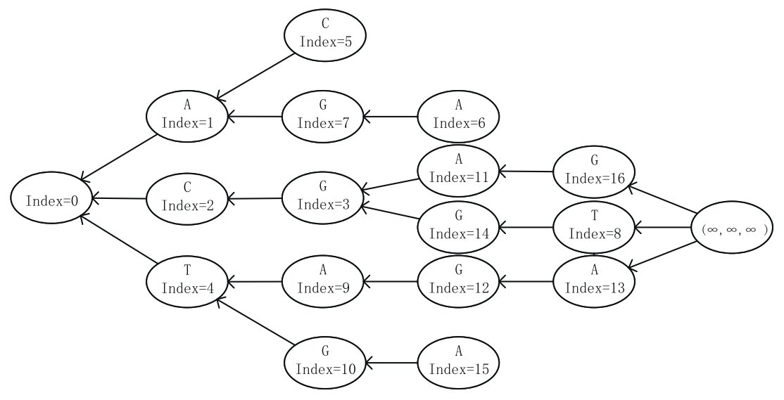

Small-DAG

Slide 13
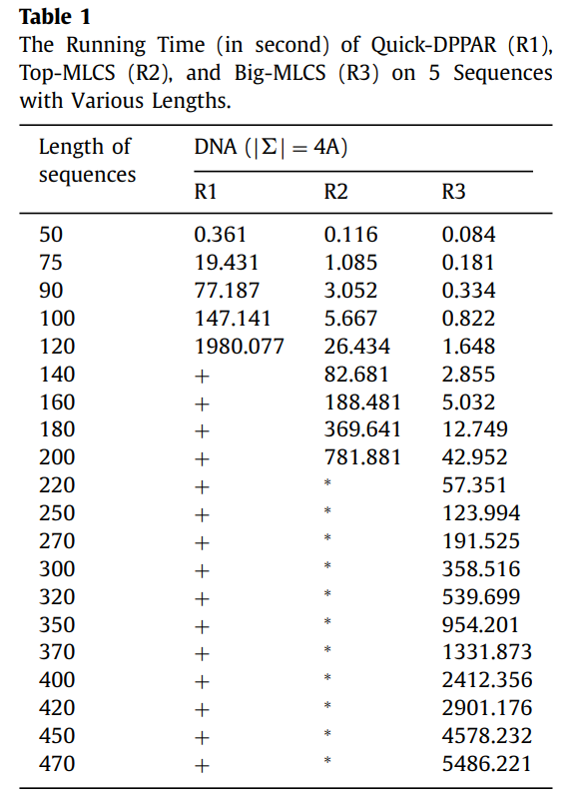
Experimental reults
‘∗’ indicates that the algorithm cannot get results in limited memory (128G)
’ + ’ indicates that the algorithm cannot get results in our limited time of 6000 seconds
Notes:
序列數量 5
序列長度 不斷增加
結果:
序列長度在小於120時，3種算法都能在短時間內得到答案，
Top-MLCS 時間大約是Big-MLCS的1.5倍-16倍
120 and 200之間，Top-MLCS 時間大約是Big-MLCS的1.8倍-29倍
超過 200，Quick-MLCS 和 Top-MLCS 算法都無法在時間內得到答案，而Big-MLCS仍然可以
這圖表明了
相同環境下，Big-MLCS 可以解決更長的 MLCS

Slide 14
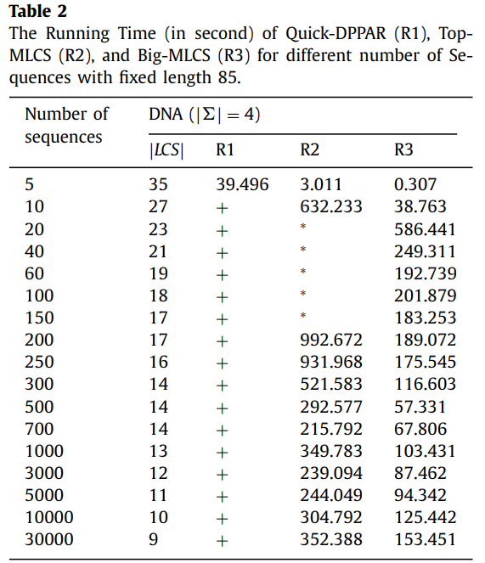
Experimental reults
‘∗’ indicates that the algorithm cannot get results in limited memory (128G)
’ + ’ indicates that the algorithm cannot get results in our limited time of 6000 seconds
Notes:
使用DNA來比較 字母種類為ATCG 4種
序列長度 85
序列數量 不斷增加
結果:
Big-MLCS仍優於另外兩個演算法
隨著序列數的增加，用於時間總體趨勢將先增加，然後逐漸減少。
出現這種現象的原因是因為隨著序列數的增加大於一定規模（在這種情況下，當比對序列超過100），最終MLCS的長度與match points數量會逐漸減少。
這意味著對於固定長度的問題，並不是序列越多，MLCS問題的難度就越大。
我們可以看到序列長度固定為 85時，最困難的是序列數量20 to 200

Slide 15
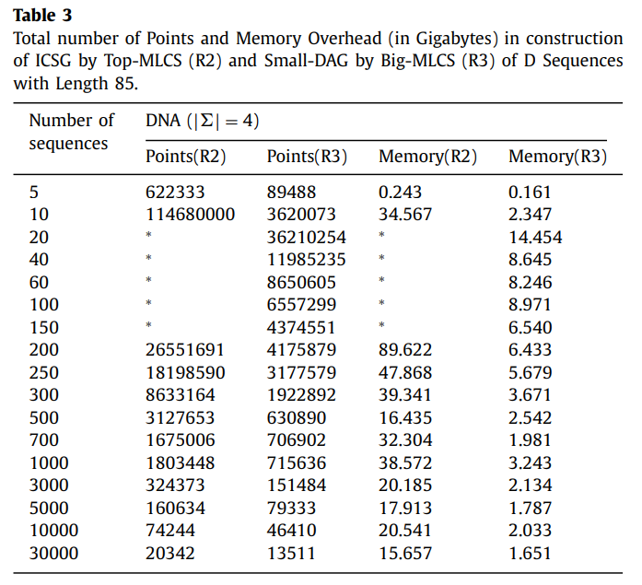
Experimental reults
‘∗’ indicates that the algorithm cannot get results in limited memory (128G)
’ + ’ indicates that the algorithm cannot get results in our limited time of 6000 seconds
Notes:
序列長度 85
序列數量 不斷增加
結果:
當序列數逐漸增加時，Top-MLCS 和 Big-MLCS不管是在point的數量還是memory消耗皆是先增加後減少。
結論
使用新的數據結構(GHT)以避免拓撲排序。branch and bound.
實驗結果表明，Big-MLCS 在時間、空間方面皆優於兩種最先進的算法：Quick-MLCS 和 Top-MLCS

