Slide 1
Monge Properties of Sequence Alignment
Luís M.S. Russo
Theoretical Computer Science, 2012
Volume 423, pp. 30-49
Presenter: Tsung-Lin Lu
Date: June 14, 2022

Slide 2
Abstract (1/2)
Alignment is an important sequence comparison measure. Algorithms that compute alignments have a wide range of applications, namely in bioinformatic tools. Alignments can be computed as maximum scoring paths in Alignment DAGs. In this paper we study the properties of matrices that contain alignment scores between a string and all the substrings of another string. We focus on the fact that these matrices have the Monge property and are sparse in some sense. Related studies were recently presented for HSM and DIST matrices, leading to O(nlogn) procedure for multiplying those matrices, where O(n) bounds the sizes of the strings. Our results strictly generalize previous solutions.

Slide 3
Abstract (2/2)
We measure the sparseness of the matrices with variable 𝛅 and present an algorithm for matrix multiplication in O((n+𝛅)log³(n+𝛅)) time, which we improve to O((n+𝛅)log²(n+𝛅)) , within the same space. We discuss applications of this algorithm, namely fully incremental alignment and alignment update. We study, experimentally, the performance of the methods we propose.

Slide 4
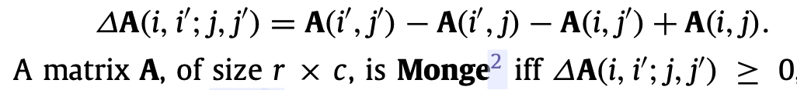
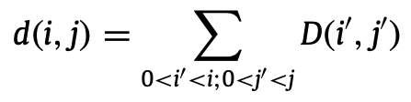
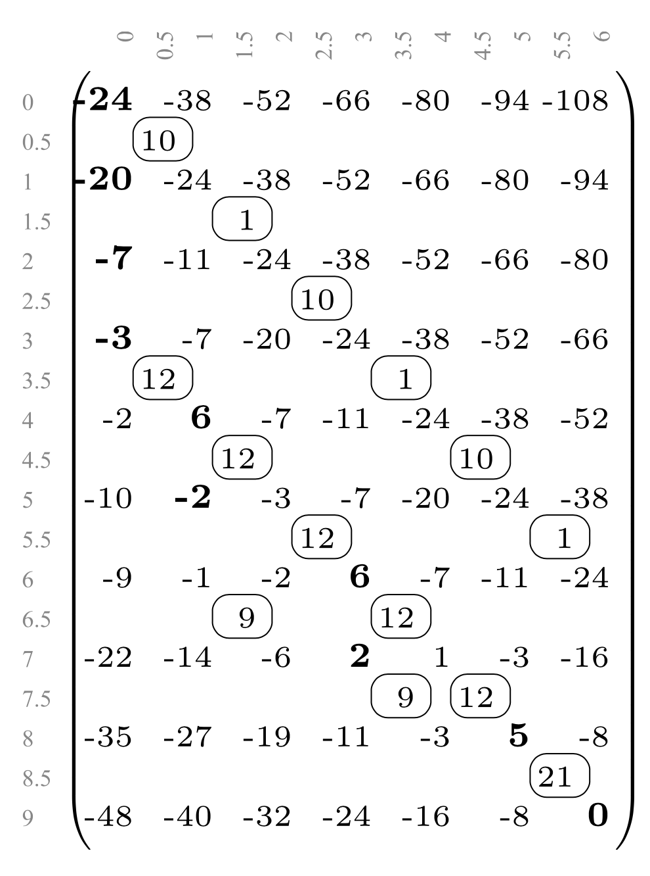
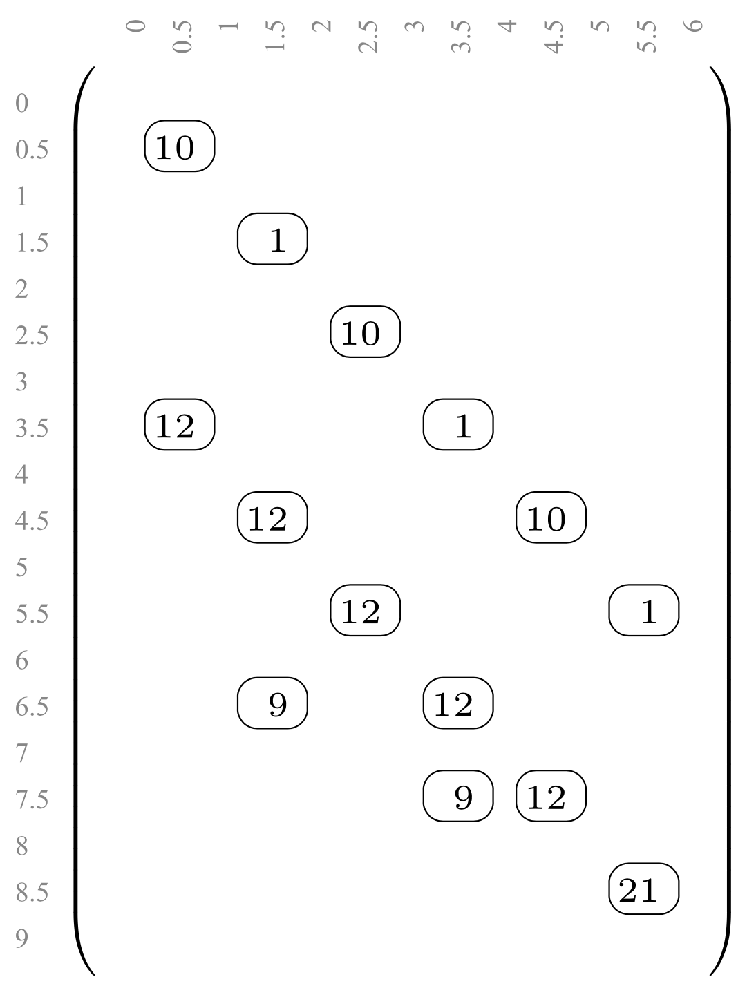
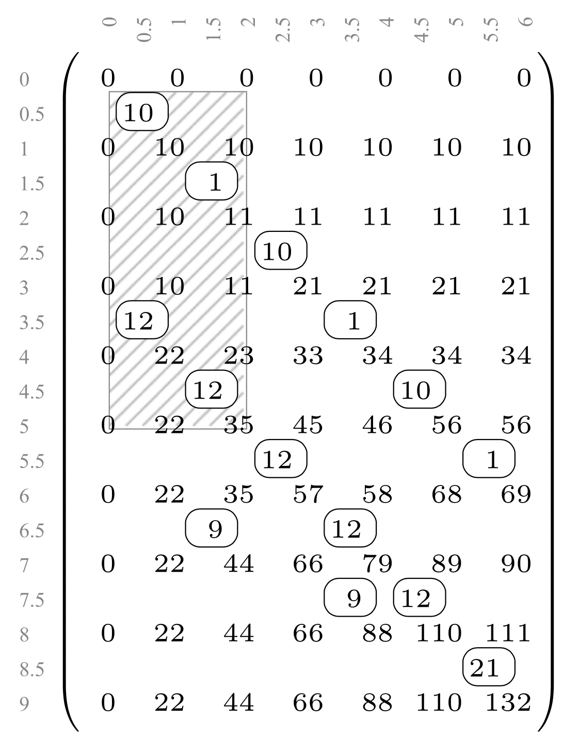
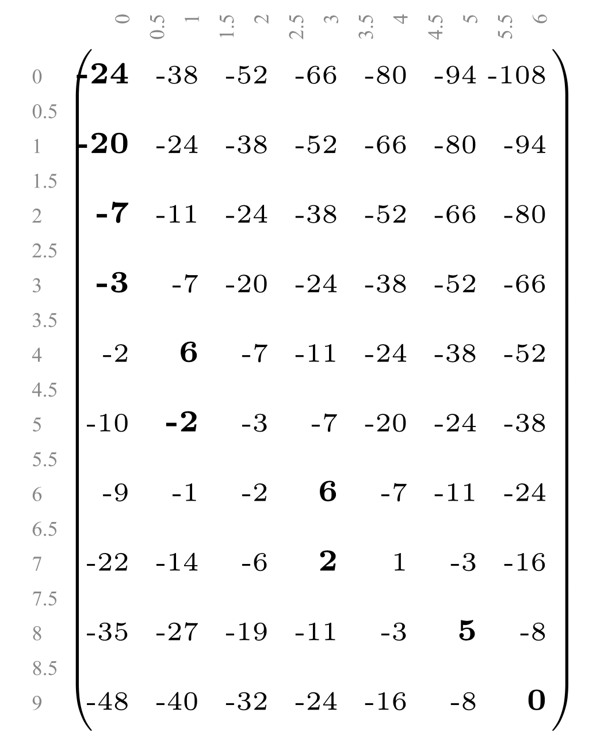
Monge Matrix
Density
Monge
Distribution
(a) The A Monge matrix. The leftmost maximum per row is in bold.
(b) The A Monge matrix and the underlying density matrix.
(c) The A density matrix, the 0 entries are omitted.
(d) The A density matrix and distribution matrix. A(5, 2) = 10 + 1 + 12 + 12 = 35.

Slide 5
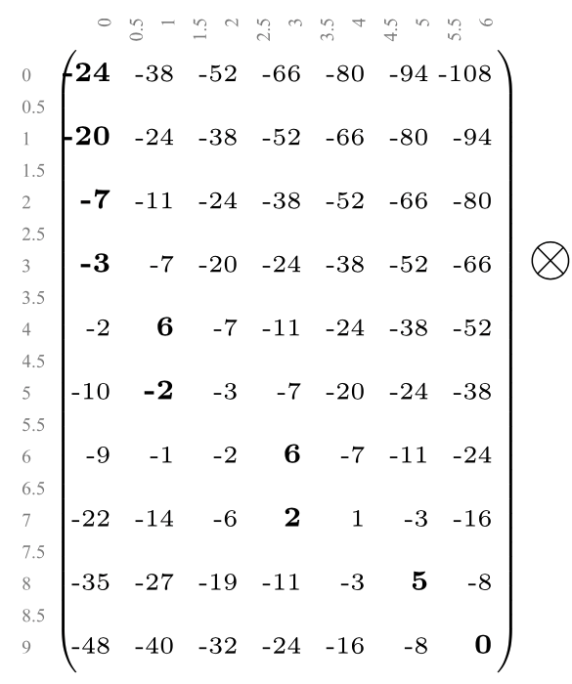
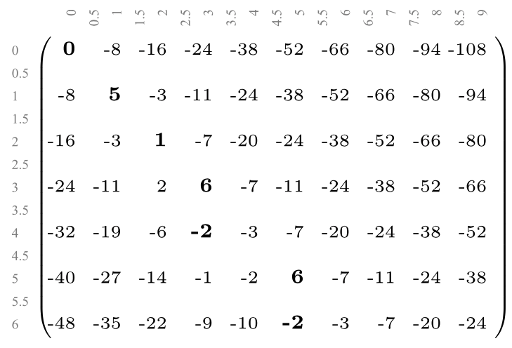
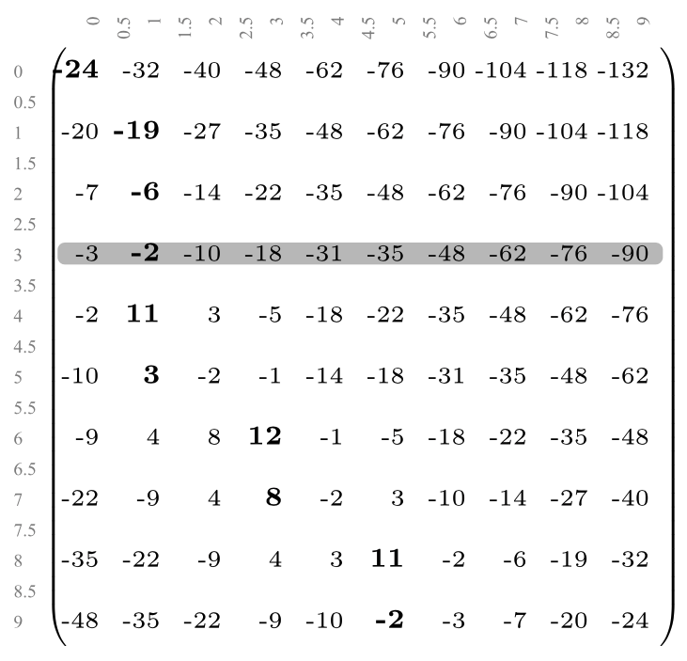
Matrix Multiplication
A
B
C
=
(a) Monge max-plus product. C = A ⊗ B

Slide 6
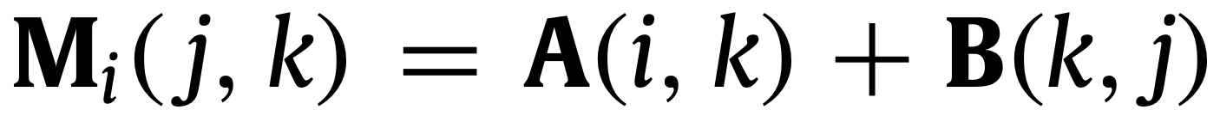
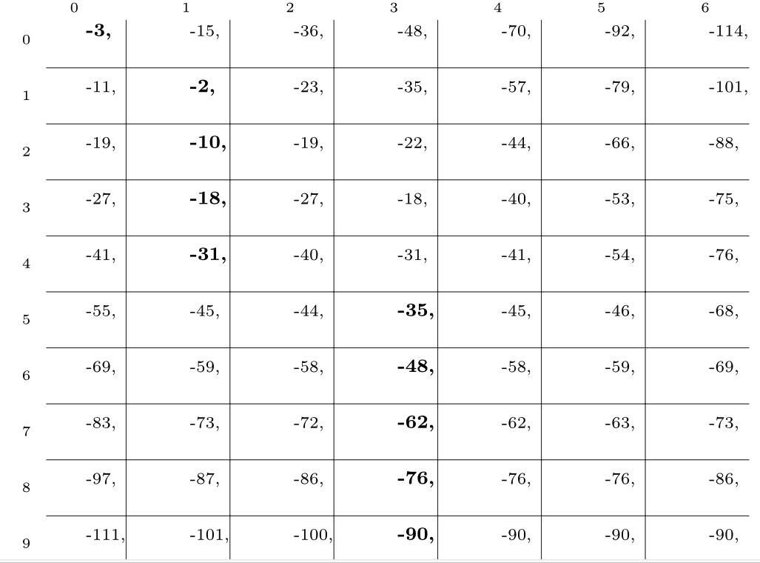
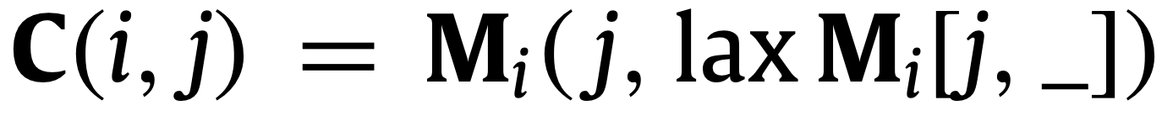
Intermediate Computation Matrices M_{i}
(a) The C Monge matrix.
(b) The M₃ matrix.

Slide 7
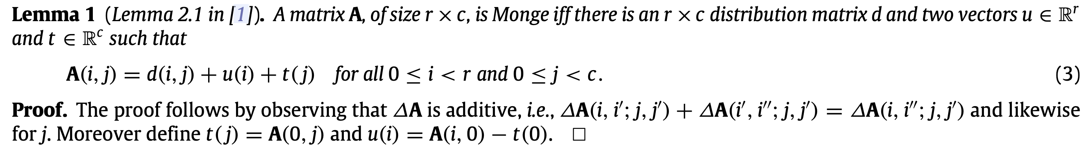
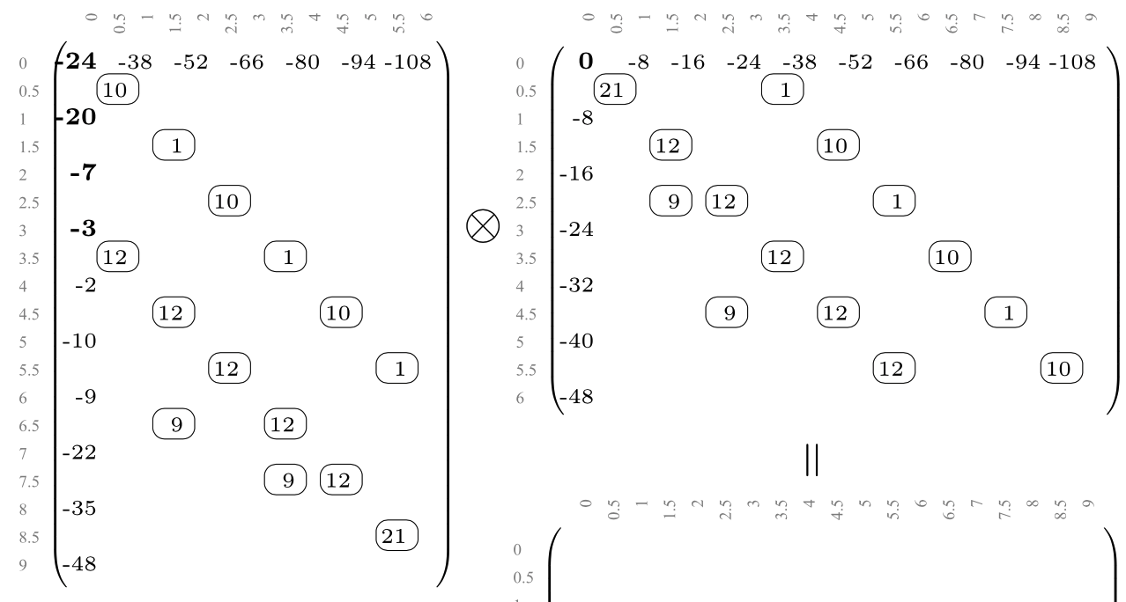
Implicit Matrix Multiplication
≈

Slide 8
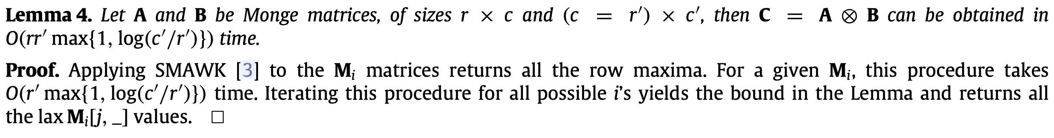
Lemma (1)
Monge matrix可以被拆解成空間更少的形式
(max, +) product
Intermediate Computation Matrices
Algorithm1 : SMAWK

Slide 9
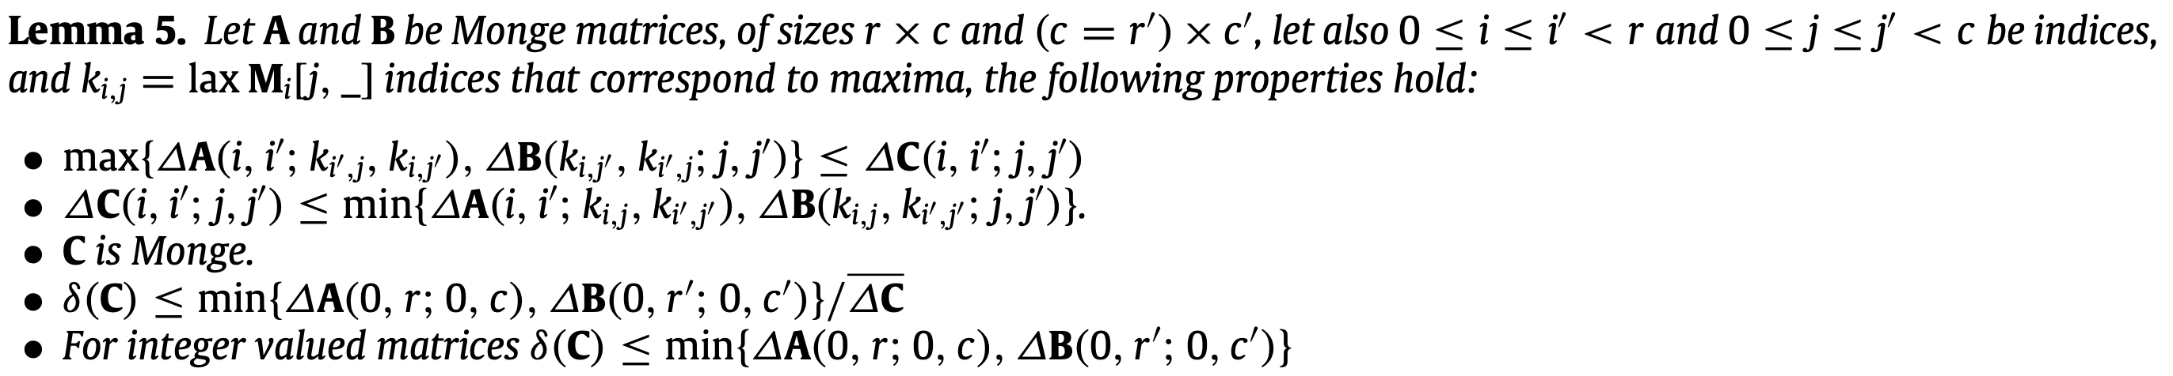
Lemma (2)
C的基本性質
Algorithm2 : Tiskin for Unit-Monge Matrix
[17] A. Tiskin, Fast distance multiplication of Unit-Monge matrices, in: Proc. 21th Annual ACM-SIAM Symposium on Discrete Algorithms, SODA, 2010, pp. 1287–1296.

Slide 10
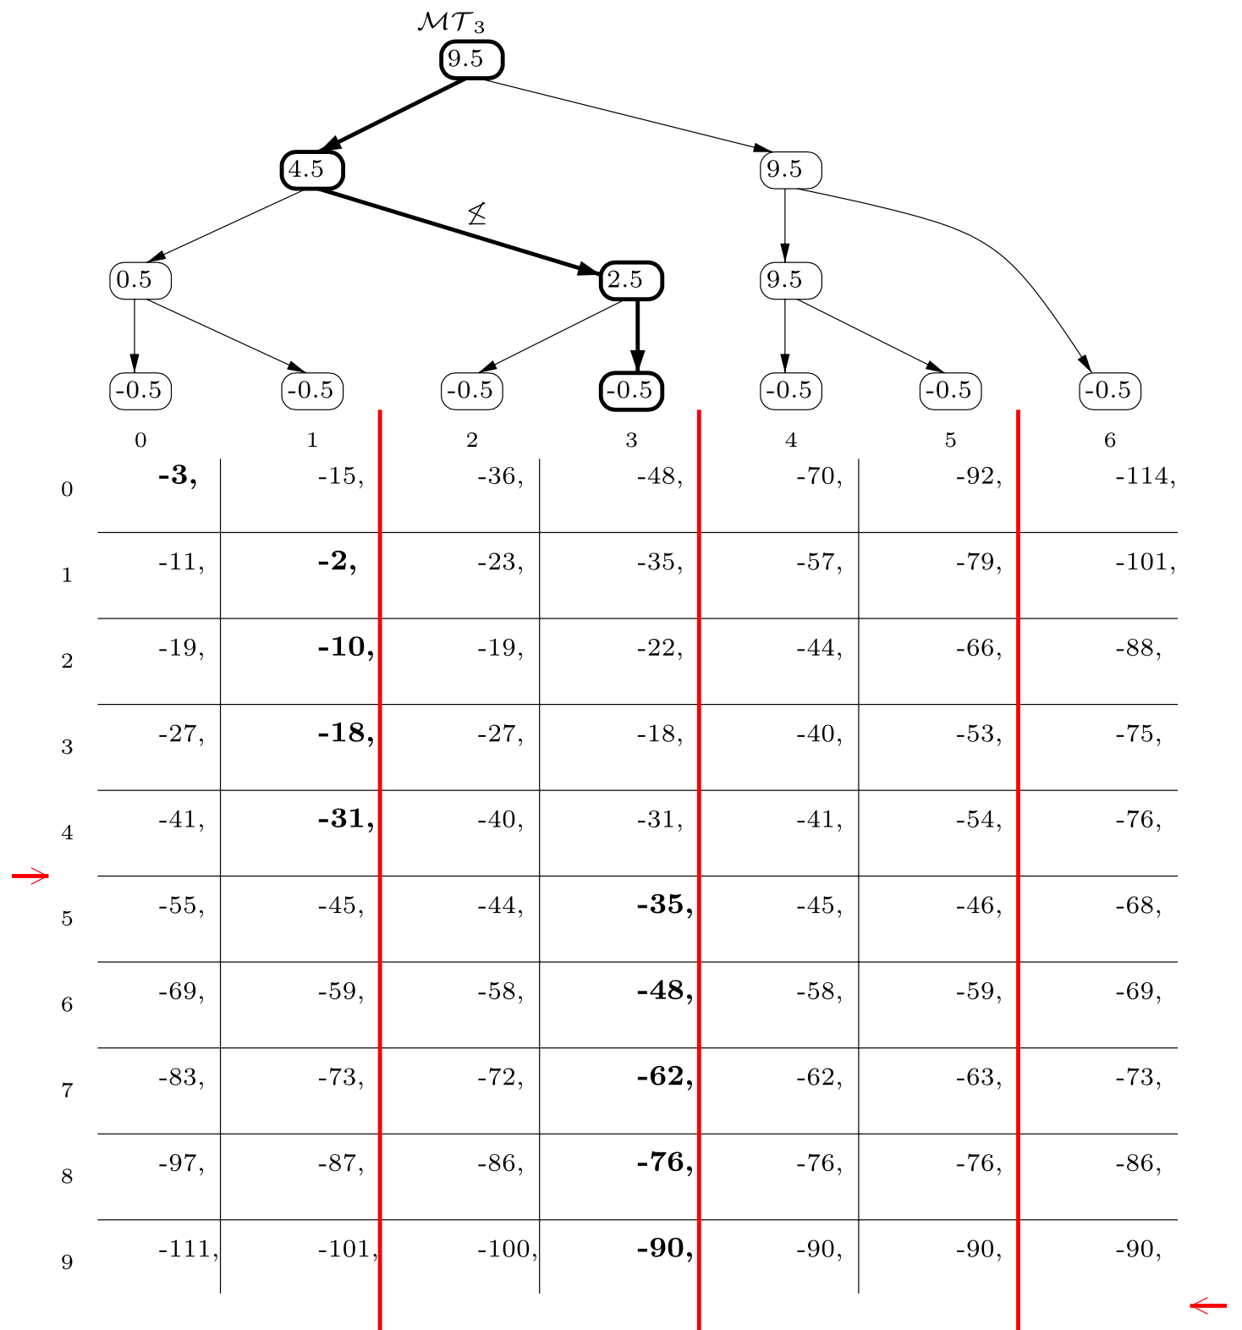
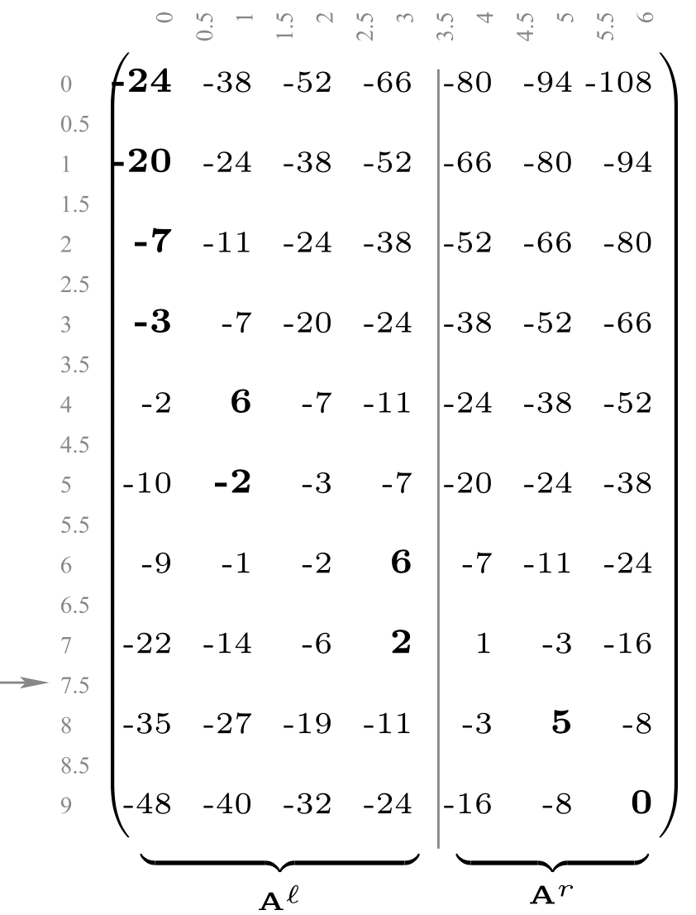
Transition Point (TR) Maxima Trees
(a) The A Monge matrix. TR(A) = 7.5
(b) The M₃ matrix. TR(M₃) = 9.5, TR(M₃^{r}) = 9.5, TR(M₃^{l}) =4.5

Slide 11
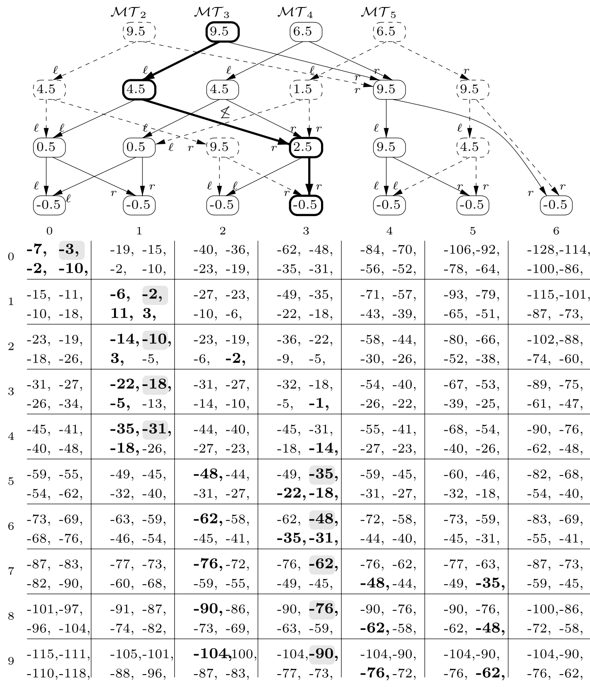
Multiple Maxima Trees
∆A(2, 4;4, 6) = 0 → M₂, M₃, M₄ share the right subtree
∆A(4, 5;4, 6) ≠ 0 → M₄, M₅ doesn't share the right subtree
M₂ (top-left), M₃ (top-right), M₄ (bottom-left) and M₅ (bottom-right).

Slide 12
Lemma (3)
Transition point
Maxima tree
使用Maxima tree找到laxA[i,_]時間
建構Maxima tree時間，使用二元搜索決定transition point
Maxima trees共用的部分
Algorithm3 : Multiple Maxima Trees (MMT) by this paper

Slide 13
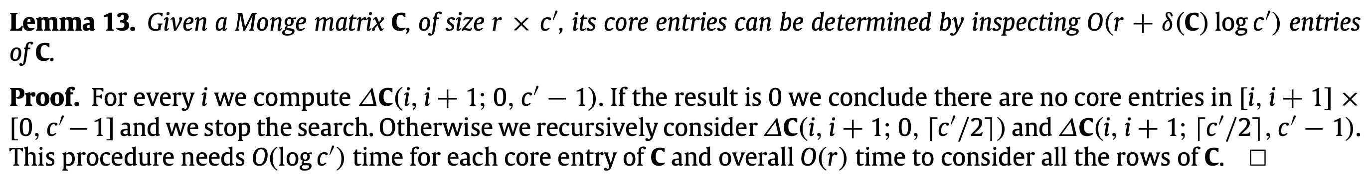
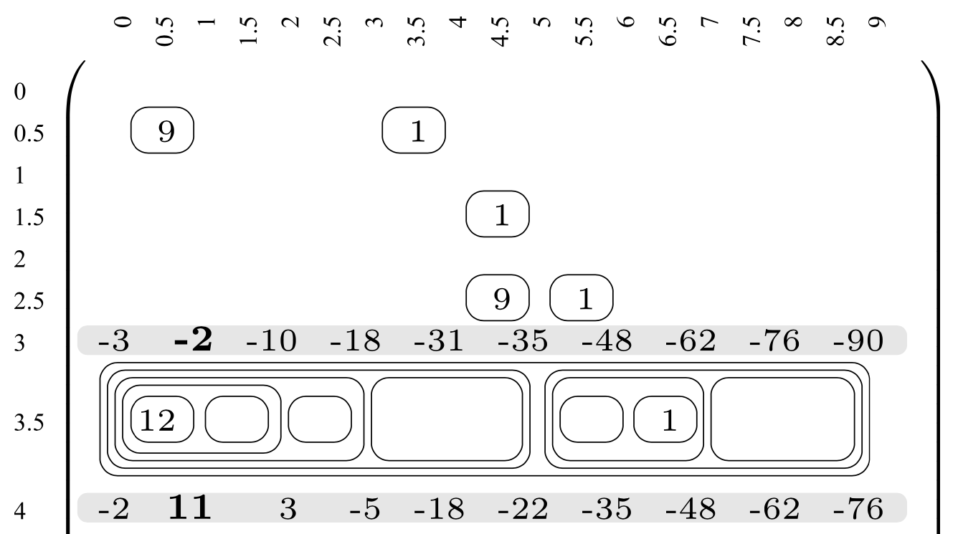
Obtaining The Core

Slide 14
Lemma (4)
在Monge matrix中找到所有core entries (density>0)的時間
因為不需要儲存所有的MT，只需要MT_{i}和MT_{i+1}，故MMT可以再改良
TR(Mi)具有monotnoic性質
這列有非零的density
Amortized Multiple Maxima Trees：使用Lemma15、16和線性搜尋，可改進搜尋效率
Algorithm4 : Amortized Multiple Maxima Trees (AMMT) by this paper

Slide 15
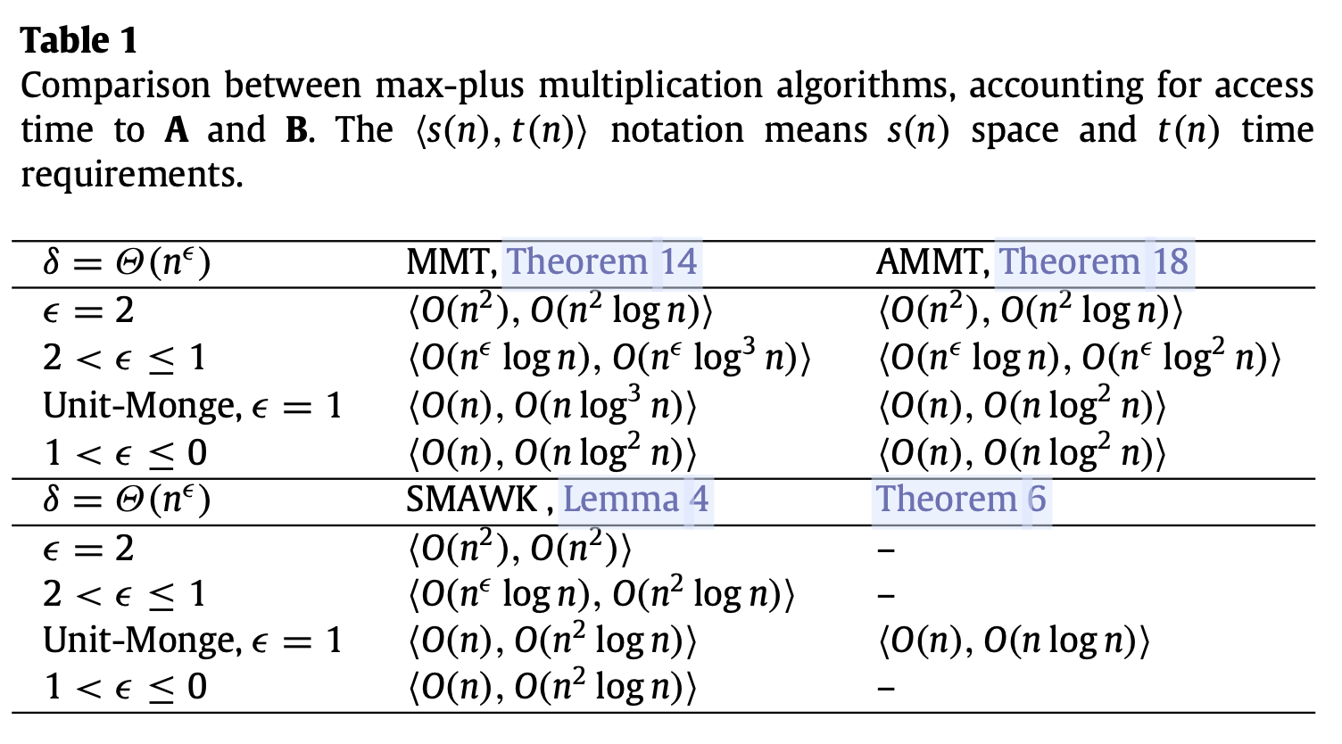
Analysis
Alg. 3
Alg. 4
Alg. 1
Alg. 2

Slide 16
Thank you for listening

Slide 17
老師反饋
p7 Lemma 1其實也不用是Monge matrix，只要是任何矩陣，都可以拆解成四個部分，原點、列值、行值與累加值。
如果是Monge matrix（Density >= 0），只要某區域Density為0，則代表這個區域內必定沒有非0 Density的存在。

