Slide 1
A Filtration Method for Order-Preserving Matching
T. Chhabra, J. Tarhio
Information Processing Letters, Vol. 116, Issue 2, February 2016,
pp. 71-74,
Presenter: Guan-Ting Chen
Date: June 21, 2022

Slide 2
Abstract
The problem of order-preserving matching has gained attention lately. The text and the pattern consist of numbers. The task is to ﬁnd all the substrings in the text which have the same length and relative order as the pattern. The problem has applications in analysis of time series.
We present a new sublinear solution based on ﬁltration. Any algorithm for exact string matching can be used as a ﬁltering method. If the ﬁltration algorithm is sublinear, the total method is sublinear on average. We show by practical experiments that the new solution is more eﬃcient than earlier algorithms.

Slide 3
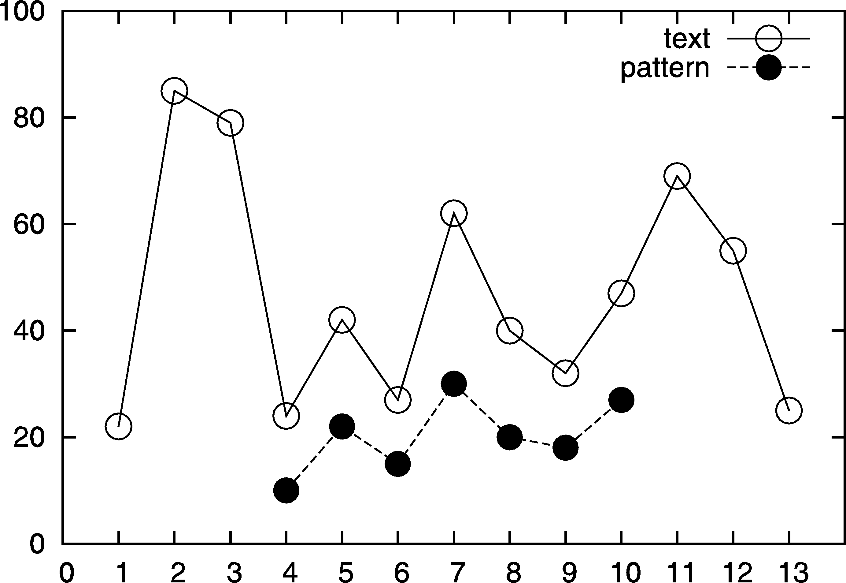
Order Preserving Pattern Matching

Slide 4
Order Preserving Pattern Matching
Two Strings
u = u₁u₂ ··· u_{m}
v = v₁v₂ ··· v_{m}
u ≈ v
u_{i} ≤ u_{j} ⇔ v_{i} ≤ v_{j}

Slide 5
Encoding
T = 22, 85, 79, 24, 42, 27, 62, 40, 32, 47, 69, 55, 25
P = 10, 22, 15, 30, 20, 18, 27
T | 22 | 85 | 79 | 24 | 42 | 27 | 62 | 40 | 32 | 47 | 69 | 55 | 25
T’ | 1 | 0 | 0 | 1 | 0 | 1 | 0 | 0 | 1 | 1 | 0 | 0
P | 10 | 22 | 15 | 30 | 20 | 18 | 27
P’ | 1 | 0 | 1 | 0 | 0 | 1

Slide 6
Preprocessing
Auxiliary Table r
Equalities E
i | 1 | 2 | 3 | 4 | 5 | 6 | 7
P | 10 | 22 | 15 | 30 | 20 | 18 | 27
r | 1 | 3 | 6 | 5 | 2 | 7 | 4
i | 1 | 2 | 3 | 4 | 5 | 6 | 7
P | 10 | 22 | 15 | 20 | 20 | 18 | 27
E | 0 | 0 | 0 | 1 | 0 | 0

Slide 7
Filtration
Need algorithm for exact string matching.
Example: KMP
i | 1 | 2 | 3 | 4 | 5 | 6 | 7 | 8 | 9 | 10 | 11 | 12 | 13
T | 22 | 85 | 79 | 24 | 42 | 27 | 62 | 40 | 32 | 47 | 69 | 55 | 25
T’ | 1 | 0 | 0 | 1 | 0 | 1 | 0 | 0 | 1 | 1 | 0 | 0
P |  |  |  | 10 | 22 | 15 | 30 | 20 | 18 | 27
P’ |  |  |  | 1 | 0 | 1 | 0 | 0 | 1

Slide 8
Veriﬁcation
i | 1 | 2 | 3 | 4 | 5 | 6 | 7
T[4..10] | 24 | 42 | 27 | 62 | 40 | 32 | 47
T’[4..10] | 1 | 0 | 1 | 0 | 0 | 1 | 1
P | 10 | 22 | 15 | 30 | 20 | 18 | 27
r | 1 | 3 | 6 | 5 | 2 | 7 | 4

Slide 9
Veriﬁcation
Mismatch
t_{j − 1 + r[i]} > t_{j − 1 + r [i + 1]}
i | 1 | 2 | 3 | 4 | 5 | 6 | 7
T | 24 | 42 | 27 | 62 | 40 | 32 | 47
P | 12 | 22 | 15 | 30 | 20 | 18 | 27
r | 1 | 3 | 6 | 5 | 2 | 7 | 4

Slide 10
Veriﬁcation
Mismatch
t_{j − 1 + r [i]} = t_{j − 1 + r [i + 1]} and E[i] = 0
i | 1 | 2 | 3 | 4 | 5 | 6 | 7
T | 24 | 42 | 24 | 62 | 40 | 32 | 47
P | 10 | 22 | 15 | 30 | 20 | 18 | 27
r | 1 | 3 | 6 | 5 | 2 | 7 | 4
E | 0 | 0 | 0 | 0 | 0 | 0 | 0

Slide 11
Veriﬁcation
Mismatch
t_{j − 1 + r [i]} < t_{j − 1 + r [i + 1]} and E[i] = 1
i | 1 | 2 | 3 | 4 | 5 | 6 | 7
T | 24 | 42 | 27 | 62 | 40 | 32 | 47
P | 10 | 22 | 10 | 30 | 20 | 18 | 27
r | 1 | 3 | 6 | 5 | 2 | 7 | 4
E | 1 | 0 | 0 | 0 | 0 | 0 | 0

Slide 12
Time Complexity
Sorting
O(mlogm)
Total in the worst case
O(nm)

Slide 13
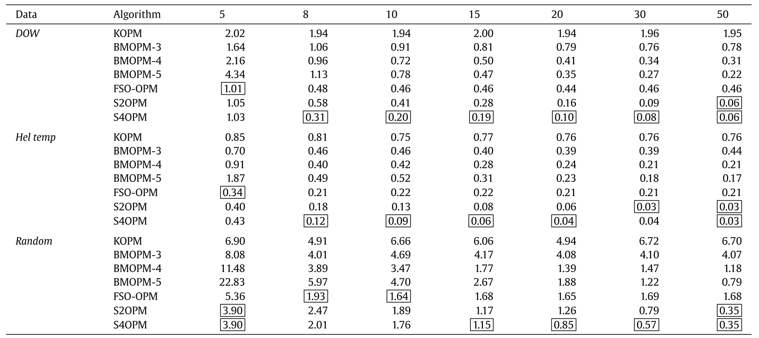
Experiments

