Slide 1
Deadline-constrained workflow scheduling algorithms for Infrastructure as a Service Clouds
Saeid Abrishami, Mahmoud Naghibzadeh, Dick H.J. Epema
Future Generation Computer Systems, Vol. 29, Issue 1, pp. 158- 169, 2013
Presenter: Chih- Hsuan Chien​
Date: June. 21, 2022

Slide 2
Abstract(1/2)
The advent of Cloud computing as a new model of service provisioning in distributed systems encourages researchers to investigate its benefits and drawbacks on executing scientific applications such as workflows. One of the most challenging problems in Clouds is workflow scheduling, i.e., the problem of satisfying the QoS requirements of the user as well as minimizing the cost of workflow execution. We have previously designed and analyzed a two-phase scheduling algorithm for utility Grids, called Partial Critical Paths (PCP), which aims to minimize the cost of workflow execution while meeting a userdefined deadline. However, we believe Clouds are different from utility Grids in three ways: on-demand resource provisioning, homogeneous networks, and the pay-as-you-go pricing model.

Slide 3
Abstract(2/2)
In this paper, we adapt the PCP algorithm for the Cloud environment and propose two workflow scheduling algorithms: a one-phase algorithm which is called IaaS Cloud Partial Critical Paths (IC-PCP), and a two-phase algorithm which is called IaaS Cloud Partial Critical Paths with Deadline Distribution (IC-PCPD2). Both algorithms have a polynomial time complexity which make them suitable options for scheduling large workflows. The simulation results show that both algorithms have a promising performance, with IC-PCP performing better than IC-PCPD2 in most cases.

Slide 4

IC-PCP
EST
EFT
LFT
Critical parent
Max(EFT($t_{P}$)+TT($e_{P,i}$))

Slide 5
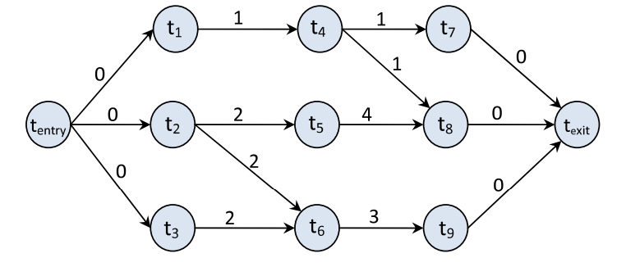
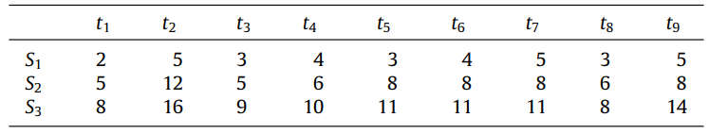
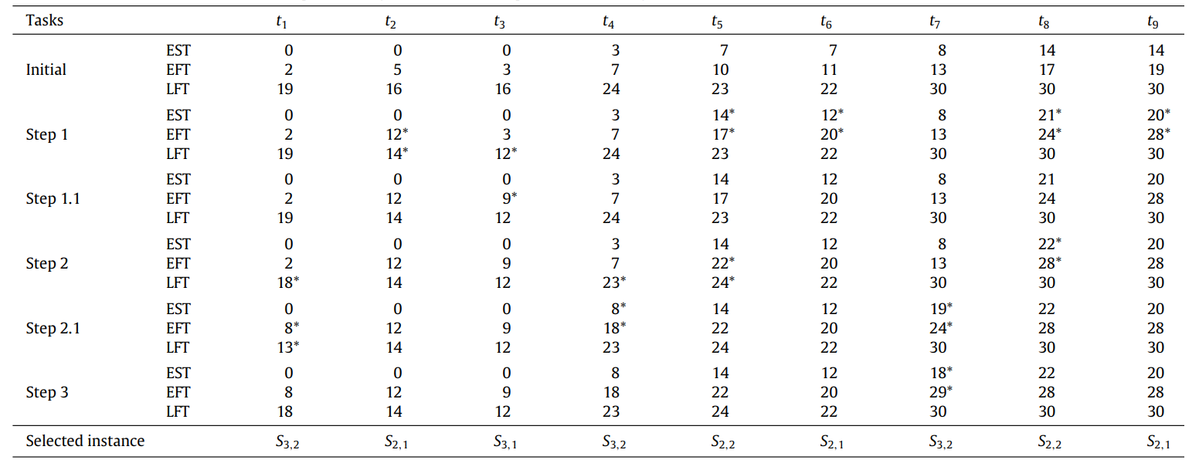








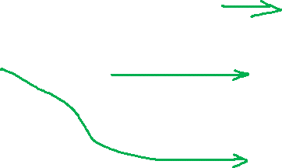



Slide 6


IC-PCP2
Path subdeadline(PSD)
Notes:
更公平的分配時間，不能用LFT是因為LFT是從後面算過來，前面的DEADLINE會比較寬鬆

Slide 7
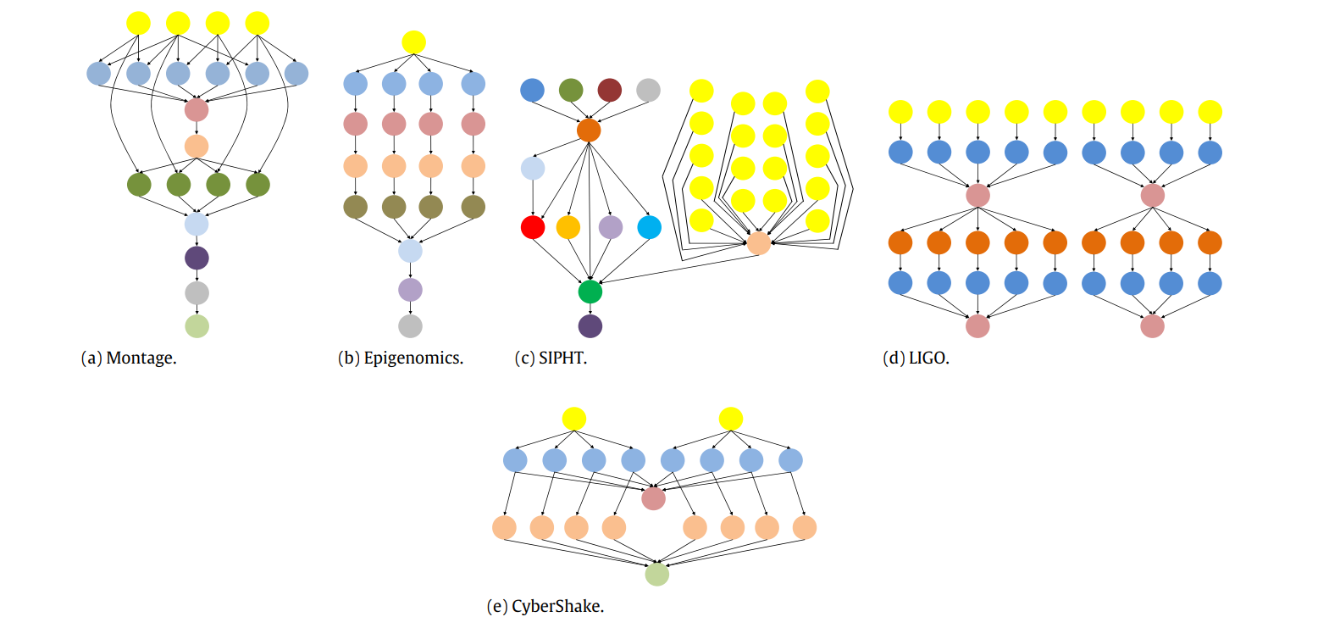

Slide 8
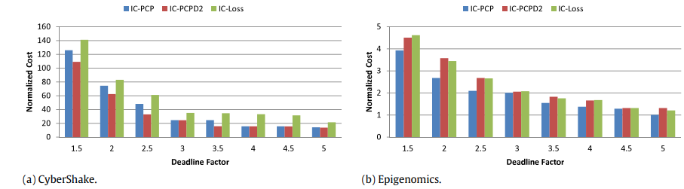
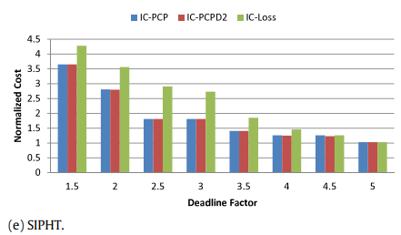
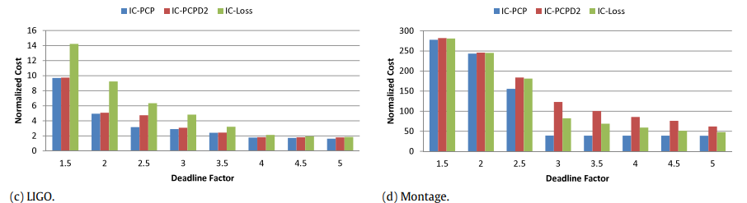
Experiment
Notes:
第二種可能是沒考量到communication cost所以偏高

