Slide 1
A dynamic edit distance table
Sung-Ryul Kim and Kunsoo Park
Journal of Discrete Algorithms, vol. 2, pp. 303-312, 2004
Presenter：Hsiu-Chieh Hung
Date：2018/4/3

Slide 2
Abstract
In this paper we consider the incremental/decremental version of the edit distance problem: given a solution to the edit distance between two strings A and B, find a solution to the edit distance between A and B where B = aB (incremental) or bB = B (decremental). As a solution for the edit distance between A and B, we define the difference representation of the D-table, which leads to a simple and intuitive algorithm for the incremental/decremental edit distance problem.

Slide 3
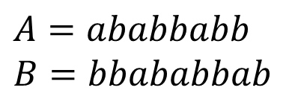
Edit Distance
$$A=ababbabb$$
$$B=bbababbab$$
 |  | b | b | a | b | a | b | b | a | b
 | 0 | 1 | 2 | 3 | 4 | 5 | 6 | 7 | 8 | 9
a | 1 | 1 | 2 | 2 | 3 | 4 | 5 | 6 | 7 | 8
b | 2 | 1 | 1 | 2 | 2 | 3 | 4 | 5 | 6 | 7
a | 3 | 2 | 2 | 1 | 2 | 2 | 3 | 4 | 5 | 6
b | 4 | 3 | 2 | 2 | 1 | 2 | 2 | 3 | 4 | 5
b | 5 | 4 | 3 | 3 | 2 | 2 | 2 | 2 | 3 | 4
a | 6 | 5 | 4 | 3 | 3 | 2 | 3 | 3 | 2 | 3
b | 7 | 6 | 5 | 4 | 3 | 3 | 2 | 3 | 3 | 2
b | 8 | 7 | 6 | 5 | 4 | 4 | 3 | 2 | 3 | 3
Insertion：1
Deletion：1
Substitution：1

Slide 4
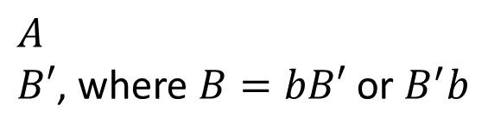
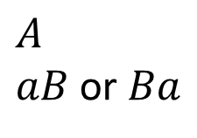
Incremental/Decremental Edit Distance
Incremental：
$$A$$
$aB$ or $Ba$
Decremental：
$$A$$
$B′$, where $B=bB′$ or $B^{′}b$

Slide 5
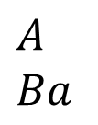

Incremental/Decremental Edit Distance
Incremental：
$$A$$
$$Ba$$
 |  | b | b | a | b | a | b | b | a | b | a
 | 0 | 1 | 2 | 3 | 4 | 5 | 6 | 7 | 8 | 9
a | 1 | 1 | 2 | 2 | 3 | 4 | 5 | 6 | 7 | 8
b | 2 | 1 | 1 | 2 | 2 | 3 | 4 | 5 | 6 | 7
a | 3 | 2 | 2 | 1 | 2 | 2 | 3 | 4 | 5 | 6
b | 4 | 3 | 2 | 2 | 1 | 2 | 2 | 3 | 4 | 5
b | 5 | 4 | 3 | 3 | 2 | 2 | 2 | 2 | 3 | 4
a | 6 | 5 | 4 | 3 | 3 | 2 | 3 | 3 | 2 | 3
b | 7 | 6 | 5 | 4 | 3 | 3 | 2 | 3 | 3 | 2
b | 8 | 7 | 6 | 5 | 4 | 4 | 3 | 2 | 3 | 3
$$O(m)$$

Slide 6
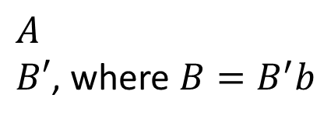
Incremental/Decremental Edit Distance
Decremental：
$$A$$
$B′$, where $B=B^{′}b$
 |  | b | b | a | b | a | b | b | a | b
 | 0 | 1 | 2 | 3 | 4 | 5 | 6 | 7 | 8 | 9
a | 1 | 1 | 2 | 2 | 3 | 4 | 5 | 6 | 7 | 8
b | 2 | 1 | 1 | 2 | 2 | 3 | 4 | 5 | 6 | 7
a | 3 | 2 | 2 | 1 | 2 | 2 | 3 | 4 | 5 | 6
b | 4 | 3 | 2 | 2 | 1 | 2 | 2 | 3 | 4 | 5
b | 5 | 4 | 3 | 3 | 2 | 2 | 2 | 2 | 3 | 4
a | 6 | 5 | 4 | 3 | 3 | 2 | 3 | 3 | 2 | 3
b | 7 | 6 | 5 | 4 | 3 | 3 | 2 | 3 | 3 | 2
b | 8 | 7 | 6 | 5 | 4 | 4 | 3 | 2 | 3 | 3
$$O(m)$$

Slide 7
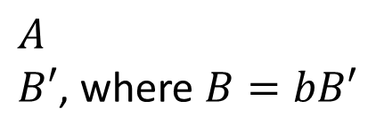
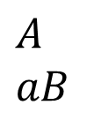
Incremental/Decremental Edit Distance
Incremental：
$$A$$
$$aB$$
Decremental： (以此為例)
$$A$$
$B′$, where $B=bB′$

Slide 8

$$A=ababbabb$$
$$B=bbababbab$$
 |  | b | b | a | b | a | b | b | a | b
 | 0 | 1 | 2 | 3 | 4 | 5 | 6 | 7 | 8 | 9
a | 1 | 1 | 2 | 2 | 3 | 4 | 5 | 6 | 7 | 8
b | 2 | 1 | 1 | 2 | 2 | 3 | 4 | 5 | 6 | 7
a | 3 | 2 | 2 | 1 | 2 | 2 | 3 | 4 | 5 | 6
b | 4 | 3 | 2 | 2 | 1 | 2 | 2 | 3 | 4 | 5
b | 5 | 4 | 3 | 3 | 2 | 2 | 2 | 2 | 3 | 4
a | 6 | 5 | 4 | 3 | 3 | 2 | 3 | 3 | 2 | 3
b | 7 | 6 | 5 | 4 | 3 | 3 | 2 | 3 | 3 | 2
b | 8 | 7 | 6 | 5 | 4 | 4 | 3 | 2 | 3 | 3
Insertion：1
Deletion：1
Substitution：1
$D$-table

Slide 9

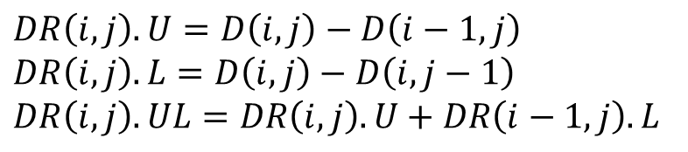
$$A=ababbabb$$
$$B=bbababbab$$
$DR$-table
$$DR\left(i,j\right).U=D\left(i,j\right)−D\left(i−1,j\right)$$
$$DR\left(i,j\right).L=D\left(i,j\right)−D\left(i,j−1\right)$$
$$DR\left(i,j\right).UL=DR\left(i,j\right).U+DR\left(i−1,j\right).L$$

Slide 10
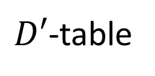
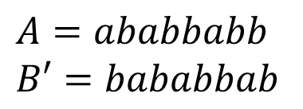
$$A=ababbabb$$
$$B′=bababbab$$
 |  | b | a | b | a | b | b | a | b
 | 0 | 1 | 2 | 3 | 4 | 5 | 6 | 7 | 8
a | 1 | 1 | 1 | 2 | 3 | 4 | 5 | 6 | 7
b | 2 | 1 | 2 | 1 | 2 | 3 | 4 | 5 | 6
a | 3 | 2 | 1 | 2 | 1 | 2 | 3 | 4 | 5
b | 4 | 3 | 2 | 1 | 2 | 1 | 2 | 3 | 4
b | 5 | 4 | 3 | 2 | 2 | 2 | 1 | 2 | 3
a | 6 | 5 | 4 | 3 | 2 | 3 | 2 | 1 | 2
b | 7 | 6 | 5 | 4 | 3 | 2 | 3 | 2 | 1
b | 8 | 7 | 6 | 5 | 4 | 3 | 2 | 3 | 2
Insertion：1
Deletion：1
Substitution：1
$D′$-table

Slide 11

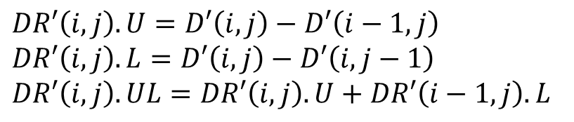
$$A=ababbabb$$
$$B′=bababbab$$
$DR′$-table
$$DR′\left(i,j\right).U=D′\left(i,j\right)−D′\left(i−1,j\right)$$
$$DR′\left(i,j\right).L=D′\left(i,j\right)−D′\left(i,j−1\right)$$
$$DR′\left(i,j\right).UL=DR′\left(i,j\right).U+DR′\left(i−1,j\right).L$$

Slide 12

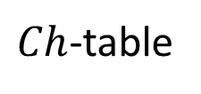
$$Ch\left(i,j\right)=D^{′}\left(i,j\right)−D(i,j+1)$$
$Ch$-table
 |  | b | a | b | a | b | b | a | b
 | -1 | -1 | -1 | -1 | -1 | -1 | -1 | -1 | -1
a | 0 | -1 | -1 | -1 | -1 | -1 | -1 | -1 | -1
b | 1 | 0 | 0 | -1 | -1 | -1 | -1 | -1 | -1
a | 1 | 0 | 0 | 0 | -1 | -1 | -1 | -1 | -1
b | 1 | 1 | 0 | 0 | 0 | -1 | -1 | -1 | -1
b | 1 | 1 | 0 | 0 | 0 | 0 | -1 | -1 | -1
a | 1 | 1 | 1 | 0 | 0 | 0 | -1 | -1 | -1
b | 1 | 1 | 1 | 1 | 0 | 0 | 0 | -1 | -1
b | 1 | 1 | 1 | 1 | 0 | 0 | 0 | 0 | -1

Slide 13
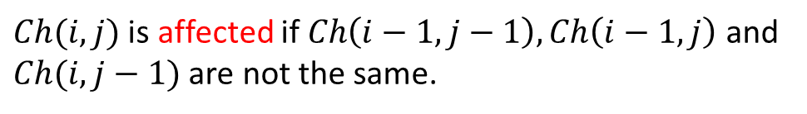
$$Ch\left(i,j\right)=D^{′}\left(i,j\right)−D(i,j+1)$$
$Ch(i,j)$ is affected if $Ch\left(i−1,j−1\right), Ch\left(i−1,j\right)$ and $Ch(i,j−1)$ are not the same.
$Ch$-table
 |  | b | a | b | a | b | b | a | b
 | -1 | -1 | -1 | -1 | -1 | -1 | -1 | -1 | -1
a | 0 | -1 | -1 | -1 | -1 | -1 | -1 | -1 | -1
b | 1 | 0 | 0 | -1 | -1 | -1 | -1 | -1 | -1
a | 1 | 0 | 0 | 0 | -1 | -1 | -1 | -1 | -1
b | 1 | 1 | 0 | 0 | 0 | -1 | -1 | -1 | -1
b | 1 | 1 | 0 | 0 | 0 | 0 | -1 | -1 | -1
a | 1 | 1 | 1 | 0 | 0 | 0 | -1 | -1 | -1
b | 1 | 1 | 1 | 1 | 0 | 0 | 0 | -1 | -1
b | 1 | 1 | 1 | 1 | 0 | 0 | 0 | 0 | -1

Slide 14
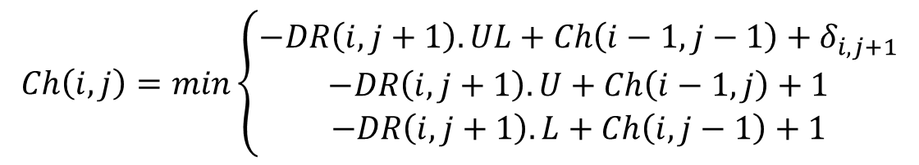

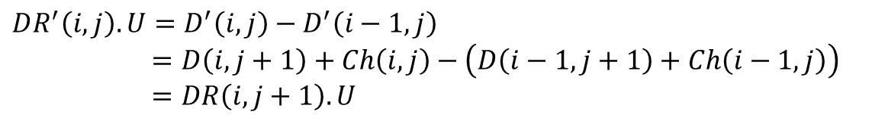
If $Ch(i,j)$ is affected, then $DR^{′}\left(i,j\right)$ is also affected.
If $DR′(i,j)$ is not affected, then $DR^{′}\left(i,j\right)=DR\left(i,j+1\right).$
$$Ch\left(i,j\right)=D^{′}\left(i,j\right)−D(i,j+1)$$
$$DR^{′}\left(i,j\right).U=D^{′}\left(i,j\right)−D^{′}\left(i−1,j\right)$$
$$=D\left(i,j+1\right)+Ch\left(i,j\right)−\left(D\left(i−1,j+1\right)+Ch\left(i−1,j\right)\right)$$
$$=DR\left(i,j+1\right).U$$
$$Ch\left(i,j\right)=min\left\{\begin{aligned}−DR\left(i,j+1\right).UL+Ch\left(i−1,j−1\right)+δ_{i,j+1} \\ −DR\left(i,j+1\right).U+Ch\left(i−1,j\right)+1 \\ −DR\left(i,j+1\right).L+Ch\left(i,j−1\right)+1\end{aligned}\right.$$

Slide 15
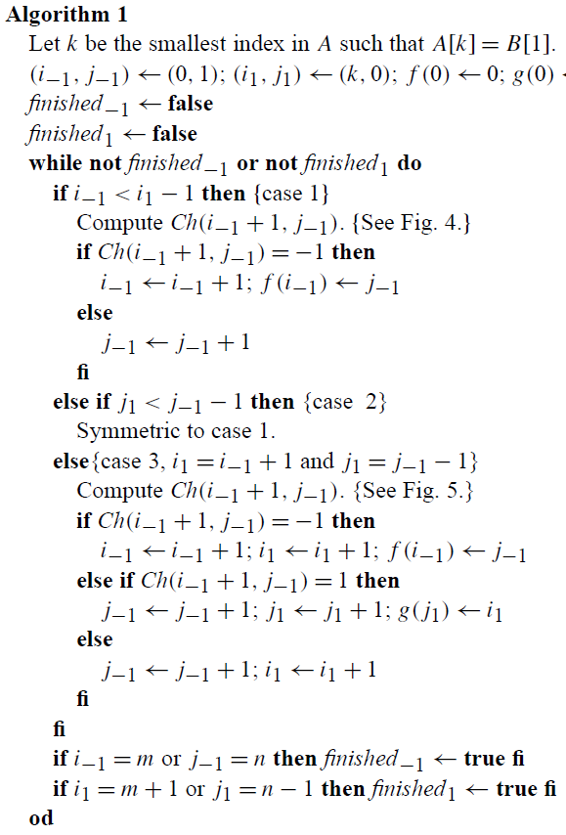
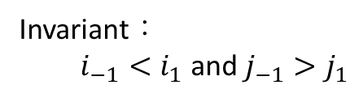

$f\left(i\right)$：the smallest integer j such that $Ch\left(i,j\right)=−1$
g$\left(j\right)$：the smallest integer i such that $Ch\left(i,j\right)=1$
Invariant：
$i_{−1}<i_{1}$ and $j_{−1}>j_{1}$

Slide 16
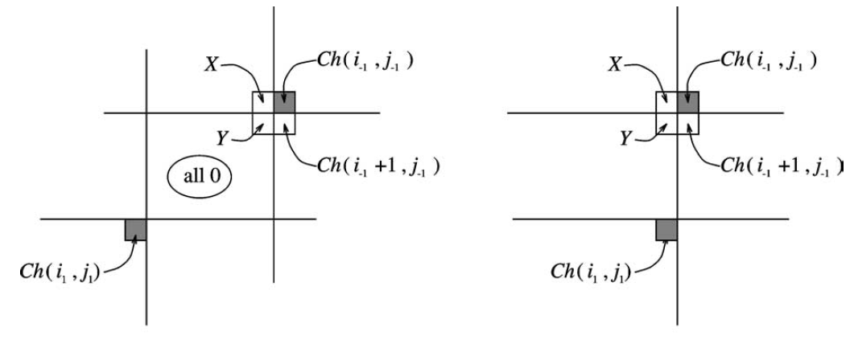

Slide 17
$f\left(i\right)$：the smallest integer j such that $Ch\left(i,j\right)=−1$
g$\left(j\right)$：the smallest integer i such that $Ch\left(i,j\right)=1$
Invariant：
$i_{−1}<i_{1}$ and $j_{−1}>j_{1}$

Slide 18
$f\left(i\right)$：the smallest integer j such that $Ch\left(i,j\right)=−1$
g$\left(j\right)$：the smallest integer i such that $Ch\left(i,j\right)=1$
Invariant：
$i_{−1}<i_{1}$ and $j_{−1}>j_{1}$

Slide 19
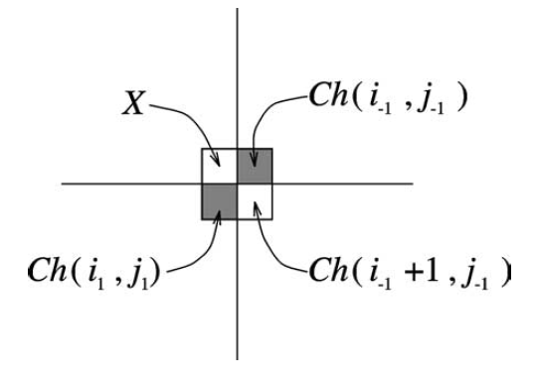

Slide 20
$f\left(i\right)$：the smallest integer j such that $Ch\left(i,j\right)=−1$
g$\left(j\right)$：the smallest integer i such that $Ch\left(i,j\right)=1$
Invariant：
$i_{−1}<i_{1}$ and $j_{−1}>j_{1}$

Slide 21
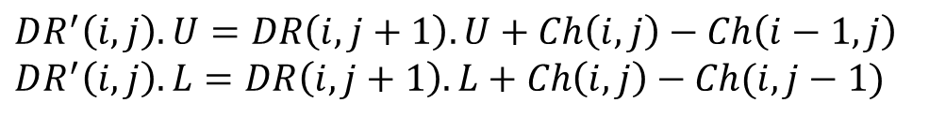
$f\left(i\right)$：the smallest integer j such that $Ch\left(i,j\right)=−1$
g$\left(j\right)$：the smallest integer i such that $Ch\left(i,j\right)=1$
Invariant：
$i_{−1}<i_{1}$ and $j_{−1}>j_{1}$
$$DR^{′}\left(i,j\right).U=DR\left(i,j+1\right).U+Ch\left(i,j\right)−Ch\left(i−1,j\right)$$
$$DR^{′}\left(i,j\right).L=DR\left(i,j+1\right).L+Ch\left(i,j\right)−Ch(i,j−1)$$

Slide 22

Conclusion
$DR′$-table can be computed in $O(m+n)$ time.

