Slide 1
Counting distinct palindromes in a word in linear time
Richard Groult, Élise Prieur, Gwénaël Richomme
Université de Picardie Jules Verne, Laboratoire MIS, 33, rue Saint Leu, F-80039 Amiens cedex 1, France
Université de Rouen, LITIS EA-4108, 1, rue Thomas Becket, F-76821 Mont-St-Aignan cedex, France
Université Paul-Valéry Montpellier 3, UFR 4, Département MIAp, Route de Mende, 34199 Montpellier cedex 5, France
LIRMM (CNRS, Univ. Montpellier 2) – UMR 5506, 161, rue Ada, 34095 Montpellier cedex 5, France
\
Information Processing Letters
Volume 110, 2010, Pages 908-912
Presenter: Ting-Wei Liang
Date:2018/04/03

Slide 2
Abstract
We design an algorithm to count the number of distinct palindromes in a word w in time O(|w|), by adapting an algorithm to detect all occurrences of maximal palindromes in a given word and using the longest previous factor array. As a direct consequence, this shows that the palindromic richness (or fullness) of a word can be checked in linear time.

Slide 3


Longest Palindromic Suffixes (LPS)
1 | 2 | 3 | 4 | 5 | 6 | 7 | 8 | 9 | 10 | 11
i
w
a | b | b | a | b | a | a | b | a | b | a
b | a | b | a | a | b | a | b
$$P_{2}$$
b | a | b
$$P_{1}$$
LPS[10] = 8

Slide 4


Longest Palindromic Suffix (LPS)
1 | 2 | 3 | 4 | 5 | 6 | 7 | 8 | 9 | 10 | 11
i
w
a | b | b | a | b | a | a | b | a | b | a
a | b | a | a | b | a
$$P_{2}$$
a | b | a
$$P_{1}$$
LPS[9] = 6

Slide 5


Longest Maximal Palindrome (LMP)
1 | 2 | 3 | 4 | 5 | 6 | 7 | 8 | 9 | 10 | 11
j
w
a | b | b | a | b | a | a | b | a | b | a
a | b | a | a | b | a
$P_{2}$
LMP[9] = 3
a | b | a
$$P_{1}$$
w[i..j] is maximal if w[i-1..j+1] is not a palindrome

Slide 6
Longest Previous Factor (LPF)
1 | 2 | 3 | 4 | 5 | 6 | 7 | 8 | 9 | 10 | 11
i
w
a | b | b | a | b | a | a | b | a | b | a
a | b | a
a | b | b | a | b | a | a | b | a | b
LPS[9] = 3

Slide 7
Longest Previous Factor (LPF)
1 | 2 | 3 | 4 | 5 | 6 | 7 | 8 | 9 | 10 | 11
i
w
a | b | b | a | b | a | a | b | a | b | a
a | b | a
a | b | b | a | b | a | a | b
LPS[7] = 3

Slide 8
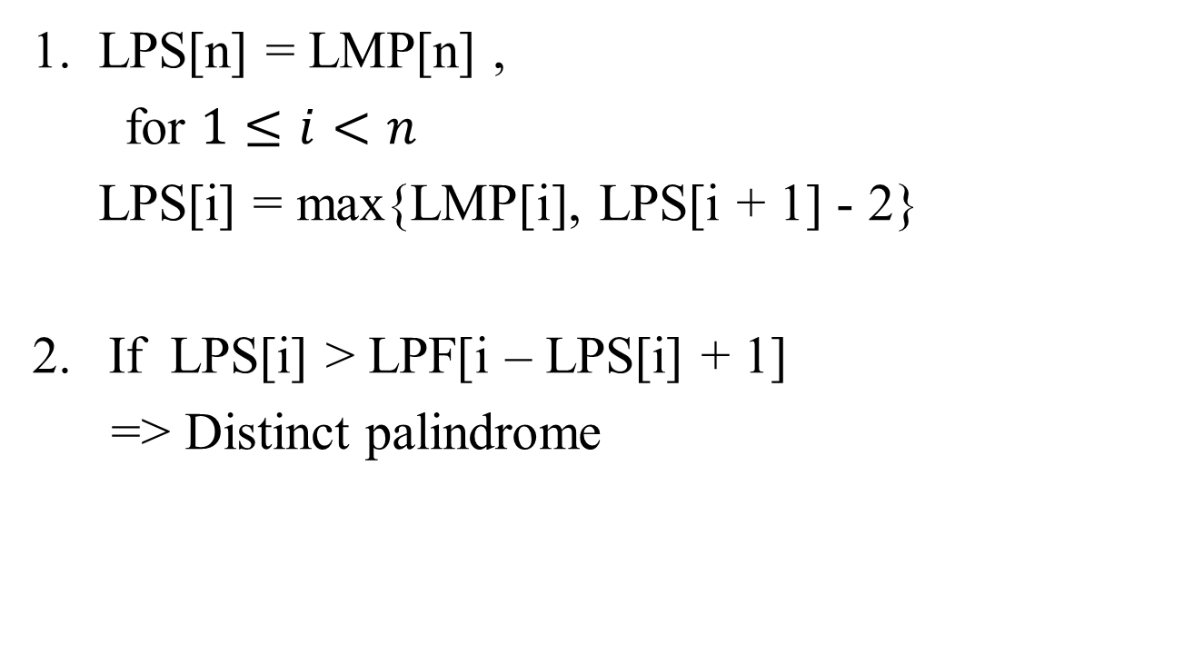
Relations
1. LPS[n] = LMP[n] ,
for $1≤i<n$
LPS[i] = max{LMP[i], LPS[i + 1] - 2}
If LPS[i] > LPF[i – LPS[i] + 1]
=> Distinct palindrome

Slide 9
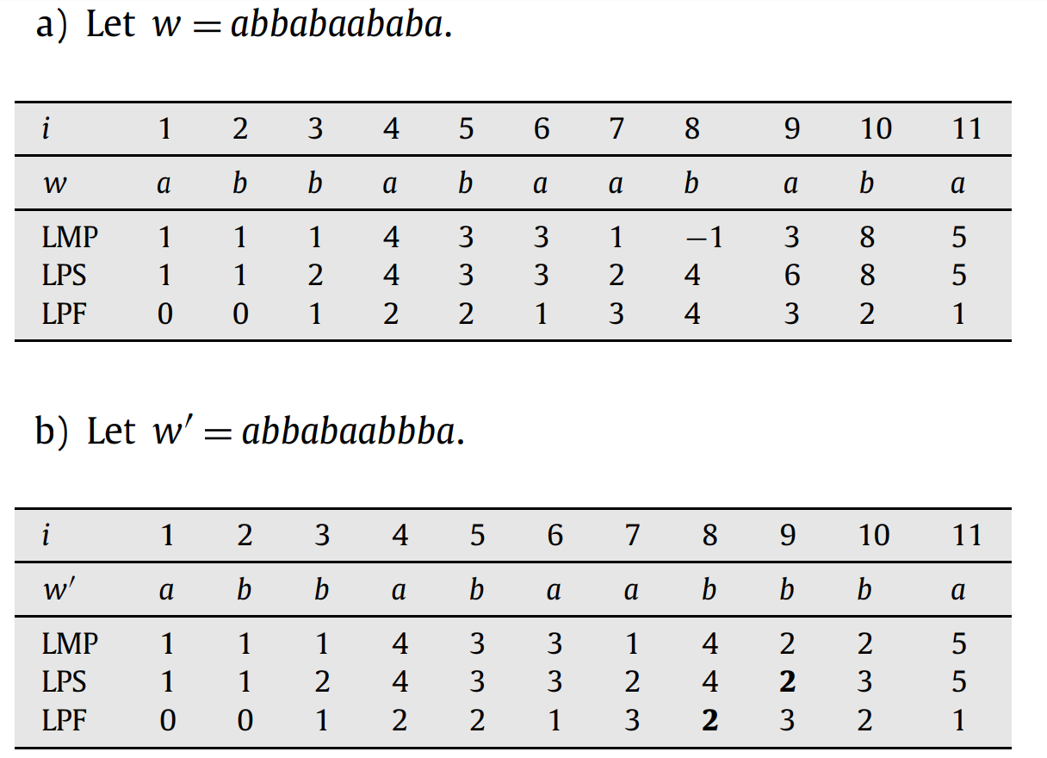
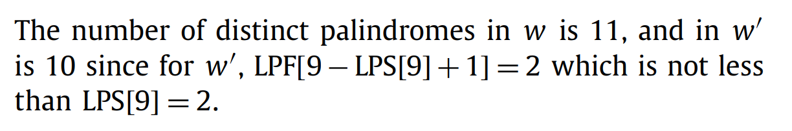
Example

Slide 10
Complete Algorithm
Compute LPF
Compute LMP
Compute LPS by LMP
Count distinct palindromes by LPS and LPF
Time Complexity : O(|w|)

