Slide 1
LCS algorithm with vector-markers
Levon Aslanyan
Institute for Informatics and Automation Problems of the National Academy of Science of Armenia, Yerevan, Armenia
Proceedings of Computer Science and Information Technologies (CSIT)
25-29 Sept. 2017, Yerevan, Armenia
Presenter: Ting-Wei Liang
Date: 2018/05/01

Slide 2
Abstract(1/2)
The Multiple Longest Common Subsequence (MLCS) problem is aimed at constructing a maximum length subsequence, common to a given set of sequences, defined on some finite alphabet of symbols. The paper considers the particular case of two input sequences (LCS), which is simply extendable to the general MLCS problem. We consider the problem in an online manner, where symbols arrive one-by-one and the next acquired symbol is appending any one of the two input sequences.

Slide 3
Abstract(2/2)
The sought-for LCS algorithm acts by recursive handling of parts of sequences arrived so far, constructing and updating specific supportive structures of markers representing the interrelations of the longest common subsequences of the two input sequences. In paper we discuss a perfect online parallelization framework of the algorithm for the “simple” memory model, so that the parallel complexity becomes O(mn/t) for t parallel threads. The general outcome of paper is the use of vector markers instead of matrix markers or graphs, which helps in minimization of the memory, used by the algorithm.

Slide 4
LCS problem in this paper
A
a | b | c | b | a
B
a | c | b | a | a
A’
a | b | c | b | a | b

Slide 5
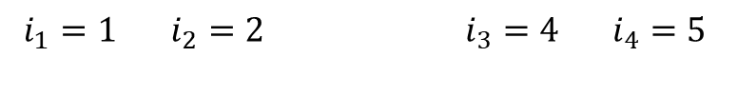


Minimum last elements of k-length LCS
A
a | b | c | b | a
$$i_{1}=1$$ | $$i_{2}=2$$ |  | $$i_{3}=4$$ | $$i_{4}=5$$
$$l=5$$
B
a | c | b | a | a
$$j_{1}=1$$ | $$j_{2}=2$$ | $$j_{3}=3$$ | $$j_{4}=5$$

Slide 6
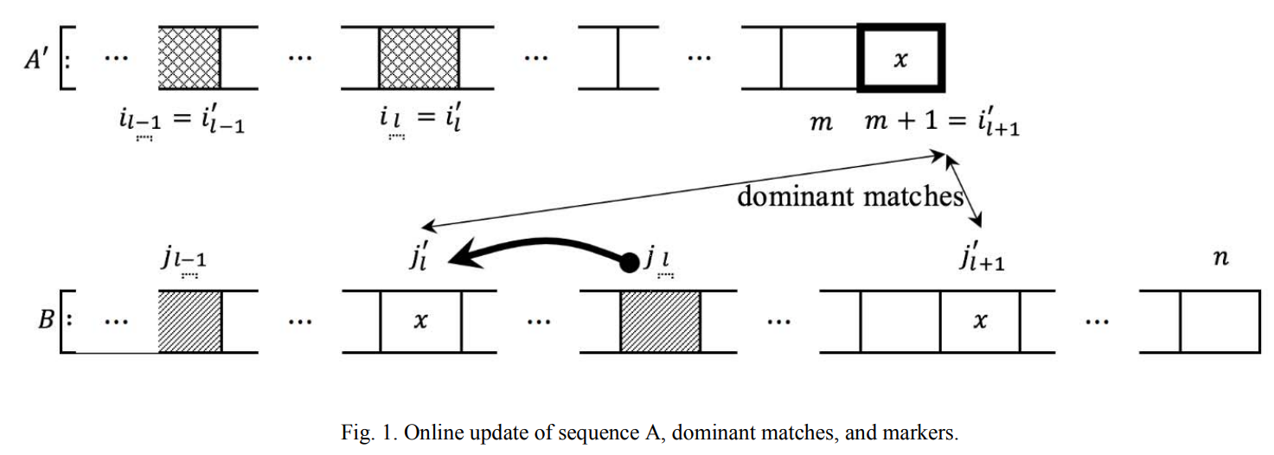

Slide 7



Arrivals & Updating($l^{′}=l$)
A’
a | b | c | b | a | b
$$i_{1}=1$$ | $$i_{2}=2$$ |  | $$i_{3}=4$$ | $$i_{4}=5$$
Update:
$$i_{1}′=1$$ | $$i_{2}′=2$$ |  | $$i_{3}′=4$$ | $$i_{4}′=5$$
B
a | c | b | a | a
$$j_{1}=1$$ | $$j_{2}=2$$ | $$j_{3}=3$$ | $$j_{4}=5$$
Update:
$$j_{1}′=1$$ | $$j_{2}′=2$$ | $$j_{3}′=3$$ | $$j_{4}′=5$$

Slide 8

Arrivals & Updating
A’
a | b | c | b | b | a | c | d
$$i_{1}$$ | $$i_{2}$$ |  | $$i_{3}$$ | $$i_{4}$$ | $$i_{5}$$
B
a | d | c | b | b | b | a | d | a
$$j_{1}$$ |  | $$j_{2}$$ | $$j_{3}$$ | $$j_{4}$$ |  | $$j_{5}$$

Slide 9


Arrivals & Updating($l^{′}=l+1$)
A’
a | b | c | b | b | a | c | d
$$i_{1}$$ | $$i_{2}$$ |  | $$i_{3}$$ | $$i_{4}$$ | $$i_{5}$$
Update:
$$i_{1}′$$ | $$i_{2}′$$ |  | $$i_{3}′$$ | $$i_{4}′$$ | $$i_{5}′$$ |  | $$i_{6}′$$
B
a | d | c | b | b | b | a | d | a
$$j_{1}$$ |  | $$j_{2}$$ | $$j_{3}$$ | $$j_{4}$$ |  | $$j_{5}$$
Update:
$$j_{1}′$$ | $$j_{2}′$$ |  | $$j_{3}′$$ | $$j_{4}′$$ |  | $$j_{5}′$$ | $$j_{6}′$$

