Slide 1
An adaptive portfolio trading system: A risk-return portfolio optimization using recurrent reinforcement learning with expected maximum drawdown
Saud Almahdi, Steve Y. Yang
Financial Engineering Program, School of Business, Stevens Institute of Technology, 1 Castle Point on Hudson, Hoboken, NJ 07030, USA
Expert Systems With Applications 87 (2017) 267–279
Presenter: Cheng-Han Wu
Date:2018/5/1

Slide 2
Abstract(1/2)
Dynamic control theory has long been used in solving optimal asset allocation problems, and a number of trading decision systems based on reinforcement learning methods have been applied in asset allocation and portfolio rebalancing. In this paper, we extend the existing work in recurrent reinforcement learning (RRL) and build an optimal variable weight portfolio allocation under a coherent downside risk measure, the expected maximum drawdown, E(MDD). In particular, we propose a recurrent reinforcement learning method, with a coherent risk adjusted performance objective function, the Calmar ratio, to obtain both buy and sell signals and asset allocation weights.

Slide 3
Abstract(2/2)
Using a portfolio consisting of the most frequently traded exchange-traded funds, we show that the expected maximum drawdown risk based objective function yields superior return performance compared to previously proposed RRL objective functions (i.e. the Sharpe ratio and the Sterling ratio), and that variable weight RRL long/short portfolios outperform equal weight RRL long/short portfolios under different transaction cost scenarios. We further propose an adaptive E(MDD) risk based RRL portfolio rebalancing decision system with a transaction cost and market condition stop-loss retraining mechanism, and we show that the proposed portfolio trading system responds to transaction cost effects better and outperforms hedge fund benchmarks consistently.

Slide 4
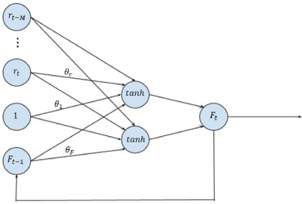

Recurrent reinforcement learning
$x_{t}=[1;r_{t}…r_{t−M};F_{t−1}]$, $r_{t}=\log\left(price_{t}\right)−\log\left(price_{t−1}\right)$,
$F_{t}=tanh⁡(x_{t}^{′}θ)$, $F_{t} ε \{−1, 1\}$
$F_{t}>0$ : take a long position
$F_{t}<0$ : take a short position
$R_{t}=μ∗\left[F_{t−1}∙r_{t}−δ\left|F_{t}−F_{t−1}\right|\right]$
Notes:
𝜇 : 股價點數，$δ$ : transaction cost，M is time series we want to trade in

Slide 5
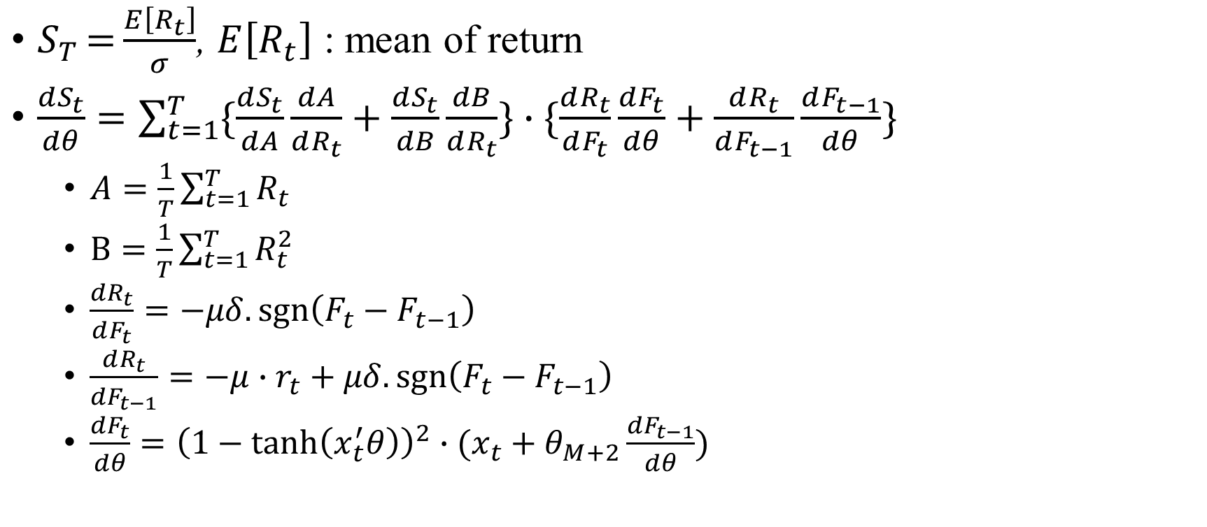
Sharpe ratio (SR)
$S_{T}={\frac{E\left[R_{t}\right]}{σ}}$, $E\left[R_{t}\right]$ : mean of return
$\frac{dS_{t}}{dθ}=\sum_{t=1}^{T}{\{\frac{dS_{t}}{dA}\frac{dA}{dR_{t}}+\frac{dS_{t}}{dB}\frac{dB}{dR_{t}}\}}∙\{\frac{dR_{t}}{dF_{t}}\frac{dF_{t}}{dθ}+\frac{dR_{t}}{dF_{t−1}}\frac{dF_{t−1}}{dθ}\}$
$A=\frac{1}{T}\sum_{t=1}^{T}{R_{t}}$
$B=\frac{1}{T}\sum_{t=1}^{T}{R_{t}^{2}}$
$\frac{dR_{t}}{dF_{t}}=−μδ.\operatorname{sgn}\left(F_{t}−F_{t−1}\right)$
$\frac{dR_{t}}{dF_{t−1}}=−μ∙r_{t}+μδ.\operatorname{sgn}\left(F_{t}−F_{t−1}\right)$
$\frac{dF_{t}}{dθ}={\left(1−\tanh\left(x_{t}^{′}θ\right)\right)}^{2}∙(x_{t}+θ_{M+2}\frac{dF_{t−1}}{dθ})$
Notes:
ST=2% means 每多增加1%風險可以換來2%收益

Slide 6
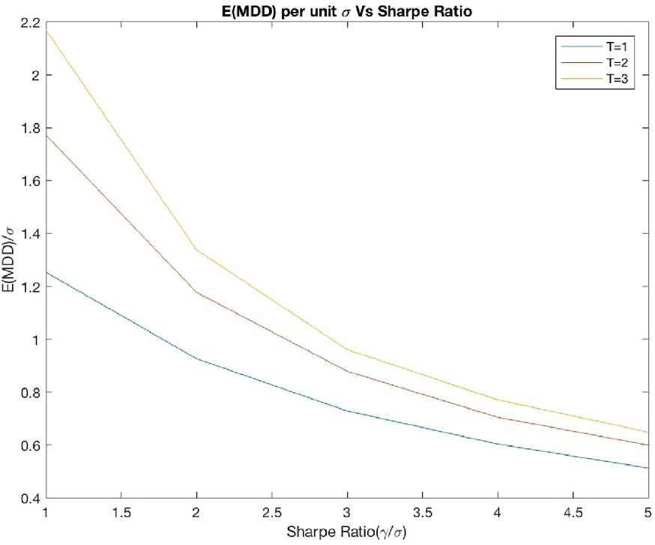

Calmar ratio (CR)
$$C_{T}={\frac{γ_{T}}{E(MDD)}}$$
$$C_{T}={\frac{TShrp^{2}}{0.63519+0.5logT+logShrp}}$$
$Shrp=\frac{γ}{σ}$
Notes:
CT 的 E(MDD)度量從峰值到最低谷值的最大累積損失, r means of return

Slide 7

$$f_{it}=logsig⁡(x_{it}^{′}θ_{i})$$
$$F_{it}=softmax⁡(f_{it})$$
$$\sum_{i}^{n}{F_{it}}=1$$
Notes:
fit is the action on asset i at time t , n is the number of assets in the portfolio
Long portfolio : Softmax is applied to all assets decision at time t, 分配給每個asset w

Slide 8
Data collection
IWD : iShare Russell 1000 value
IWC : iShare Micro-Cap
SPY : SPDR S&P 500 ETF
DEM : WisdomTree Emerging Markets High Dividend
CLY : iShare 10+ Year Credit Bond
From 2011/1/1~2015/12/31
3 years training, 2 years testing (104 weeks)
Notes:
iShares羅素1000中大型美國股票的股票基金，iShares微型股ETF
ETF交易所買賣基金:在證券交易所交易，提供投資人參與指數表現的指數基金

Slide 9
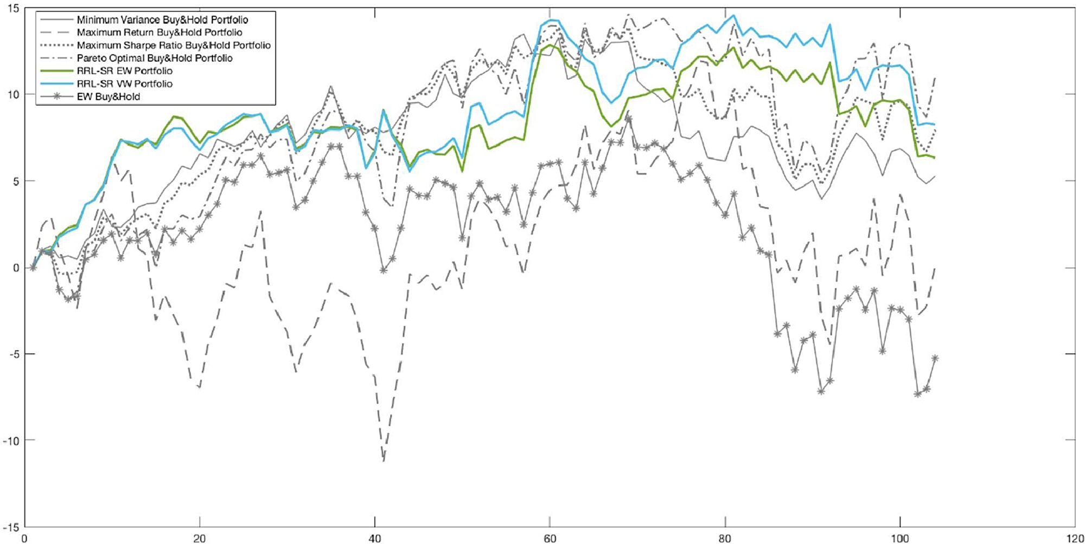
Portfolio performance RRL with SR

Slide 10
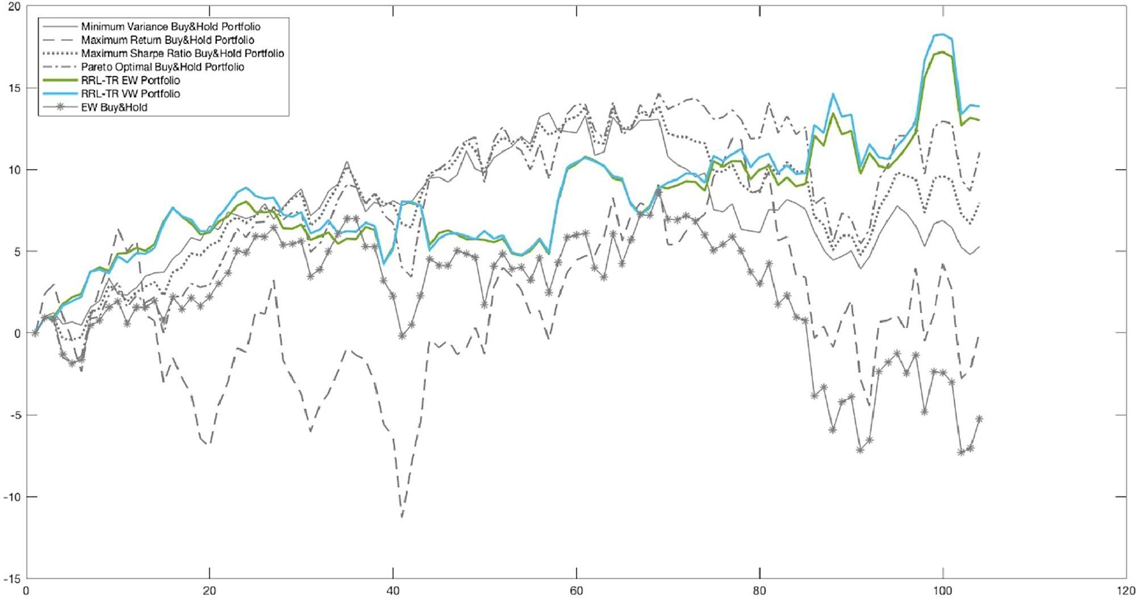
Portfolio performance RRL with Sterling Ratio (TR)

Slide 11
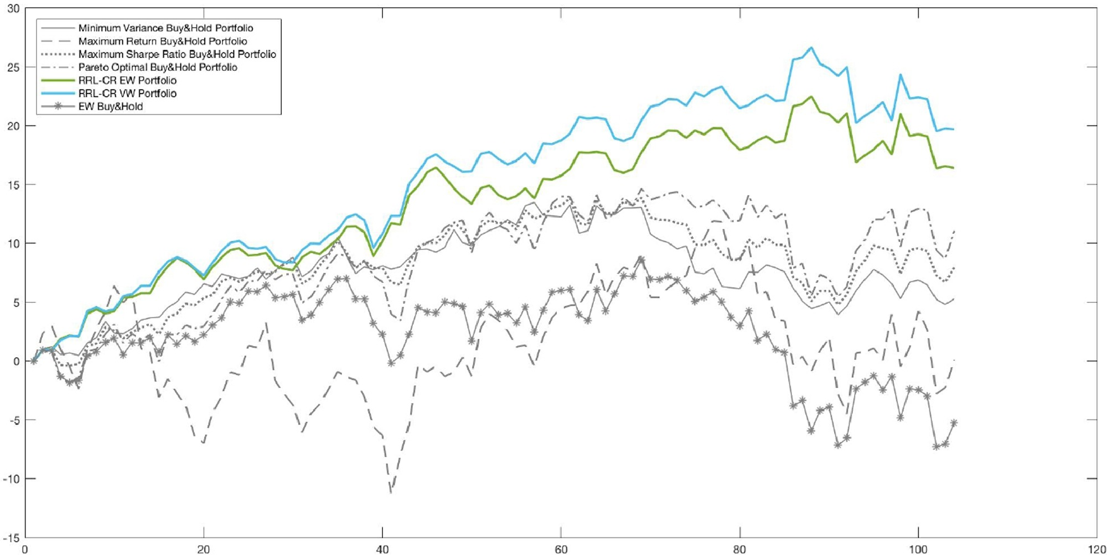
Portfolio performance RRL with CR

Slide 12
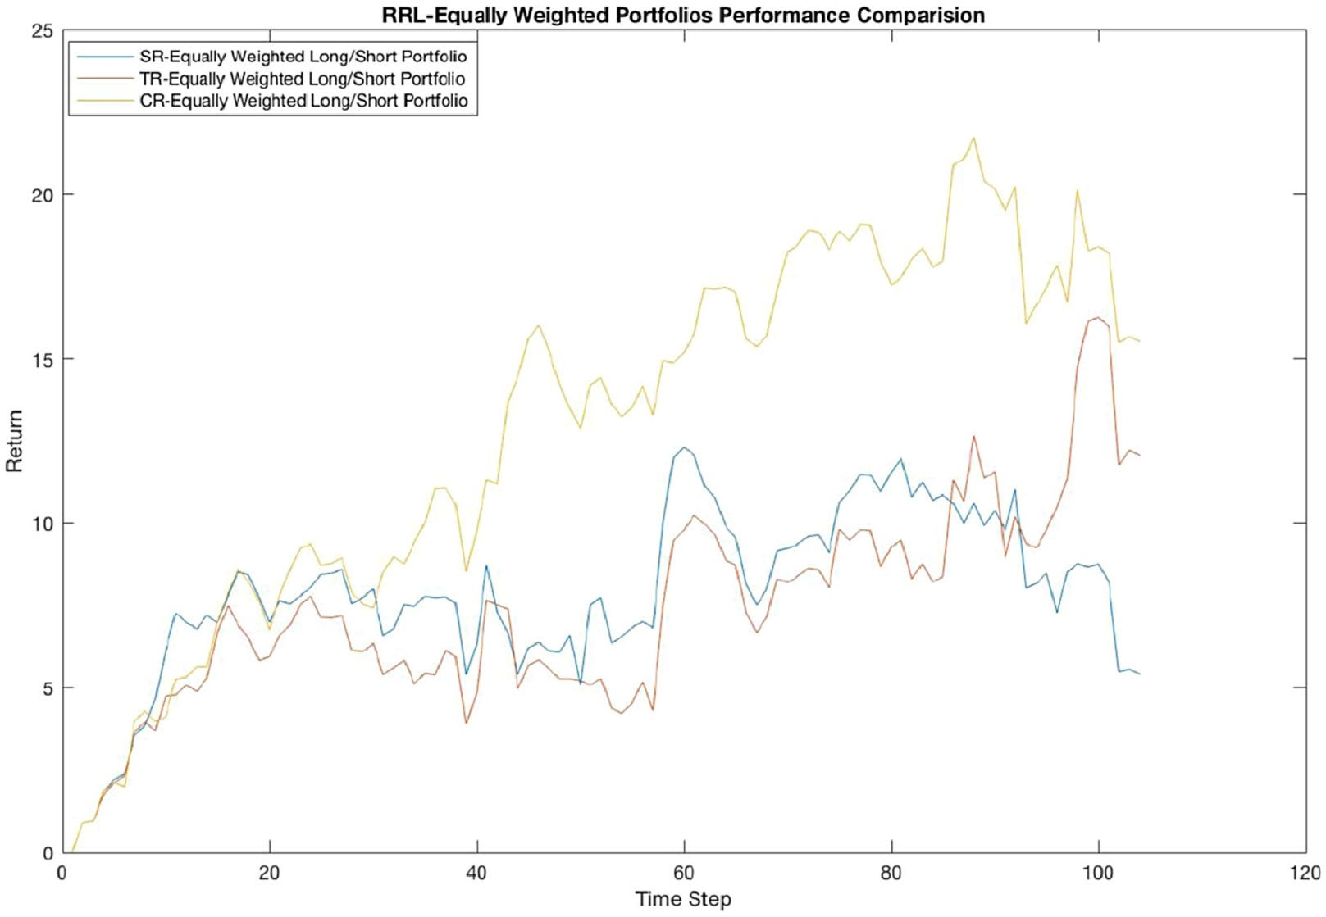
Comparison

Slide 13
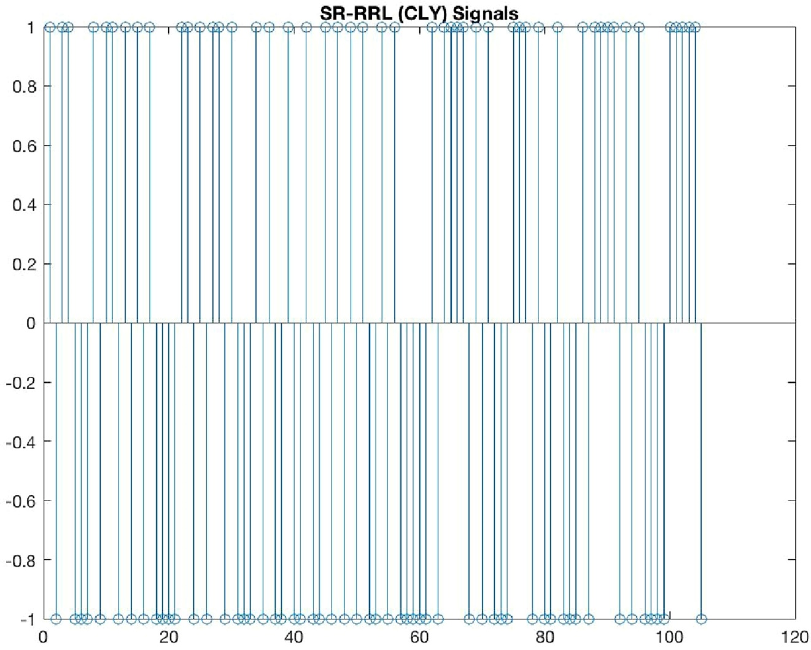
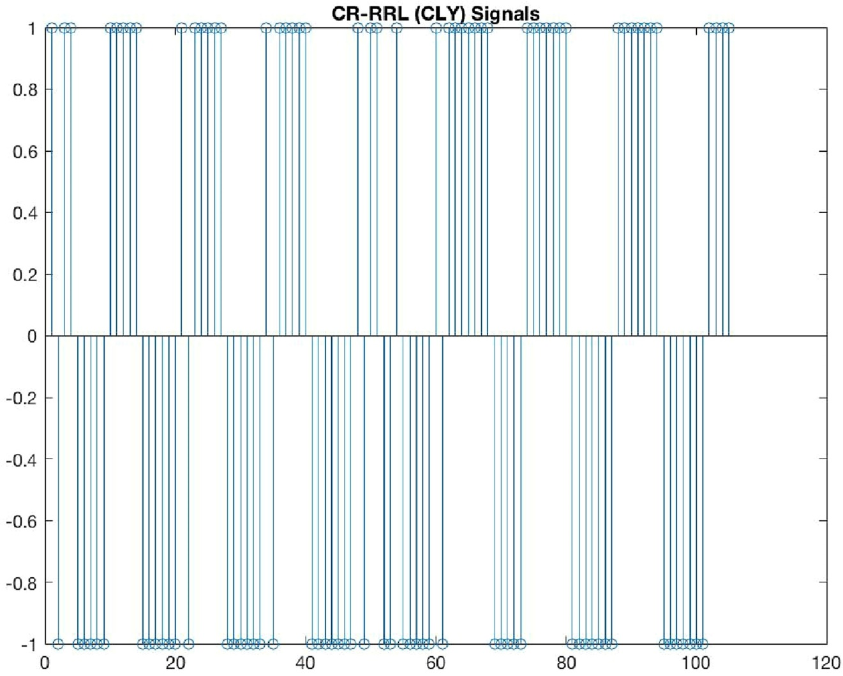
CLY RTF Signal generated
Notes:
SR rebalancing no signal more frequently，CR is more sensitive to large loss

Slide 14
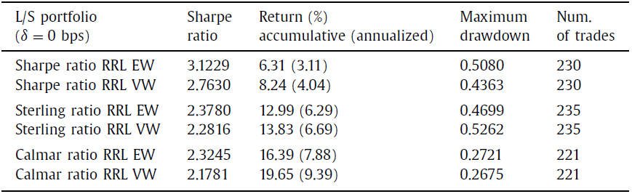
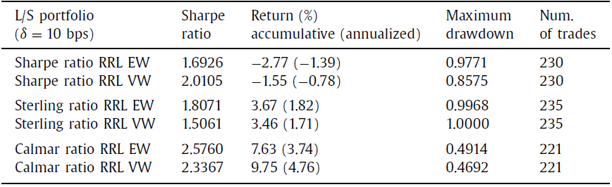

Comparison at different $δ$

Slide 15
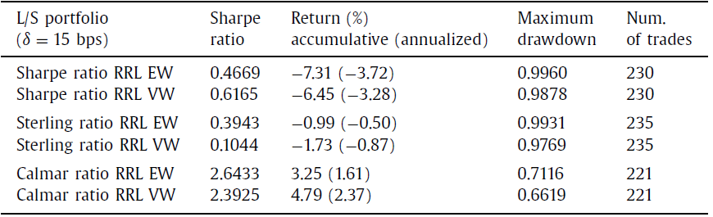
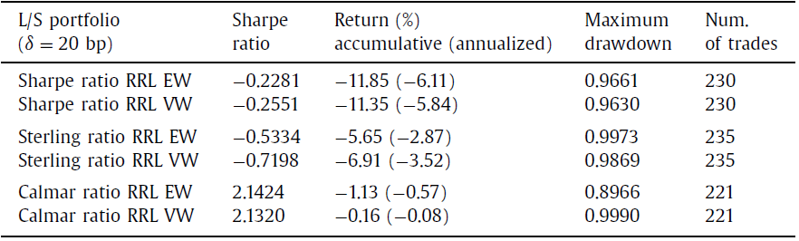
Comparison at different $δ$

Slide 16
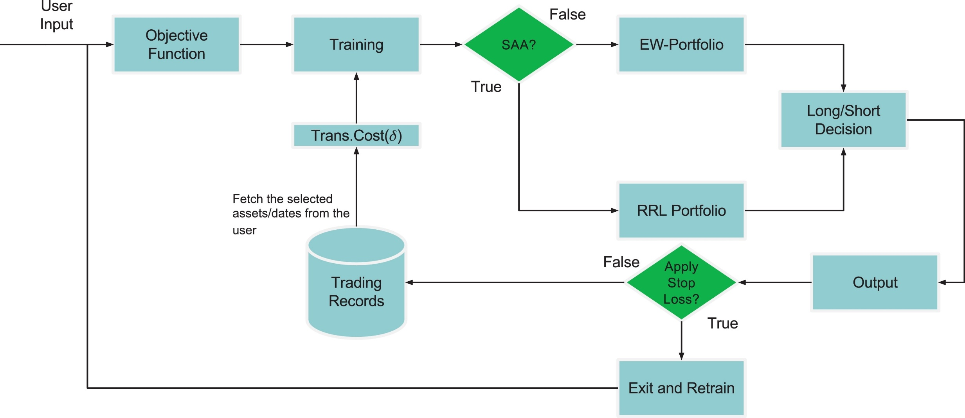
RRL based trading decision system

Slide 17
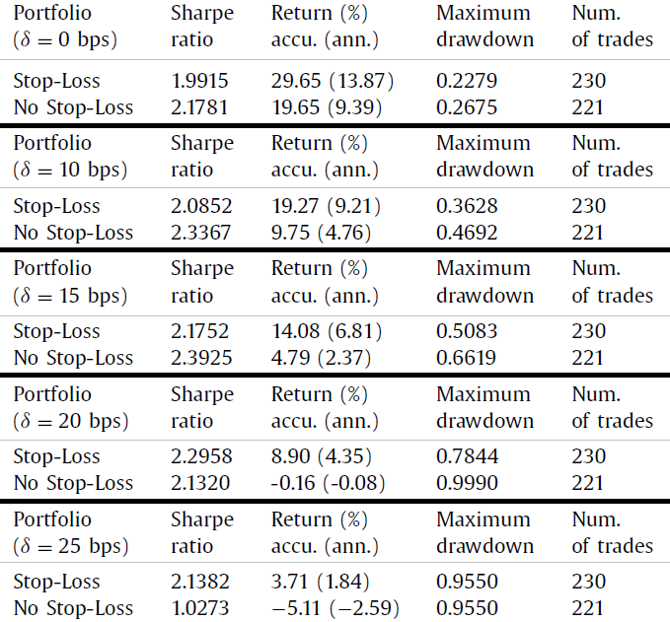
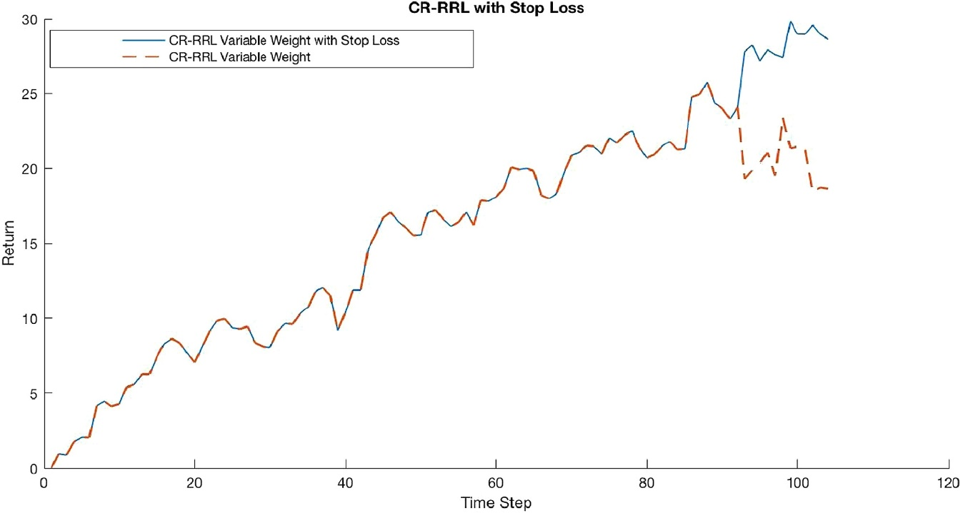

Dynamic stop-loss strategy
$\frac{r_{t−1}}{σ_{t−1}}≤−n$

Slide 18
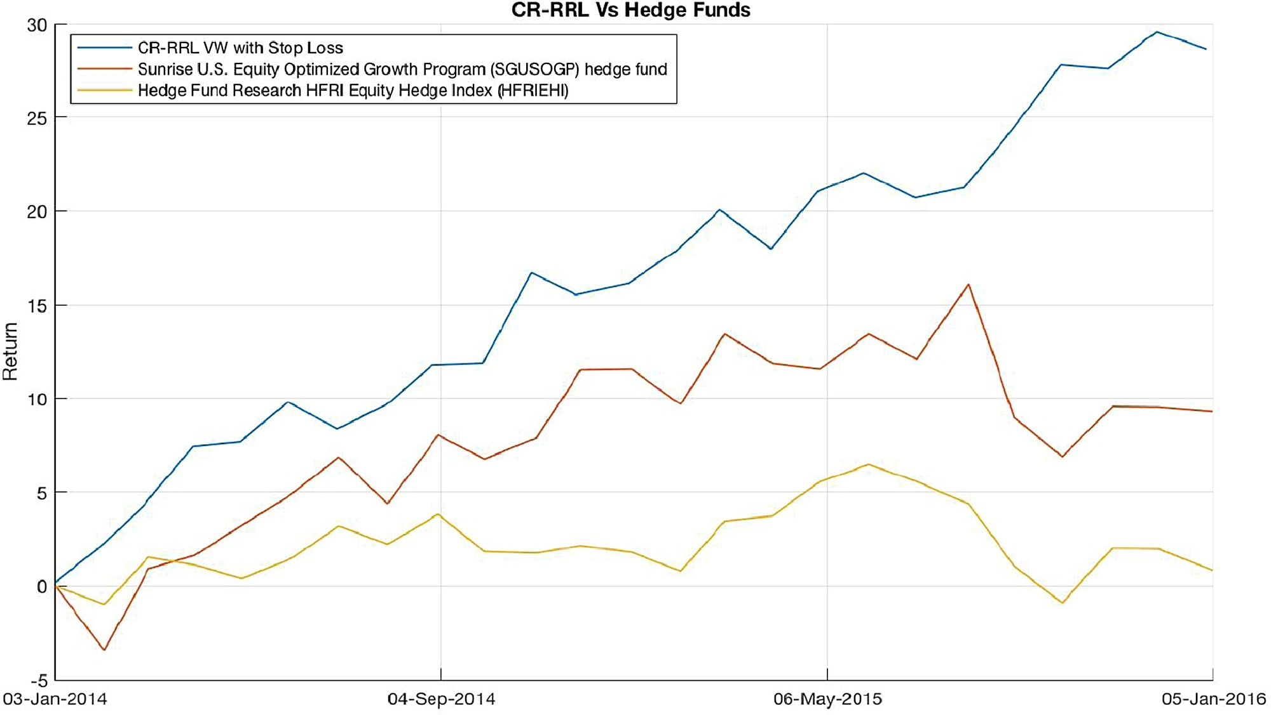
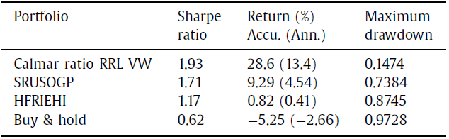
Comparison with others

