Slide 1
Maximal Common Subsequence Algorithms
Yoshifumi Sakai
29th Annual Symposium on Combinatorial Pattern Matching (CPM 2018) Article No. 1; pp. 1:1–1:10 .
Presenter: Kuo-Feng Huang
Date: 2018/06/05

Slide 2
Abstract
A common subsequence of two strings is maximal, if inserting any character into the subsequence can no longer yield a common subsequence of the two strings. The present article proposes a (sub)linearithmic-time, linear-space algorithm for finding a maximal common subsequence of two strings and also proposes a linear-time algorithm for determining if a common subsequence of two strings is maximal.

Slide 3
MCS
A: acdef
B: adecf
LCS: adef
MCS: acf, adef

Slide 4
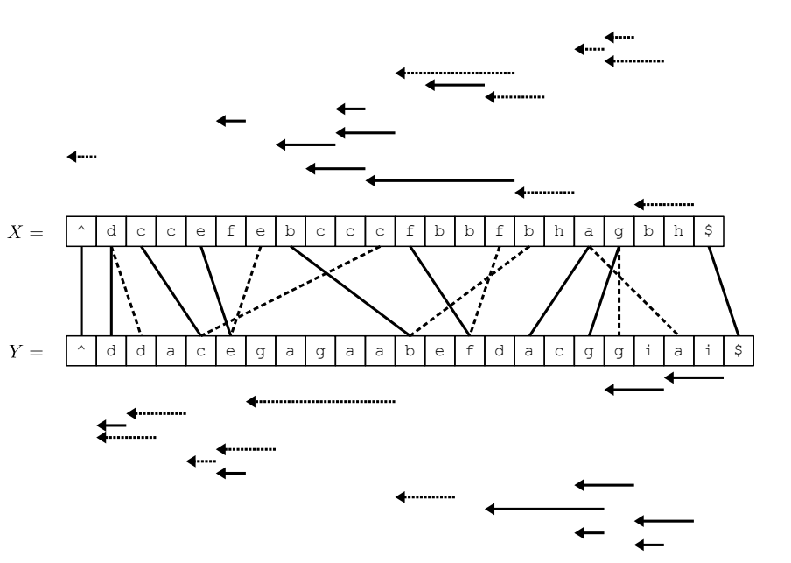
MCS
A: acdef
B: adecf
LCS: adef
MCS: acf, adef

Slide 5
MCS
A: ^ d c c e f e b c c c f b b f b h a g b h $
B: ^ d d a c e g a g a a b e f d a c g g I a I $
LCS: adef
MCS: acf, adef
W: ^ $
W^: (1,1), (20,21)

Slide 6
MCS
A: ^ d c c e f e b c c c f b b f b h a g b h $
B: ^ d d a c e g a g a a b e f d a c g g I a I $
LCS: adef
MCS: acf, adef
W: ^ a $
W^: (1,1), (16,19), (19,20)

Slide 7
MCS
A: ^ d c c e f e b c c c f b b f b h a g b h $
B: ^ d d a c e g a g a a b e f d a c g g I a I $
LCS: adef
MCS: acf, adef
W: ^ b a $
W^: (1,1), (14,10)
, (15,18), (19,20)

Slide 8
MCS
A: ^ d c c e f e b c c c f b b f b h a g b h $
B: ^ d d a c e g a g a a b e f d a c g g I a I $
LCS: adef
MCS: acf, adef
W: ^ b a $
W^: (1,1), (13,9)
, (15,18), (19,20)

Slide 9
MCS
A: ^ d c c e f e b c c c f b b f b h a g b h $
B: ^ d d a c e g a g a a b e f d a c g g I a I $
LCS: adef
MCS: acf, adef
W: ^ b a $
W^: (1,1), (12,8)
, (15,18), (19,20)

Slide 10
MCS
A: ^ d c c e f e b c c c f b b f b h a g b h $
B: ^ d d a c e g a g a a b e f d a c g g I a I $
LCS: adef
MCS: acf, adef
W: ^ b a $
W^: (1,1), (11,7)
, (15,18), (19,20)

Slide 11
MCS
A: ^ d c c e f e b c c c f b b f b h a g b h $
B: ^ d d a c e g a g a a b e f d a c g g I a I $
LCS: adef
MCS: acf, adef
W: ^ c b a $
W^: (1,1), (9,3), (10,6)
, (15,18), (19,20)

Slide 12
MCS
A: ^ d c c e f e b c c c f b b f b h a g b h $
B: ^ d d a c e g a g a a b e f d a c g g I a I $
LCS: adef
MCS: acf, adef
W: ^ d c b a $
W^: (1,1), (0,1)
(8,2), (10,6)
, (15,18), (19,20)

Slide 13
MCS
A: ^ d c c e f e b c c c f b b f b h a g b h $
B: ^ d d a c e g a g a a b e f d a c g g I a I $
LCS: adef
MCS: acf, adef
W: ^ d c b a $
W^: (1,1), (1,1)
(8,2), (10,6)
, (15,18), (19,20)

Slide 14
MCS
A: ^ d c c e f e b c c c f b b f b h a g b h $
B: ^ d d a c e g a g a a b e f d a c g g I a I $
LCS: adef
MCS: acf, adef
W: ^ d c b a $
W^: (1,1), (1,1)
(7,1), (10,6)
, (15,18), (19,20)

Slide 15
MCS
A: ^ d c c e f e b c c c f b b f b h a g b h $
B: ^ d d a c e g a g a a b e f d a c g g I a I $
LCS: adef
MCS: acf, adef
W: ^ d c b a $
W^: (1,1), (1,1)
(2,4), (10,6)
, (15,18), (19,20)

Slide 16
MCS
A: ^ d c c e f e b c c c f b b f b h a g b h $
B: ^ d d a c e g a g a a b e f d a c g g I a I $
LCS: adef
MCS: acf, adef
W: ^ d c e b a $
W^: (1,1), (1,1)
(2,4), (5,4), (9,5)
, (15,18), (19,20)

Slide 17
MCS
A: ^ d c c e f e b c c c f b b f b h a g b h $
B: ^ d d a c e g a g a a b e f d a c g g I a I $
LCS: adef
MCS: acf, adef
W: ^ d c e b a $
W^: (1,1), (1,1)
(2,4), (4,5), (9,5)
, (15,18), (19,20)

Slide 18
MCS
A: ^ d c c e f e b c c c f b b f b h a g b h $
B: ^ d d a c e g a g a a b e f d a c g g I a I $
LCS: adef
MCS: acf, adef
W: ^ d c e b a $
W^: (1,1), (1,1)
(2,4), (4,5), (7,11)
, (15,18), (19,20)

Slide 19
MCS
A: ^ d c c e f e b c c c f b b f b h a g b h $
B: ^ d d a c e g a g a a b e f d a c g g I a I $
LCS: adef
MCS: acf, adef
W: ^ d c e b a $
W^: (1,1), (1,1)
(2,4), (4,5), (7,11)
, (14,17), (19,20)

Slide 20
MCS
A: ^ d c c e f e b c c c f b b f b h a g b h $
B: ^ d d a c e g a g a a b e f d a c g g I a I $
LCS: adef
MCS: acf, adef
W: ^ d c e b f a $
W^: (1,1), (1,1)
(2,4), (4,5), (7,11),
(13,12), (14,17), (19,20)

Slide 21
MCS
A: ^ d c c e f e b c c c f b b f b h a g b h $
B: ^ d d a c e g a g a a b e f d a c g g I a I $
LCS: adef
MCS: acf, adef
W: ^ d c e b f a $
W^: (1,1), (1,1)
(2,4), (4,5), (7,11),
(12,11), (14,17), (19,20)

Slide 22
MCS
A: ^ d c c e f e b c c c f b b f b h a g b h $
B: ^ d d a c e g a g a a b e f d a c g g I a I $
LCS: adef
MCS: acf, adef
W: ^ d c e b f a $
W^: (1,1), (1,1)
(2,4), (4,5), (7,11),
(11,13), (14,17), (19,20)

Slide 23
MCS
A: ^ d c c e f e b c c c f b b f b h a g b h $
B: ^ d d a c e g a g a a b e f d a c g g I a I $
LCS: adef
MCS: acf, adef
W: ^ d c e b f a $
W^: (1,1), (1,1)
(2,4), (4,5), (7,11),
(11,13), (13,16), (19,20)

Slide 24
MCS
A: ^ d c c e f e b c c c f b b f b h a g b h $
B: ^ d d a c e g a g a a b e f d a c g g I a I $
LCS: adef
MCS: acf, adef
W: ^ d c e b f a $
W^: (1,1), (1,1)
(2,4), (4,5), (7,11),
(11,13), (12,15), (19,20)

Slide 25
MCS
A: ^ d c c e f e b c c c f b b f b h a g b h $
B: ^ d d a c e g a g a a b e f d a c g g I a I $
LCS: adef
MCS: acf, adef
W: ^ d c e b f a $
W^: (1,1), (1,1)
(2,4), (4,5), (7,11),
(11,13), (11,14), (19,20)

Slide 26
MCS
A: ^ d c c e f e b c c c f b b f b h a g b h $
B: ^ d d a c e g a g a a b e f d a c g g I a I $
LCS: adef
MCS: acf, adef
W: ^ d c e b f a $
W^: (1,1), (1,1)
(2,4), (4,5), (7,11),
(11,13), (17,15), (19,20)

Slide 27
MCS
A: ^ d c c e f e b c c c f b b f b h a g b h $
B: ^ d d a c e g a g a a b e f d a c g g I a I $
LCS: adef
MCS: acf, adef
W: ^ d c e b f a $
W^: (1,1), (1,1)
(2,4), (4,5), (7,11),
(11,13), (17,15), (18,19)

Slide 28
MCS
A: ^ d c c e f e b c c c f b b f b h a g b h $
B: ^ d d a c e g a g a a b e f d a c g g I a I $
LCS: adef
MCS: acf, adef
W: ^ d c e b f a g $
W^: (1,1), (1,1)
(2,4), (4,5), (7,11),
(11,13), (17,15),
(17,16),(18,19)

Slide 29
MCS
A: ^ d c c e f e b c c c f b b f b h a g b h $
B: ^ d d a c e g a g a a b e f d a c g g I a I $
LCS: adef
MCS: acf, adef
W: ^ d c e b f a g $
W^: (1,1), (1,1)
(2,4), (4,5), (7,11),
(11,13), (17,15),
(18,17),(18,19)

Slide 30
MCS
A: ^ d c c e f e b c c c f b b f b h a g b h $
B: ^ d d a c e g a g a a b e f d a c g g I a I $
LCS: adef
MCS: acf, adef
W: ^ d c e b f a g $
W^: (1,1), (1,1)
(2,4), (4,5), (7,11),
(11,13), (17,15),
(18,17),(18,19)

