Slide 1
Maximum and minimum stock price forecasting of Brazilian power distribution companies based on artificial neural networks
Leonel A.Laboissiere, Ricardo A.S.Fernandes, Guilherme G.Lage
Applied Soft Computing, Volume 35, October 2015, Pages 66-74
Presenter: Cheng-Han Wu
Date:2018/6/5

Slide 2
Abstract(1/2)
Time series forecasting has been widely used to determine future prices of stocks, and the analysis and modeling of finance time series is an important task for guiding investors’ decisions and trades. Nonetheless, the prediction of prices by means of a time series is not trivial and it requires a thorough analysis of indexes, variables and other data. In addition, in a dynamic environment such as the stock market, the non-linearity of the time series is a pronounced characteristic, and this immediately affects the efficacy of stock price forecasts. Thus, this paper aims at proposing a methodology that forecasts the maximum and minimum day stock prices of three Brazilian power distribution companies, which are traded in the São Paulo Stock Exchange BM&FBovespa. When compared to the other papers already published in the literature, one of the main contributions and novelty of this paper is the forecast of the range of closing prices of Brazilian power distribution companies’ stocks.

Slide 3
Abstract(2/2)
As a result of its application, investors may be able to define threshold values for their stock trades. Moreover, such a methodology may be of great interest to home brokers who do not possess ample knowledge to invest in such companies. The proposed methodology is based on the calculation of distinct features to be analysed by means of attribute selection, defining the most relevant attributes to predict the maximum and minimum day stock prices of each company. Then, the actual prediction was carried out by Artificial Neural Networks (ANNs), which had their performances evaluated by means of Mean Absolute Error (MAE), Mean Absolute Percentage Error (MAPE) and Root Mean Square Error (RMSE) calculations. The proposed methodology for addressing the problem of prediction of maximum and minimum day stock prices for Brazilian distribution companies is effective. In addition, these results were only possible to be achieved due to the combined use of attribute selection by correlation analysis and ANNs.

Slide 4
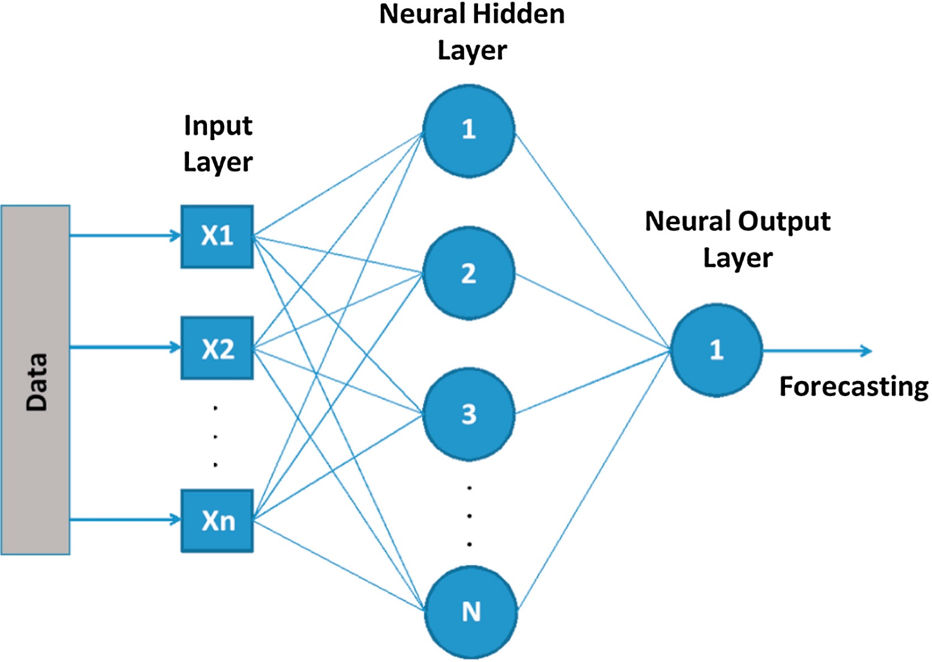

ANN
$y=g\left(\sum_{i=1}^{n}{w_{i}x_{i}+b}\right)$
$g_{1}\left(u\right)=\frac{2}{1−e^{−2u}}−1$
$g_{2}\left(u\right)=u$

Slide 5
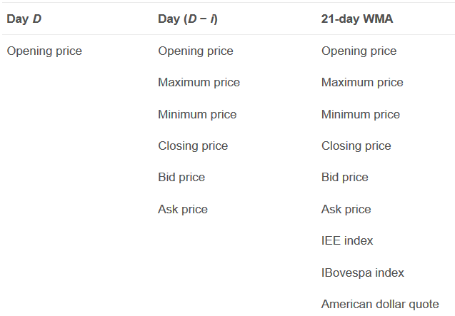
Input feature
CSRN3
CEBR3
CPFE3
IBovespa : 巴西證券期貨交易所
IEE : Electric Energy Index
American dollar
January 2008~July 2012 (train)
October 2012~September 2013(test)
Notes:
IBovespa :巴西證券期貨交易所

Slide 6
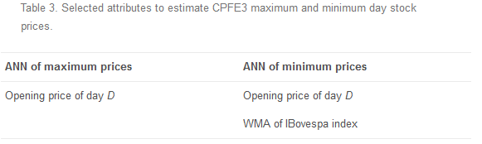
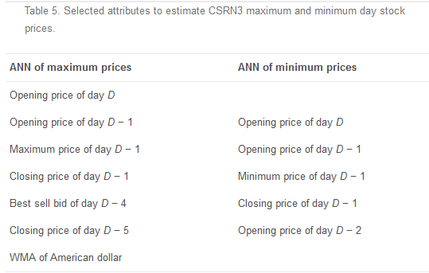
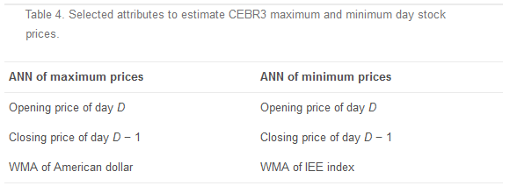
Select Attributes

Slide 7

Results evaluation
$MAE=\frac{1}{N}\sum_{i=1}^{N}{|P_{i}−\overline{P_{i}}|}$
$MAPE=\frac{100}{N}\sum_{i=1}^{N}{\frac{|P_{i}−\overline{P_{i}}|}{P_{i}}}$
$RMSE=\sqrt{\frac{1}{N}\sum_{i=1}^{N}{{\left(P_{i}−\overline{P_{i}}\right)}^{2}}}$

Slide 8
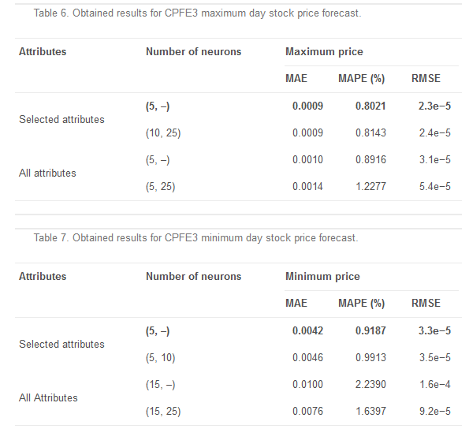
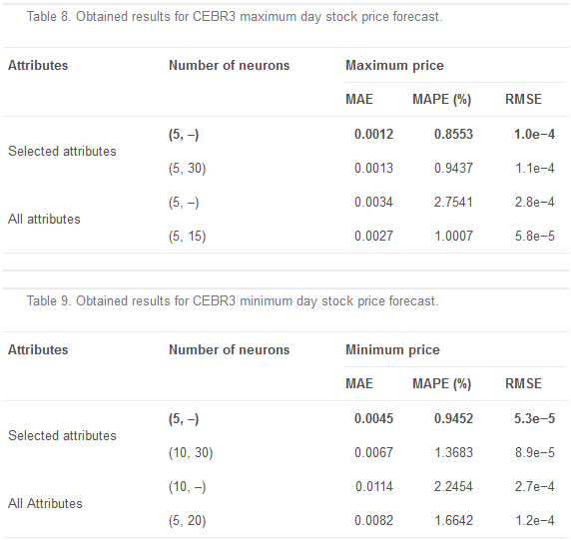
Results

Slide 9
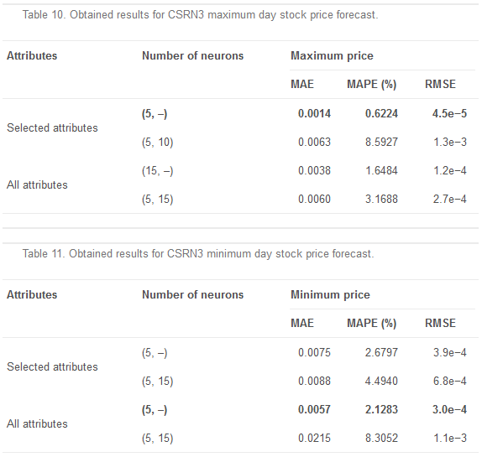
Results

Slide 10
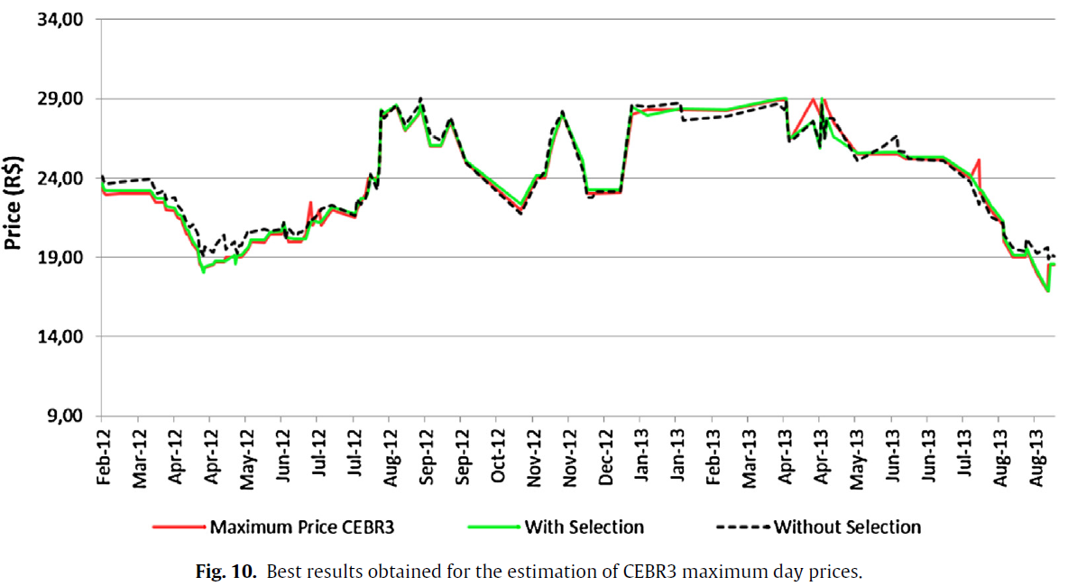
Results

