Slide 1
Heuristics for the Sorting Signed Permutations by Reversals and Transpositions Problem
Klairton Lima Brito, Andre Rodrigues Oliveira, Ulisses Dias and Zanoni Dias
5th International Conference on Algorithms for Computational Biology (AlCoB), Hong Kong, China, June 25 ~ June 26, 2018
Speaker: Kuan-Chih Chen
Date: 2018.07.31
Notes:
香港

Slide 2


Slide 3
Abstract (1/2)
We present two heuristics, Sliding Window and Look Ahead, to improve solutions for the Sorting Signed Permutations by Reversals and Transpositions Problem. To assess the heuristics, we implemented algorithms described in the literature to provide initial solutions. Despite the fact that we addressed a specific problem, both heuristics can be applied to many others within the area of genome rearrangement.

Slide 4
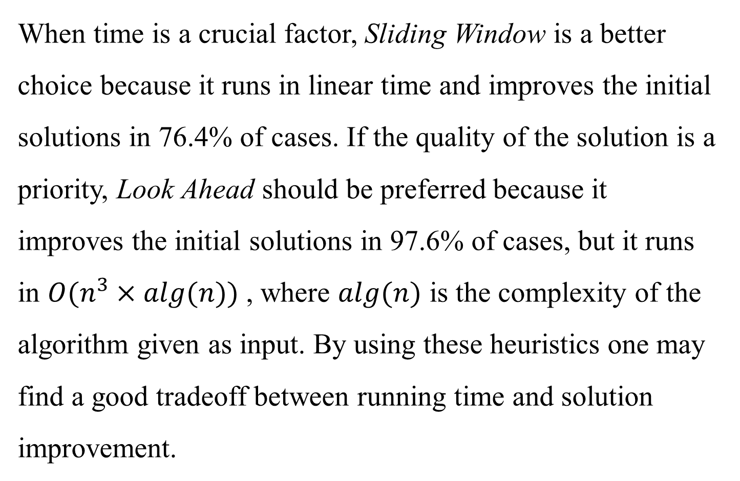
Abstract (2/2)
When time is a crucial factor, Sliding Window is a better choice because it runs in linear time and improves the initial solutions in 76.4% of cases. If the quality of the solution is a priority, Look Ahead should be preferred because it improves the initial solutions in 97.6% of cases, but it runs in $O(n^{3}×alg(n))$, where $alg(n)$ is the complexity of the algorithm given as input. By using these heuristics one may find a good tradeoff between running time and solution improvement.

Slide 5
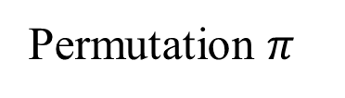
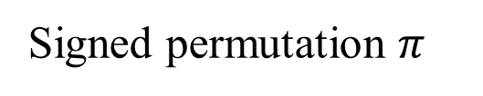

Definition
Permutation $π$
< 1, 2, 3, 4, 5, 6 >
< 2, 1, 3, 4, 5, 6 >
< 5, 1, 6, 2, 4, 3 >
(unsigned permutation)
Signed permutation $π$
(as the relative orientation of the genes)
$π =$< +2, -1, +5, +3, -4, +6 >

Slide 6
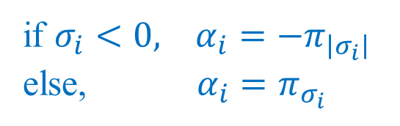

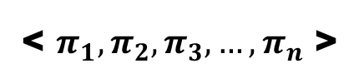



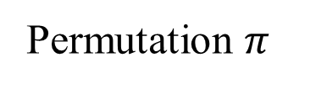


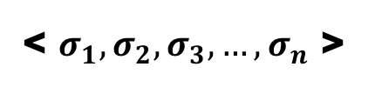

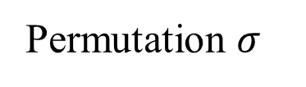


Composition (1/2)
Permutation $π$
< $π_{1},π_{2},π_{3}, …,π_{n}$ >
Permutation $σ$
< $σ_{1},σ_{2},σ_{3}, …,σ_{n}$ >
Composition:
$$α= π∘σ=\left(π_{σ1},π_{σ2}, …, π_{σn}\right)$$
if $σ_{i}<0, α_{i}=−π_{\left|σ_{i}\right|}$
else, $α_{i}=π_{σ_{i}}$
$$π= <+2, +6, +1, +5, +4, +3>$$
$$σ= <−3, +5, −2, +1, +6, −4>$$
$$α=π∘σ$$
$$α= <−3, +5, −2, +1, +6, −4>$$
$$−1$$
$$+4$$
$$−6$$
$$+2$$
$$+3$$
$$−5$$

Slide 7

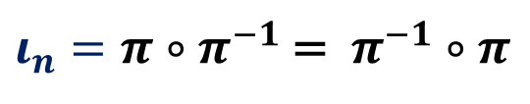








Composition (2/2)
Permutation $π$
< $π_{1},π_{2},π_{3}, …,π_{n}$ >
Permutation $σ$
< $σ_{1},σ_{2},σ_{3}, …,σ_{n}$ >
Composition:
$$α= π∘σ=\left(π_{σ1},π_{σ2}, …, π_{σn}\right)$$
if $σ_{i}<0, α_{i}=−π_{\left|σ_{i}\right|}$
else, $α_{i}=π_{σ_{i}}$
$$π= <+2, +6, +1, +5, +4, +3>$$
$$π^{−1}= <−3, +5, −2, +1, +6, −4>$$
$$+3$$
$$+1$$
$$+6$$
$$+5$$
$$+4$$
$$+2$$
position of $i$ in $π$
$ι_{n}=π∘π^{−1}$ =$π^{−1}∘π$
$$= <+1, +2, +3, +4, +5, +6>$$

Slide 8
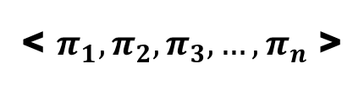

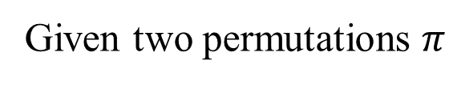
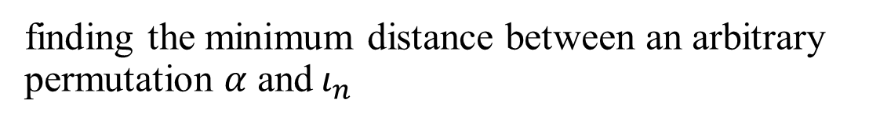
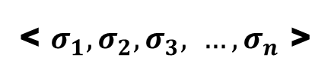


The sorting problem
Rearrangement-distance problem:
Given two permutations $π$
< $π_{1},π_{2},π_{3}, …,π_{n}$ >
and $σ$
< $σ_{1},σ_{2}, σ_{3}, …,σ_{n}$ >
$$d(π,σ)$$
find the minimum distance to transform $π$ into $σ$
$$d\left(π,σ\right)=d\left(π∘σ^{−1}, σ∘σ^{−1}\right)=d(α, ι_{n})$$
Sorting problem:
$$d(α, ι_{n})$$
finding the minimum distance between an arbitrary permutation $α$ and$ι_{n}$

Slide 9


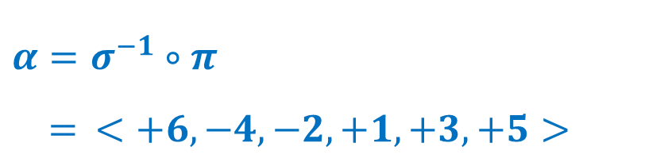

An example for the sorting problem
$$π= <+6, +5, +1, +2, +4, +3>$$
$$σ= <+2, −1, +4, −5, +3, +6>$$
$$σ^{−1}= <−2, +1, +5, +3, −4, +6>$$
$$α=σ^{−1}∘π$$
$= <+6, −4, −2, +1, +3, +5>$

Slide 10
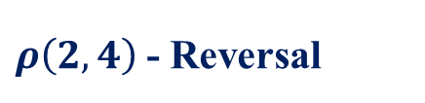



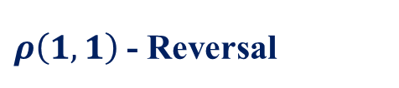
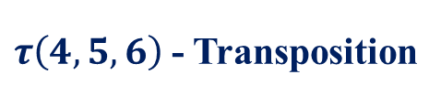


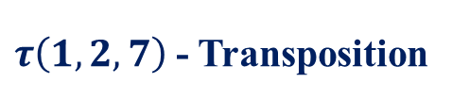
An example for the sorting problem
$$α= <+6, −4, −2, +1, +3, +5>$$
$$ι_{6}= <+1, +2, +3, +4, +5, +6>$$
$α$ $= <+6, −4, −2, +1, +3, +5>$
$ρ\left(2,4\right)$- Reversal
$τ\left(1,2,7\right)$- Transposition
$$= <+6, −1, +2, +4, +3, +5>$$
$$= <−1, +2, +3, +4, +5, +6>$$
$τ\left(4,5,6\right)$- Transposition
$ρ\left(1,1\right)$- Reversal
$$= <+6, −1, +2, +3, +4, +5>$$
$$= <+1, +2, +3, +4, +5, +6>$$
$$d\left(α, ι_{6}\right)=4$$

Slide 11





An example for the sorting problem
$$π= <+6, +5, +1, +2, +4, +3>$$
$$σ= <+2, −1, +4, −5, +3, +6>$$
$π$ $= <+6, +5, +1, +2, +4, +3>$
$ρ\left(2,4\right)$- Reversal
$τ\left(1,2,7\right)$- Transposition
$$= <+6, −2, −1, −5, +4, +3>$$
$$= <−2, −1, +4, −5, +3, +6>$$
$τ\left(4,5,6\right)$- Transposition
$ρ\left(1,1\right)$- Reversal
$$= <+6, −2, −1, +4, −5, +3>$$
$$= <+2, −1, +4, −5, +3, +6>$$
$$d\left(π, σ\right)=d\left(α, ι_{6}\right)=4$$

Slide 12


Reduced permutation
$$breakpoint$$
$$π= <+1, +2, −9, −8, +5, +6, +7, +3, +4>$$
$$strip$$
$$π= <−9, −8, +5, +6, +7, +3, +4>$$
$$π= <−9, +5, +3>$$
$$π= <−3, +2, +1>$$
(I)(II). Remove the first /last strip if it starts with +1/ ends with +n
(III). Replace each strip with the smallest element in it
(IV). Renumber the sequence to obtain a valid permutation

Slide 13



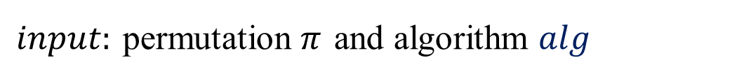
Heuristic – Sliding Window
$$O(n+alg(n))$$
$input:$ permutation $π$ and algorithm $alg$
$output:$ a sequence of rearrangement events
$$S^{W′}=[π^{0},π^{1},…,π^{y}]$$
window
database

Slide 14
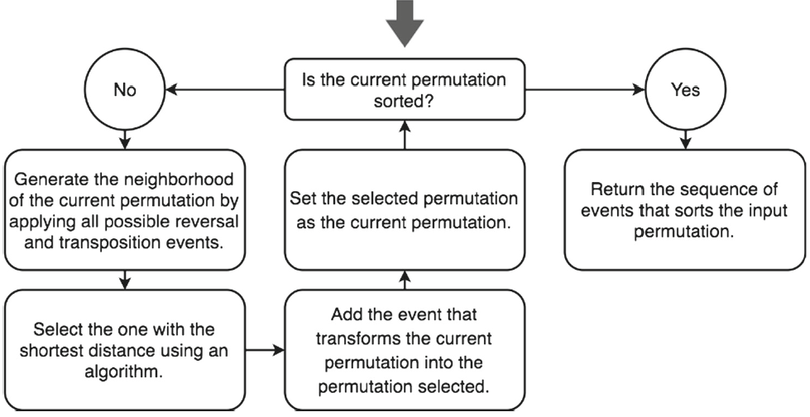
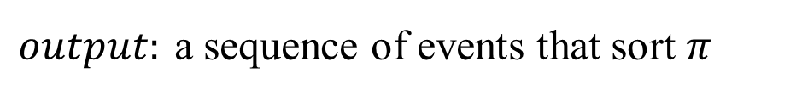


Heuristic – Look Ahead
$$O(n^{3}+alg(n))$$
$input:$ permutation $π$ and algorithm $alg$
$output:$ a sequence of events that sort $π$
$$bfs?$$

Slide 15
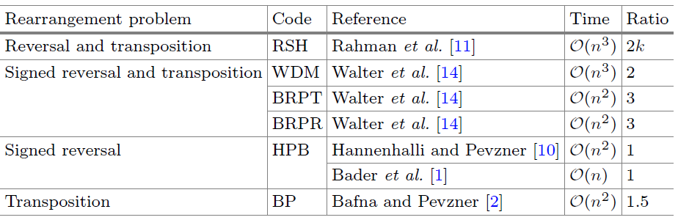
Implemented Algorithms
U
U
BRPT: greedily removes the largest number of breakpoints
BRPR: A variation of BRPT (only reversals)
BP: first reverse all negative strips
Notes:
RSH: Unsigned Permutations by Reversals and Transpositions /k is the approximation of the algorithm that decomposes π in cycles
WDM: Signed Permutations by Reversals and Transpositions
BRPT: Signed Permutations by Reversals and Transpositions /In case of ties between reversals and transpositions, a transposition is chosen.
BRPR: A variation of BRPT /(reversals)
HPB: Signed Permutations by Reversals
BP: Unsigned Permutations by Transpositions /first reverse all negative strips / 最後序列由反轉+後續動作組成

Slide 16
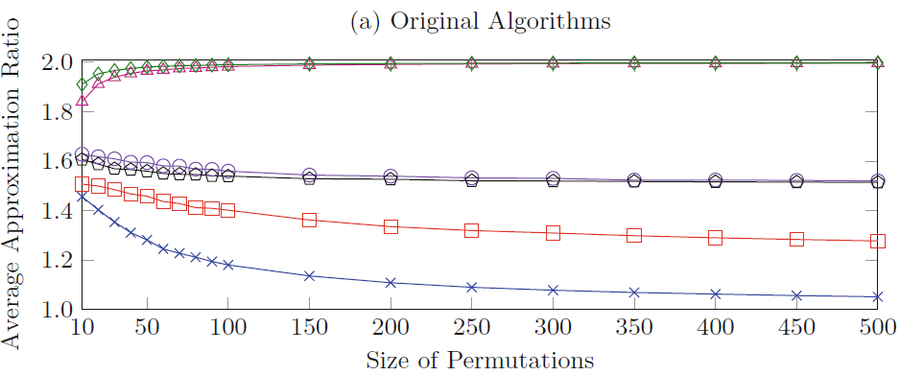
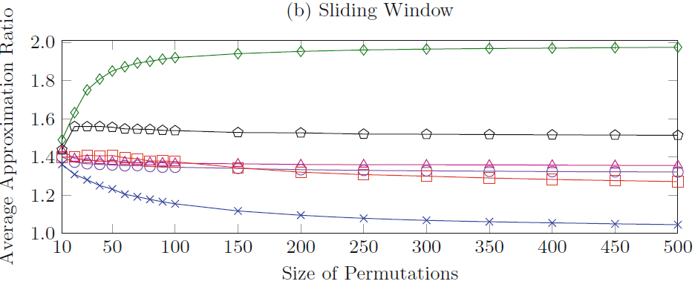
Result

Slide 17
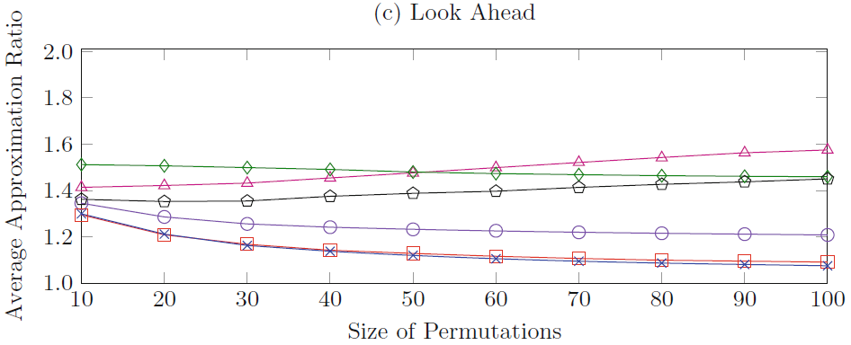
Result

