Slide 1
A Fast Algorithm for Approximate String Matching on Gene Sequences
Zheng Liu, Xin Chen, James Borneman, and Tao Jiang(姜濤) Proceedings of 16th Annual Symposium on Combinatorial Pattern Matching(CPM)
June 19-22, 2005, Jeju Island, Korea
Speaker：Kuan Lin Lai
Date: 2018/10/16

Slide 2
Abstract (1/2)
Approximate string matching is a fundamental and challenging problem in computer science, for which a fast algorithm is highly demanded in many applications including text processing and DNA sequence analysis. In this paper, we present a fast algorithm for approximate string matching, called FAAST. It aims at solving a popular variant of the approximate string matching problem, the k-mismatch problem, whose objective is to find all occurrences of a short pattern in a long text string with at most k mismatches.

Slide 3
Abstract (2/2)
FAAST generalizes the well-known Tarhio-Ukkonen algorithm by requiring two or more matches when calculating shift distances, which makes the approximate string matching process significantly faster than the Tarhio-Ukkonen algorithm. Theoretically, we prove that FAAST on average skips more characters than the Tarhio-Ukkonen algorithm in a single shift, and makes fewer character comparisons in an entire matching process. Experiments on both simulated data sets and real gene sequences also demonstrate that FAAST runs several times faster than the Tarhio-Ukkonen algorithm in all the cases that we tested.

Slide 4
Approximate string matching：k-mismatch problem
Text：ACAACTTATTTA Pattern：ATTG
 | A | C | A | A | C | T | T | A | T | T | T | A
A | 1 | 0 | 1 | 1 | 0 | 0 | 0 | 1 | 0 | 0 | 0 | 1
T | 0 | 0 | 0 | 0 | 0 | 1 | 1 | 0 | 1 | 1 | 1 | 0
T | 0 | 0 | 0 | 0 | 0 | 1 | 1 | 0 | 1 | 1 | 1 | 0
G | 0 | 0 | 0 | 0 | 0 | 0 | 0 | 0 | 0 | 0 | 0 | 0

Slide 5
Approximate string matching：1-mismatch problem
Text：ACAACTTATTTA Pattern：ATTG
 | A | C | A | A | C | T | C | A | T | T | T | A
A | 1 | 0 | 1 | 1 | 0 | 0 | 0 | 1 | 0 | 0 | 0 | 1
T | 0 | 0 | 0 | 0 | 0 | 1 | 0 | 0 | 1 | 1 | 1 | 0
T | 0 | 0 | 0 | 0 | 0 | 1 | 0 | 0 | 1 | 1 | 1 | 0
G | 0 | 0 | 0 | 0 | 0 | 0 | 0 | 0 | 0 | 0 | 0 | 0

Slide 6
Approximate string matching：2-mismatch problem
Text：ACAACTTATTTA Pattern：ATTG
 | A | C | A | A | C | T | C | A | T | T | T | A
A | 1 | 0 | 1 | 1 | 0 | 0 | 0 | 1 | 0 | 0 | 0 | 1
T | 0 | 0 | 0 | 0 | 0 | 1 | 0 | 0 | 1 | 1 | 1 | 0
T | 0 | 0 | 0 | 0 | 0 | 1 | 0 | 0 | 1 | 1 | 1 | 0
G | 0 | 0 | 0 | 0 | 0 | 0 | 0 | 0 | 0 | 0 | 0 | 0

Slide 7
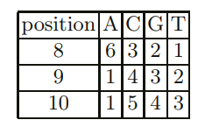
Tarhio-Ukkonen algorithm
Text： A A C T G T T A A C T T G C G A C T A G
Pattern：A A G T C G T A A C
A A G T C G T A A C
A A G T C G T A A C
d_{k}[AAC] = min{ d_{k}[8,A], d_{k}[9,A], d_{k}[10,C] } = 1
d_{k}[ACT] = min{ d_{k}[8,A], d_{k}[9,C], d_{k}[10,T] } = 3
O( kn(1/m-k+k/c) )

Slide 8
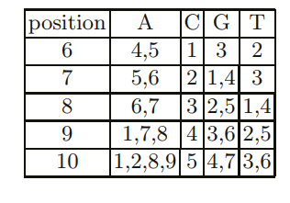
FAAST
Ex： Pattern：A A G T C G T A A C

Slide 9
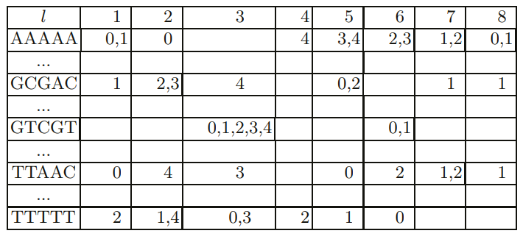
FAAST
Ex： Pattern：A A G T C G T A A C

Slide 10
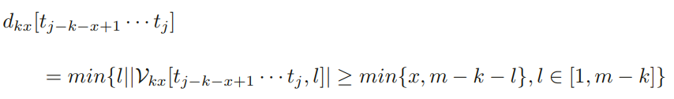
FAAST
Text： A A C T G T T A A C T T G C G A C T A G
Pattern：A A G T C G T A A C
A A G T C G T A A C
A A G T C G T A A C
d_{k}[TTAAC] = 7
d_{k}[GCGAC] = 7

Slide 11
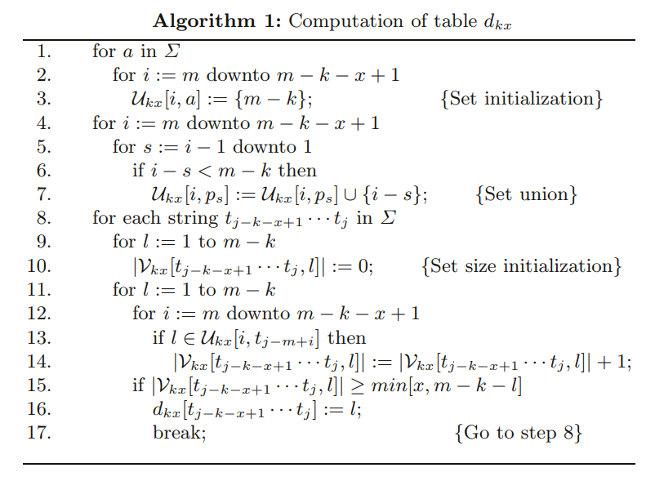
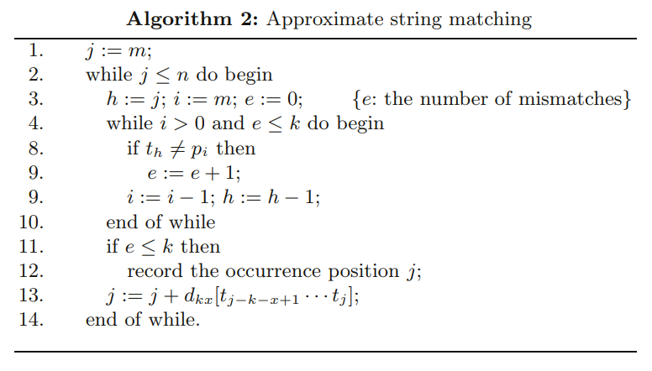
FAAST
O( (k+x)((m-k)c^{k+x}+m) ) + O(mn)

Slide 12


Analysis：average shift distance
Proof：

Slide 13
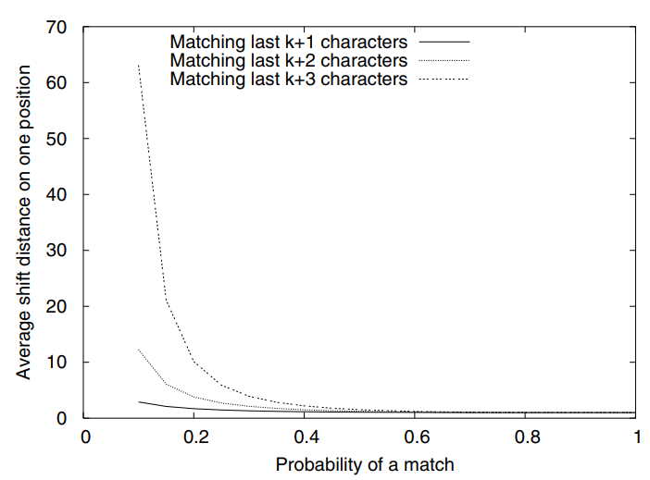
Analysis：average shift distance

Slide 14
Analysis：total character comparisons

Slide 15
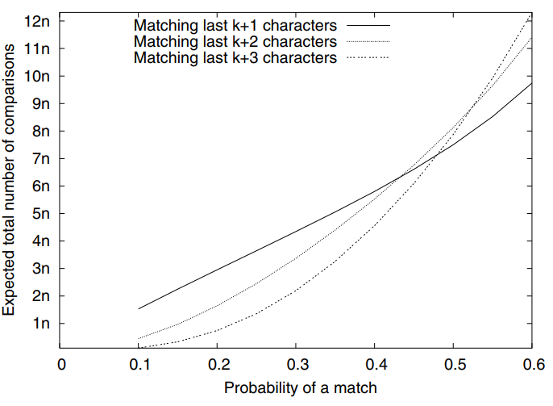
Analysis：total character comparisons

Slide 16
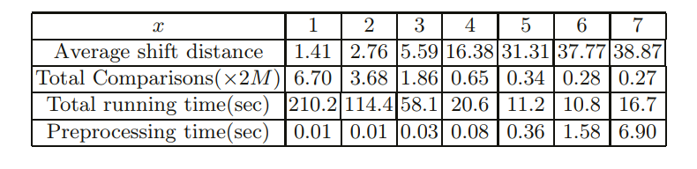
Experiment (1/2)
Simulated DNA sequence：2M Pattern size：39

Slide 17
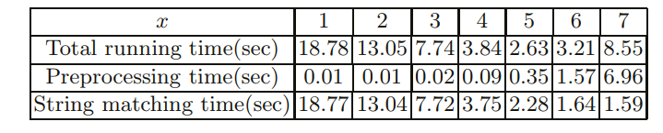
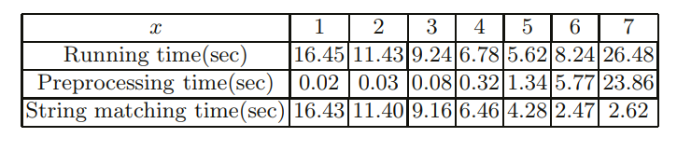
Experiment (2/2)
bacterial DNA sequences：170K
Pattern：AGRRTTTGATYHTGGYTCAG
fungal DNA sequences：179K
Pattern：TTAGCATGGAATAATRRAATAGGA

