Slide 1
Computing longest common square subsequences
Takafumi Inoue, Shunsuke Inenaga, *Heikki Hyyrö,
Hideo Bannai, Masayuki Takeda
Department of Informatics, Kyushu University, Japan
*Faculty of Natural Sciences, University of Tampere, Finland
Proceedings of 29th Annual Symposium on Combinatorial Pattern Matching, CPM 2018, Qingdao, China
Presenter: Ting-Wei Liang
Date:2018/10/16

Slide 2
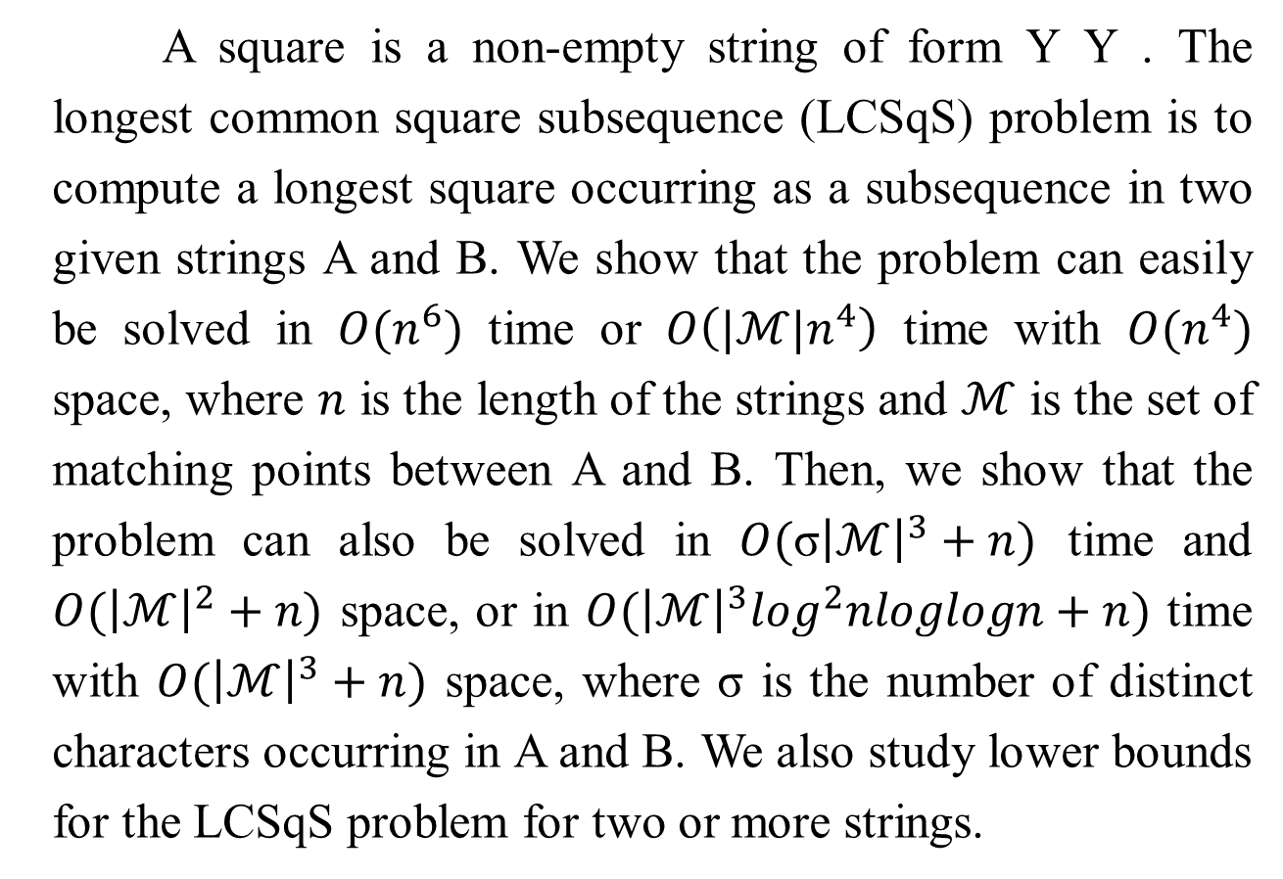
Abstract
A square is a non-empty string of form Y Y . The longest common square subsequence (LCSqS) problem is to compute a longest square occurring as a subsequence in two given strings A and B. We show that the problem can easily be solved in $O(n^{6})$ time or $O\left(|ℳ|n^{4}\right)$ time with $O(n^{4})$ space, where $n$ is the length of the strings and $ℳ$ is the set of matching points between A and B. Then, we show that the problem can also be solved in $O(\text{σ}{\left|ℳ\right|}^{3}+n)$ time and $O({\left|ℳ\right|}^{2}+n)$ space, or in $O({\left|ℳ\right|}^{3}\log^{2}nloglogn+n)$ time with $O({\left|ℳ\right|}^{3}+n)$ space, where σ is the number of distinct characters occurring in A and B. We also study lower bounds for the LCSqS problem for two or more strings.

Slide 3
Longest common square subsequence (LCSqS)
S₁ = a₁a₂…a_{n} = BBABACBABACAC, n = 14
S₂ = b₁b₂…b_{n} = AABBCAABBCCAA
LCSqS(S₁, S₂) = BBAABBAA , | LCSqS | = 8

Slide 4
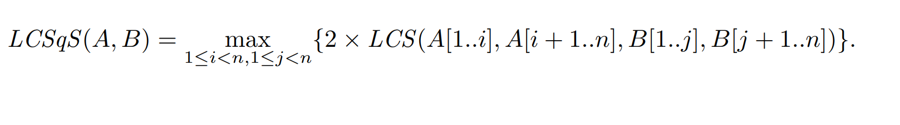
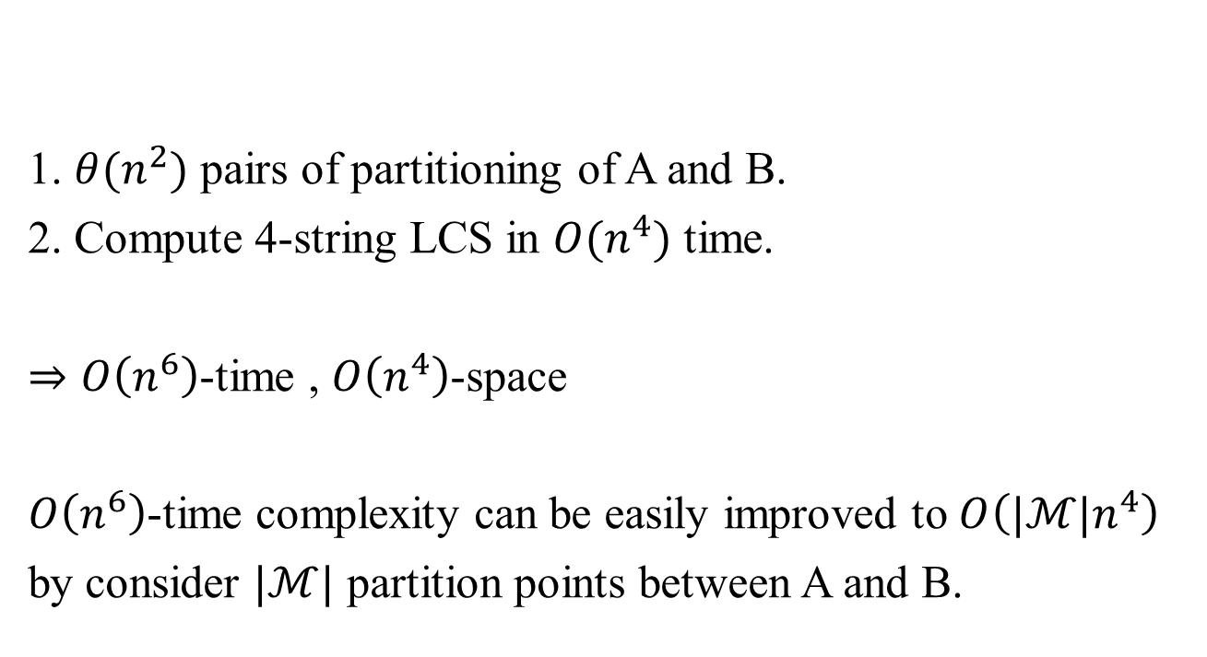
Simple Algorithm
1. $θ(n^{2})$ pairs of partitioning of A and B.
2. Compute 4-string LCS in $O(n^{4})$ time.
$⇒O\left(n^{6}\right)$-time , $O\left(n^{4}\right)$-space
$O\left(n^{6}\right)$-time complexity can be easily improved to $O\left({|ℳ|n}^{4}\right)$
by consider $|ℳ|$ partition points between A and B.

Slide 5
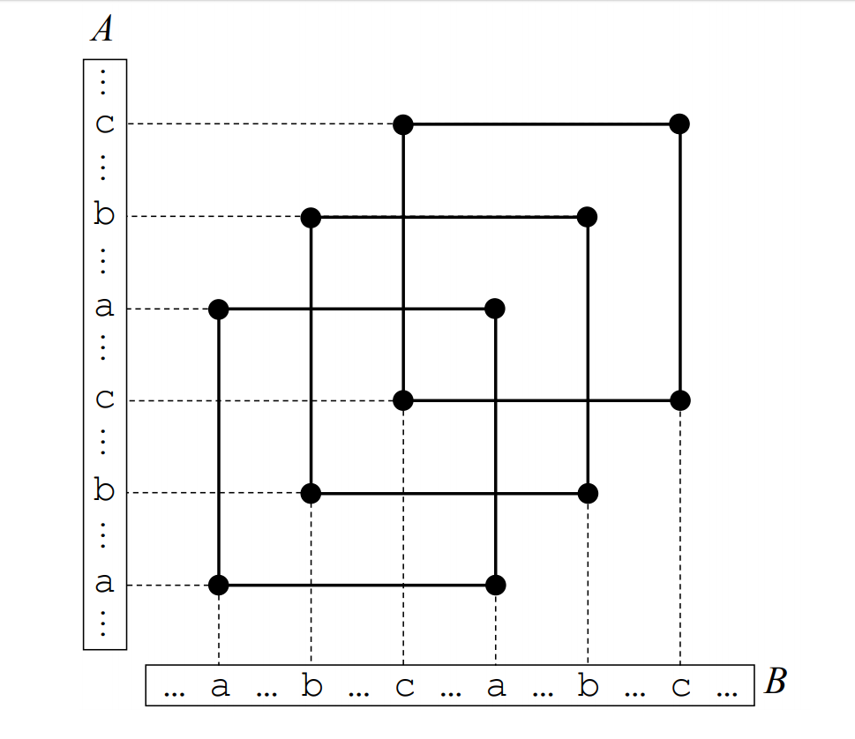





Diagonally overlapping matching rectangles (DOMRs)
Matching Rectangle : $r(i,j,k,l)$
$$j$$
$$i$$
$$k$$
$$l$$

Slide 6






Diagonally overlapping matching rectangles (DOMRs)
$$(j_{m},l_{m})$$
$$i^{′}<j_{1}$$
$$(j_{1},l_{1})$$
$$k^{′}<l_{1}$$
$$(i_{m},k_{m})$$
$$(i_{1},k_{1})$$

Slide 7

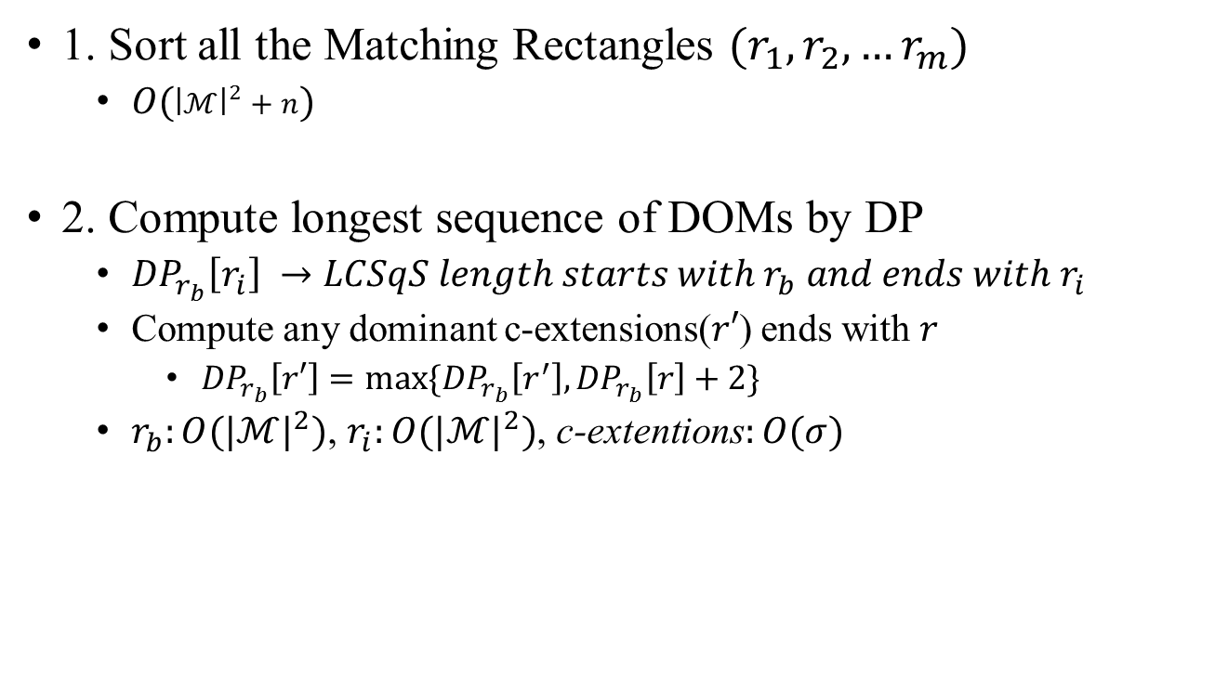
$O(\text{σ}{\left|ℳ\right|}^{4}+n)$ Algorithm
1. Sort all the Matching Rectangles $(r_{1}, r_{2},…r_{m})$
$O({\left|ℳ\right|}^{2}+n)$
2. Compute longest sequence of DOMs by DP
${DP}_{r_{b}}\left[r_{i}\right] →LCSqS length starts with r_{b} and ends with r_{i}$
Compute any dominant c-extensions($r′$) ends with $r$
${DP}_{r_{b}}\left[r′\right]=max\{{DP}_{r_{b}}\left[r^{′}\right],{DP}_{r_{b}}\left[r\right]+2\}$
$r_{b}:O({|ℳ|}^{2})$, $r_{i}:O({|ℳ|}^{2})$, c-extentions$:O(σ)$

Slide 8
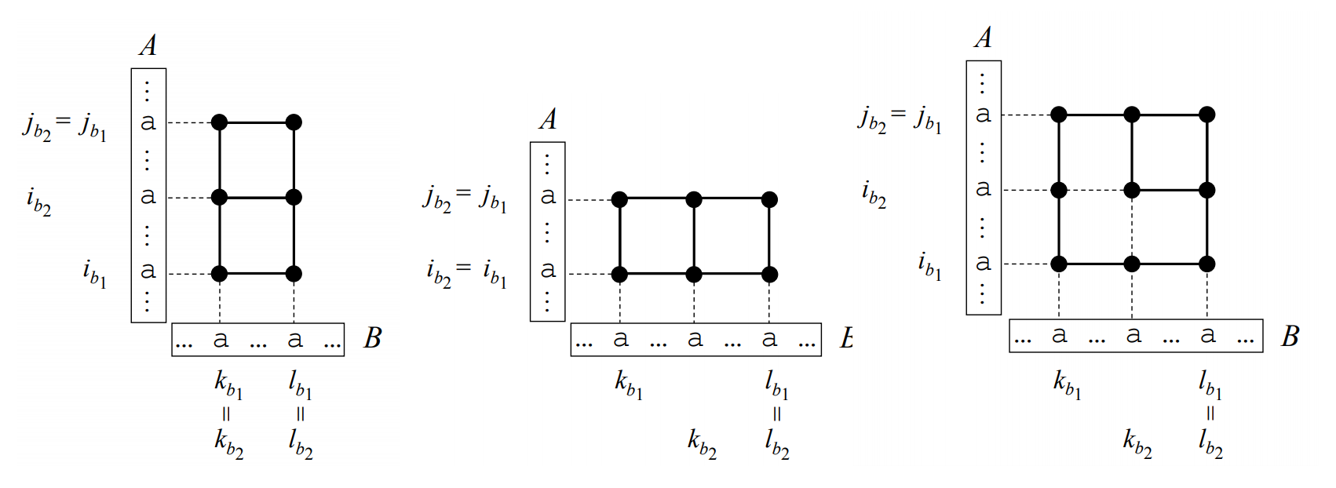

$O(\text{σ}{\left|ℳ\right|}^{3}+n)$ Algorithm

Slide 9

$O(\text{σ}{\left|ℳ\right|}^{3}+n)$ Algorithm
$${⇒DOMs}_{1}≥{DOMs}_{2}$$
$r_{b}$ can consider only right-upper corners$(j_{b},l_{b})$ instead of matching rectangles

Slide 10
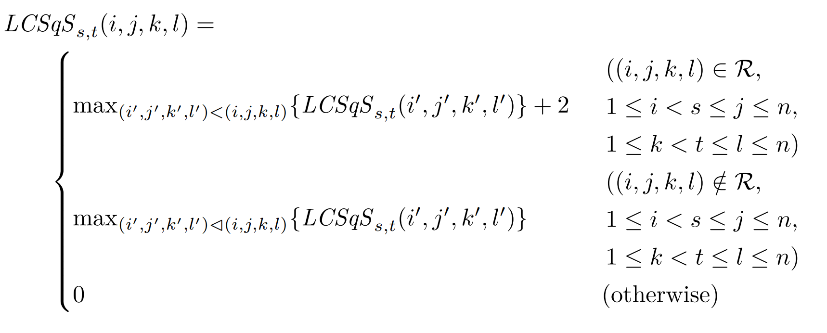
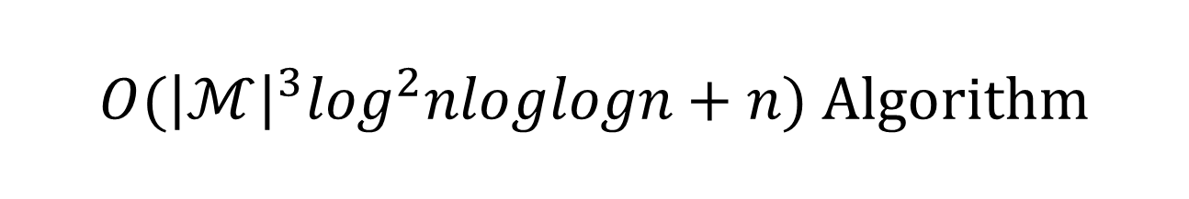
$O({\left|ℳ\right|}^{3}\log^{2}nloglogn+n)$ Algorithm
Using van Emde Boas tree

