Slide 1
An Efficient Parallel Algorithm for Longest Common Subsequence Problem on GPUs
Jiaoyun Yang, Yun Xu*, Yi Shang*
Proceedings of the World Congress on Engineering 2010 Vol I
WCE 2010, June 30 - July 2, 2010, London, U.K.
Presenter : De-Sheng Jhan
2014/7/8

Slide 2
Abstract(1/2)
Abstract—Sequence alignment is an important problem in computational biology and finding the longest common subsequence (LCS) of multiple biological sequences is an essential and effective technique in sequence alignment. A major computational approach for solving the LCS problem is dynamic programming. Several dynamic programming methods have been proposed to have reduced time and space complexity. As databases of biological sequences become larger, parallel algorithms become increasingly important to tackle large size problems. In the meantime, general-purpose computing on graphics processing units (GPGPU) has emerged as a promising technology for cost-effective high performance computing. In this paper, we develop an efficient parallel algorithm on GPUs for the LCS problem.

Slide 3
Abstract(2/2)
We propose a new technique that changes the data dependency in the score table used by dynamic programming algorithms to enable higher degrees of parallelism. The algorithm takes advantage of the large number of processing units and the unique memory-accessing properties of GPUs to achieve high performance. The algorithm was implemented on Nvidia 9800GT GPUs and tested on randomly generated sequences of different lengths. The experiment results show that the new algorithm is about 6 times faster on GPUs than on typical CPUs and is 3 times faster than an existing efficient parallel algorithm, the diagonal parallel algorithm.

Slide 4
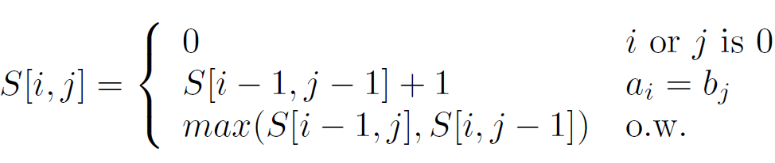
Introduction(1/5)
 |  | T | G | C | A | T | A
 | 0 | 0 | 0 | 0 | 0 | 0 | 0
A | 0 | 0 | 0 | 0 | 1 | 1 | 1
T | 0 | 1 | 1 | 1 | 1 | 2 | 2
C | 0 | 1 | 1 | 2 | 2 | 2 | 2
T | 0 | 1 | 1 | 2 | 2 | 3 | 3
G | 0 | 1 | 2 | 2 | 2 | 3 | 3
A | 0 | 1 | 2 | 2 | 3 | 3 | 4

Slide 5
Introduction(2/5)
 |  | T | G | C | A | T | A
 | 0 | 0 | 0 | 0 | 0 | 0 | 0
A | 0
T | 0
C | 0
T | 0
G | 0
A | 0

Slide 6
Introduction(3/5)
 |  | T | G | C | A | T | A
 | 0 | 0 | 0 | 0 | 0 | 0 | 0
A | 0
T | 0
C | 0
T | 0
G | 0
A | 0

Slide 7
Introduction(4/5)
 |  | T | G | C | A | T | A
 | 0 | 0 | 0 | 0 | 0 | 0 | 0
A | 0
T | 0
C | 0
T | 0
G | 0
A | 0

Slide 8
Introduction(5/5)
 |  | T | G | C | A | T | A
 | 0 | 0 | 0 | 0 | 0 | 0 | 0
A | 0 | 0 | 0 | 0 | 1 | 1 | 1
T | 0
C | 0
T | 0
G | 0
A | 0

Slide 9
Data Dependency Analysis(1/6)

Slide 10
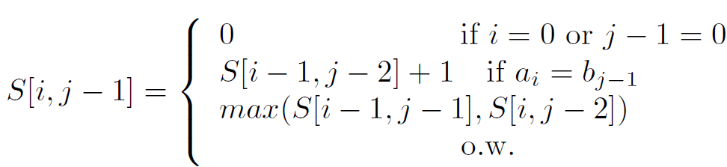
Data Dependency Analysis(2/6)

Slide 11
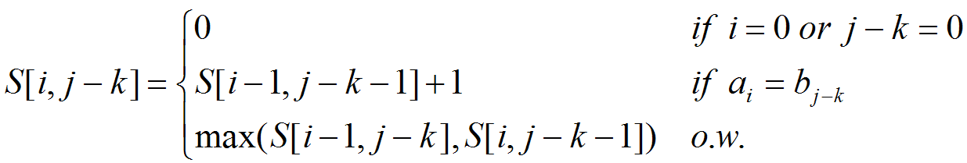
Data Dependency Analysis(3/6)
k must be the minimum number that make a_{i} = b_{j-k} or j – k = 0

Slide 12
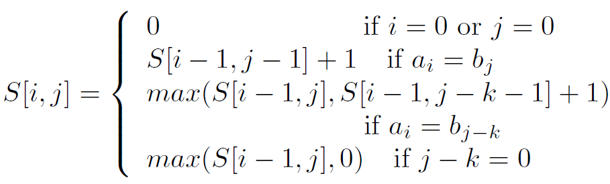
Data Dependency Analysis(4/6)

Slide 13
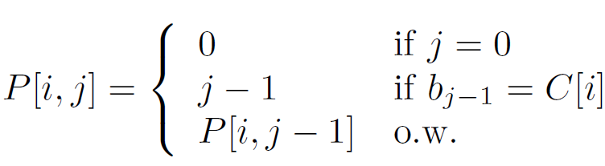
Data Dependency Analysis(5/6)
 |  | A | T | T | G | C | C | A
 | 0 | 1 | 2 | 3 | 4 | 5 | 6 | 7
A | 0 | 0 | 1 | 1 | 1 | 1 | 1 | 1
T | 0 | 0 | 0 | 2 | 3 | 3 | 3 | 3
C | 0 | 0 | 0 | 0 | 0 | 0 | 5 | 6
G | 0 | 0 | 0 | 0 | 0 | 4 | 4 | 4
P[c , j] = j - k
ex:P[2,7] => ATTGCCA

Slide 14
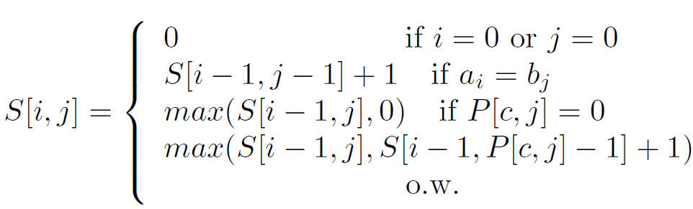
Data Dependency Analysis(6/6)
replacing j - k with P[c, j]

Slide 15
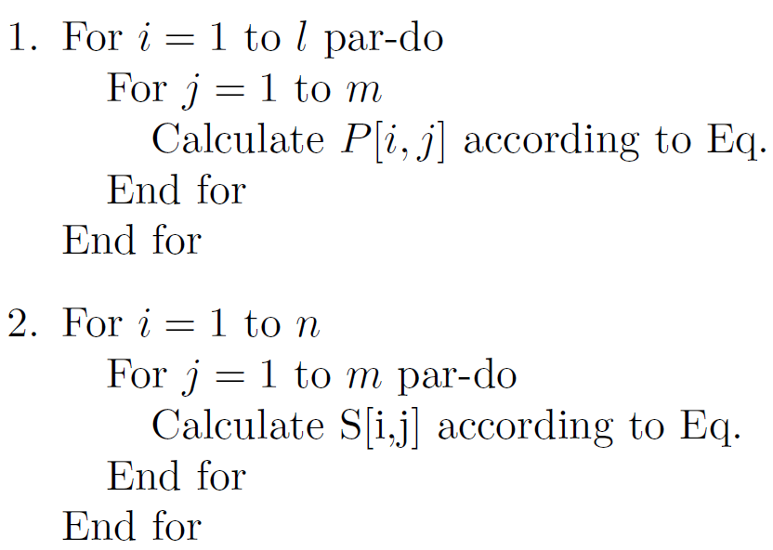
A New Technique for Efficient Parallelization
O(m)
O(n)
Assuming max(m, n) processors, Overall the algorithm’s time complex is O(max(m, n)). |A| = n ,|B| = m

Slide 16
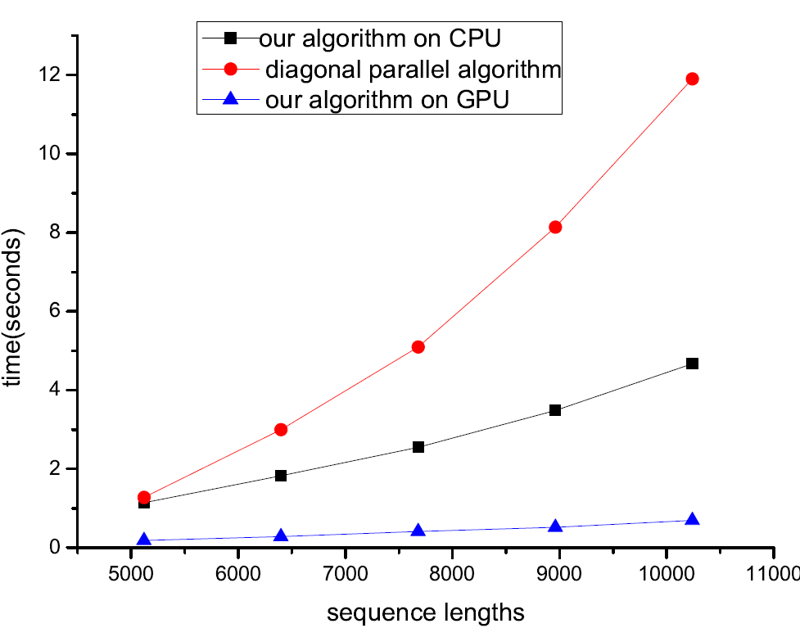
Experimental Results

Slide 17
Thank you for listening

