Slide 1
Speeding-up Hirschberg and Hunt-Szymanski LCS Algorithms
Maxime Crochemore, Costas S. Iliopoulos, and Yoan J. Pinzon Fundamental Informaticae XX pp.1-14(2003)

Slide 2
Abstract
Two algorithms are presented that solve the problem of recovering the longest common subsequence of two strings. The first algorithm is an improvement of Hirschberg's divide-and-conquer algorithm. The second algorithm is an improvement of Hunt-Szymanski algorithm based on an efficient computation of all dominant match points. These two algorithms use bit-vector operations and are shown to work very efficiently in practice.

Slide 3
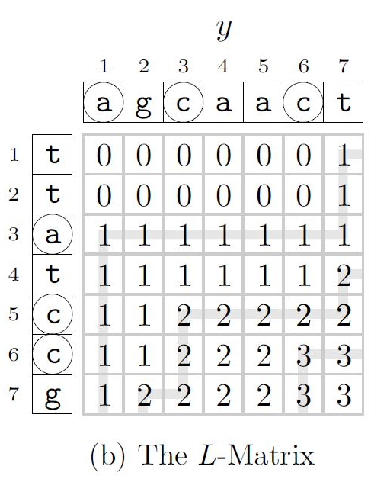
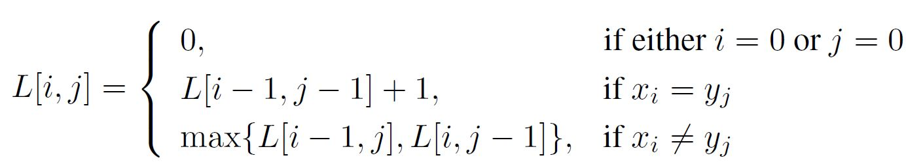
Basic Background
x = ttatccg
y = agcaact

Slide 4
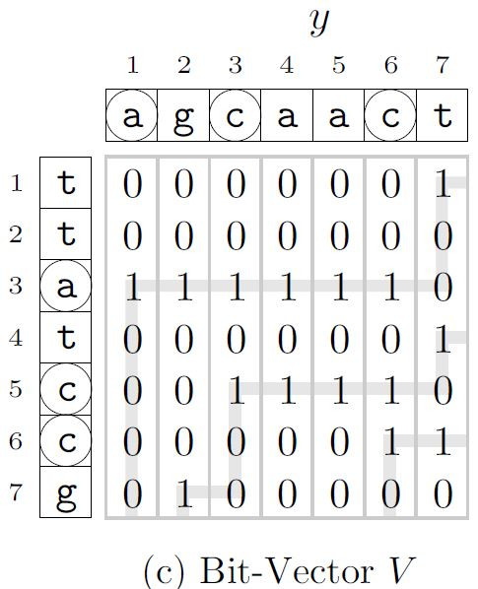
Basic Background
x = ttatccg
y = agcaact

Slide 5
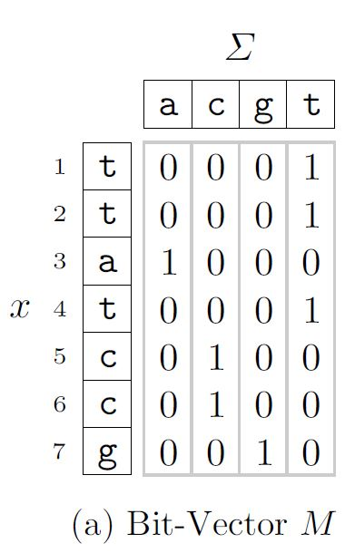
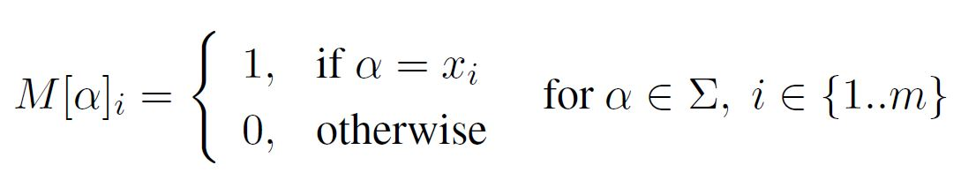
Basic Background
x = ttatccg
y = agcaact

Slide 6
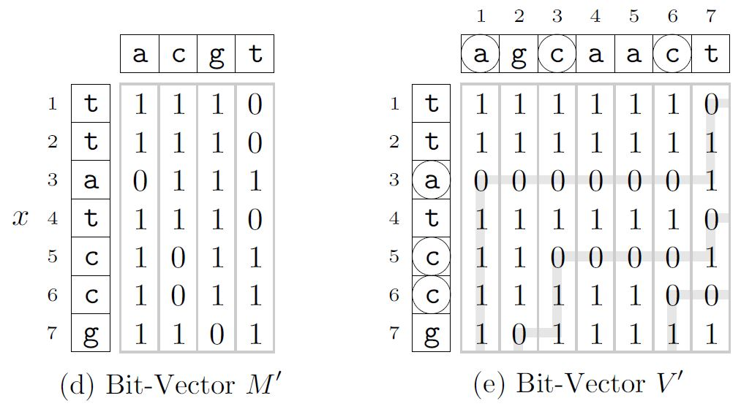
Basic Background
x = ttatccg
y = agcaact

Slide 7
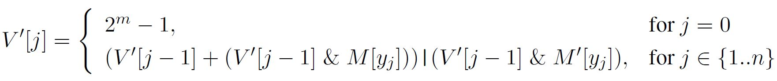
Basic Background
x = ttatccg
y = agcaact

Slide 8
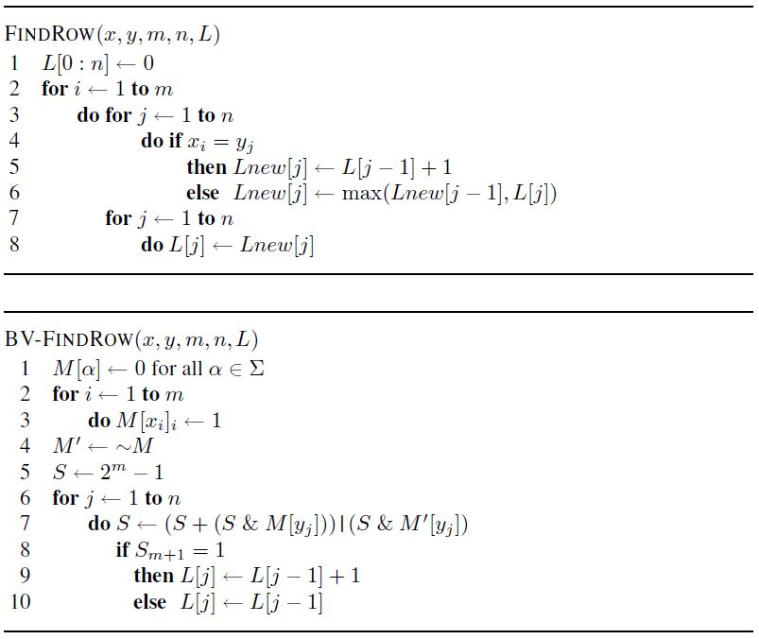
Speeding-up the Hirschberg Algorithm

Slide 9
FindRow
A = “ABCD” B = “ACDE”
 |  | A | C | D | E
 | 0 | 0 | 0 | 0 | 0
A | 0 | 1 | 1 | 1 | 1
B | 0 | 1 | 1 | 1 | 1
C | 0 | 1 | 2 | 2 | 2
D | 0 | 1 | 2 | 3 | 3
 |  | A | C | D | E
A | 0 | 0 | 0 | 0 | 0
 |  | A | C | D | E
 | 0 | 0 | 0 | 0 | 0
A | 0 | 1 | 1 | 1 | 1

Slide 10
FindRow
A = “ABCD” B = “ACDE”
 |  | A | C | D | E
 | 0 | 0 | 0 | 0 | 0
A | 0 | 1 | 1 | 1 | 1
B | 0 | 1 | 1 | 1 | 1
C | 0 | 1 | 2 | 2 | 2
D | 0 | 1 | 2 | 3 | 3
 |  | A | C | D | E
 | 0 | 1 | 1 | 1 | 1
B | 0 | 0 | 0 | 0 | 0
 |  | A | C | D | E
 | 0 | 1 | 1 | 1 | 1
B | 0 | 1 | 1 | 1 | 1

Slide 11
FindRow
A = “ABCD” B = “ACDE”
 |  | A | C | D | E
 | 0 | 0 | 0 | 0 | 0
A | 0 | 1 | 1 | 1 | 1
B | 0 | 1 | 1 | 1 | 1
C | 0 | 1 | 2 | 2 | 2
D | 0 | 1 | 2 | 3 | 3
 |  | A | C | D | E
 | 0 | 1 | 1 | 1 | 1
C | 0 | 0 | 0 | 0 | 0
 |  | A | C | D | E
 | 0 | 1 | 1 | 1 | 1
C | 0 | 1 | 2 | 2 | 2

Slide 12
FindRow
A = “ABCD” B = “ACDE”
 |  | A | C | D | E
 | 0 | 0 | 0 | 0 | 0
A | 0 | 1 | 1 | 1 | 1
B | 0 | 1 | 1 | 1 | 1
C | 0 | 1 | 2 | 2 | 2
D | 0 | 1 | 2 | 3 | 3
 |  | A | C | D | E
 | 0 | 1 | 2 | 2 | 2
D | 0 | 0 | 0 | 0 | 0
 |  | A | C | D | E
 | 0 | 1 | 2 | 2 | 2
D | 0 | 1 | 2 | 3 | 3

Slide 13
BV-FindRow
Bit-Vector M
 | A | B | C | D | E
A | 1 | 0 | 0 | 0 | 0
B | 0 | 0 | 0 | 0 | 0
C | 0 | 0 | 1 | 0 | 0
D | 0 | 0 | 0 | 1 | 0
L-metrix
 |  | A | C | D | E
 | 0 | 0 | 0 | 0 | 0
A | 0 | 0 | 0 | 0 | 0
Bit-Vector M’
 | A | B | C | D | E
A | 0 | 1 | 1 | 1 | 1
B | 1 | 1 | 1 | 1 | 1
C | 1 | 1 | 0 | 1 | 1
D | 1 | 1 | 1 | 0 | 1
 | 0 | A | C | D | E
 | 0 | 0 | 0 | 0 | 0
A | 0 | 1 | 1 | 1 | 1
V’[0] = 1
V’[1] = (V’[0] + (V’[0] & M[A])) | (V’[0] & M’[A])
= (1 + 1 & 1) | (1 & 0) = 0, carry = 1, L[1] = L[0] + 1

Slide 14
BV-FindRow
Bit-Vector M
 | A | B | C | D | E
A | 1 | 0 | 0 | 0 | 0
B | 0 | 0 | 0 | 0 | 0
C | 0 | 0 | 1 | 0 | 0
D | 0 | 0 | 0 | 1 | 0
L-metrix
 |  | A | C | D | E
 | 0 | 0 | 0 | 0 | 0
B | 0 | 1 | 1 | 1 | 1
Bit-Vector M’
 | A | B | C | D | E
A | 0 | 1 | 1 | 1 | 1
B | 1 | 1 | 1 | 1 | 1
C | 1 | 1 | 0 | 1 | 1
D | 1 | 1 | 1 | 0 | 1
 | 0 | A | C | D | E
 | 0 | 1 | 1 | 1 | 1
B | 0 | 1 | 1 | 1 | 1
V’[0] = 1
V’[1] = (V’[0] + (V’[0] & M[B])) | (V’[0] & M’[B])
= (1 + 1 & 0) | (1 & 1) = 1, carry = 0, L[1] = L[0]

Slide 15
BV-FindRow
Bit-Vector M
 | A | B | C | D | E
A | 1 | 0 | 0 | 0 | 0
B | 0 | 0 | 0 | 0 | 0
C | 0 | 0 | 1 | 0 | 0
D | 0 | 0 | 0 | 1 | 0
L-metrix
 |  | A | C | D | E
 | 0 | 0 | 0 | 0 | 0
C | 0 | 1 | 1 | 1 | 1
Bit-Vector M’
 | A | B | C | D | E
A | 0 | 1 | 1 | 1 | 1
B | 1 | 1 | 1 | 1 | 1
C | 1 | 1 | 0 | 1 | 1
D | 1 | 1 | 1 | 0 | 1
 | 0 | A | C | D | E
 | 0 | 1 | 1 | 1 | 1
C | 0 | 1 | 2 | 2 | 2
V’[0] = 1
V’[1] = (V’[0] + (V’[0] & M[C])) | (V’[0] & M’[C])
= (1 + 1 & 1) | (1 & 0) = 1, carry = 1, L[1] = L[0] + 1

Slide 16
BV-FindRow
Bit-Vector M
 | A | B | C | D | E
A | 1 | 0 | 0 | 0 | 0
B | 0 | 0 | 0 | 0 | 0
C | 0 | 0 | 1 | 0 | 0
D | 0 | 0 | 0 | 1 | 0
L-metrix
 |  | A | C | D | E
 | 0 | 0 | 0 | 0 | 0
D | 0 | 1 | 1 | 1 | 1
Bit-Vector M’
 | A | B | C | D | E
A | 0 | 1 | 1 | 1 | 1
B | 1 | 1 | 1 | 1 | 1
C | 1 | 1 | 0 | 1 | 1
D | 1 | 1 | 1 | 0 | 1
 | 0 | A | C | D | E
 | 0 | 1 | 2 | 2 | 2
D | 0 | 1 | 2 | 3 | 3
V’[0] = 1
V’[1] = (V’[0] + (V’[0] & M[D])) | (V’[0] & M’[D])
= (1 + 1 & 1) | (1 & 0) = 1, carry = 1, L[1] = L[0] + 1

Slide 17
Hirschberg’s Algorithm
H(4, 4, “ABCD”, “ACDE”)
BV-FindRow(2, 4, “AB”, “ACDE”)
BV-FindRow(2, 4, “DC”, “EDCA”)
 |  | A | C | D | E
 | 0 | 0 | 0 | 0 | 0
A | 0 | 1 | 1 | 1 | 1
B | 0 | 1 | 1 | 1 | 1
 |  | E | D | C | A
 | 0 | 0 | 0 | 0 | 0
D | 0 | 0 | 1 | 1 | 1
C | 0 | 0 | 1 | 2 | 2

Slide 18
Hirschberg’s Algorithm
A = “ABCD” B = “ACDE”
 |  | A | C | D | E
 | 0 | 1 | 1 | 1 | 1
B | 0 | 1 | 1 | 1 | 1
 |  | E | D | C | A
 | 0 | 0 | 1 | 1 | 1
C | 0 | 0 | 1 | 2 | 2
J = 0, 0 + 2 = 2
J = 1, 1 + 2 = 3
J = 2, 1 + 1 = 2
J = 3, 1 + 0 = 1
J = 4, 1 + 0 = 1
H(2, 1, “AB”, “A”)
H(2, 3, “CD”, “CDE”)

Slide 19
Hirschberg’s Algorithm
H(2, 1, “AB”, “A”)
H(2, 3, “CD”, “CDE”)
BV-FindRow(1, 1, “A”, “A”)
BV-FindRow(1, 3, “C”, “CDE”)
 |  | A
 | 0 | 0
A | 0 | 1
 |  | C | D | E
 | 0 | 0 | 0 | 0
C | 0 | 1 | 1 | 1
BV-FindRow(1, 1, “B”, “A”)
BV-FindRow(1, 3, “D”, “EDC”)
 |  | A
 | 0 | 0
B | 0 | 0
 |  | E | D | C
 | 0 | 0 | 0 | 0
D | 0 | 0 | 1 | 1

Slide 20
Hirschberg’s Algorithm
 |  | A
 | 0 | 0
A | 0 | 1
 |  | C | D | E
 | 0 | 0 | 0 | 0
C | 0 | 1 | 1 | 1
 |  | A
 | 0 | 0
B | 0 | 0
 |  | E | D | C
 | 0 | 0 | 0 | 0
D | 0 | 0 | 1 | 1
J = 0, 0 + 0 = 0
J = 1, 1 + 0 = 1
J = 0, 0 + 1 = 1
J = 1, 1 + 1 = 2
J = 2, 1 + 0 = 0
J = 3, 1 + 0 = 1
H(1, 1, “A”, “A”) => A
H(1, 0, “B”, null) = >null
H(1, 1, “C”, “C”) => C
H(1, 2, “D”, “DE”) => D
LCS : ACD

Slide 21
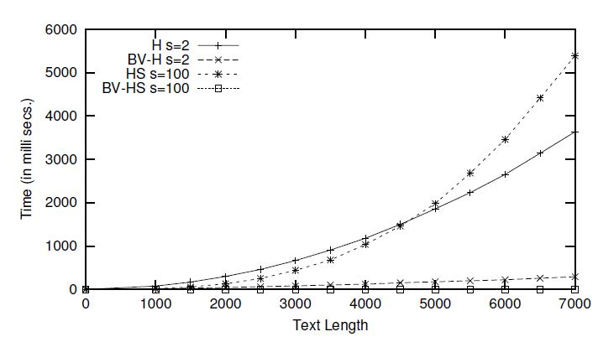
Timing Curves for the H, and BV-H Algorithms

Slide 22
Speeding-up the Hunt-Szymanski Algorithm
Dominant Match Point = $\left(V^{′}{\left[j−1\right]}^{^}V^{′}\left[j\right]\right)\& V′[j−1]$

Slide 23
Speeding-up the Hunt-Szymanski Algorithm
A = “ABCD” B = “ACDE”
Dominant Match Point = $\left(V^{′}{\left[j−1\right]}^{^}V^{′}\left[j\right]\right)\& V′[j−1]$
Bit-Vector V’
 | 0 | A | C | D | E
A | 1
B | 1
C | 1
D | 1
THRESH
0 | 1 | 2 | 3 | 4
0

Slide 24
Speeding-up the Hunt-Szymanski Algorithm
A = “ABCD” B = “ACDE”
Dominant Match Point = $\left(V^{′}{\left[j−1\right]}^{^}V^{′}\left[j\right]\right)\& V′[j−1]$
Bit-Vector V’
 | 0 | A | C | D | E
A | 1 | 0
B | 1 | 1
C | 1 | 1
D | 1 | 1
THRESH
0 | 1 | 2 | 3 | 4
0 | 1

Slide 25
Speeding-up the Hunt-Szymanski Algorithm
A = “ABCD” B = “ACDE”
Dominant Match Point = $\left(V^{′}{\left[j−1\right]}^{^}V^{′}\left[j\right]\right)\& V′[j−1]$
Bit-Vector V’
 | 0 | A | C | D | E
A | 1 | 0 | 0
B | 1 | 1 | 1
C | 1 | 1 | 0
D | 1 | 1 | 1
THRESH
0 | 1 | 2 | 3 | 4
0 | 1 | 2

Slide 26
Speeding-up the Hunt-Szymanski Algorithm
A = “ABCD” B = “ACDE”
Dominant Match Point = $\left(V^{′}{\left[j−1\right]}^{^}V^{′}\left[j\right]\right)\& V′[j−1]$
Bit-Vector V’
 | 0 | A | C | D | E
A | 1 | 0 | 0 | 0
B | 1 | 1 | 1 | 1
C | 1 | 1 | 0 | 0
D | 1 | 1 | 1 | 0
THRESH
0 | 1 | 2 | 3 | 4
0 | 1 | 2 | 3

Slide 27
Speeding-up the Hunt-Szymanski Algorithm
A = “ABCD” B = “ACDE”
Dominant Match Point = $\left(V^{′}{\left[j−1\right]}^{^}V^{′}\left[j\right]\right)\& V′[j−1]$
Bit-Vector V’
 | 0 | A | C | D | E
A | 1 | 0 | 0 | 0 | 0
B | 1 | 1 | 1 | 1 | 1
C | 1 | 1 | 0 | 0 | 0
D | 1 | 1 | 1 | 0 | 0
THRESH
0 | 1 | 2 | 3 | 4
0 | 1 | 2 | 3
LCS = ACD

Slide 28
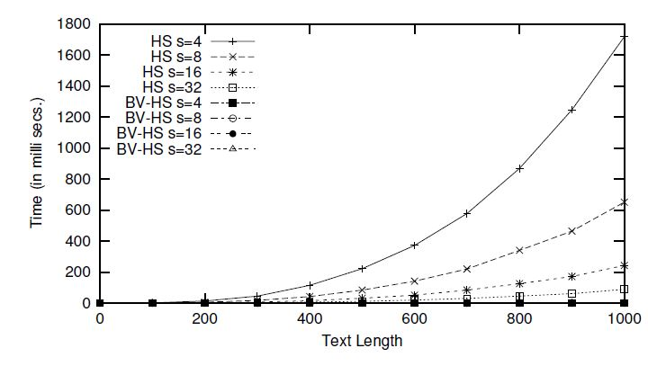
Timing Curves for the BV-H and BV-HS Algorithms

