Slide 1
Efficient algorithms for the longest common subsequence in k-length substrings
Sebastian Deorowicz, Szymon Grabowski
Information Processing Letters
Volume 114, Issue 11, November 2013, Pages 634–638
Presenter: Huang-Ting Chan
Date:2014/7/22

Slide 2
Abstract
Finding the longest common subsequence in k-length substrings (LCSk) is a recently proposed problem motivated by computational biology. This is a generalization of the well-known LCS problem in which matching symbols from two sequences A and B are replaced with matching non-overlapping substrings of length k from A and B.

Slide 3
We propose several algorithms for LCSk, being non-trivial incarnations of the major concepts known from LCS research (dynamic programming, sparse dynamic programming, tabulation). Our algorithms make use of a linear-time and linear-space preprocessing finding the occurrences of all the substrings of length k from one sequence in the other sequence.

Slide 4
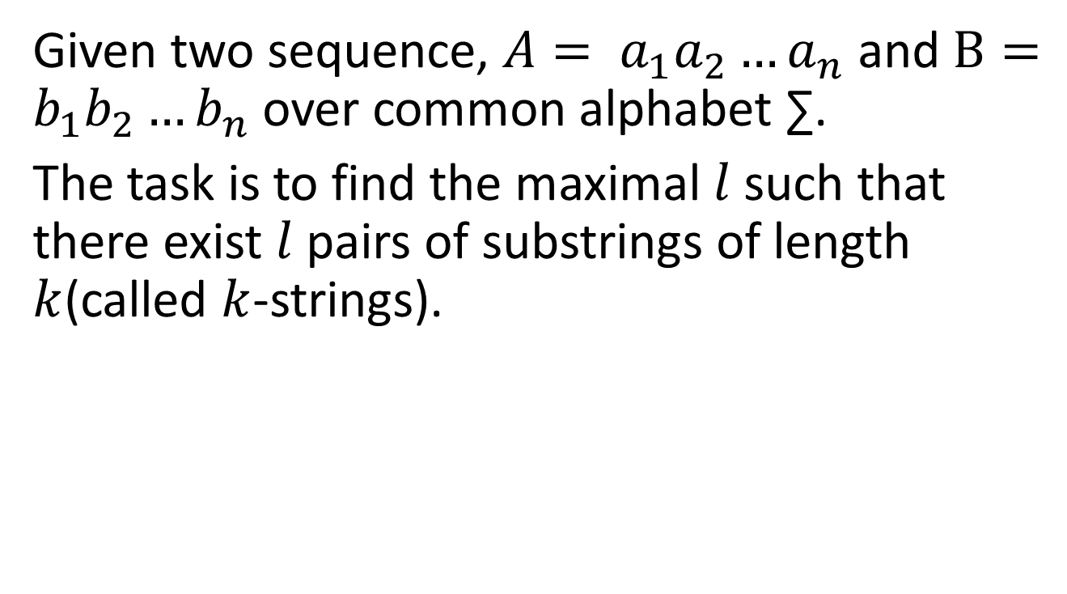
Define LCSk
Given two sequence, $A= a_{1}a_{2}{…a}_{n}$ and $B=b_{1}b_{2}{…b}_{n}$ over common alphabet ∑.
The task is to find the maximal $l$ such that there exist $l$ pairs of substrings of length $k$(called $k$-strings).

Slide 5

$a_{i_{e−k+1}}{…a}_{i_{e}}$ and $b_{j_{e−k+1}}{…b}_{j_{e}}$, $1≤e≤l$, where $a_{i_{e−k+1}}{…a}_{i_{e}}$ is equal to $b_{j_{e−k+1}}{…b}_{j_{e}}$ and $i_{e}+k≤i_{e+1}$ for any valid $e$
(that is, strings of length $k$ are no overlapping)

Slide 6
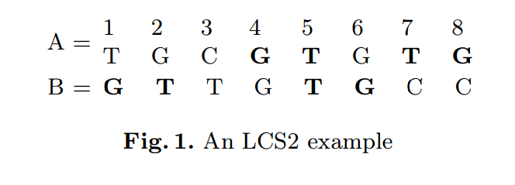

Example
$A=TGCGTGTG$, $B=GTTGTGCC$ if $k=2$.
A possible common subsequence in pairs (k = 2) is$GTTG$ obtained from a4,a5, a7, a8 and b1, b2, b5, b6.

Slide 7
For k = 3, one of the possible solutions is T G C achieved by matching a1, a2, a3, with b5, b6, b7.
For k = 4 a possible solution is T G T G obtained from matching a5, a6, a7, a8 and b3, b4, b5, b6.

Slide 8
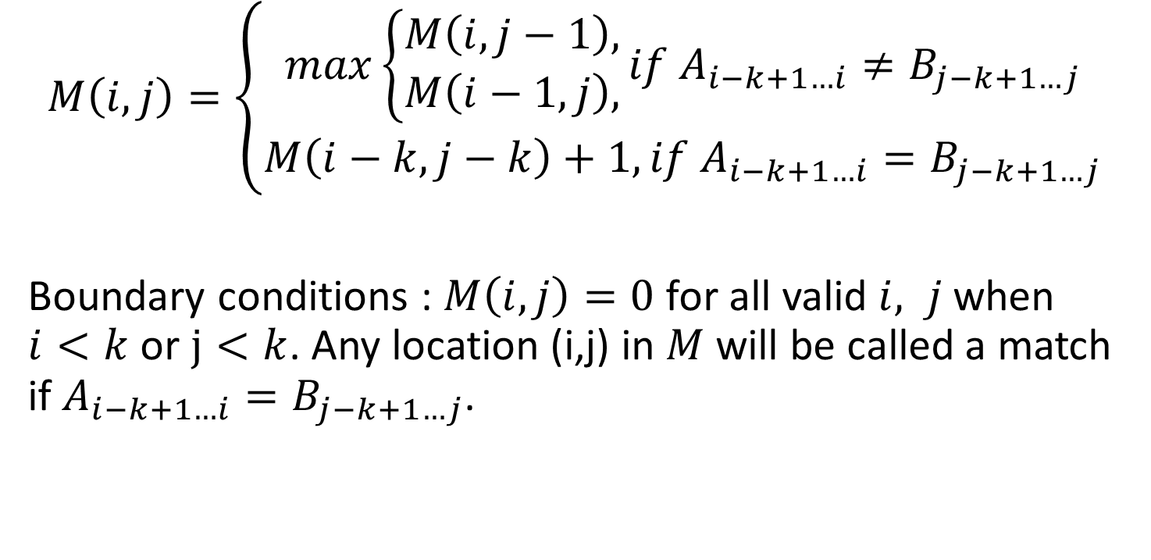

The LCSk in O($n^{2}$) time
$$M\left(i,j\right)=\left\{\begin{aligned}max\left\{\begin{aligned}M\left(i,j−1\right), \\ M\left(i−1,j\right),\end{aligned}\right.if{ A}_{i−k+1…i}≠B_{j−k+1…j} \\ M\left(i−k,j−k\right)+1, if A_{i−k+1…i}=B_{j−k+1…j}\end{aligned}\right.$$
Boundary conditions : $M\left(i,j\right)=0$ for all valid $i, j$when $i<k$ or $j<k$. Any location (i,j) in $M$ will be called a match if $A_{i−k+1…i}=B_{j−k+1…j}$.

Slide 9
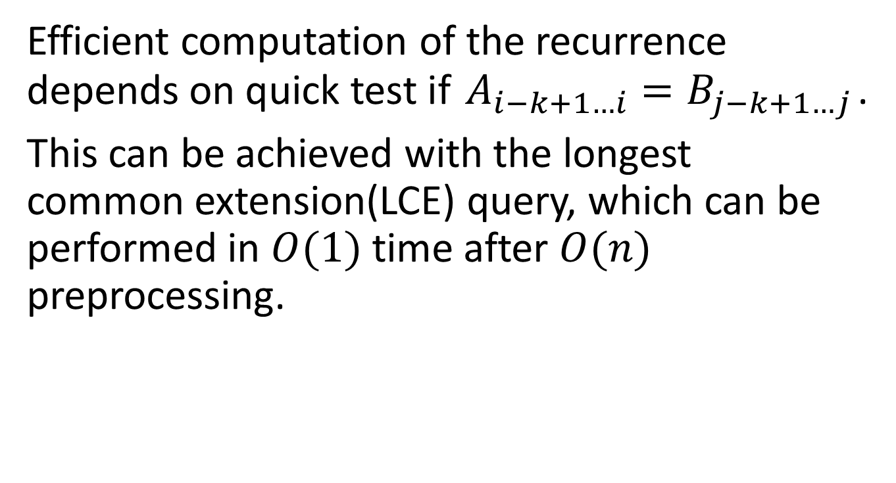
Efficient computation of the recurrence depends on quick test if $A_{i−k+1…i}=B_{j−k+1…j}$.
This can be achieved with the longest common extension(LCE) query, which can be performed in $O(1)$ time after $O(n)$ preprocessing.

Slide 10
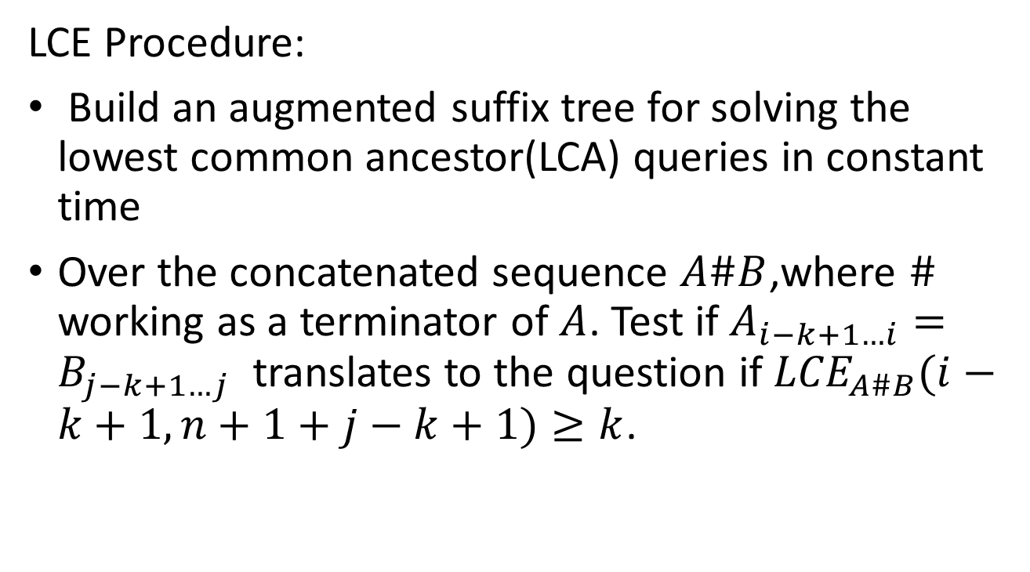
Preprocessing-1
LCE Procedure:
Build an augmented suffix tree for solving the lowest common ancestor(LCA) queries in constant time
Over the concatenated sequence $A\#B$,where $\#$ working as a terminator of $A$. Test if $A_{i−k+1…i}=B_{j−k+1…j}$ translates to the question if ${LCE}_{A\#B}(i−k+1,n+1+j−k+1)≥k$.

Slide 11
LCE
The longest common extension (LCE) problem takes as input a string S and many pairs(i,j), for each pair(i,j), the longest substring of S that occurs both starting at position i and at j in S.
That is, the longest common prefix of the suffixes of S that start at positions i and j, respectively.

Slide 12

Example
$$S=aabbcccaabbbccc$$
LCE(0,7)=$aabb$
LCE(2,9)=$bb$

Slide 13
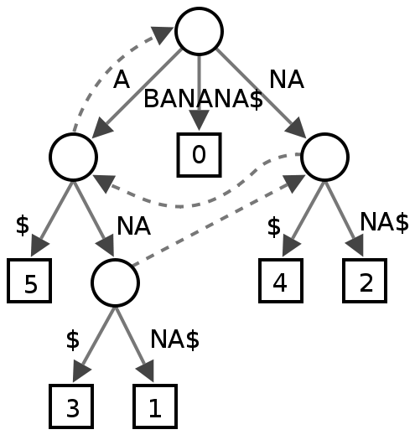
Suffix tree

Slide 14
Preprocessing-2
The procedure makes use of a suffix array for the concatenated sequence B#A. We also build its longest common prefix (LCP) table; both operations can be accomplished in linear time and using linear space. The computed LCP values allow us to partition the sorted set of suffixes into maximal groups such that the LCP between successive items is at least k. In other words, suffixes from such groups have a prefix of length k symbols in common.

Slide 15
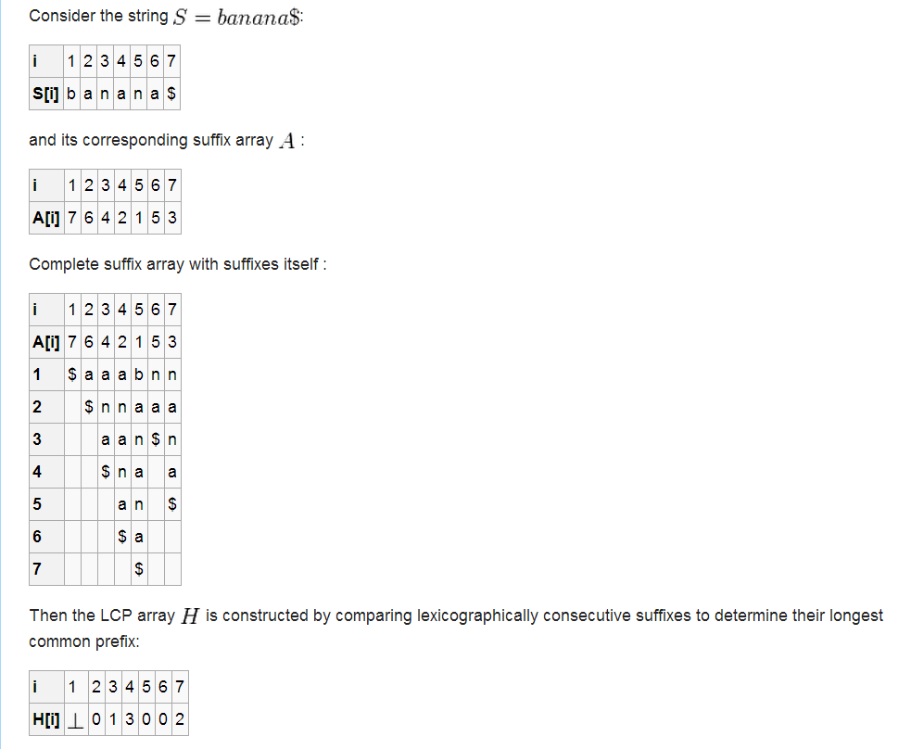

Slide 16
These k-string groups are radix-sorted according to the starting position of the suffix. To make it efficient (O(n)time); all the suffixes are represented as pairs (group_id, start_pos). Let us denote the array with such pairs with S.
After the sort, suffixes in the groups are kept together, in starting position order.
Note that within a group all suffixes starting in B are located before any suffix starting in A.

Slide 17
We scan over all the items in S, except for the last one (which must correspond to the suffix starting with #), and we insert related data into another array, X of length |A| +|B| =2n.
More precisely, for each examined S[i] we write in X[S[i].start_pos] a triple: (fa_pos, fb_pos, ng_pos), where fa_pos(fb_pos) is the position in S of the first suffix from this group starting in A(in B) and ng_pos is the position in S of the first suffix from the next group. This operation also takes linear time and the preprocessing is done.

Slide 18
It is now enough to examine the information stored at X[S[i].start_pos](which in turn refers to S), to find the match locations in the row in O(1)time per each.

Slide 19
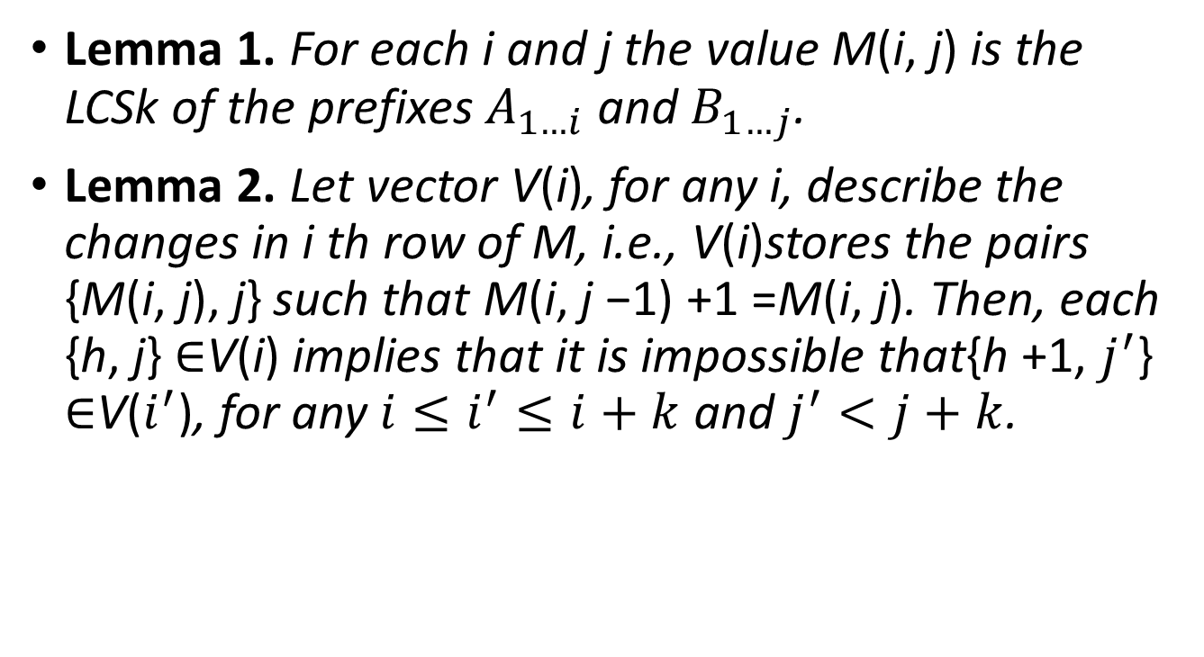
Lemma 1. For each i and j the value M(i, j) is the LCSk of the prefixes $A_{1…i}$ and $B_{1…j}$.
Lemma 2. Let vector V(i), for any i, describe the changes in i th row of M, i.e., V(i)stores the pairs {M(i, j), j} such that M(i, j −1) +1 =M(i, j). Then, each {h, j} ∈V(i) implies that it is impossible that{h +1, $j^{′}$} ∈V($i^{′}$), for any $i≤i^{′}≤i+k$ and $j^{′}<j+k$.

Slide 20

Sparse dynamic programing-1
The overall idea is to visit only those DP matrix cells which correspond to matches. As the number of matches, r, is usually significantly smaller than $n^{2}$.
This algorithm called LCSk-Sparse.

Slide 21
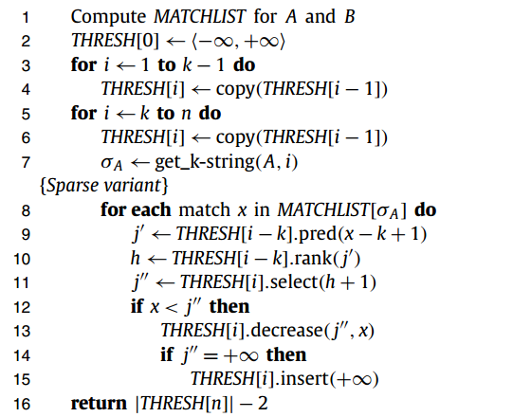

Slide 22
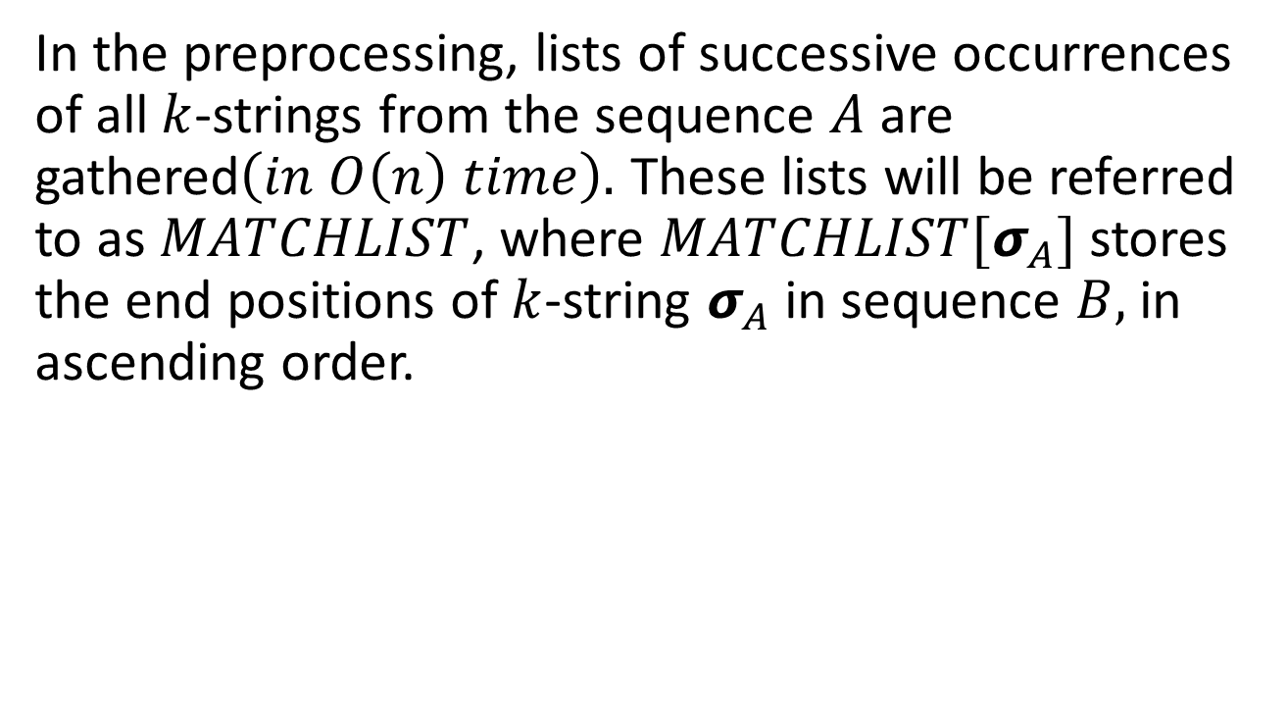
LCSk-Sparse
In the preprocessing, lists of successive occurrences of all $k$-strings from the sequence $A$ are gathered$\left(in O\left(n\right) time\right).$ These lists will be referred to as $MATCHLIST$, where $MATCHLIST[σ_{A}]$ stores the end positions of $k$-string $σ_{A}$ in sequence $B,$ in ascending order.

Slide 23
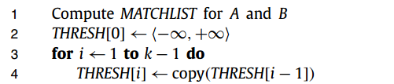

Initialization
Accessing $THRESH\left[i\right][h]$ answers the question about the leftmost column in row i with a match of rank h. When processing row $i$, we will often be interested in accessing $THRESH\left[i−k\right]$, i.e., the state of this structure k rows earlier.

Slide 24


Step
Copy previous state
Get sequence $A_{i−k…i}$

Slide 25
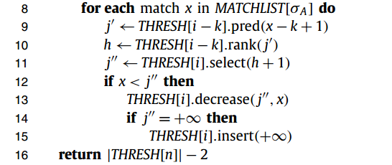
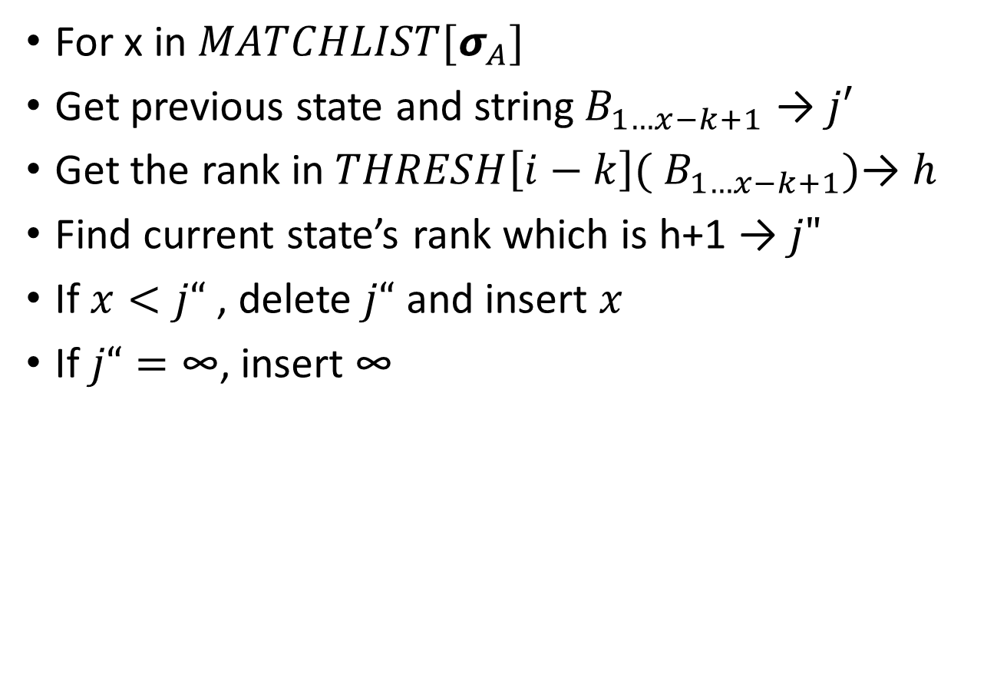
For x in $MATCHLIST[σ_{A}]$
Get previous state and string${ B}_{1…x−k+1}$ → $j′$
Get the rank in $THRESH\left[i−k\right]({ B}_{1…x−k+1})$→ $h$
Find current state’s rank which is h+1 → $j"$
If $x<j“$ , delete $j“$ and insert $x$
If $j“=\text{∞}$, insert $\text{∞}$

Slide 26

Because of the we need to store $k$ previous versions of $THRESH$(for $k$ previous rows), and using naïve list copies add an extra additive $nl$ term to the time complexity, which is prohibitive.
So we need to make use of persistent red-black tree.

Slide 27
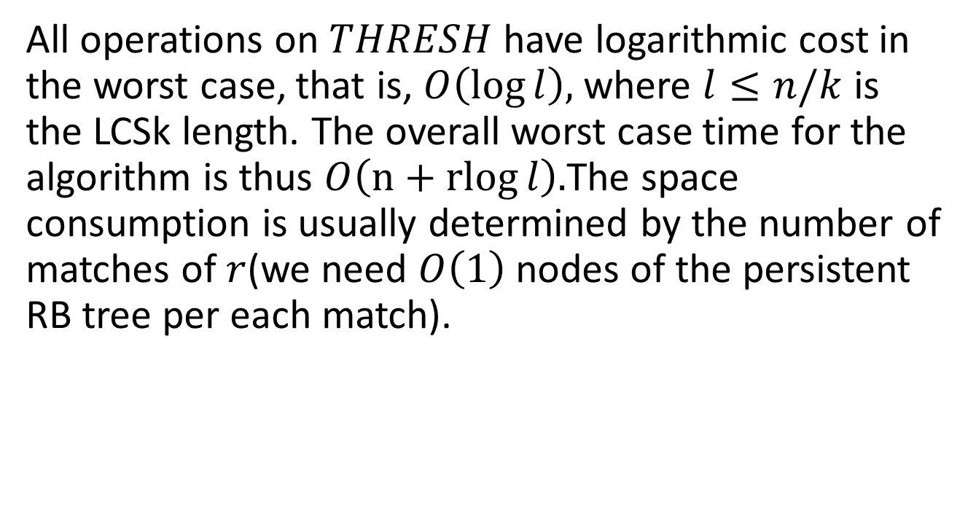
All operations on $THRESH$ have logarithmic cost in the worst case, that is, $O\left(\log{l}\right),$ where $l≤n/k$ is the LCSk length. The overall worst case time for the algorithm is thus $O\left(n+rlog{l}\right).$The space consumption is usually determined by the number of matches of $r$(we need $O\left(1\right)$ nodes of the persistent RB tree per each match).

Slide 28

LCSk-Dense
If the number of matches is close to $n^{2}$.
The specific trait is skipping over some matches, when we are certain they cannot affect the algorithm’s output.

Slide 29
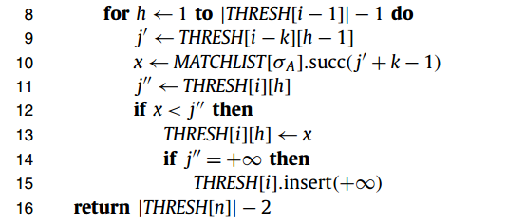

Slide 30
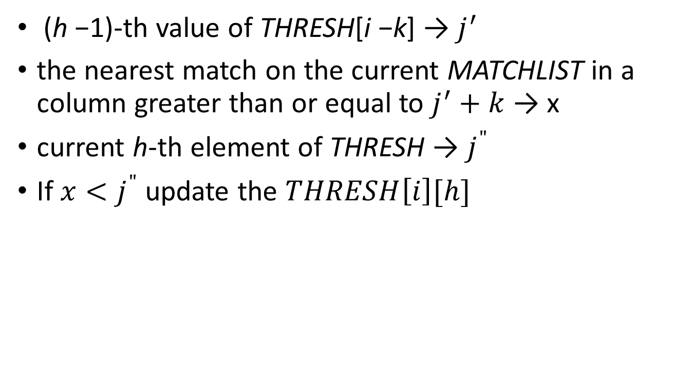
(h −1)-th value of THRESH[i −k] → $j^{′}$
the nearest match on the current MATCHLIST in a column greater than or equal to $j^{′}+k$ → x
current h-th element of THRESH → $j^{"}$
If $x<j^{"}$ update the $THRESH\left[i\right][h]$

Slide 31

The successor queries may be handled with vEB tree, in $O(loglogn)$ time.
The space consumption is $O\left(nloglogn\right)$.
The overall time complexity is $O(n^{2}loglogn/k)$.

Slide 32
Tabulation-based algorithm
The tabulation (also called “4-Russians”) technique for dynamic programming algorithms consists in dividing the DP matrix into small blocks (usually 1 × b or b × b, for some b), such that the number of distinct blocks is small enough to be precomputed beforehand, e.g., with linear time-space resources.
Let us now present a tabulation-based algorithm for LCSk, called DP-4R

Slide 33
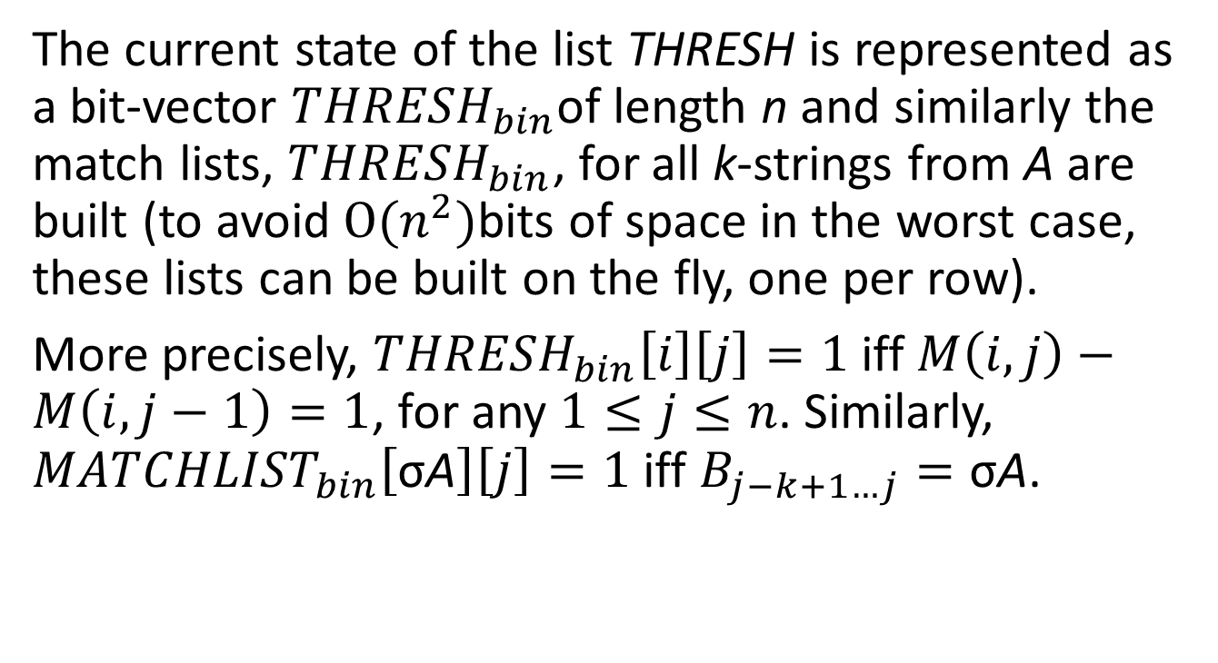
The current state of the list THRESH is represented as a bit-vector ${THRESH}_{bin}$of length n and similarly the match lists, ${THRESH}_{bin}$, for all k-strings from A are built (to avoid $O(n^{2})$bits of space in the worst case, these lists can be built on the fly, one per row).
More precisely, ${THRESH}_{bin}\left[i\right]\left[j\right]=1$iff$M\left(i,j\right)−M\left(i,j−1\right)=1$, for any $1≤j≤n$. Similarly, ${MATCHLIST}_{bin}\left[\text{σ}\text{A}\right]\left[j\right]=1$ iff $B_{j−k+1…j}=\text{σ}\text{A}$.

Slide 34
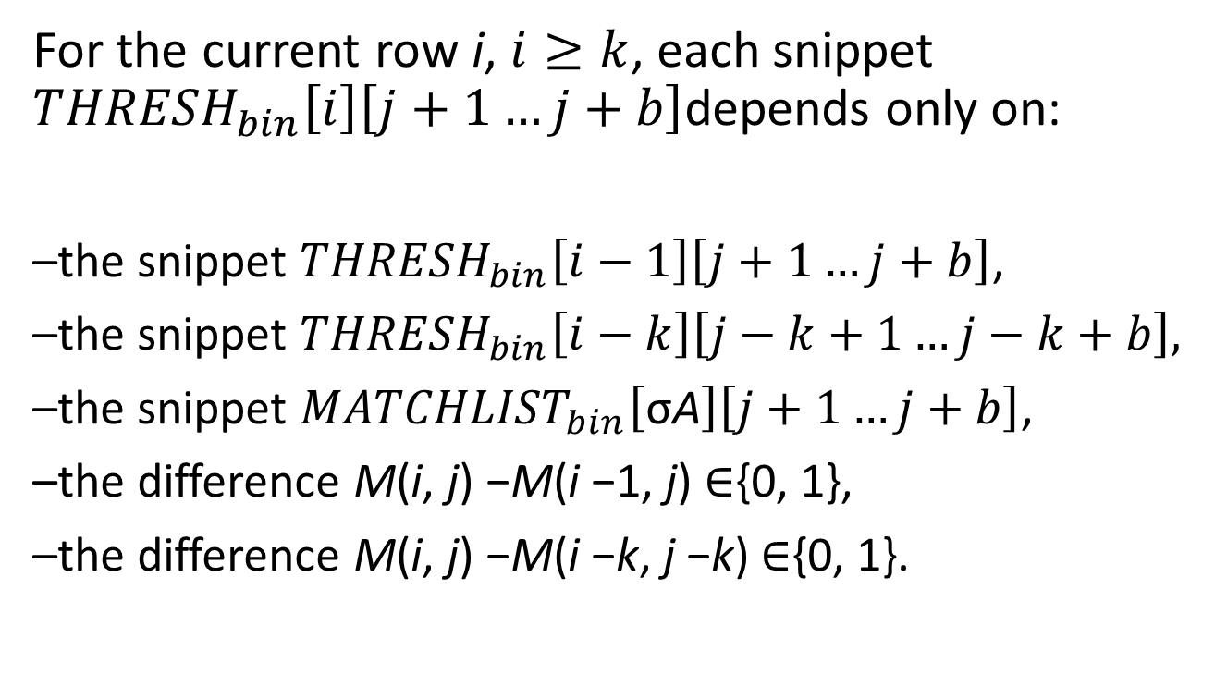
For the current row i, $i≥k$, each snippet ${THRESH}_{bin}\left[i\right]\left[j+1…j+b\right]$depends only on:
–the snippet ${THRESH}_{bin}\left[i−1\right]\left[j+1…j+b\right]$,
–the snippet ${THRESH}_{bin}\left[i−k\right]\left[j−k+1…j−k+b\right],$
–the snippet ${MATCHLIST}_{bin}\left[\text{σ}\text{A}\right]\left[j+1…j+b\right]$,
–the difference M(i, j) −M(i −1, j) ∈{0, 1},
–the difference M(i, j) −M(i −k, j −k) ∈{0, 1}.

Slide 35
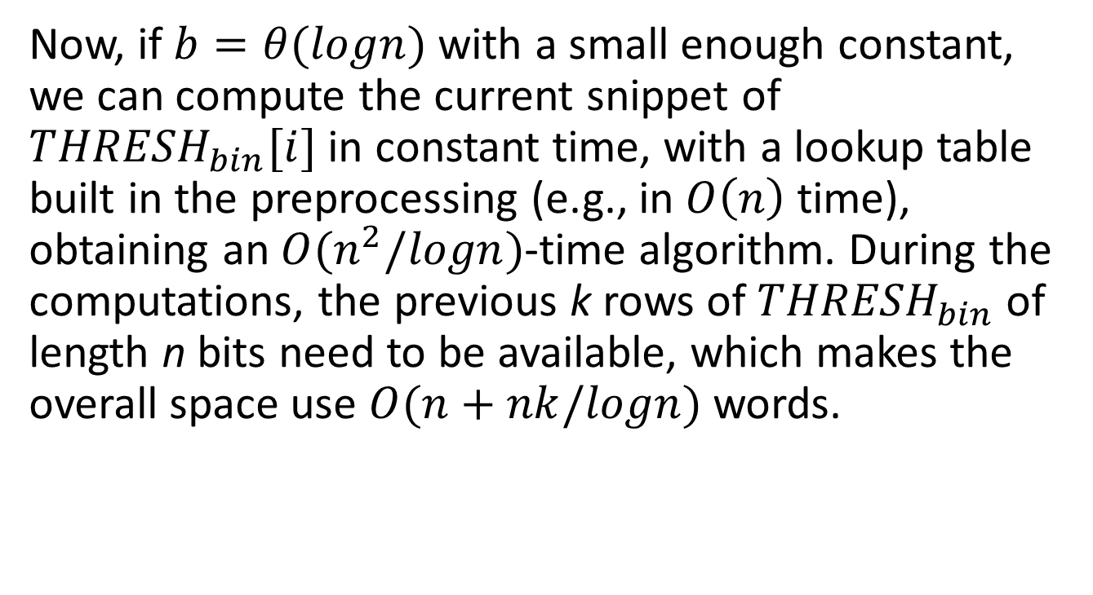
Now, if $b=θ(logn)$ with a small enough constant, we can compute the current snippet of ${THRESH}_{bin}[i]$ in constant time, with a lookup table built in the preprocessing (e.g., in $O\left(n\right)$ time), obtaining an $O(n^{2}/logn)$-time algorithm. During the computations, the previous k rows of ${THRESH}_{bin}$ of length n bits need to be available, which makes the overall space use $O(n+nk/logn)$ words.

Slide 36
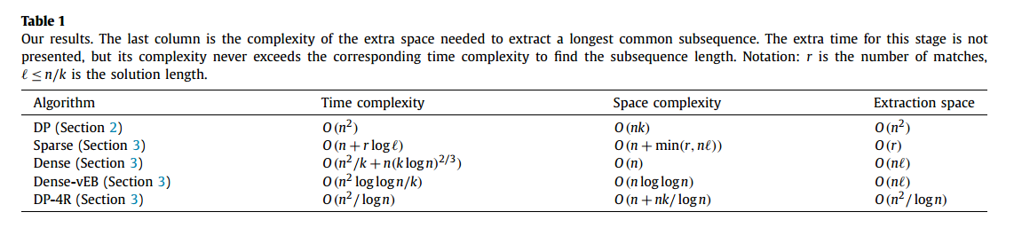
Conclusions

