Slide 1
A Simple Algorithm for the Constrained Sequence Problems
Francis Y.L. Chin, Alfredo De Santis, Anna Lisa Ferrara, N.L. Hoa, S.K. Kim Information Processing Letters 90 pp.175-179(2004)

Slide 2
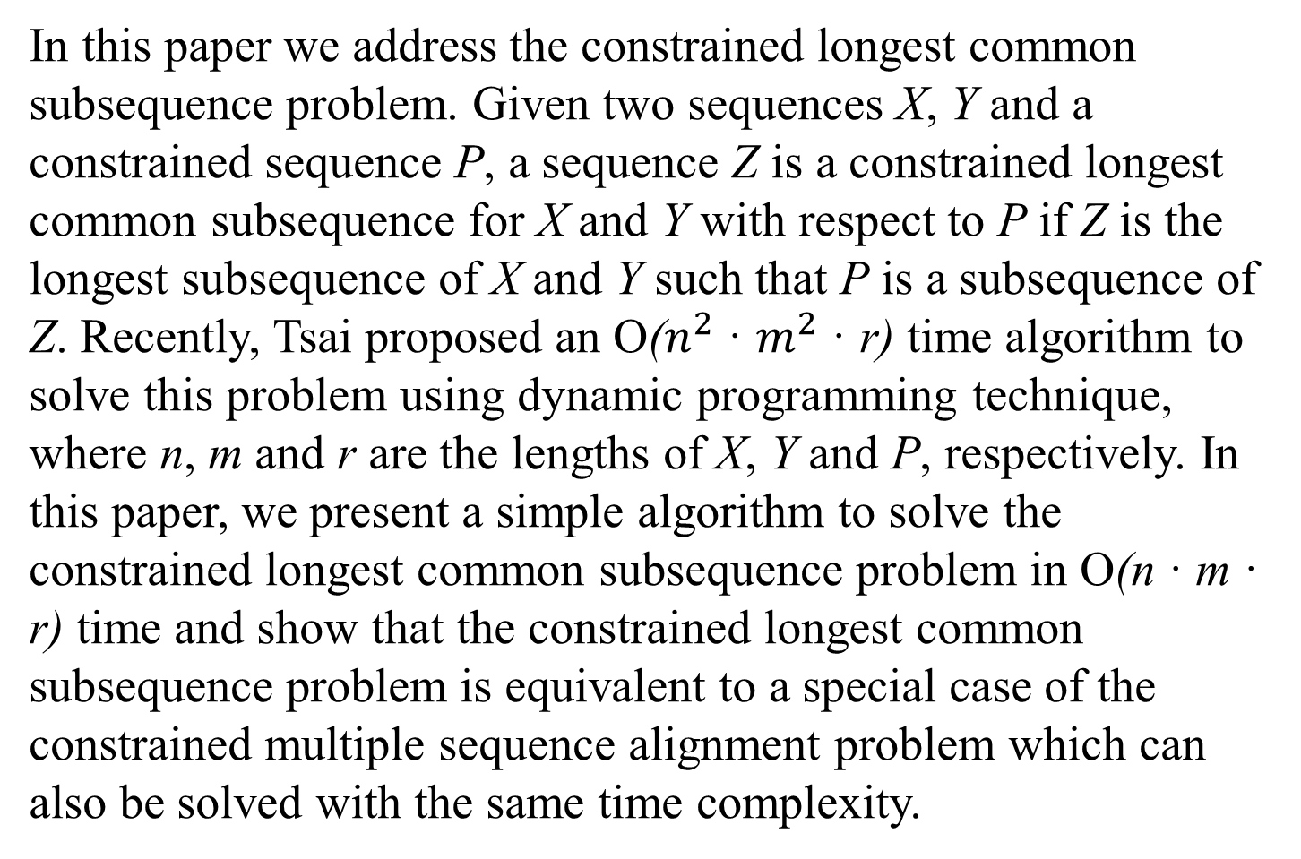
Abstract
In this paper we address the constrained longest common subsequence problem. Given two sequences X, Y and a constrained sequence P, a sequence Z is a constrained longest common subsequence for X and Y with respect to P if Z is the longest subsequence of X and Y such that P is a subsequence of Z. Recently, Tsai proposed an O($n^{2}$· $m^{2}$ · r) time algorithm to solve this problemusing dynamic programming technique, where n, m and r are the lengths of X, Y and P, respectively. In this paper, we present a simple algorithm to solve the constrained longest common subsequence problem in O(n · m · r) time and show that the constrained longest common subsequence problem is equivalent to a special case of the constrained multiple sequence alignment problem which can also be solved with the same time complexity.

Slide 3
CLCS
X = a t c a t c t a g g
Y = a t c a t a t g c g
P = t t c g
Z 為 X 與 Y 的CS，若P為Z的子序列，則Z為對應到 P 的 X 與 Y 之 constrained LCS。在這例子中就不是 a t c a t t a g， 而是a t c a t c g

Slide 4
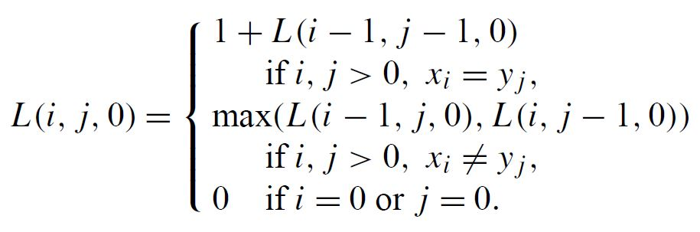

Algorithm
X, Y, P 的長度分別為 n, m, r
$0≤i≤n$, $0≤j≤m$, $0≤k≤r$
L 為 CLCS 長度

Slide 5
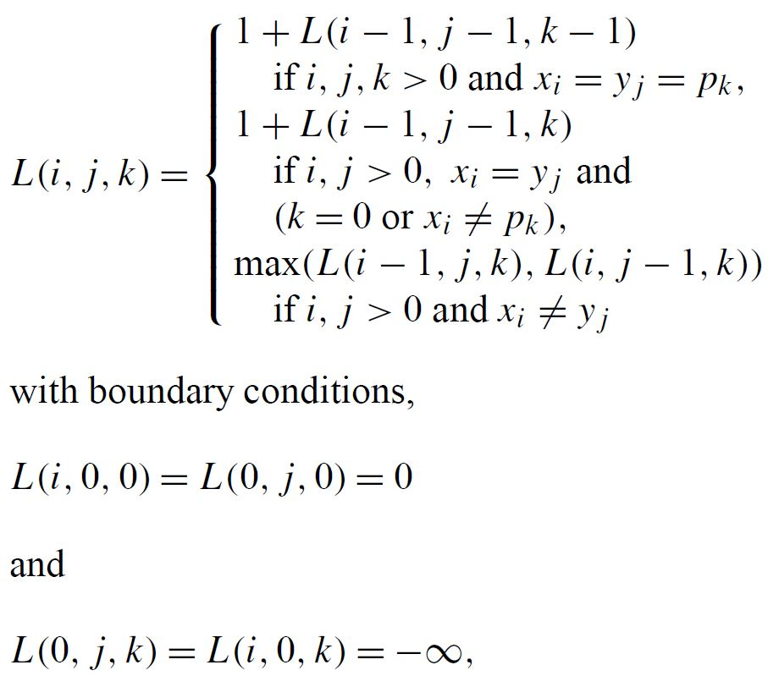
Algorithm

Slide 6
Example
X = a t c a t c t a g g Y = a t c a t a t g a g P = a c g
k = 0
 | - | a | t | c | a | t | c | t | a | g | g
- | 0 | 0 | 0 | 0 | 0 | 0 | 0 | 0 | 0 | 0 | 0
a | 0 | 1 | 1 | 1 | 1 | 1 | 1 | 1 | 1 | 1 | 1
t | 0 | 1 | 2 | 2 | 2 | 2 | 2 | 2 | 2 | 2 | 2
c | 0 | 1 | 2 | 3 | 3 | 3 | 3 | 3 | 3 | 3 | 3
a | 0 | 1 | 2 | 3 | 4 | 4 | 4 | 4 | 4 | 4 | 4
t | 0 | 1 | 2 | 3 | 4 | 5 | 5 | 5 | 5 | 5 | 5
a | 0 | 1 | 2 | 3 | 4 | 5 | 5 | 5 | 6 | 6 | 6
t | 0 | 1 | 2 | 3 | 4 | 5 | 5 | 6 | 6 | 6 | 6
g | 0 | 1 | 2 | 3 | 4 | 5 | 5 | 6 | 6 | 7 | 7
a | 0 | 1 | 2 | 3 | 4 | 5 | 5 | 6 | 7 | 7 | 7
g | 0 | 1 | 2 | 3 | 4 | 5 | 5 | 6 | 7 | 8 | 8

Slide 7
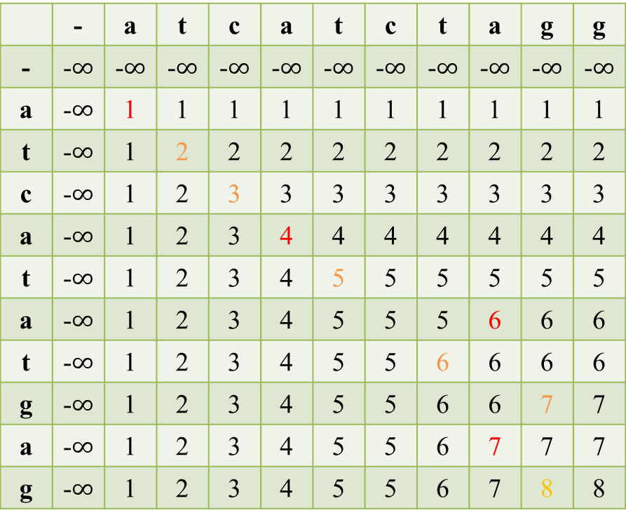
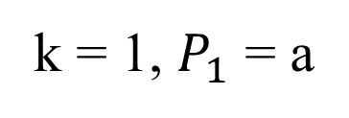
Example
X = a t c a t c t a g g Y = a t c a t a t g a g P = a c g
k = 1, $P_{1}$= a
 | - | a | t | c | a | t | c | t | a | g | g
- | -$∞$ | -$∞$ | -$∞$ | -$∞$ | -$∞$ | -$∞$ | -$∞$ | -$∞$ | -$∞$ | -$∞$ | -$∞$
a | -$∞$ | 1 | 1 | 1 | 1 | 1 | 1 | 1 | 1 | 1 | 1
t | -$∞$ | 1 | 2 | 2 | 2 | 2 | 2 | 2 | 2 | 2 | 2
c | -$∞$ | 1 | 2 | 3 | 3 | 3 | 3 | 3 | 3 | 3 | 3
a | -$∞$ | 1 | 2 | 3 | 4 | 4 | 4 | 4 | 4 | 4 | 4
t | -$∞$ | 1 | 2 | 3 | 4 | 5 | 5 | 5 | 5 | 5 | 5
a | -$∞$ | 1 | 2 | 3 | 4 | 5 | 5 | 5 | 6 | 6 | 6
t | -$∞$ | 1 | 2 | 3 | 4 | 5 | 5 | 6 | 6 | 6 | 6
g | -$∞$ | 1 | 2 | 3 | 4 | 5 | 5 | 6 | 6 | 7 | 7
a | -$∞$ | 1 | 2 | 3 | 4 | 5 | 5 | 6 | 7 | 7 | 7
g | -$∞$ | 1 | 2 | 3 | 4 | 5 | 5 | 6 | 7 | 8 | 8
k = 0
 | - | a | t | c | a | t | c | t | a | g | g
- | 0 | 0 | 0 | 0 | 0 | 0 | 0 | 0 | 0 | 0 | 0
a | 0 | 1 | 1 | 1 | 1 | 1 | 1 | 1 | 1 | 1 | 1
t | 0 | 1 | 2 | 2 | 2 | 2 | 2 | 2 | 2 | 2 | 2
c | 0 | 1 | 2 | 3 | 3 | 3 | 3 | 3 | 3 | 3 | 3
a | 0 | 1 | 2 | 3 | 4 | 4 | 4 | 4 | 4 | 4 | 4
t | 0 | 1 | 2 | 3 | 4 | 5 | 5 | 5 | 5 | 5 | 5
a | 0 | 1 | 2 | 3 | 4 | 5 | 5 | 5 | 6 | 6 | 6
t | 0 | 1 | 2 | 3 | 4 | 5 | 5 | 6 | 6 | 6 | 6
g | 0 | 1 | 2 | 3 | 4 | 5 | 5 | 6 | 6 | 7 | 7
a | 0 | 1 | 2 | 3 | 4 | 5 | 5 | 6 | 7 | 7 | 7
g | 0 | 1 | 2 | 3 | 4 | 5 | 5 | 6 | 7 | 8 | 8

Slide 8
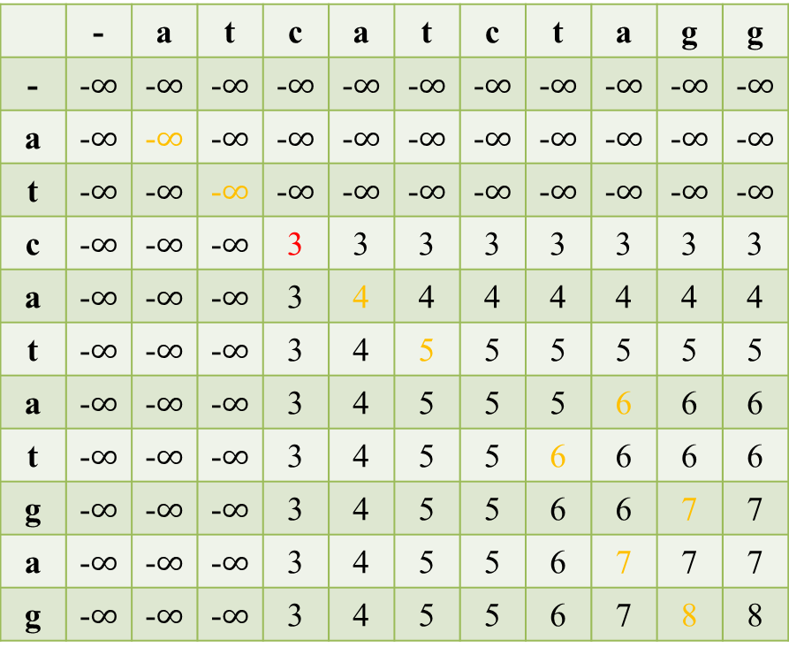
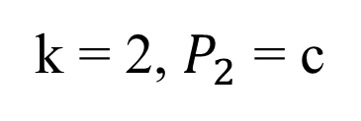
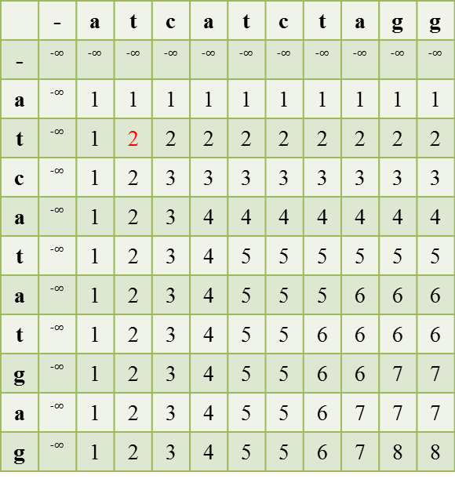
Example
X = a t c a t c t a g g Y = a t c a t a t g a g P = a c g
k = 2, $P_{2}$= c
k = 1
 | - | a | t | c | a | t | c | t | a | g | g
-
a |  | 1 | 1 | 1 | 1 | 1 | 1 | 1 | 1 | 1 | 1
t |  | 1 | 2 | 2 | 2 | 2 | 2 | 2 | 2 | 2 | 2
c |  | 1 | 2 | 3 | 3 | 3 | 3 | 3 | 3 | 3 | 3
a |  | 1 | 2 | 3 | 4 | 4 | 4 | 4 | 4 | 4 | 4
t |  | 1 | 2 | 3 | 4 | 5 | 5 | 5 | 5 | 5 | 5
a |  | 1 | 2 | 3 | 4 | 5 | 5 | 5 | 6 | 6 | 6
t |  | 1 | 2 | 3 | 4 | 5 | 5 | 6 | 6 | 6 | 6
g |  | 1 | 2 | 3 | 4 | 5 | 5 | 6 | 6 | 7 | 7
a |  | 1 | 2 | 3 | 4 | 5 | 5 | 6 | 7 | 7 | 7
g |  | 1 | 2 | 3 | 4 | 5 | 5 | 6 | 7 | 8 | 8
 | - | a | t | c | a | t | c | t | a | g | g
- | -$∞$ | -$∞$ | -$∞$ | -$∞$ | -$∞$ | -$∞$ | -$∞$ | -$∞$ | -$∞$ | -$∞$ | -$∞$
a | -$∞$ | -$∞$ | -$∞$ | -$∞$ | -$∞$ | -$∞$ | -$∞$ | -$∞$ | -$∞$ | -$∞$ | -$∞$
t | -$∞$ | -$∞$ | -$∞$ | -$∞$ | -$∞$ | -$∞$ | -$∞$ | -$∞$ | -$∞$ | -$∞$ | -$∞$
c | -$∞$ | -$∞$ | -$∞$ | 3 | 3 | 3 | 3 | 3 | 3 | 3 | 3
a | -$∞$ | -$∞$ | -$∞$ | 3 | 4 | 4 | 4 | 4 | 4 | 4 | 4
t | -$∞$ | -$∞$ | -$∞$ | 3 | 4 | 5 | 5 | 5 | 5 | 5 | 5
a | -$∞$ | -$∞$ | -$∞$ | 3 | 4 | 5 | 5 | 5 | 6 | 6 | 6
t | -$∞$ | -$∞$ | -$∞$ | 3 | 4 | 5 | 5 | 6 | 6 | 6 | 6
g | -$∞$ | -$∞$ | -$∞$ | 3 | 4 | 5 | 5 | 6 | 6 | 7 | 7
a | -$∞$ | -$∞$ | -$∞$ | 3 | 4 | 5 | 5 | 6 | 7 | 7 | 7
g | -$∞$ | -$∞$ | -$∞$ | 3 | 4 | 5 | 5 | 6 | 7 | 8 | 8

Slide 9
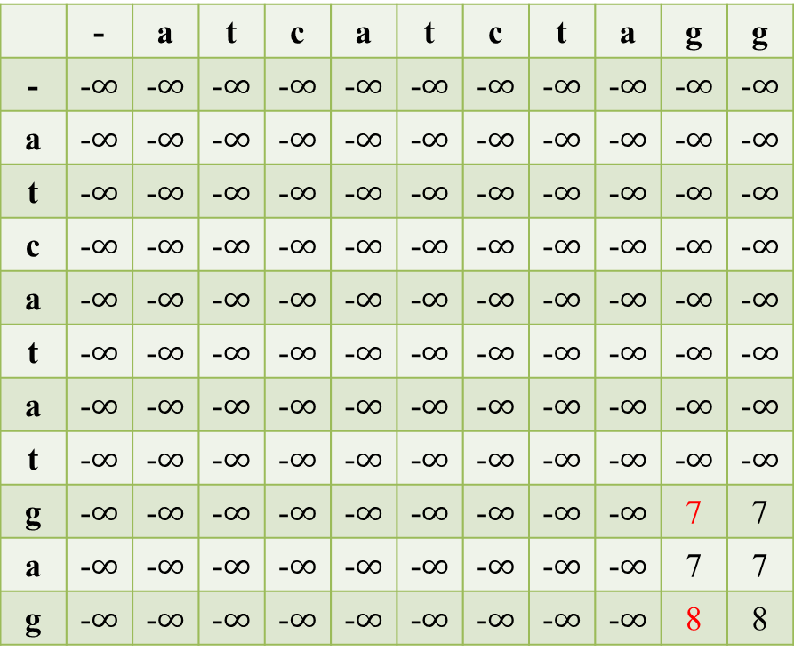
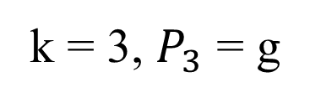
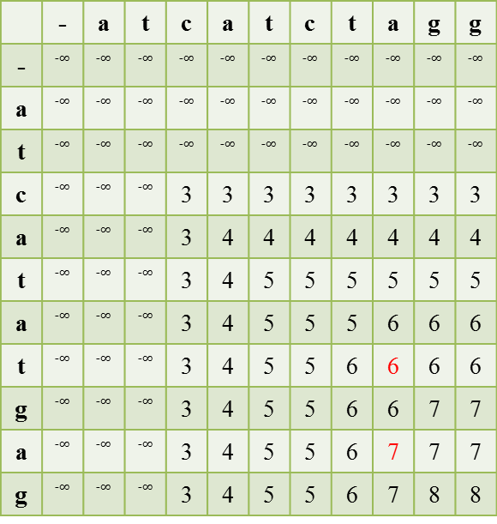
Example
X = a t c a t c t a g g Y = a t c a t a t g a g P = a c g
k = 3, $P_{3}$= g
k = 2
 | - | a | t | c | a | t | c | t | a | g | g
-
a
t
c |  |  |  | 3 | 3 | 3 | 3 | 3 | 3 | 3 | 3
a |  |  |  | 3 | 4 | 4 | 4 | 4 | 4 | 4 | 4
t |  |  |  | 3 | 4 | 5 | 5 | 5 | 5 | 5 | 5
a |  |  |  | 3 | 4 | 5 | 5 | 5 | 6 | 6 | 6
t |  |  |  | 3 | 4 | 5 | 5 | 6 | 6 | 6 | 6
g |  |  |  | 3 | 4 | 5 | 5 | 6 | 6 | 7 | 7
a |  |  |  | 3 | 4 | 5 | 5 | 6 | 7 | 7 | 7
g |  |  |  | 3 | 4 | 5 | 5 | 6 | 7 | 8 | 8
 | - | a | t | c | a | t | c | t | a | g | g
- | -$∞$ | -$∞$ | -$∞$ | -$∞$ | -$∞$ | -$∞$ | -$∞$ | -$∞$ | -$∞$ | -$∞$ | -$∞$
a | -$∞$ | -$∞$ | -$∞$ | -$∞$ | -$∞$ | -$∞$ | -$∞$ | -$∞$ | -$∞$ | -$∞$ | -$∞$
t | -$∞$ | -$∞$ | -$∞$ | -$∞$ | -$∞$ | -$∞$ | -$∞$ | -$∞$ | -$∞$ | -$∞$ | -$∞$
c | -$∞$ | -$∞$ | -$∞$ | -$∞$ | -$∞$ | -$∞$ | -$∞$ | -$∞$ | -$∞$ | -$∞$ | -$∞$
a | -$∞$ | -$∞$ | -$∞$ | -$∞$ | -$∞$ | -$∞$ | -$∞$ | -$∞$ | -$∞$ | -$∞$ | -$∞$
t | -$∞$ | -$∞$ | -$∞$ | -$∞$ | -$∞$ | -$∞$ | -$∞$ | -$∞$ | -$∞$ | -$∞$ | -$∞$
a | -$∞$ | -$∞$ | -$∞$ | -$∞$ | -$∞$ | -$∞$ | -$∞$ | -$∞$ | -$∞$ | -$∞$ | -$∞$
t | -$∞$ | -$∞$ | -$∞$ | -$∞$ | -$∞$ | -$∞$ | -$∞$ | -$∞$ | -$∞$ | -$∞$ | -$∞$
g | -$∞$ | -$∞$ | -$∞$ | -$∞$ | -$∞$ | -$∞$ | -$∞$ | -$∞$ | -$∞$ | 7 | 7
a | -$∞$ | -$∞$ | -$∞$ | -$∞$ | -$∞$ | -$∞$ | -$∞$ | -$∞$ | -$∞$ | 7 | 7
g | -$∞$ | -$∞$ | -$∞$ | -$∞$ | -$∞$ | -$∞$ | -$∞$ | -$∞$ | -$∞$ | 8 | 8

Slide 10
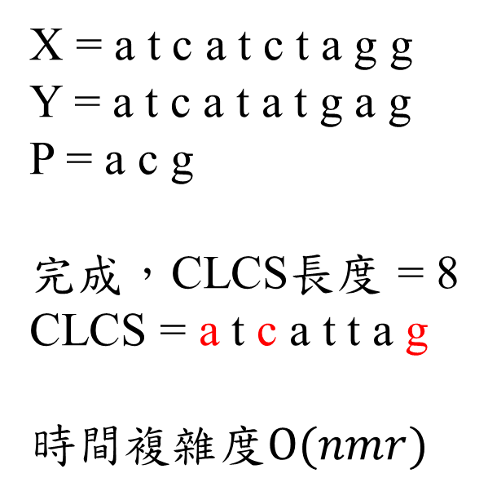
Example
k = 3, $P_{3}$= g
X = a t c a t c t a g g Y = a t c a t a t g a g P = a c g 完成，CLCS長度 = 8 CLCS=at c a t t a g 時間複雜度$O(nmr)$
 | - | a | t | c | a | t | c | t | a | g | g
- | -$∞$ | -$∞$ | -$∞$ | -$∞$ | -$∞$ | -$∞$ | -$∞$ | -$∞$ | -$∞$ | -$∞$ | -$∞$
a | -$∞$ | -$∞$ | -$∞$ | -$∞$ | -$∞$ | -$∞$ | -$∞$ | -$∞$ | -$∞$ | -$∞$ | -$∞$
t | -$∞$ | -$∞$ | -$∞$ | -$∞$ | -$∞$ | -$∞$ | -$∞$ | -$∞$ | -$∞$ | -$∞$ | -$∞$
c | -$∞$ | -$∞$ | -$∞$ | -$∞$ | -$∞$ | -$∞$ | -$∞$ | -$∞$ | -$∞$ | -$∞$ | -$∞$
a | -$∞$ | -$∞$ | -$∞$ | -$∞$ | -$∞$ | -$∞$ | -$∞$ | -$∞$ | -$∞$ | -$∞$ | -$∞$
t | -$∞$ | -$∞$ | -$∞$ | -$∞$ | -$∞$ | -$∞$ | -$∞$ | -$∞$ | -$∞$ | -$∞$ | -$∞$
a | -$∞$ | -$∞$ | -$∞$ | -$∞$ | -$∞$ | -$∞$ | -$∞$ | -$∞$ | -$∞$ | -$∞$ | -$∞$
t | -$∞$ | -$∞$ | -$∞$ | -$∞$ | -$∞$ | -$∞$ | -$∞$ | -$∞$ | -$∞$ | -$∞$ | -$∞$
g | -$∞$ | -$∞$ | -$∞$ | -$∞$ | -$∞$ | -$∞$ | -$∞$ | -$∞$ | -$∞$ | 7 | 7
a | -$∞$ | -$∞$ | -$∞$ | -$∞$ | -$∞$ | -$∞$ | -$∞$ | -$∞$ | -$∞$ | 7 | 7
g | -$∞$ | -$∞$ | -$∞$ | -$∞$ | -$∞$ | -$∞$ | -$∞$ | -$∞$ | -$∞$ | 8 | 8

