Slide 1
The Department Score Prediction and Analysis of the College Entrance Examination
指導老師:楊昌彪
Presentator :Chun-Chieh Hsu
Date: 2014/07/22

Slide 2
Admission Way
Star recommendation (less than 15%)
The application for admission to a school(less than 45%)
College Entrance Advanced Subjects Test (greater than 40%)

Slide 3

College Entrance Examination (CEE) Prediction System
College Entrance Advanced Subjects Test
Minimum required test score(MRTS)
${MRTS}_{s,d,j}=\sum_{i}^{|SUB|}{{score}_{i,j}×{weight}_{s,d,i,j}}$

Slide 4
The Forward Method
We make two assumptions that the preferences of students to schools are not changed in two consecutive years, and that a student has equal rank to all subjects.

Slide 5
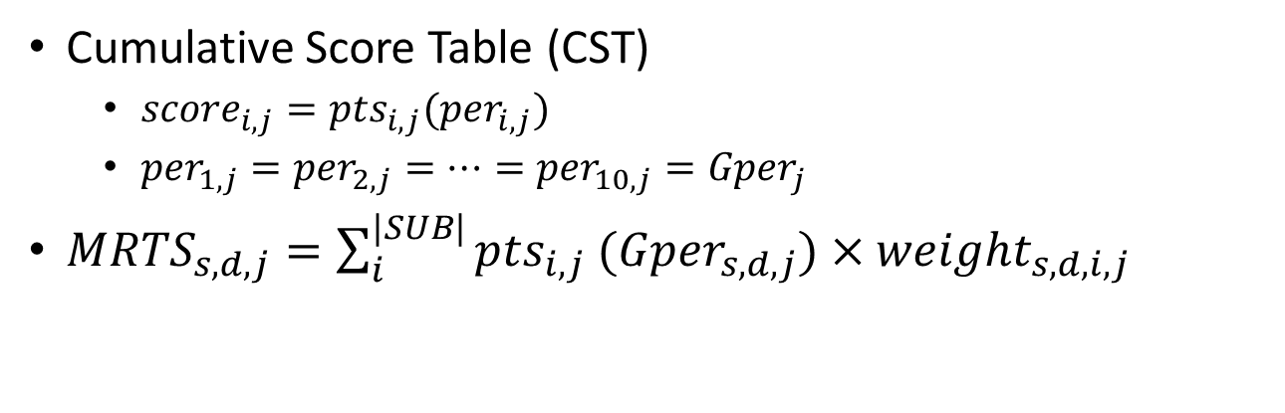
The Forward Method
Cumulative Score Table (CST)
${score}_{i,j}={pts}_{i,j}({per}_{i,j})$
${per}_{1,j}={per}_{2,j}=…={per}_{10,j}={Gper}_{j}$
${MRTS}_{s,d,j}=\sum_{i}^{|SUB|}{{pts}_{i,j} ({Gper}_{s,d,j})×{weight}_{s,d,i,j}}$
國文 (2012)
分數 | 人數 | 百分比 | 自高分往低分累計 |  | 自低分往高分累計 |  | 分數 | 人數 | 百分比 | 自高分往低分累計 |  | 自低分往高分累計
 |  |  | 累計 | 累計 | 累計 | 累計 |  |  |  | 累計 | 累計 | 累計 | 累計
 |  |  | 人數 | 百分比 | 人數 | 百分比 |  |  |  | 人數 | 百分比 | 人數 | 百分比
73.00 - 73.99 | 1175 | 1.87% | 7806 | 12.40% | 56336 | 89.47% | 22.00 - 22.99 | 72 | 0.11% | 62473 | 99.22% | 566 | 0.90%
72.00 - 72.99 | 1329 | 2.11% | 9135 | 14.51% | 55161 | 87.60% | 21.00 - 21.99 | 78 | 0.12% | 62551 | 99.34% | 494 | 0.78%
71.00 - 71.99 | 1478 | 2.35% | 10613 | 16.85% | 53832 | 85.49% | 20.00 - 20.99 | 68 | 0.11% | 62619 | 99.45% | 416 | 0.66%
70.00 - 70.99 | 1463 | 2.32% | 12076 | 19.18% | 52354 | 83.15% | 19.00 - 19.99 | 58 | 0.09% | 62677 | 99.54% | 348 | 0.55%

Slide 6

The Forward Method
$${MRTS}_{s,d,j}=\sum_{i}^{|SUB|}{{pts}_{i,j} ({Gper}_{s,d,j−1})×{weight}_{s,d,i,j}}$$

Slide 7
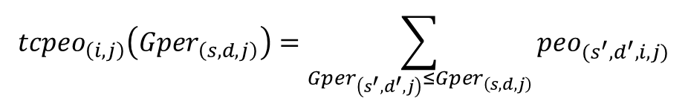
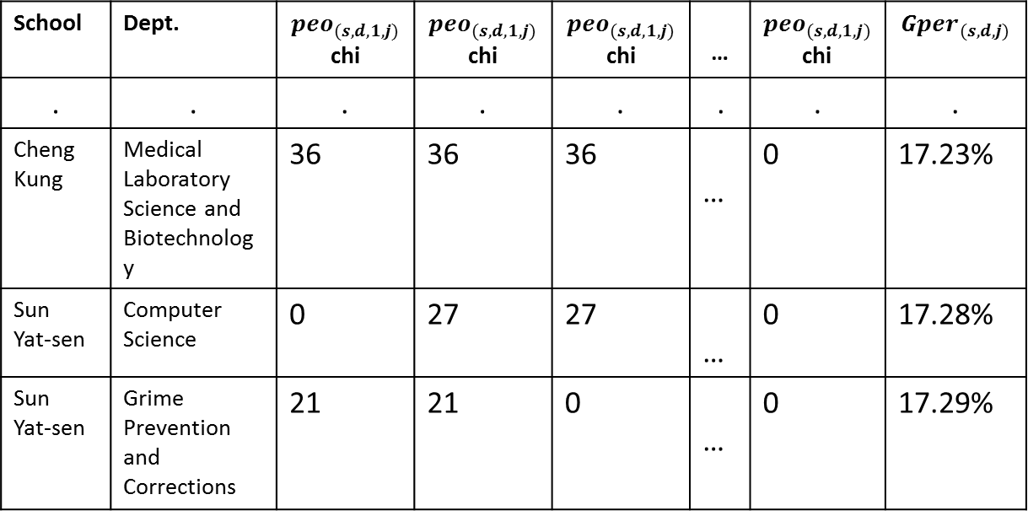
Forward Method with School Ranking
$${tcpeo}_{\left(i,j\right)}\left({Gper}_{\left(s,d,j\right)}\right)=\sum_{\begin{aligned}{Gper}_{\left(s^{′},d^{′},j\right)}≤{Gper}_{\left(s,d,j\right)}\end{aligned}}{{peo}_{(s^{′},d^{′},i,j)}}$$
School | Dept. | $${peo}_{(s,d,1,j)}$$ chi | $${peo}_{(s,d,1,j)}$$ chi | $${peo}_{(s,d,1,j)}$$ chi | … | $${peo}_{(s,d,1,j)}$$ chi | $${Gper}_{(s,d,j)}$$
. | . | . | . | . | . | . | .
Cheng Kung | Medical Laboratory Science and Biotechnology | 36 | 36 | 36 | … | 0 | 17.23%
Sun Yat-sen | Computer Science | 0 | 27 | 27 | … | 0 | 17.28%
Sun Yat-sen | Grime Prevention and Corrections | 21 | 21 | 0 | … | 0 | 17.29%

Slide 8
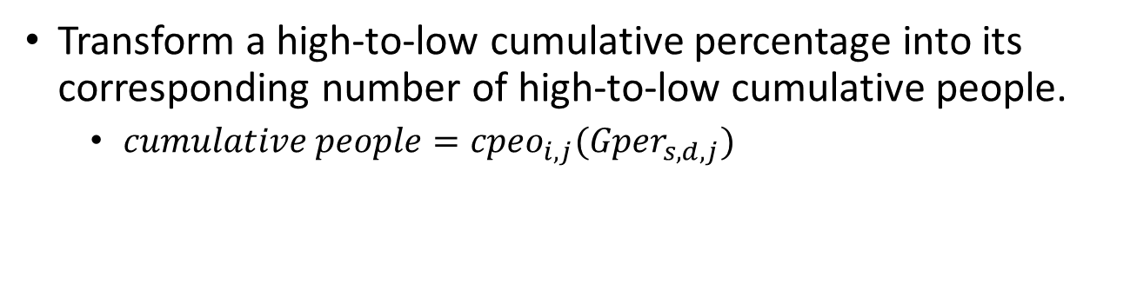
Forward Method with School Ranking
Transform a high-to-low cumulative percentage into its corresponding number of high-to-low cumulative people.
$cumulative people={cpeo}_{i,j}({Gper}_{s,d,j})$
國文 (2012)
分數 | 人數 | 百分比 | 自高分往低分累計 |  | 自低分往高分累計 |  | 分數 | 人數 | 百分比 | 自高分往低分累計 |  | 自低分往高分累計
 |  |  | 累計 | 累計 | 累計 | 累計 |  |  |  | 累計 | 累計 | 累計 | 累計
 |  |  | 人數 | 百分比 | 人數 | 百分比 |  |  |  | 人數 | 百分比 | 人數 | 百分比
73.00 - 73.99 | 1175 | 1.87% | 7806 | 12.40% | 56336 | 89.47% | 22.00 - 22.99 | 72 | 0.11% | 62473 | 99.22% | 566 | 0.90%
72.00 - 72.99 | 1329 | 2.11% | 9135 | 14.51% | 55161 | 87.60% | 21.00 - 21.99 | 78 | 0.12% | 62551 | 99.34% | 494 | 0.78%
71.00 - 71.99 | 1478 | 2.35% | 10613 | 16.85% | 53832 | 85.49% | 20.00 - 20.99 | 68 | 0.11% | 62619 | 99.45% | 416 | 0.66%
70.00 - 70.99 | 1463 | 2.32% | 12076 | 19.18% | 52354 | 83.15% | 19.00 - 19.99 | 58 | 0.09% | 62677 | 99.54% | 348 | 0.55%

Slide 9

Forward Method with School Ranking
$\frac{{cpeo}_{i,j−1({Gper}_{s,d,j−1})}}{{tcpeo}_{i,j−1({Gper}_{s,d,j−1})}}=\frac{{cpeo}_{i,j ({Gper′}_{s,d,j})}}{{tcpeo}_{i,j ({Gper}_{s,d,j−1})}}$
${MRTS′}_{s,d,j}=\sum_{i}^{|SUB|}{{pts}_{i,j} ({Gper′}_{s,d,j})×{weight}_{s,d,i,j}}$

Slide 10
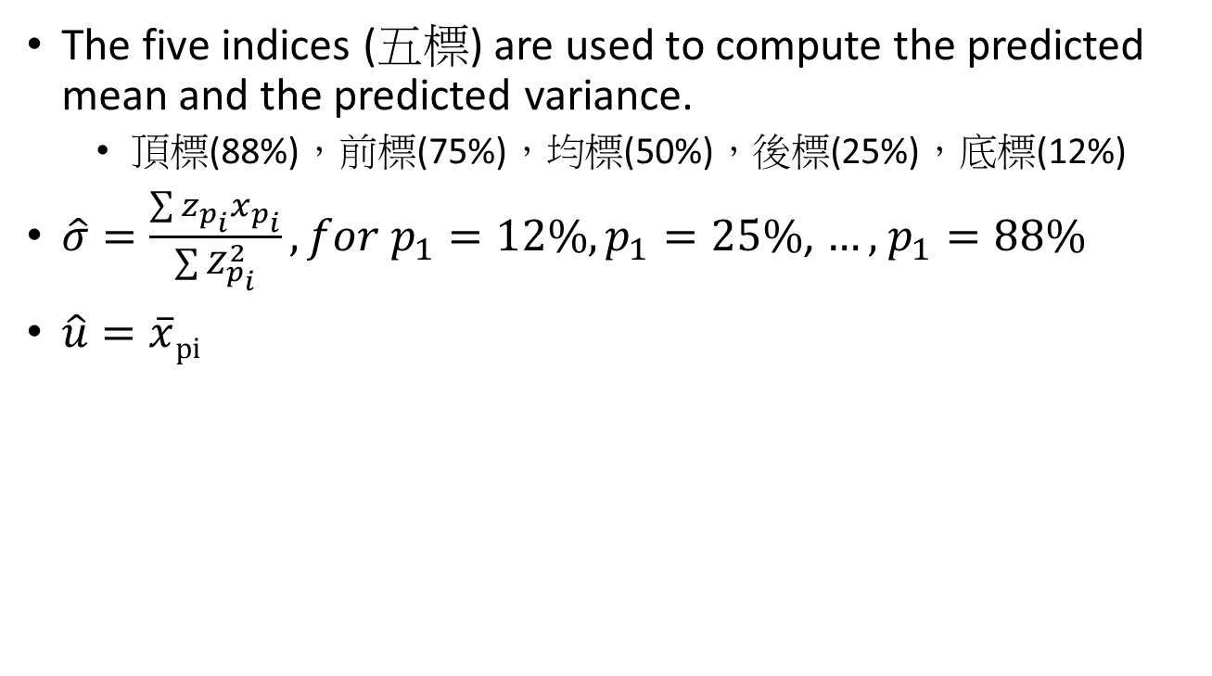
Lin’s Method
The five indices (五標)are used to compute the predicted mean and the predicted variance.
頂標(88%)，前標(75%)，均標(50%)，後標(25%)，底標(12%)
$\hat{σ}=\frac{\sum{z_{p_{i}}x_{p_{i}}}}{\sum{Z_{p_{i}}^{2}}}, for p_{1}=12\%,p_{1}=25\%$, $…,$$p_{1}=88\%$
$\hat{u}=\overline{x}pi$

Slide 11
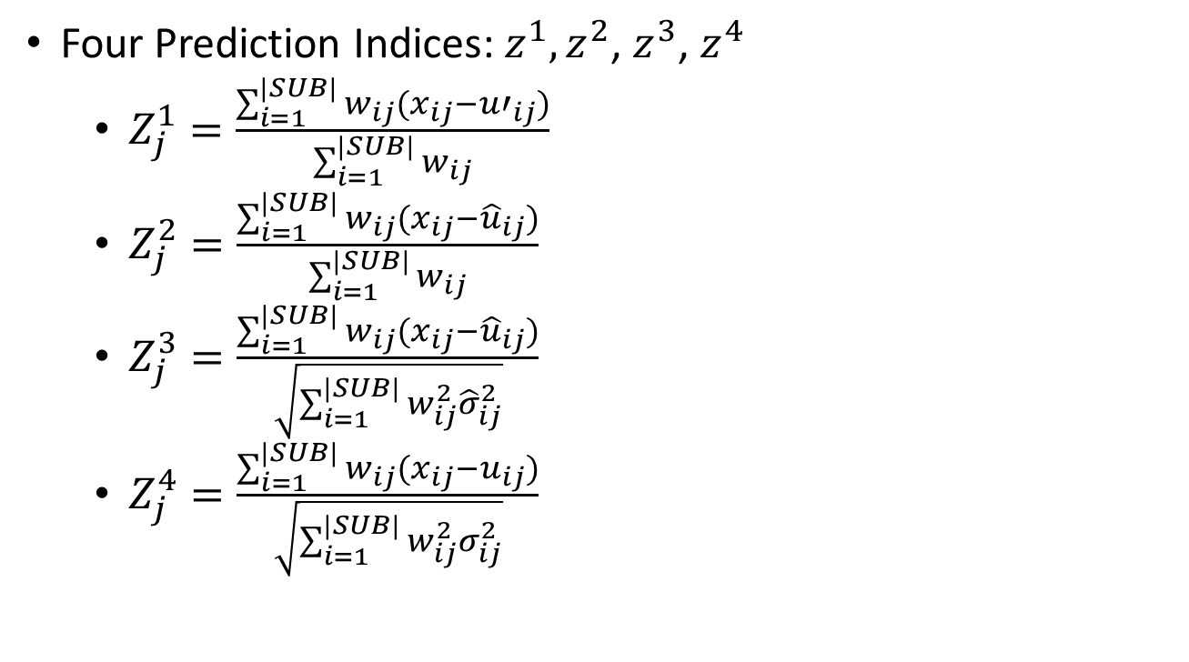
Lin’s Method
Four Prediction Indices: $z^{1},z^{2}$,$z^{3}$,$z^{4}$
$Z_{j}^{1}=\frac{\sum_{i=1}^{|SUB|}{w_{ij}(x_{ij}−{u′}_{ij})}}{\sum_{i=1}^{|SUB|}{w_{ij}}}$
$Z_{j}^{2}=\frac{\sum_{i=1}^{|SUB|}{w_{ij}(x_{ij}−{\hat{u}}_{ij})}}{\sum_{i=1}^{|SUB|}{w_{ij}}}$
$Z_{j}^{3}=\frac{\sum_{i=1}^{|SUB|}{w_{ij}(x_{ij}−{\hat{u}}_{ij})}}{\sqrt{\sum_{i=1}^{|SUB|}{w_{ij}^{2}{\hat{σ}}_{ij}^{2}}}}$
$Z_{j}^{4}=\frac{\sum_{i=1}^{|SUB|}{w_{ij}(x_{ij}−u_{ij})}}{\sqrt{\sum_{i=1}^{|SUB|}{w_{ij}^{2}σ_{ij}^{2}}}}$

Slide 12
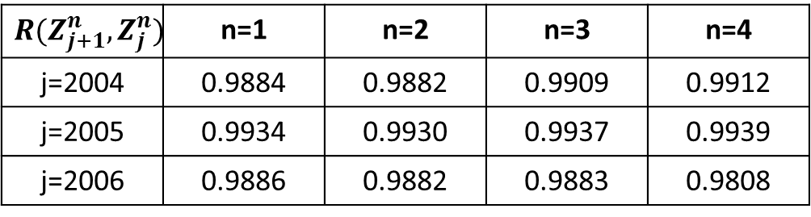
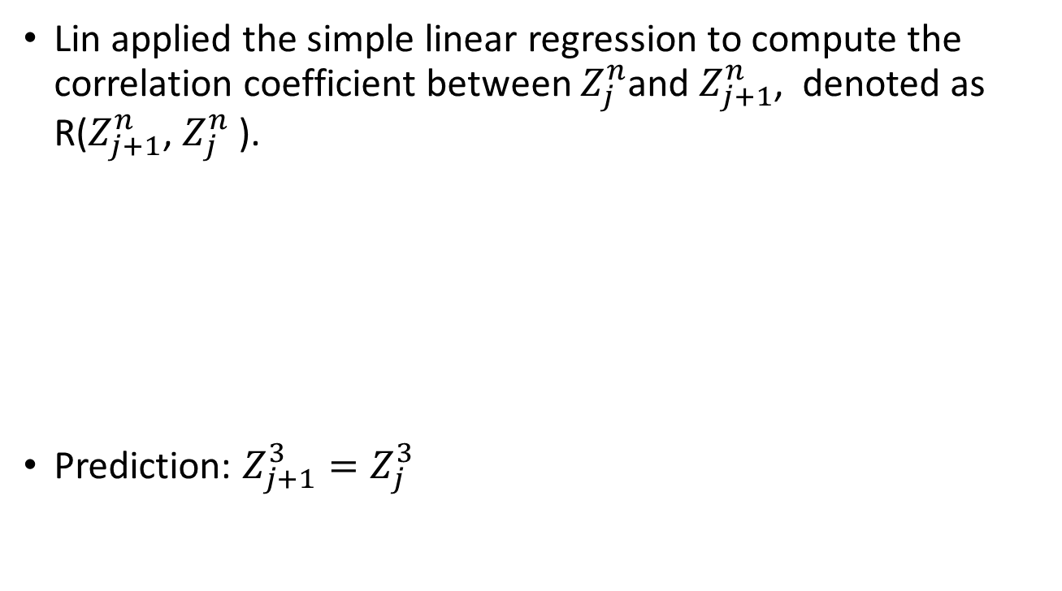
Lin’s Method
Lin applied the simple linear regression to compute the correlation coefficient between $Z_{j}^{n}$and $Z_{j+1}^{n}$, denoted as R($Z_{j+1}^{n}$,$Z_{j}^{n}$).
Prediction: $Z_{j+1}^{3}=Z_{j}^{3}$
$$R(Z_{j+1}^{n},Z_{j}^{n})$$ | n=1 | n=2 | n=3 | n=4
j=2004 | 0.9884 | 0.9882 | 0.9909 | 0.9912
j=2005 | 0.9934 | 0.9930 | 0.9937 | 0.9939
j=2006 | 0.9886 | 0.9882 | 0.9883 | 0.9808

Slide 13
Prediction with Fuzzy Time Series
Fuzzy sets were introduced by Zadeh in 1965. Since then, fuzzy sets have largely been applied in several areas including industry, financial, meteorology, etc.
Until 1993, Song and Chissom proposed a fuzzy time series.
Forecasting enrollments with fuzzy time series part 1
Forecasting enrollments with fuzzy time series part 2
Sah constructed an enrolment prediction model based on first-order fuzzy time series.
Haneen et. al forecasted the enrolments of students by using genetic algorithms and fuzzy time series.

Slide 14
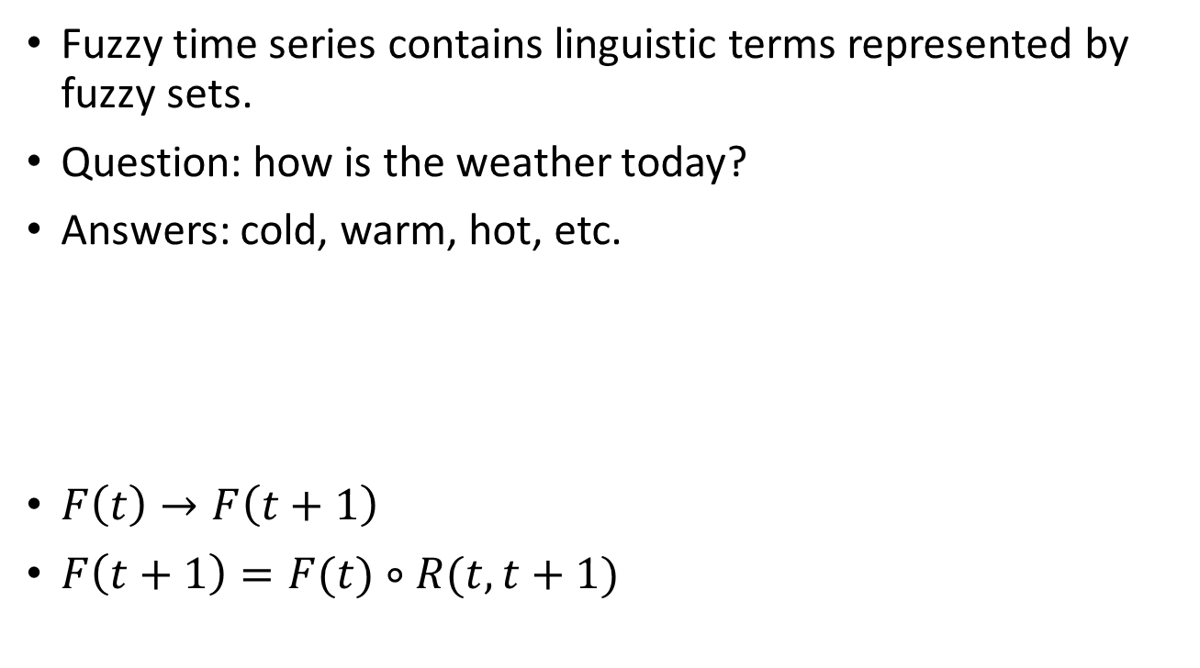
Prediction with Fuzzy Time Series
Fuzzy time series contains linguistic terms represented by fuzzy sets.
Question: how is the weather today?
Answers: cold, warm, hot, etc.
$F\left(t\right)→F\left(t+1\right)$
$F\left(t+1\right)=F(t)∘R(t,t+1)$
 | Day 1 | Day 2 | … | Day 30 | Day 31
Linguistic | Hot | Warm | … | Cold | ?
Fuzzy set | F_{H}(t=1) | F_{W}(t=2) | … | F_{C}(t=30) | ?

Slide 15
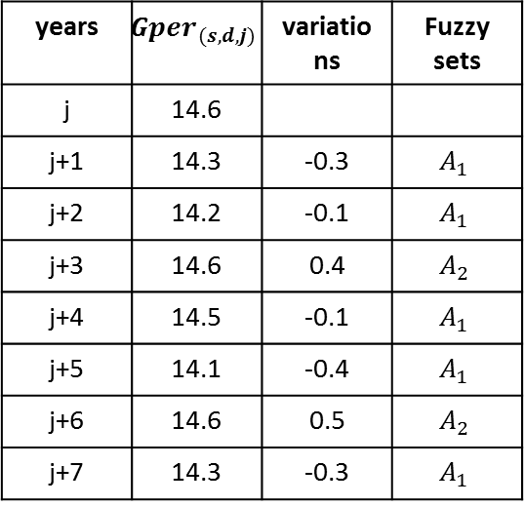
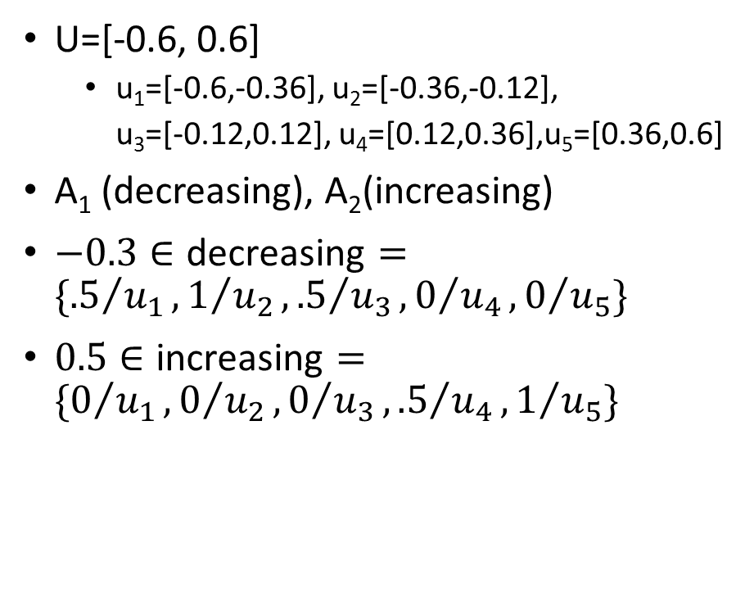
Prediction with Fuzzy Time Series
U=[-0.6, 0.6]
u₁=[-0.6,-0.36], u₂=[-0.36,-0.12],
u₃=[-0.12,0.12], u₄=[0.12,0.36],u₅=[0.36,0.6]
A₁(decreasing), A₂(increasing)
$−0.3∈\text{decreasing}=\{{.5}/{u_{1}},1/{u_{2}},{.5}/{u_{3}},0/{u_{4}},0/{u_{5}}\}$
$0.5∈\text{increasing}=\{0/{u_{1}},0/{u_{2}},0/{u_{3}},{.5}/{u_{4}},1/{u_{5}}\}$
years | $${Gper}_{(s,d,j)}$$ | variations | Fuzzy sets
j | 14.6
j+1 | 14.3 | -0.3 | $$A_{1}$$
j+2 | 14.2 | -0.1 | $$A_{1}$$
j+3 | 14.6 | 0.4 | $$A_{2}$$
j+4 | 14.5 | -0.1 | $$A_{1}$$
j+5 | 14.1 | -0.4 | $$A_{1}$$
j+6 | 14.6 | 0.5 | $$A_{2}$$
j+7 | 14.3 | -0.3 | $$A_{1}$$

Slide 16
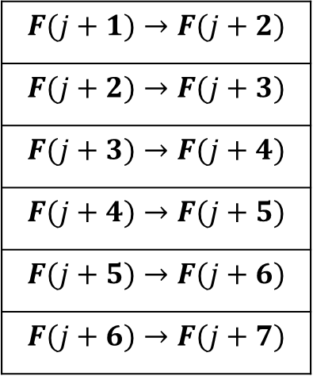
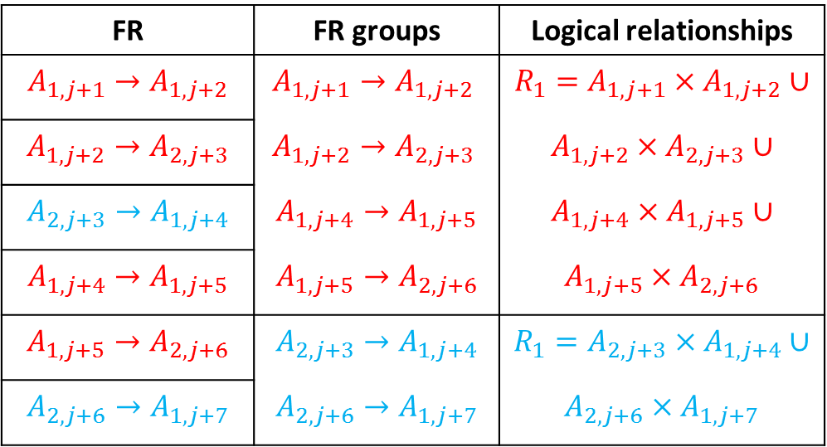
Prediction with Fuzzy Time Series
Combine fuzzy relationships (FR) into FR groups and obtain logical relationships from each FR group.
FR | FR groups | Logical relationships
$$A_{1,j+1}→A_{1,j+2}$$ | $$A_{1,j+1}→A_{1,j+2}$$ | $$R_{1}=A_{1,j+1}×A_{1,j+2}∪$$
$$A_{1,j+2}→A_{2,j+3}$$ | $$A_{1,j+2}→A_{2,j+3}$$ | $$A_{1,j+2}×A_{2,j+3}∪$$
$$A_{2,j+3}→A_{1,j+4}$$ | $$A_{1,j+4}→A_{1,j+5}$$ | $$A_{1,j+4}×A_{1,j+5}∪$$
$$A_{1,j+4}→A_{1,j+5}$$ | $$A_{1,j+5}→A_{2,j+6}$$ | $$A_{1,j+5}×A_{2,j+6}$$
$$A_{1,j+5}→A_{2,j+6}$$ | $$A_{2,j+3}→A_{1,j+4}$$ | $$R_{1}=A_{2,j+3}×A_{1,j+4}∪$$
$$A_{2,j+6}→A_{1,j+7}$$ | $$A_{2,j+6}→A_{1,j+7}$$ | $$A_{2,j+6}×A_{1,j+7}$$
$$F(j+1)→F(j+2)$$
$$F(j+2)→F(j+3)$$
$$F(j+3)→F(j+4)$$
$$F(j+4)→F(j+5)$$
$$F(j+5)→F(j+6)$$
$$F(j+6)→F(j+7)$$

Slide 17





Prediction with Fuzzy Time Series
$A_{1,j+1}×A_{1,j+2}$
$$A_{1,j+1}$$
0.5
1
0.5
0
0
0 | 0.5 | 0.5 | 0.5 | 0
0 | 0.5 | 1 | 0.5 | 0
0 | 0.5 | 0.5 | 0.5 | 0
0 | 0 | 0 | 0 | 0
0 | 0 | 0 | 0 | 0
$$A_{1,j+2}$$
$$×$$
0 | 0.5 | 1 | 0.5 | 0
$$=$$

Slide 18




Prediction with Fuzzy Time Series
$$A_{1,j+1}×A_{1,j+2}$$
$$A_{1,j+2}×A_{2,j+3}$$
0 | 0.5 | 0.5 | 0.5 | 0
0 | 0.5 | 1 | 0.5 | 0
0 | 0.5 | 0.5 | 0.5 | 0
0 | 0 | 0 | 0 | 0
0 | 0 | 0 | 0 | 0
0 | 0 | 0 | 0 | 0
0 | 0 | 0 | 0.5 | 0.5
0 | 0 | 0 | 0.5 | 1
0 | 0 | 0 | 0.5 | 0.5
0 | 0 | 0 | 0 | 0
0 | 0.5 | 0.5 | 0.5 | 0
0 | 0.5 | 1 | 0.5 | 0.5
0 | 0.5 | 0.5 | 0.5 | 1
0 | 0 | 0 | 0.5 | 0.5
0 | 0 | 0 | 0 | 0
$$∪$$
$$=$$

Slide 19






Prediction with Fuzzy Time Series
$$A_{1,j+7}$$
$$R_{1}$$
$$F(j+8)$$
0 | 0.5 | 0.5 | 0.5 | 1
0.5 | 0.5 | 1 | 0.5 | 0.5
1 | 0.5 | 0.5 | 0.5 | 1
0.5 | 0.5 | 0 | 0.5 | 0.5
0 | 0 | 0 | 0 | 0
$$−3∈decreasing$$
0.5 | 1 | 0.5 | 0 | 0
$$∘$$
$$=$$
0.5 | 0.5 | 1 | 0.5 | 0.5
Defuzzification: $\frac{0.5∗\left(−0.48\right)+0.5∗\left(−0.24\right)+1∗0+0.5∗0.48+0.5∗0.24}{0.5+0.5+1+0.5+0.5}=0$

Slide 20
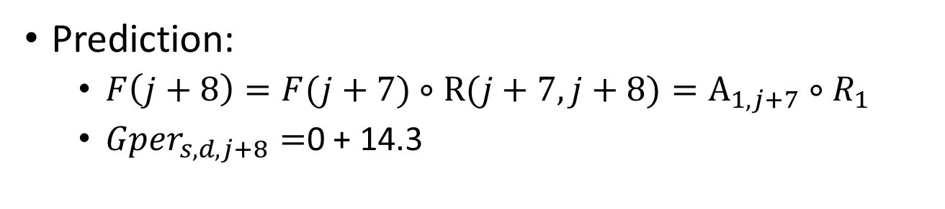
Prediction with Fuzzy Time Series
Prediction:
$F\left(j+8\right)=F(j+7)∘R(j+7,j+8)=A_{1,j+7}∘R_{1}$
${Gper}_{s,d,j+8}=$0 + 14.3

Slide 21
The Admission Rate
over-estimation (OE)
under-estimation (UE)
ratio of admission rates (RAR)
 | 2004 | 2005 | 2006 | 2007 | 2008 | 2009 | 2010 | 2011 | 2012 | 2013
OE |  | 72.02% | 78.62% | 88.20% | 87.74% | 77.40% | 32.60% | 16.86% | 30.00% | 85.69%
UE |  | 27.98% | 21.38% | 11.81% | 12.25% | 22.60% | 67.40% | 83.14% | 70.00% | 14.31%
H or L |  | H | H | H | H | H | L | L | L | H
Admission rate | 75.60% | 76.32% rise | 80.94% rise | 85.86% rise | 91.02% rise | 94.01% rise | 86.50% fall | 80.29% fall | 77.49% fall | 82.95% rise
RAR |  | 1.0095 | 1.0606 | 1.0607 | 1.0601 | 1.0329 | 0.9202 | 0.9281 | 0.9652 | 1.0705

Slide 22
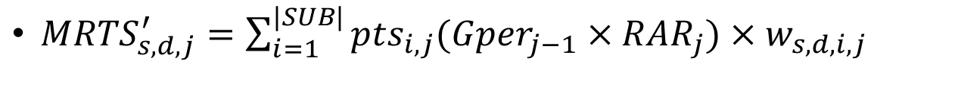
Forward method with Admission Rate (FMAR)
${MRTS}_{s,d,j}^{′}=\sum_{i=1}^{|SUB|}{{pts}_{i,j}({Gper}_{j−1}×{RAR}_{j})×w_{s,d,i,j}}$

Slide 23
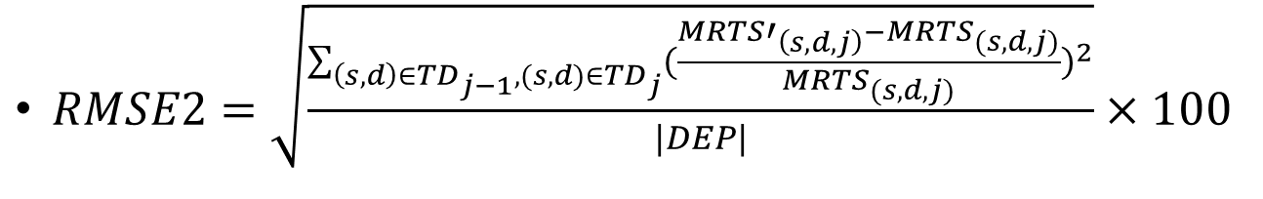
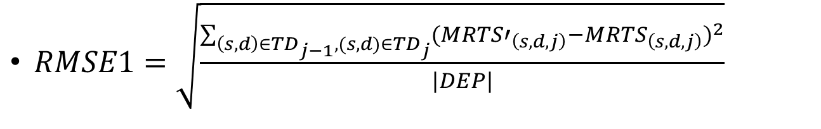
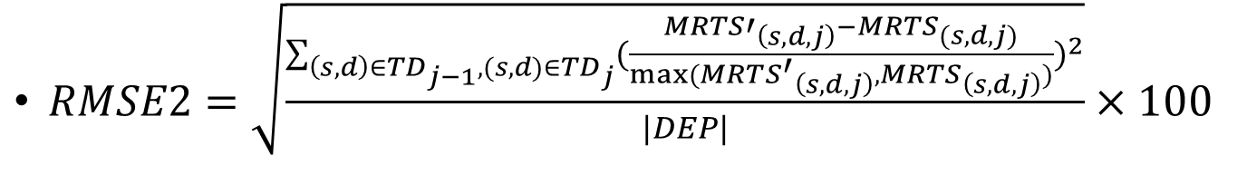
Experimental Results
Root mean square error(RMSE)
$RMSE1=\sqrt{\frac{\sum_{\left(s,d\right)∈{TD}_{j−1},(s,d)∈{TD}_{j}}{{({MRTS′}_{\left(s,d,j\right)}−{MRTS}_{\left(s,d,j\right)})}^{2}}}{|DEP|}}$
$RMSE2=\sqrt{\frac{\sum_{\left(s,d\right)∈{TD}_{j−1},(s,d)∈{TD}_{j}}{{(\frac{{MRTS′}_{\left(s,d,j\right)}−{MRTS}_{(s,d,j)}}{{MRTS}_{(s,d,j)}})}^{2}}}{|DEP|}}×100$
$RMSE2=\sqrt{\frac{\sum_{\left(s,d\right)∈{TD}_{j−1},(s,d)∈{TD}_{j}}{{(\frac{{MRTS′}_{\left(s,d,j\right)}−{MRTS}_{(s,d,j)}}{max⁡({{MRTS^{′}}_{\left(s,d,j\right)},MRTS}_{\left(s,d,j\right)})})}^{2}}}{|DEP|}}×100$

Slide 25
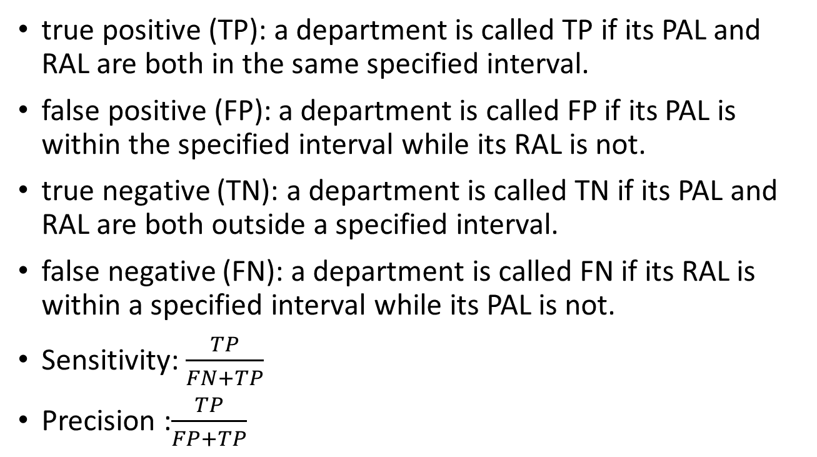
Experimental Results
true positive (TP): a department is called TP if its PAL and RAL are both in the same specified interval.
false positive (FP): a department is called FP if its PAL is within the specified interval while its RAL is not.
true negative (TN): a department is called TN if its PAL and RAL are both outside a specified interval.
false negative (FN): a department is called FN if its RAL is within a specified interval while its PAL is not.
Sensitivity: $\frac{TP}{FN+TP}$
Precision :$\frac{TP}{FP+TP}$

Slide 26
Experimental Results
[-2,2]
[-4,4]
[-6,6]
[0, ∞]
[-∞,0]
 | rmse1 | rmse2 | rmse3 | SENS. | PREC. | SENS. | PREC. | SENS. | PREC. | SNES. | PREC. | SENS. | PREC.
Forward | 20.96 | 15.26 | 8.82 | 36.4% | 36.06% | 51.93% | 51.76% | 61.02% | 61.53%
School ranking | 26.49 | 20.73 | 10.59 | 33.33% | 31.52% | 47.28% | 44.48% | 56.39% | 53.48%
Lin | 21.6 | 16.11 | 9.1 | 35.92% | 36.21% | 52.42% | 52.71% | 61.44% | 62.44%
Fuzzy | 21.73 | 12.47 | 8.81 | 34.33% | 34.58% | 49.95% | 50.84% | 57.96% | 60.08%
FMAR | 17.59 | 14.76 | 8.23 | 45.66% | 45.35% | 62.05% | 61.54% | 70.82% | 70.07%

Slide 27
Experimental Results
[-2,2]
 | 10% | 20% | 30% | 40% | 50% | 60% | 70% | 80% | 90%
forward
SENS. | 87.08% | 71.48% | 46.03% | 33.8% | 24.96% | 15.78% | 14.93% | 8.58% | 2.88%
PREC. | 80.6% | 63.45% | 37.45% | 31.62% | 24.52% | 14.42% | 18.75% | 7.46% | 7.56%
School ranking
SENS. | 78.64% | 78.95% | 63.29% | 46.65% | 35.27% | 21.67% | 9.36% | 1.17% | 0.88%
PREC. | 78.45% | 72.96% | 55.3% | 43.8% | 31.77% | 18.48% | 10.82% | 0.88% | 1%
Lin
SENS. | 82.81% | 79.16% | 51.74% | 39.84% | 29.86% | 18.01% | 15.6% | 7.37% | 2.49%
PREC. | 78.71% | 69.01% | 42.25% | 37.17% | 28.71% | 16.8% | 19.11% | 6.69% | 6.86%
Fuzzy
SENS. | 84.31% | 72.11% | 42.97% | 32.29% | 25.38% | 17.28% | 8.63% | 1.56% | 3.08%
PREC. | 77.66% | 60.33% | 35.63% | 32.02% | 23.98% | 13.93% | 11.33% | 1.94% | 5.61%
FMAR
SENS. | 81.05% | 78.8% | 66.66% | 49.84% | 50.6% | 49.45% | 42.55% | 34.39% | 10.02%
PREC. | 81.82% | 75.21% | 61.47% | 51.63% | 51.63% | 52.89% | 48.22% | 32.56% | 11.65%

Slide 28
Experimental Results
0-25(%)
25-50(%)
50-75(%)
75-100(%)
FMAR
Forward
FMAR
Forward
FMAR
Forward
FMAR
Forward
The first academic group
RMSE1
5.23
4.34
6.85
10.73
9.57
16.77
20.24
39.08
RMSE2
1.09
0.92
1.85
3.09
2.9
4.86
6.72
13.08
RMSE3
1.09
0.91
1.81
2.97
2.85
4.58
6.44
11.16
The second academic group
RMSE1
4.89
7.74
13.18
20.08
19.81
31.67
12.62
25.83
RMSE2
1.25
1.92
3.67
5.73
7.25
11.25
4.82
9.85
RMSE3
1.24
1.88
3.5
5.34
6.51
9.79
4.79
8.87
The third academic group
RMSE1
8.1
8.78
12.6
17.82
19.29
27.66
15.81
23.32
RMSE2
1.68
1.93
3.35
4.75
6.56
9.68
5.49
8.86
RMSE3
1.68
1.91
3.24
4.45
5.99
8.46
5.47
7.99

Slide 29
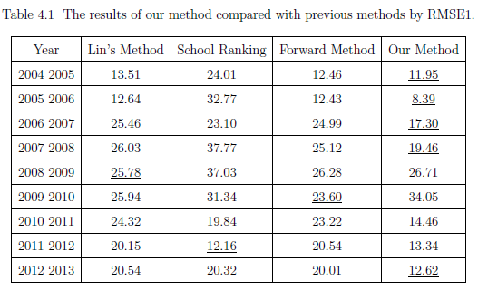
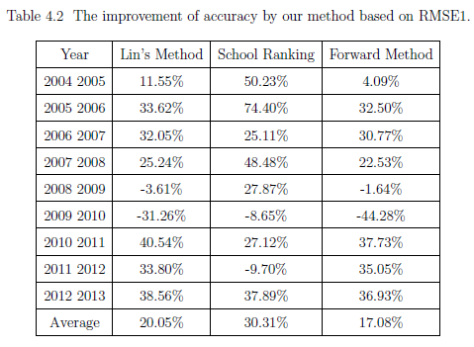
Experimental Results

Slide 30
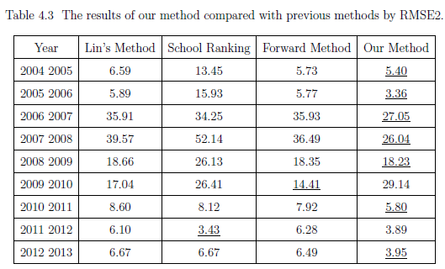
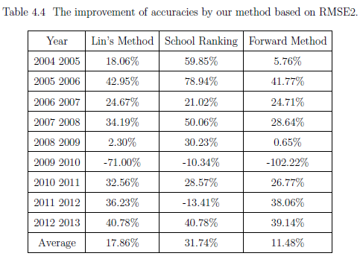
Experimental Results

Slide 31
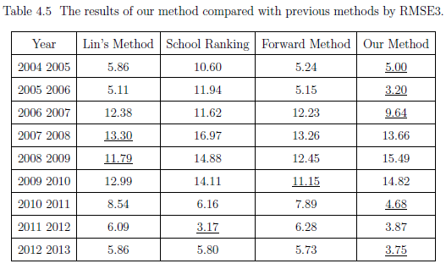
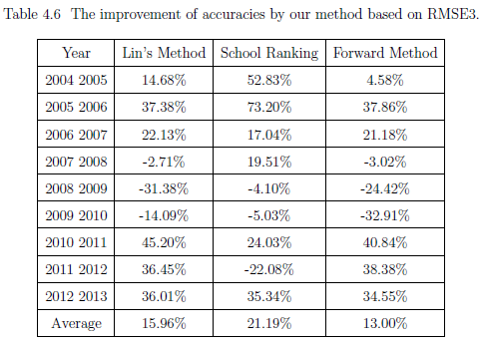
Experimental Results

Slide 32
Experimental Results
Departments | Real MRTS | Predicted MRTS
台大中文 | 491.85 | 491.78
台大外文 | 636.93 | 636.36
臺大歷史 | 500.5 | 500.09
台大哲學 | 417.2 | 411.7
台大人類 | 516.28 | 511.33
台大圖書 | 539.45 | 540.32
臺大日文 | 496.15 | 495.57
台大戲劇(男) | 486.9 | 482.18
台大戲劇(女) | 491.5 | 488.61
台大地理環境資源B | 417.9 | 415.79

Slide 33
Experimental Results
Departments | Real MRTS | Predicted MRTS
Ntal. Taiwan Univ., Dept. of Electrical Engineering | 430.4 | 431.5
Ntal. Taiwan Univ., Dept. of Materials Science and Engineering | 427.6 | 429.1
Natl. Taiwan Univ., Dept. of Physics | 423.2 | 425.11
Natl. Taiwan Univ., Dept. of Computer Science & Information Engineering | 419.8 | 421.89
Natl. Taiwan Univ., Dept. of Chemical Engineering | 415.5 | 416.91
Natl. Taiwan Univ., Dept. of Business Administration division Of Technology Management | 586 | 581.48
Natl. Taiwan Univ., Dept. of Mechanical Engineering | 413.8 | 413.3
Natl. Chiao Tung Univ., Dept. of Electrical Engineering and Computer Science Undergraduate Honors Program | 412.7 | 413.37
Natl. Taiwan Univ., Dept. of Chemistry | 411.9 | 409.6
Natl. Taiwan Univ., Dept. of Information Management | 411.3 | 410.95

Slide 34
Experimental Results
Departments | Real MRTS | Predicted MRTS
台大心理 | 481 | 478.94
台大醫學 | 544.7 | 538.75
台大牙醫 | 533.8 | 526.09
台大藥學 | 590.1 | 583.71
台大醫學檢驗暨生物技術 | 494.3 | 491.38
台大護理 | 466 | 462.4
臺大物理治療 | 493 | 487.52
臺大職能治療 | 488.8 | 484.89
台大農藝 | 513.3 | 511.51
台大農業化學 | 478.8 | 479.7

Slide 35
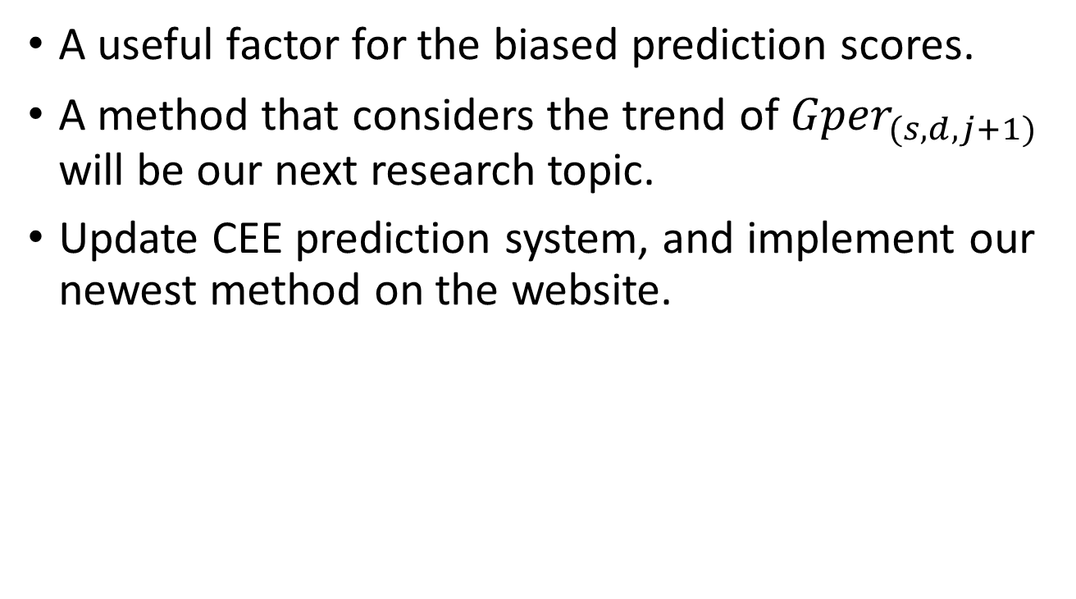
Conclusion and Future Work
A useful factor for thebiased prediction scores.
A method that considers the trend of ${Gper}_{(s,d,j+1)}$ will be our next research topic.
Update CEE prediction system, and implement our newest method on the website.

Slide 36
Thank You

