Slide 1
Approximating the Longest Approximate Common Subsequence Problem
Wen-Chen Hu, Gerhard X. Ritter, Mark S. Schmalz
Proceeding ACM-SE 36 Proceedings of the 36th annual Southeast regional conference
pp. 166-172 (1998)
Presenter：Guan-Cheng Guo Date：2014/8/5

Slide 2
Abstract
Finding a longest common subsequence of two strings is a well-known problem. We generalize this problem to a longest approximate common subsequence problem that produces a maximum-gain approximate common subsequence of two strings. An approximate subsequence of a string X is a string edited from a subsequence of X String Z is an approximate common subsequence of two strings X and Y if Z is an approximate subsequence of both X and Y. The gain function, g assigns a nonnegative real number to each subsequence. The problem is divided into smaller segments in order to lessen its complexity with some of these segments having been proven to be NP-hard.

Slide 3
Abstract
A heuristic approximation algorithm and an optimization neural network are constructed to find a near-optimal solution for the problem, where a ratio bound of the approximation algorithm is given, and a technique of interception is used to determine the values of the network weights. Some experimental results and the comparative performance of the two methods also are discussed.

Slide 4
Longest Approximate Common Subsequence Problem
Given two sequences X and Y. X = CABEBA, Y = BADACB
We can find the LCS between X and Y is “CB”.
X = C A B E B A
Y = B A D A C B

Slide 5
Longest Approximate Common Subsequence Problem
X = CABEBA, Y = BADACB
If we edit the sequences, we can get longer common subsequence. Ex:
X = A C B E B A
Y = B A D A C B

Slide 6
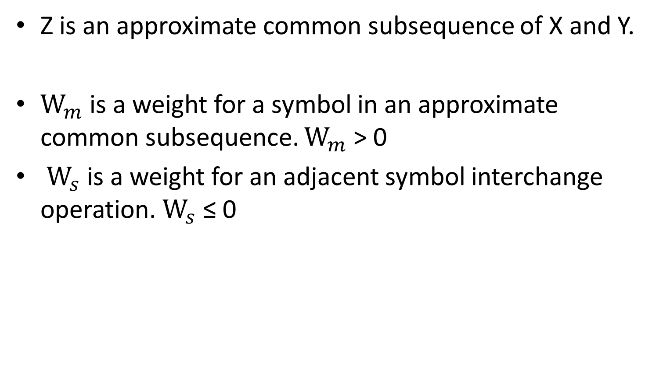
Longest Approximate Common Subsequence Problem
Z is an approximate common subsequence of X and Y.
$W_{m}$ is a weight for a symbol in an approximate common subsequence. $W_{m}$ > 0
$W_{s}$ is a weight for an adjacent symbol interchange operation. $W_{s}$ ≤ 0

Slide 7
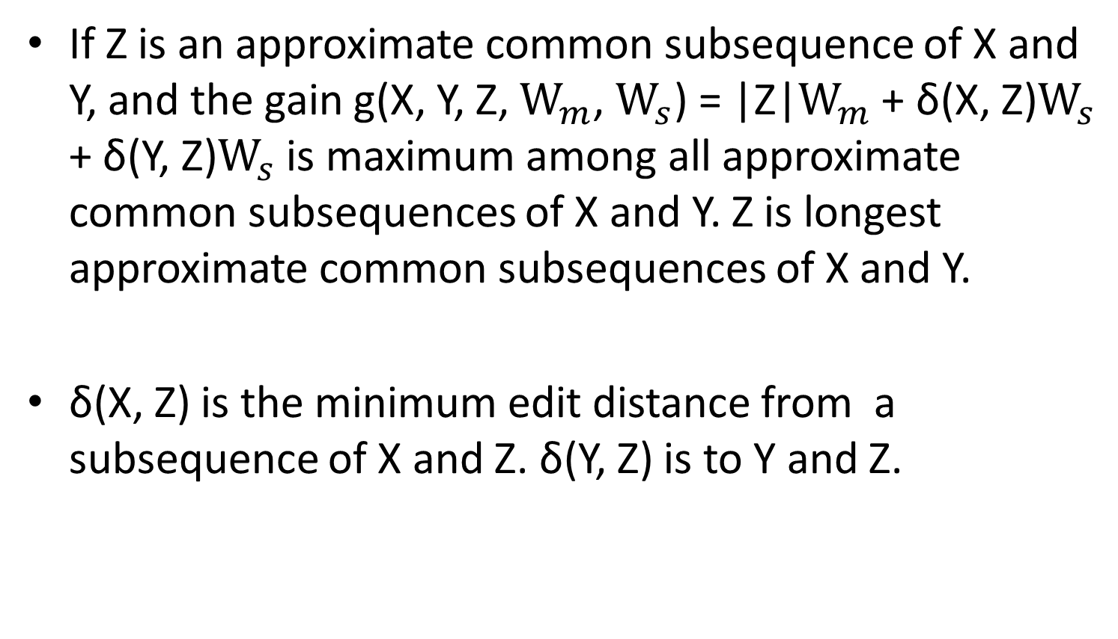
Longest Approximate Common Subsequence Problem
If Z is an approximate common subsequence of X and Y, and the gain g(X, Y, Z, $W_{m}$, $W_{s}$) = |Z|$W_{m}$ + δ(X, Z)$W_{s}$ + δ(Y, Z)$W_{s}$ is maximum among all approximate common subsequences of X and Y. Z is longest approximate common subsequences of X and Y.
δ(X, Z) is the minimum edit distance from a subsequence of X and Z. δ(Y, Z) is to Y and Z.

Slide 8
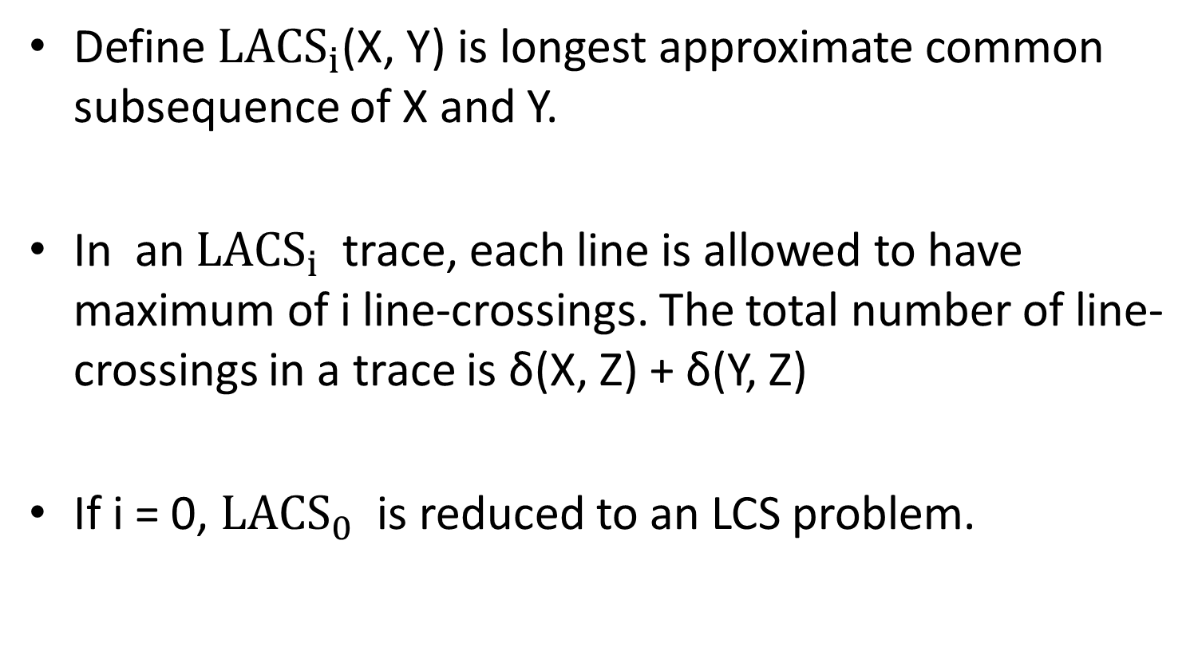
Longest Approximate Common Subsequence Problem
Define ${LACS}_{i}$(X, Y) is longest approximate common subsequence of X and Y.
In an ${LACS}_{i}$ trace, each line is allowed to have maximum of i line-crossings. The total number of line-crossings in a trace is δ(X, Z) + δ(Y, Z)
If i = 0, ${LACS}_{0}$ is reduced to an LCS problem.

Slide 9
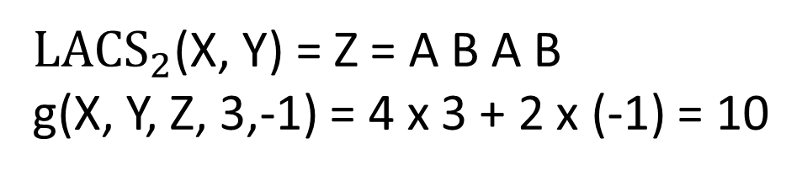
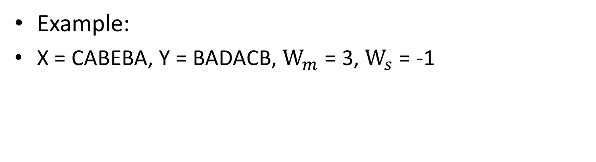
Longest Approximate Common Subsequence Problem
Example:
X = CABEBA, Y = BADACB, $W_{m}$ = 3, $W_{s}$ = -1
X = C A B E B A
Y = B A D A C B
${LACS}_{2}$(X, Y) = Z = A B A B
g(X, Y, Z, 3,-1) = 4 x 3 + 2 x (-1) = 10

Slide 10
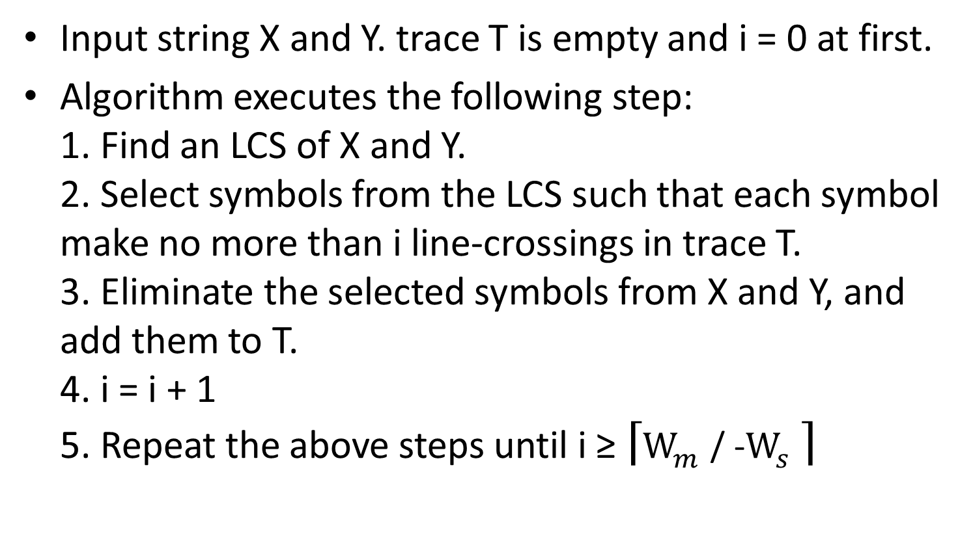
Approximate LACS Algorithm
Input string X and Y. trace T is empty and i = 0 at first.
Algorithm executes the following step: 1. Find an LCS of X and Y. 2. Select symbols from the LCS such that each symbol make no more than i line-crossings in trace T. 3. Eliminate the selected symbols from X and Y, and add them to T. 4. i = i + 1 5. Repeat the above steps until i ≥ $\left\lceil W_{m} \text{/} \text{−}W_{s} \right\rceil$

Slide 11
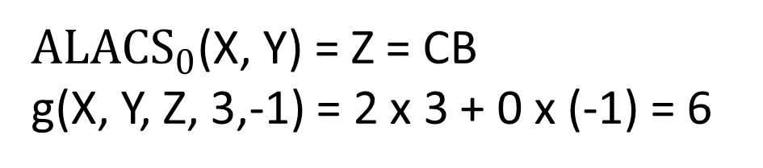
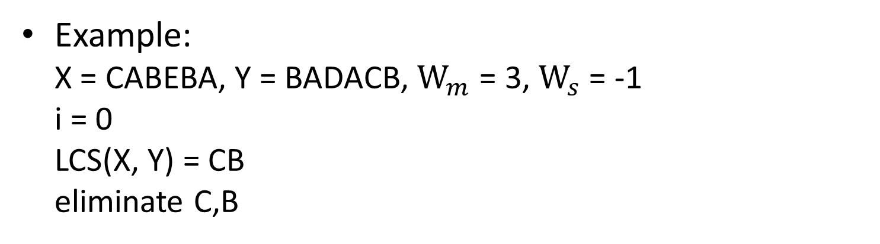
Approximate LACS Algorithm
Example: X = CABEBA, Y = BADACB, $W_{m}$ = 3, $W_{s}$ = -1 i = 0 LCS(X, Y) = CB eliminate C,B
X = C A B E B A
Y = B A D A C B
$A{LACS}_{0}$(X, Y) = Z = CB
g(X, Y, Z, 3,-1) = 2 x 3 + 0 x (-1) = 6

Slide 12
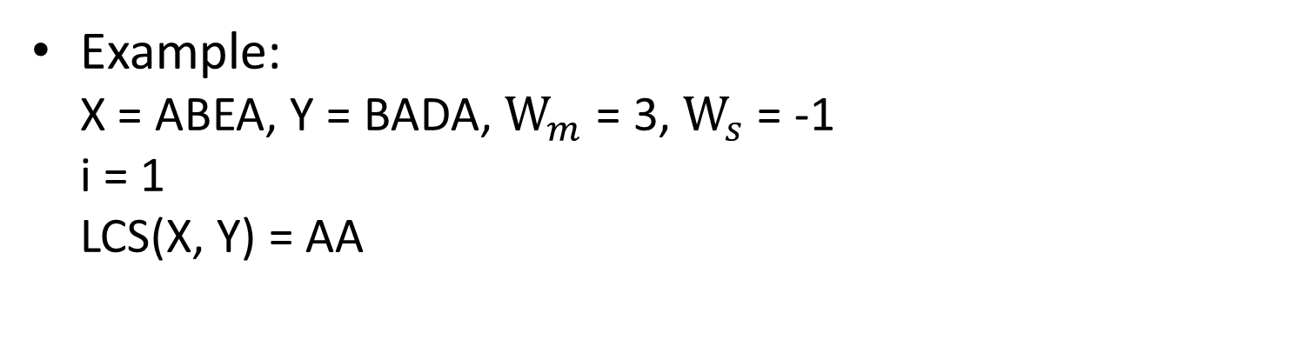
Approximate LACS Algorithm
Example: X = ABEA, Y = BADA, $W_{m}$ = 3, $W_{s}$ = -1 i = 1 LCS(X, Y) = AA
X = C A B E B A
Y = B A D A C B

Slide 13
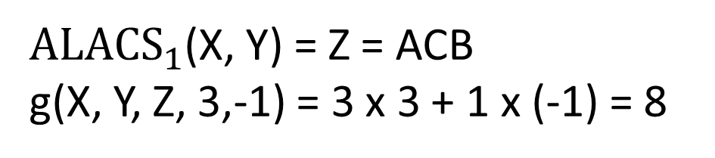
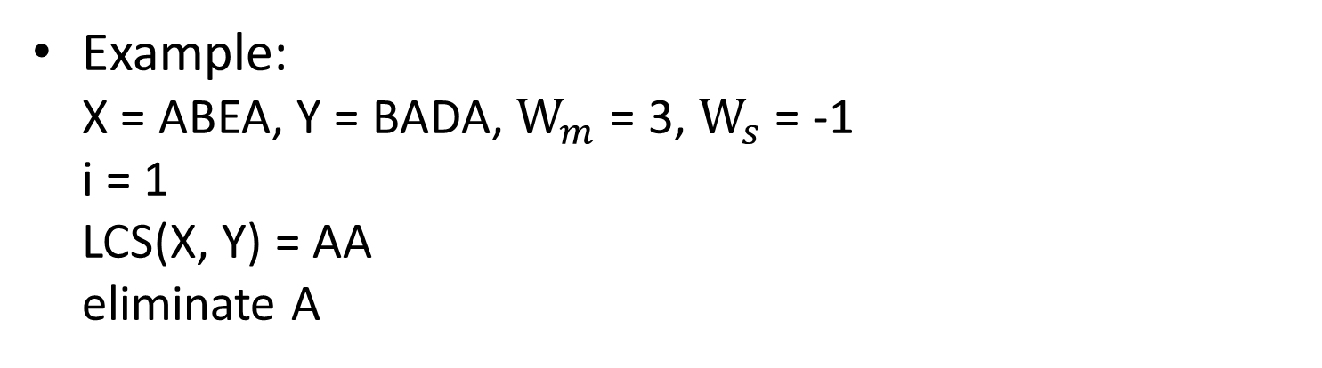
Approximate LACS Algorithm
Example: X = ABEA, Y = BADA, $W_{m}$ = 3, $W_{s}$ = -1 i = 1 LCS(X, Y) = AA eliminate A
X = C A B E B A
Y = B A D A C B
$A{LACS}_{1}$(X, Y) = Z = ACB
g(X, Y, Z, 3,-1) = 3 x 3 + 1 x (-1) = 8

Slide 14
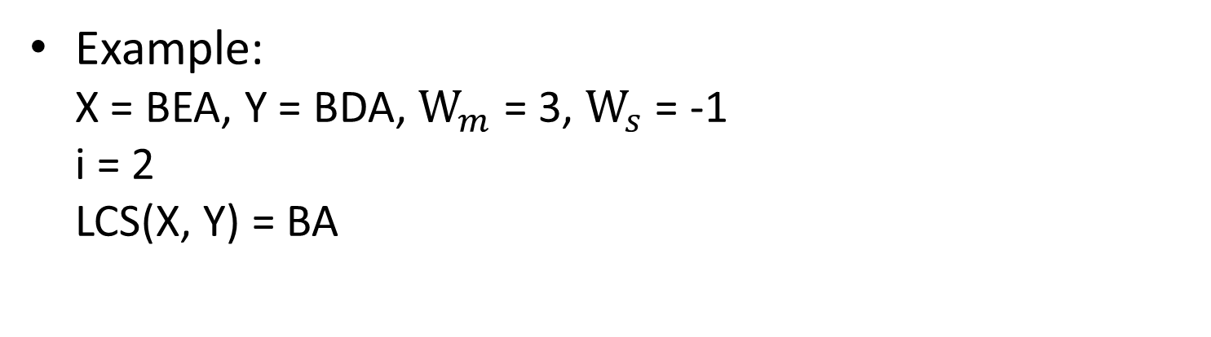
Approximate LACS Algorithm
Example: X = BEA, Y = BDA, $W_{m}$ = 3, $W_{s}$ = -1 i = 2 LCS(X, Y) = BA
X = C A B E B A
Y = B A D A C B

Slide 15
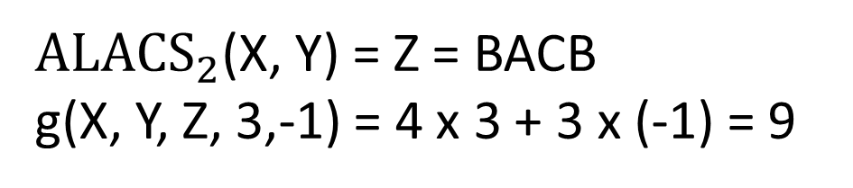
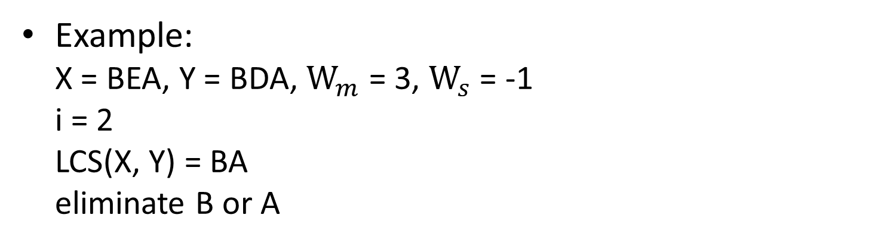
Approximate LACS Algorithm
Example: X = BEA, Y = BDA, $W_{m}$ = 3, $W_{s}$ = -1 i = 2 LCS(X, Y) = BA eliminate B or A
X = C A B E B A
Y = B A D A C B
$A{LACS}_{2}$(X, Y) = Z = BACB
g(X, Y, Z, 3,-1) = 4 x 3 + 3 x (-1) = 9

Slide 16
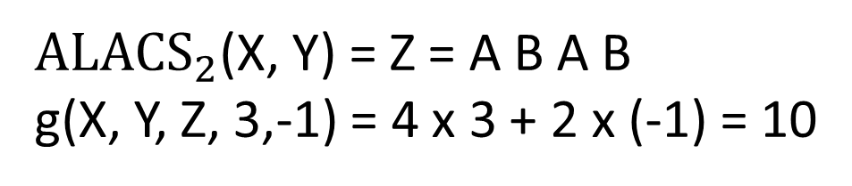
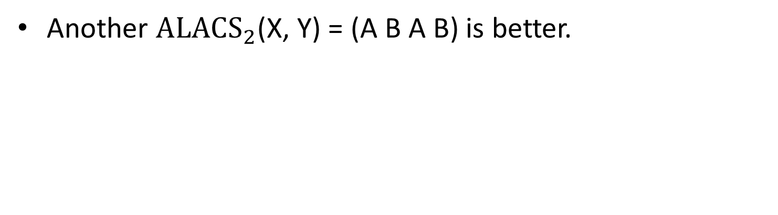
Approximate LACS Algorithm
Another $A{LACS}_{2}$(X, Y) = (A B A B) is better.
X = C A B E B A
Y = B A D A C B
$A{LACS}_{2}$(X, Y) = Z = A B A B
g(X, Y, Z, 3,-1) = 4 x 3 + 2 x (-1) = 10

Slide 17
Artificial Neural Network
Artificial neural networks (ANNs) are computational models inspired by an animal's central nervous systems.
The model includes numerous nodes(also call neurons). Each node denote a specific output function.

Slide 18
Hopfield Neural network
Hopfield nets 每個node之輸入及輸出值皆為二元值
Hopfield net 將輸出值依照threshold輸出， 將輸出值輸入回Hopfiled net 中，直到輸出值收斂

Slide 19
Hopfield Neural network
改造Hopfield neural network 用來解決LACS problem
將輸入字串計算，所得到gain值會趨近於一定值

Slide 20
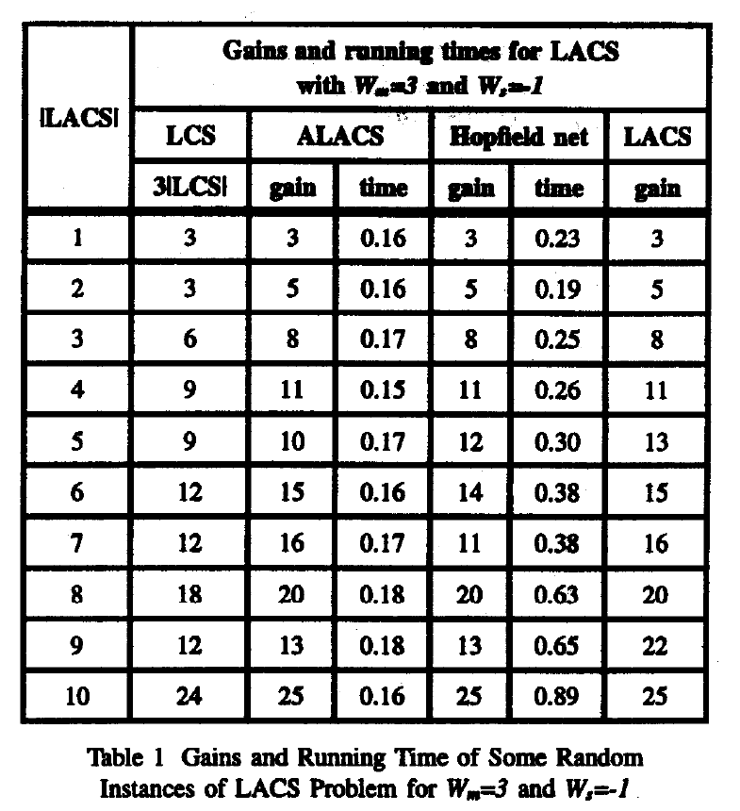
Experimental Results
The output gains of ALACS and Hopfield net are pretty much the same. And the Hopfield net is a little bit poorer. The Hopfield net is much slower, but it requires less memory.

