Slide 1
A hybrid genetic algorithm for the repetition free longest common subsequence problem
Mauro Castelli, Stefano Beretta, Leonardo Vanneschi
Operations Research Letters
Volume 41, Issue 6, November 2013, Pages 644–649
Presenter: Huang-Ting Chan
Date:2014/8/19

Slide 2
Abstract
Computing the longest common subsequence of two sequences is one of the most studied algorithmic problems. In this work we focus on a particular variant of the problem, called repetition free longest common subsequence (RF-LCS), which has been proved to be NP-hard. We propose a hybrid genetic algorithm, which combines standard genetic algorithms and estimation of distribution algorithms, to solve this problem. An experimental comparison with some well-known approximation algorithms shows the suitability of the proposed technique.

Slide 3
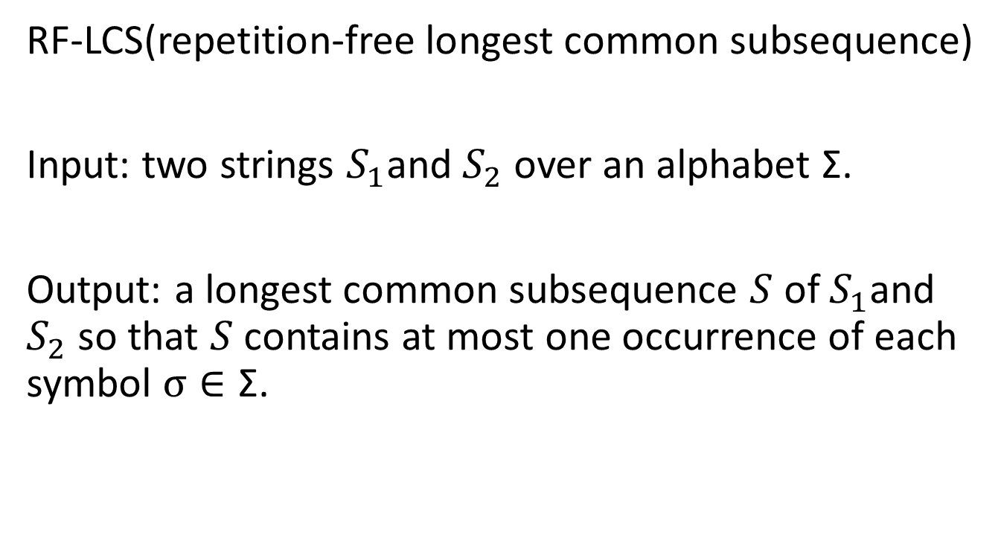
Introduction
RF-LCS(repetition-free longest common subsequence)
Input: two strings $S_{1}$and $S_{2}$ over an alphabet Σ.
Output: a longest common subsequence $S$ of $S_{1}$and $S_{2}$ so that $S$ contains at most one occurrence of each symbol $σ∈\text{Σ}$.

Slide 4
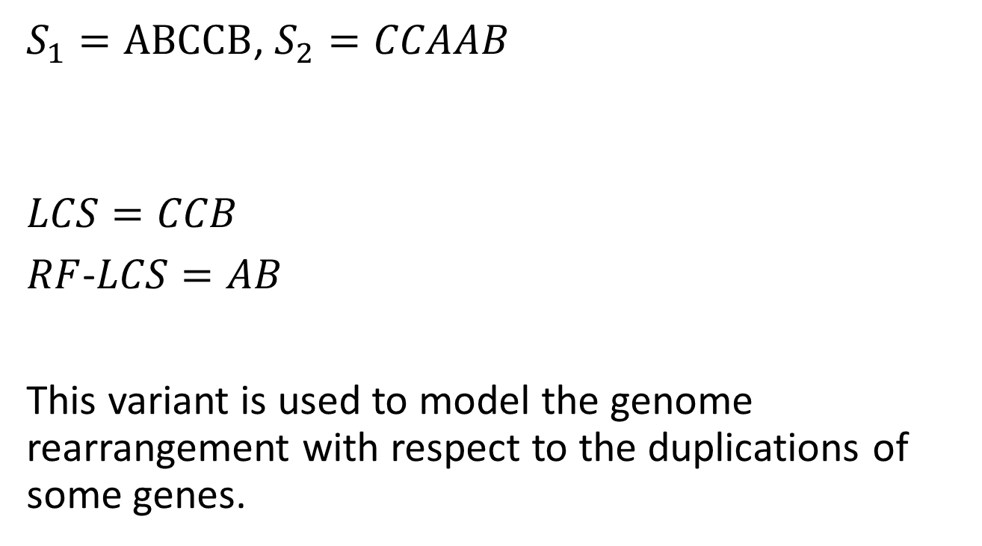
Example
$S_{1}=ABCCB$, $S_{2}=CCAAB$
$$LCS=CCB$$
$RF$-$LCS=AB$
This variant is used to model the genome rearrangement with respect to the duplications of some genes.

Slide 5
Evolution implies that genomes contain multiple copies of a gene.
Exemplar model : for each family of duplicated genes there is an exemplar one, representative gene from which all other genes have originated.

Slide 6
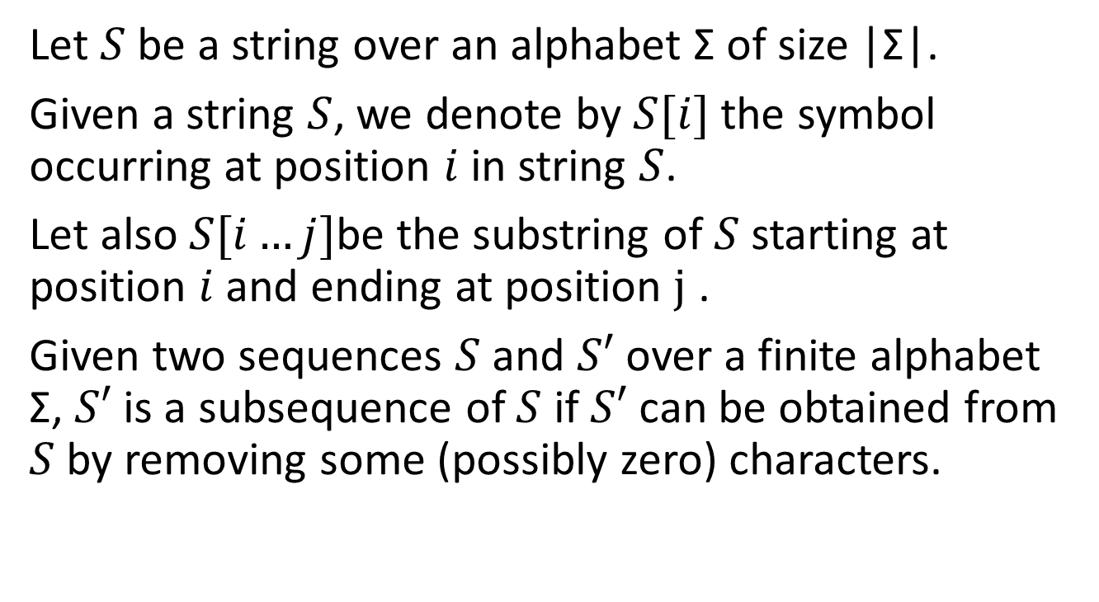
Basic definitions
Let $S$ be a string over an alphabet Σ of size |Σ|.
Given a string $S$, we denote by $S[i]$ the symbol occurring at position $i$ in string $S$.
Let also$S[i…j]$be the substring of $S$ starting at position $i$ and ending at position $j$ .
Given two sequences $S$ and $S′$ over a finite alphabet Σ, $S′$ is a subsequence of $S$ if $S′$ can be obtained from $S$ by removing some (possibly zero) characters.

Slide 7
Genetic algorithm
Genetic Algorithms (GAs) are a class of computational models that mimic the process of natural evolution.
GAs are often viewed as function optimizers although the range of problems to which they have been applied is quite broad.

Slide 8
Populations of chromosomes
Selection according to fitness
Crossover to produce new offspring
Random mutation of new offspring

Slide 9
Population
The chromosomes in a GA population typically take the form of bit strings.
Each locus in the chromosome has two possible alleles: 0 and 1.
Each chromosome (or individual) can be thought of as a point in the search space of candidate solutions.

Slide 10
Fitness function
GAs most often require a fitness function that assigns a score (fitness) to each chromosome in the current population.
The fitness of a chromosome depends on how well that chromosome solves the problem at hand.

Slide 11
Genetic operators
The operators are used to create a new population of chromosomes starting from the existing one (population of parents).
Three operators
Selection
Crossover
Mutation

Slide 12
Selection
The selection operator selects chromosomes in the population for reproduction.
The fitter the chromosome, the more times it is likely to be selected to reproduce.

Slide 13
Crossover
The crossover operator randomly chooses a locus and exchanges the subsequences before and after that locus between two chromosomes to create two offspring.
The crossover operator roughly mimics biological recombination between two single-chromosome (haploid) organisms.

Slide 14
Mutation
The mutation operator randomly flips some of the bits in a chromosome.
Mutation can occur at each bit position in a string with some probability, usually very small (e.g., 0.001).

Slide 15
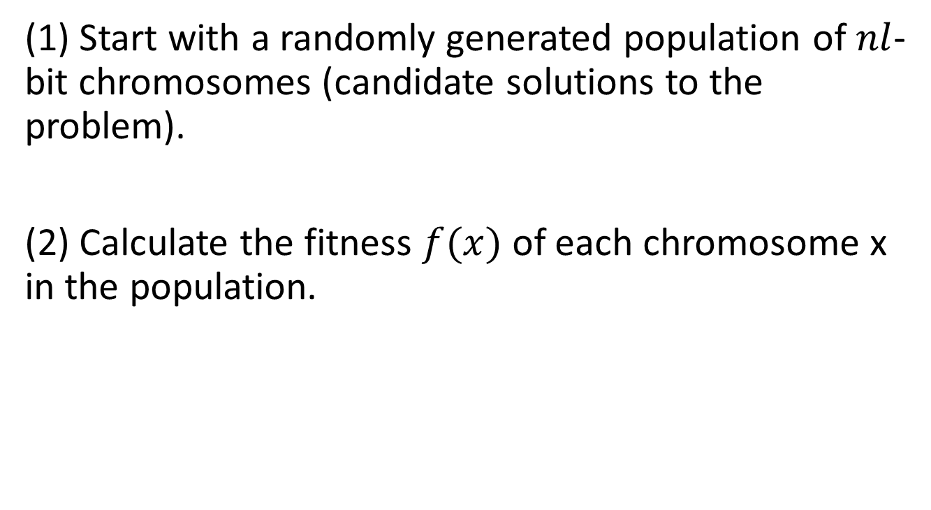
Genetic algorithm
(1) Start with a randomly generated population of $nl$-bit chromosomes (candidate solutions to the problem).
(2) Calculate the fitness $f(x)$ of each chromosome x in the population.

Slide 16
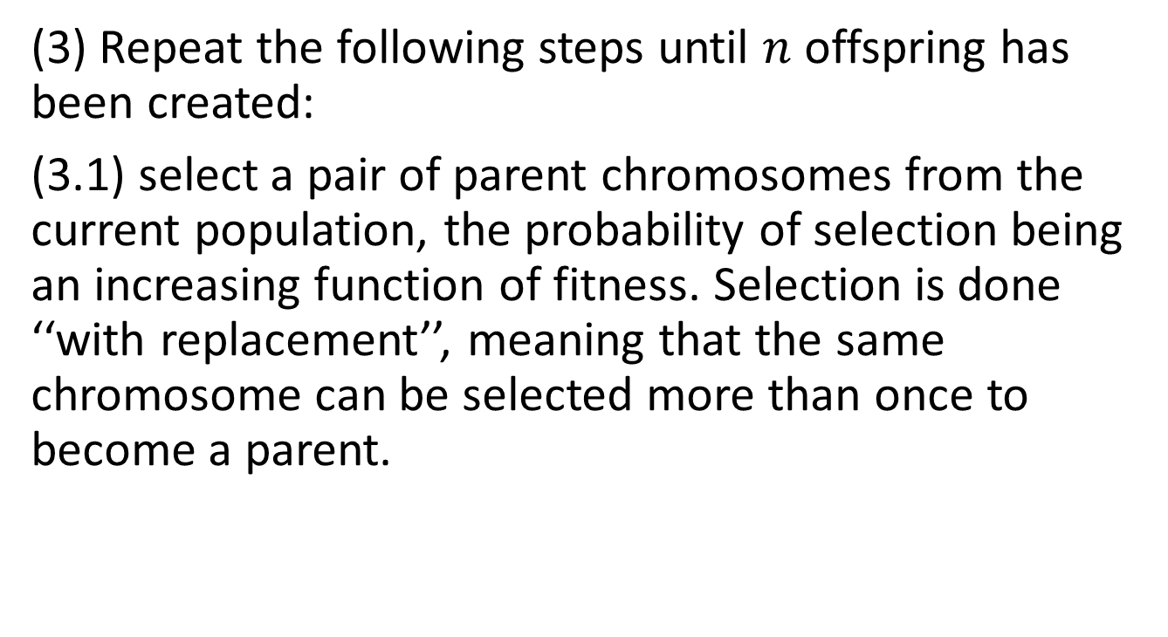
(3) Repeat the following steps until $n$ offspring has been created:
(3.1) select a pair of parent chromosomes from the current population, the probability of selection being an increasing function of fitness. Selection is done ‘‘with replacement’’, meaning that the same chromosome can be selected more than once to become a parent.

Slide 17
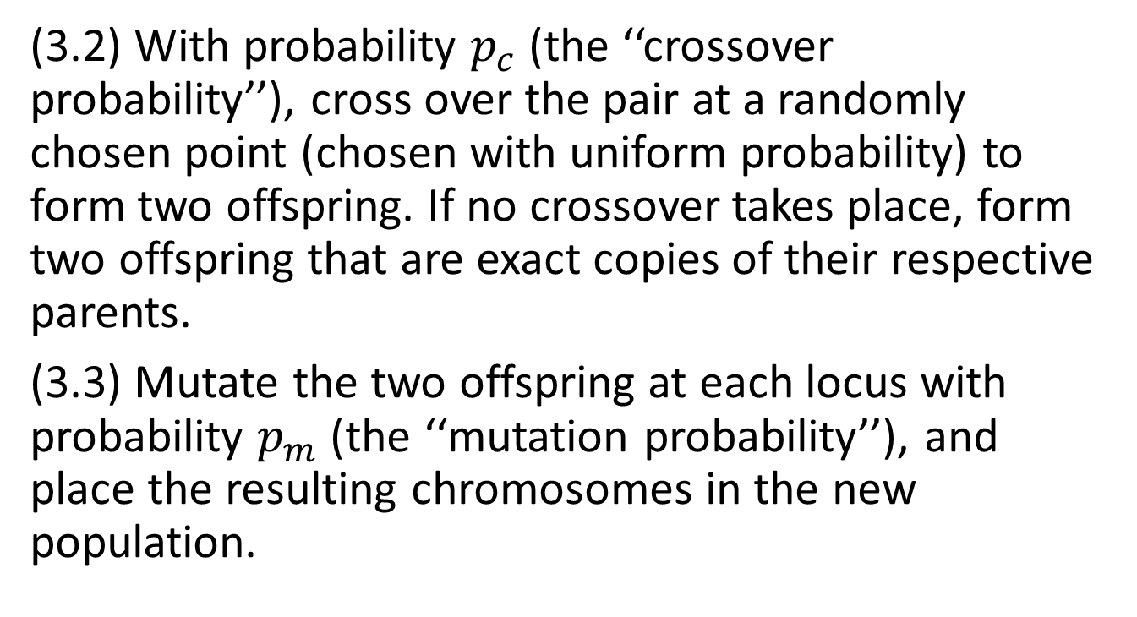
(3.2) With probability $p_{c}$ (the ‘‘crossover probability’’), cross over the pair at a randomly chosen point (chosen with uniform probability) to form two offspring. If no crossover takes place, form two offspring that are exact copies of their respective parents.
(3.3) Mutate the two offspring at each locus with probability $p_{m}$ (the ‘‘mutation probability’’), and place the resulting chromosomes in the new population.

Slide 18
(4) Replace the current population with the new population, and repeat from Step 2 until a certain number of generations have been performed (or other termination criteria are met).
Each iteration of this process is called a generation

Slide 19
EDA
EDA(estimation of distribution algorithm)
From an abstract point of view, the selected set of promising solutions can be viewed as a sample drawn from a probability distribution.
Although the true probability distribution is unknown, there are algorithms that are able to estimate that probability distribution by using the selected set of solutions itself and use this estimate to generate new solutions.

Slide 20
Then, the true probability distribution of the selected set of solutions is estimated and new solutions are generated according to this estimate.
The new solutions are then added into the original population, replacing some of the old ones. The process is repeated until the termination criteria are met.

Slide 21
EDAs therefore do the same as GAs except for that they replace genetic crossover and mutation operators by the following two steps:
a model (an estimate of the true distribution) of selected promising solutions is constructed.
new solutions are generated according to the constructed model.
Hence, while in GAs (and other heuristics from evolutionary computation) the interrelations between the different variables representing the individuals are kept in mind implicitly in EDAs the interrelations are expressed explicitly through the probability distribution associated with the individuals selected at each iteration.

Slide 22
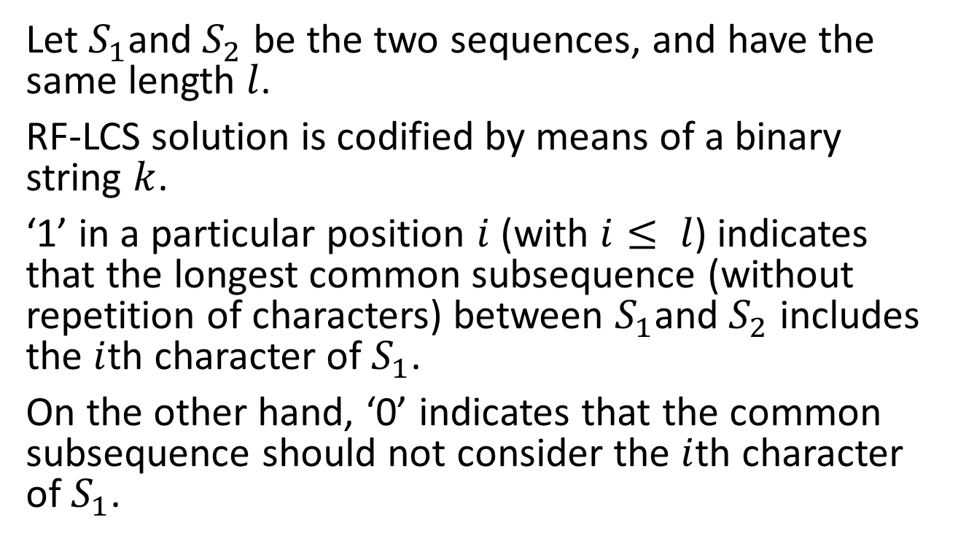
Method
Let $S_{1}$and $S_{2}$ be the two sequences, and have the same length $l$.
RF-LCS solution is codified by means of a binary string $k$.
‘1’ in a particular position $i$(with $i≤ l$) indicates that the longest common subsequence (without repetition of characters) between $S_{1}$and $S_{2}$ includes the $i$th character of $S_{1}$.
On the other hand, ‘0’ indicates that the common subsequence should not consider the $i$th character of $S_{1}$.

Slide 23
Given an initial population P of N chromosomes, the standard GA is used to build a new population of candidate solutions. It is not possible to guarantee that a particular character will appear only once in the common subsequence.
penalize the repetition of a particular character
consider a specific mechanism able to guarantee that all the chromosomes in the population satisfy the constraint of the RF-LCS problem.

Slide 24
First, integrating this penalty in the fitness function. This approach is not easy because the definition of the fitness function is the key point for a successful use of the GA, and the inclusion of a penalty mechanism makes this definition more tricky and complicated.

Slide 25
Second, the approach used in this paper considers EDA. The idea is to estimate the distribution of promising solutions assuming that the variables in the problem are independent and to look at the values of each variable regardless of the remaining solutions.

Slide 26
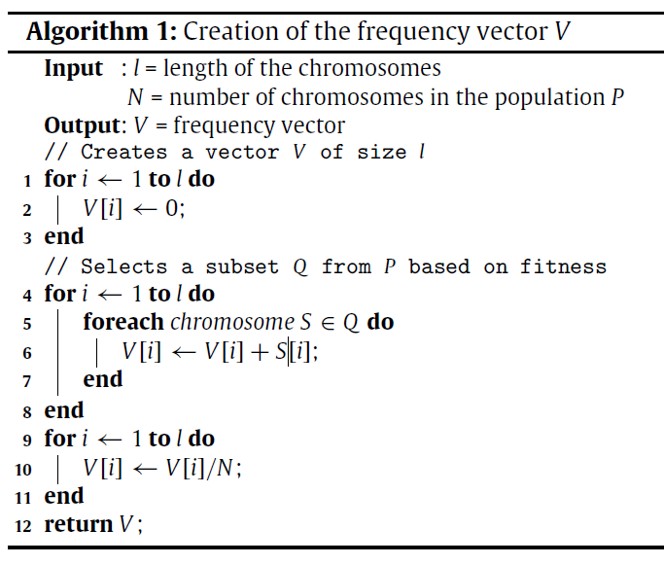

Slide 27
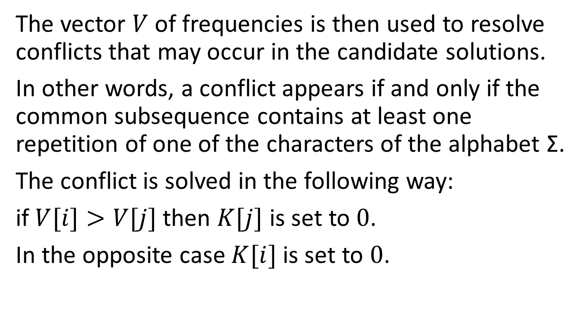
The vector $V$ of frequencies is then used to resolve conflicts that may occur in the candidate solutions.
In other words, a conflict appears if and only if the common subsequence contains at least one repetition of one of the characters of the alphabet Σ.
The conflict is solved in the following way:
if $V[i]>V[j]$then $K[j]$ is set to $0$.
In the opposite case $K[i]$ is set to $0$.

Slide 28

1. Start with a randomly generated population of $N l$-bit chromosomes(candidate solutions to the problem) where the conflicts are randomly resolved.
2. Calculate the fitness $f(x)$ of each chromosome $x$ in the population.

Slide 29
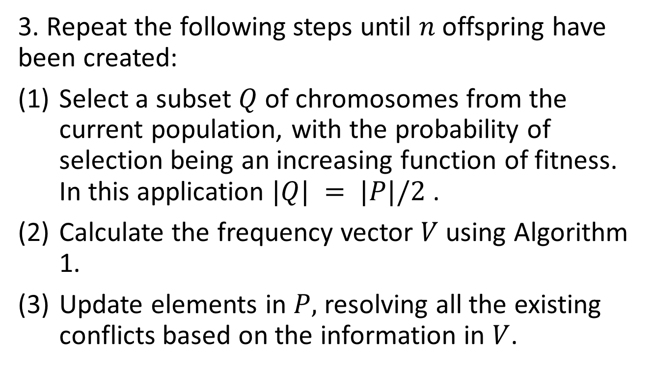
3. Repeat the following steps until $n$offspring have been created:
Select a subset $Q$ of chromosomes from the current population, with the probability of selection being an increasing function of fitness. In this application $|Q| = |P|/2$.
Calculate the frequency vector $V$ using Algorithm 1.
Update elements in $P,$ resolving all the existing conflicts based on the information in $V$.

Slide 30
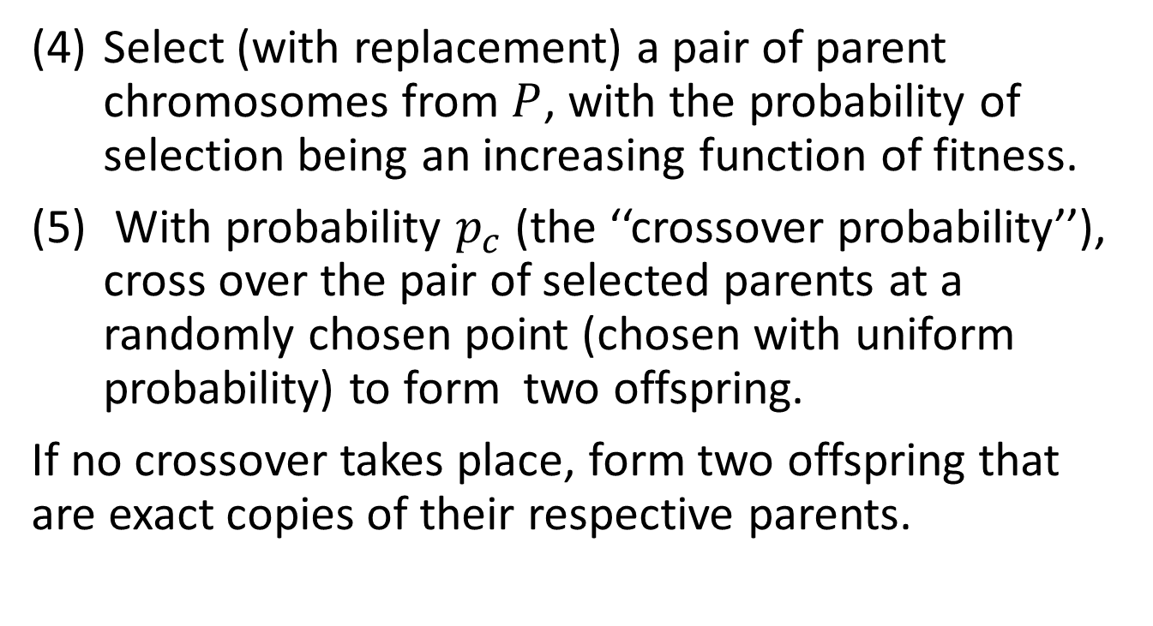
Select (with replacement) a pair of parent chromosomes from $P$, with the probability of selection being an increasing function of fitness.
With probability $p_{c}$ (the ‘‘crossover probability’’), cross over the pair of selected parents at a randomly chosen point (chosen with uniform probability) to form two offspring.
If no crossover takes place, form two offspring that are exact copies of their respective parents.

Slide 31
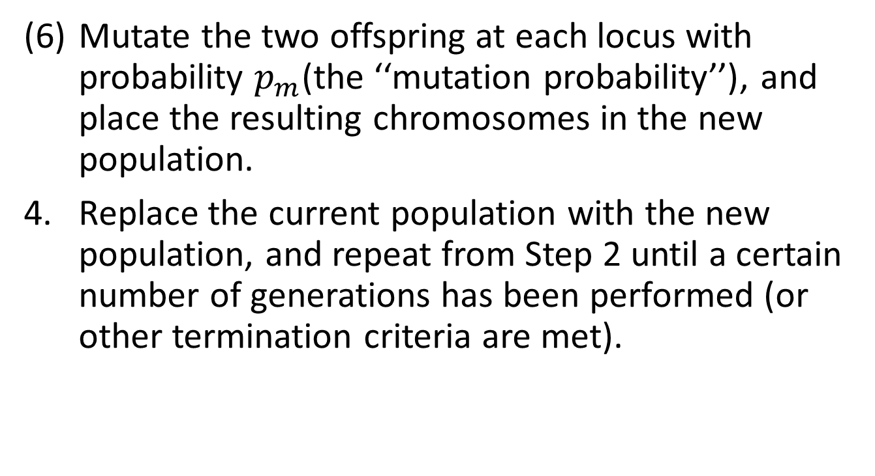
Mutate the two offspring at each locus with probability $p_{m}$(the ‘‘mutation probability’’), and place the resulting chromosomes in the new population.
Replace the current population with the new population, and repeat from Step 2 until a certain number of generations has been performed (or other termination criteria are met).

Slide 32
All the runs used populations of 100 individuals and the evolution stopped after 1000 generations.
Candidate solutions are represented as binary strings of length equal to the length of the sequences.
Individuals are randomly generated, with a probability of having 0 or 1 in a specific locus equal to 0.5. To create new individuals, one point crossover and flip mutation with probabilities equal to 0.9 and 0.05, respectively, have been used.

Slide 33
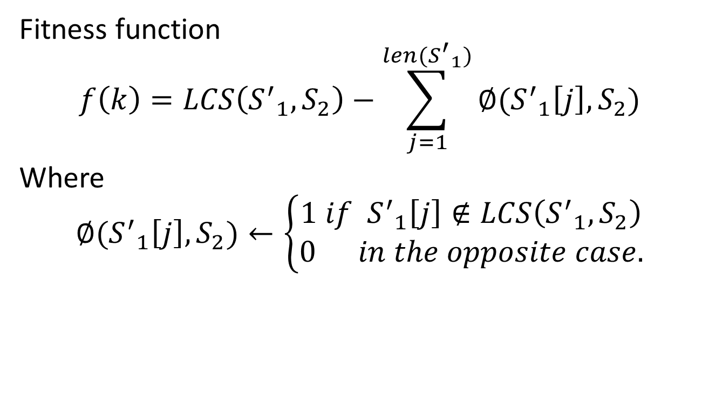
Fitness function
$$f\left(k\right)=LCS\left({S^{′}}_{1},S_{2}\right)−\sum_{j=1}^{len({S^{′}}_{1})}{∅({S^{′}}_{1}\left[j\right],S_{2})}$$
Where
$$∅({S^{′}}_{1}\left[j\right],S_{2})←\left\{\begin{aligned}1 if{{ S}^{′}}_{1}\left[j\right]∉LCS\left({S^{′}}_{1},S_{2}\right) \\ 0 in the opposite case.\end{aligned}\right.$$

Slide 34
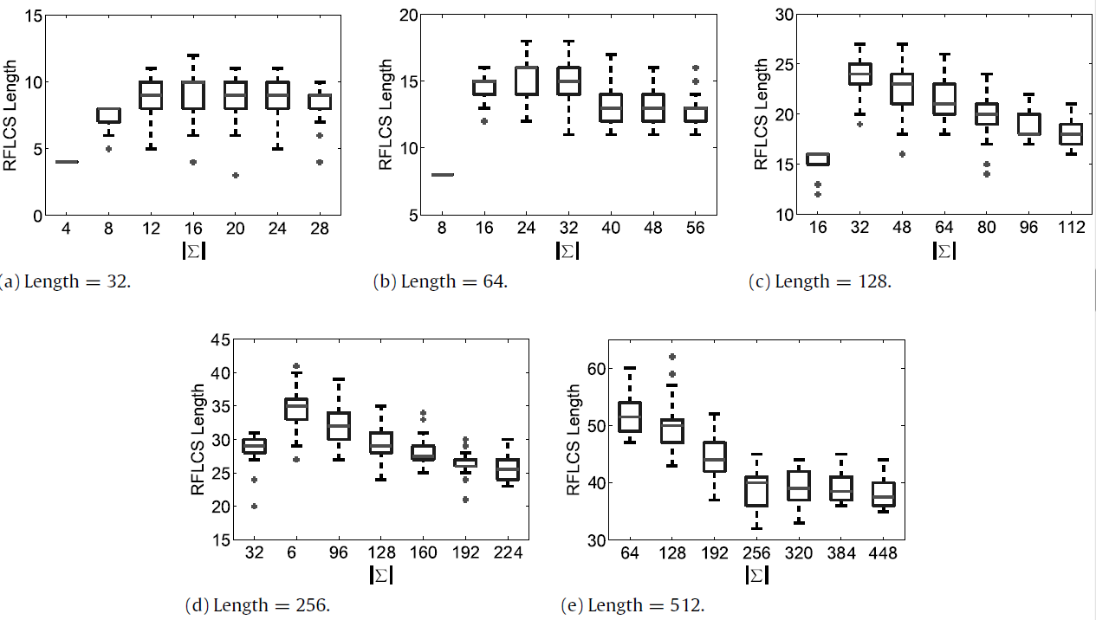

Slide 35
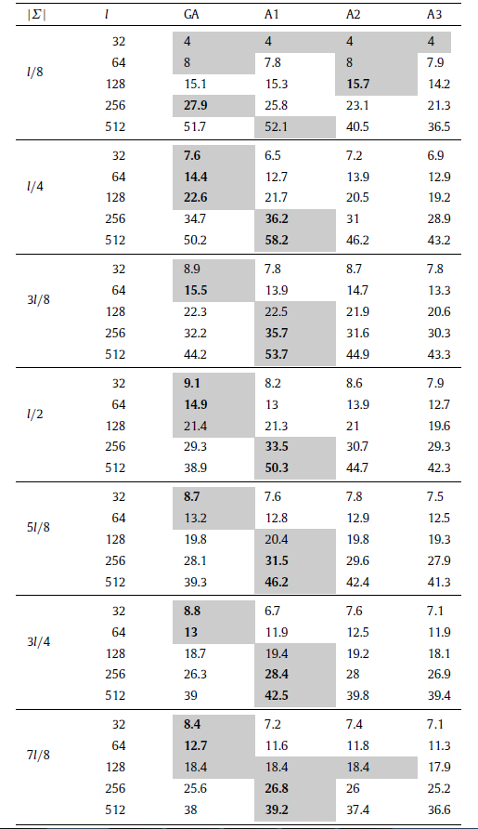

Slide 36
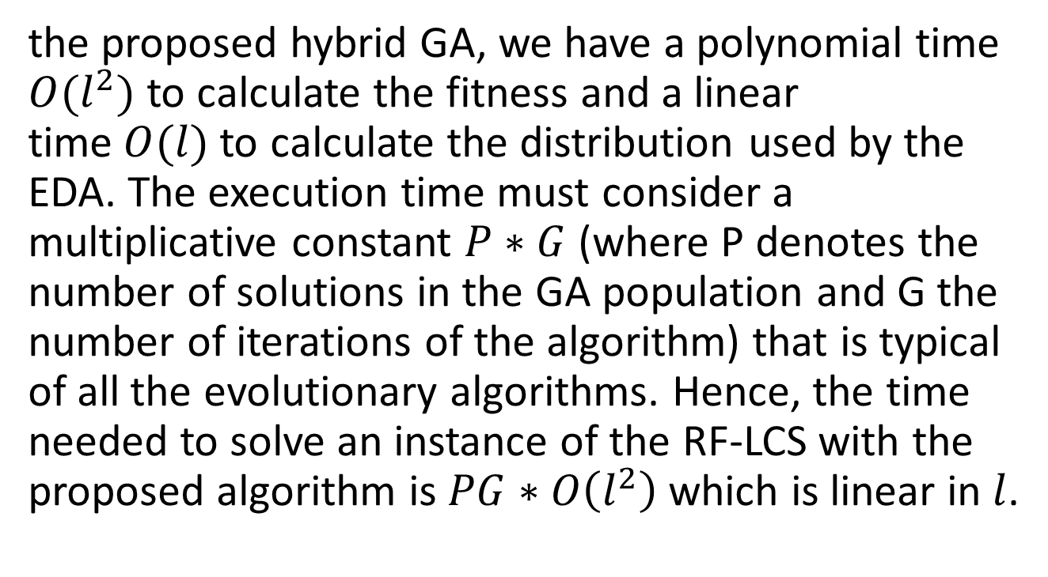
the proposed hybrid GA, we have a polynomial time $O(l^{2})$ to calculate the fitness and a linear time$O(l)$to calculate the distribution used by the EDA. The execution time must consider a multiplicative constant $P∗G$(where P denotes the number of solutions in the GA population and G the number of iterations of the algorithm) that is typical of all the evolutionary algorithms. Hence, the time needed to solve an instance of the RF-LCS with the proposed algorithm is $PG∗O\left(l^{2}\right)$ which is linear in $l$.

