Slide 1
New Approximation Algorithms for Longest Common Subsequences
Lasse Bergroth, Harri Hakonen, and Timo Raita String Processing and Information Retrieval: A South American Symposium, 1998. Proceedings page 32-40

Slide 2
Abstract
This paper focuses on finding approximations for the longest common subsequence (LCS) of two strings. Most methods which calculate an approximation for the more general problem accepting N (N ≧ 3) input strings, give typically trivial results for the restricted case under study. Because of the small number of reliable existing heuristics, we introduce several new ones in this survey.
Majority of the presented algorithms give a lower bound for the LCS. Thus they can be used, for example, as a filter to decide quickly, if a more detailed, space- and time consuming study is needed. A lower bound can also be used to limit the search space of an exact LCS method effectively. The upper bounds complement the information about the true LCS; they form a basis to make a judgement about the reliability of a lower bound. Extensive tests have been carried out to show the strengths of the heuristics and a discussion about their role in various environments is given.

Slide 3
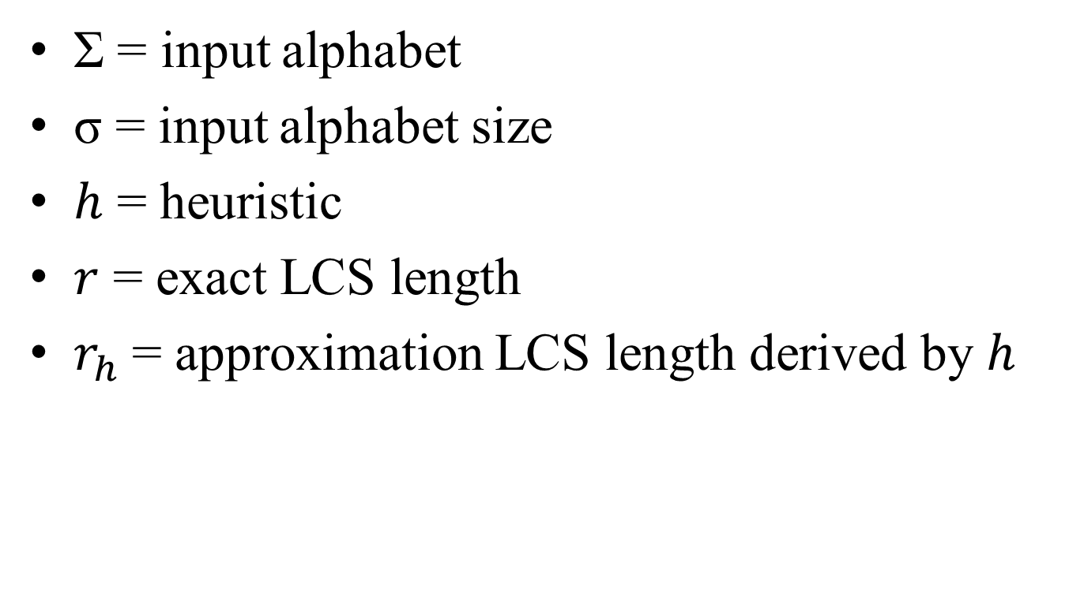
Introduction
Σ = input alphabet
σ = input alphabet size
$h$ = heuristic
$r$ = exact LCS length
$r_{h}$ = approximation LCS length derived by $h$

Slide 4
Upper Bounds
Mapping symbols of Σ into equivalence classes.
Solving independent subproblems.
Loosening the order of symbols.

Slide 5
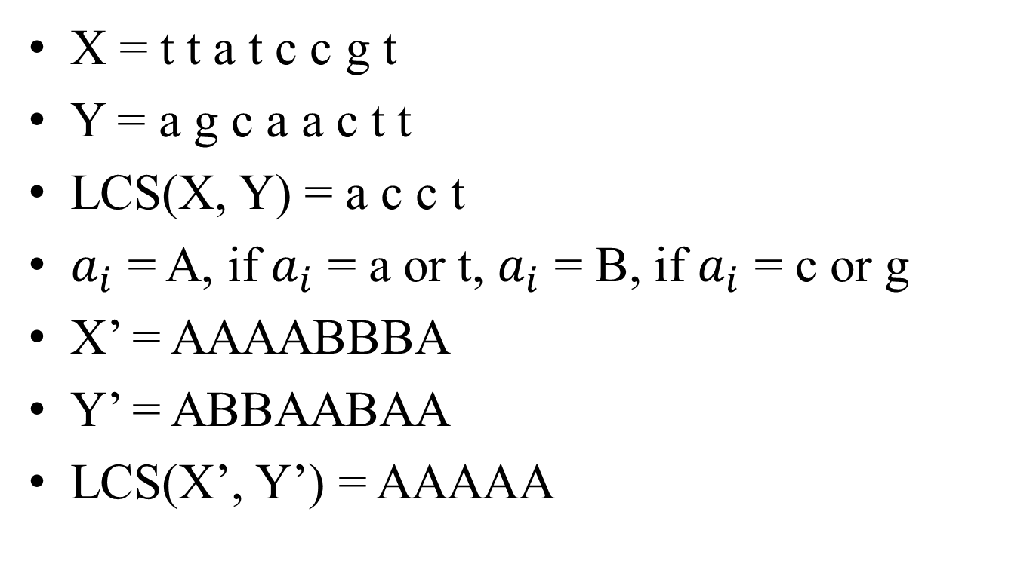
Mapping Symbols
X = t t a t c c g t
Y = a g c a a c t t
LCS(X, Y) = a c c t
$a_{i}$ = A, if $a_{i}$ = a or t, $a_{i}$ = B, if $a_{i}$ = c or g
X’ = AAAABBBA
Y’ = ABBAABAA
LCS(X’, Y’) = AAAAA

Slide 6
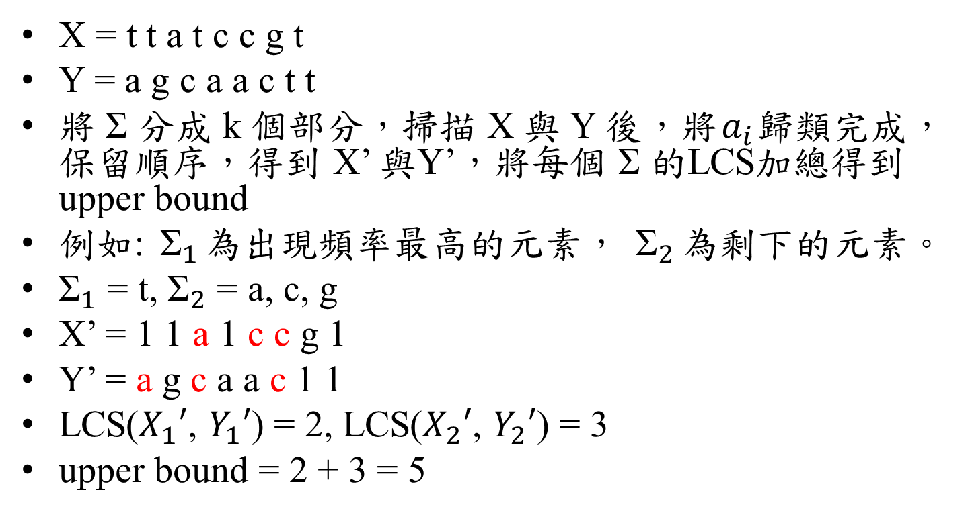
Solving Independent Subproblems
X = t t a t c c g t
Y = a g c a a c t t
將 Σ 分成 k 個部分，掃描 X 與 Y 後，將$a_{i}$歸類完成，保留順序，得到 X’ 與Y’，將每個 Σ 的LCS加總得到upper bound
例如: ${\text{Σ}}_{1}$為出現頻率最高的元素， ${\text{Σ}}_{2}$為剩下的元素。
${\text{Σ}}_{1}$ = t, ${\text{Σ}}_{2}$ = a, c, g
X’ = 1 1 a 1 c c g 1
Y’ = a g c a a c 1 1
LCS($X_{1}′$, $Y_{1}′$) = 2, LCS($X_{2}′$, $Y_{2}′$) = 3
upper bound = 2 + 3 = 5

Slide 7
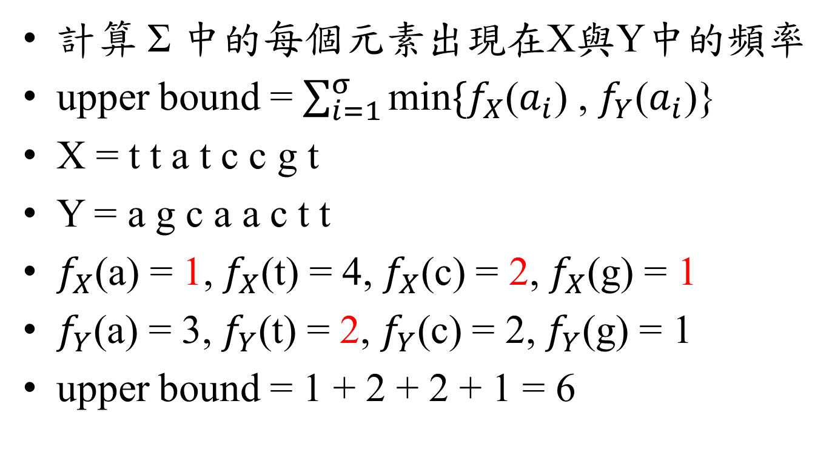
Loosening the Order of the Symbols
計算 Σ 中的每個元素出現在X與Y中的頻率
upper bound = $\sum_{i=1}^{σ}{\text{min}\{f_{X}\text{(}a_{i}\text{) , }f_{Y}\text{(}a_{i}\text{)}\text{\}} }$
X = t t a t c c g t
Y = a g c a a c t t
$f_{X}$(a) = 1, $f_{X}$(t) = 4, $f_{X}$(c) = 2, $f_{X}$(g) = 1
$f_{Y}$(a) = 3, $f_{Y}$(t) = 2, $f_{Y}$(c) = 2, $f_{Y}$(g) = 1
upper bound = 1 + 2 + 2 + 1 = 6

Slide 8
Lower Bounds
The symbol of maximum frequency.
Cnt heuristic.
Best next heuristic.
From an upper bound to a lower bound: the mapping technique.
Reducing the lengths of the input strings.
An approach used in biosequence comparison.

Slide 9
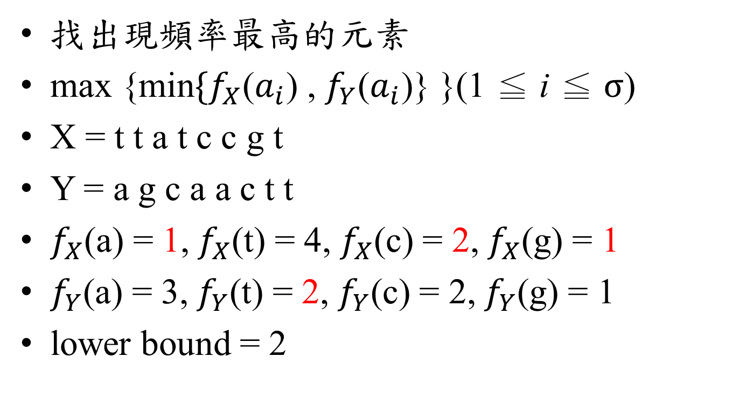
The Symbol of maximum frequency
找出現頻率最高的元素
$\text{max}\text{ \{}\text{min}\{f_{X}\text{(}a_{i}\text{) , }f_{Y}\text{(}a_{i}\text{)\}}\text{ \}}$(1 ≦ i ≦ $σ$)
X = t t a t c c g t
Y = a g c a a c t t
$f_{X}$(a) = 1, $f_{X}$(t) = 4, $f_{X}$(c) = 2, $f_{X}$(g) = 1
$f_{Y}$(a) = 3, $f_{Y}$(t) = 2, $f_{Y}$(c) = 2, $f_{Y}$(g) = 1
lower bound = 2

Slide 10
Cnt Heuristic
計算每個元素的出現頻率
從頭開始掃描X與Y，若當下元素相同，則將該元素加入CS中，且指標同時 + 1，若當下元素不同，則元素出現頻率較少的指標 + 1，直到X或Y結束。

Slide 11

Cnt Heuristic
X = t t a t c c g t
Y = a g c a a c t t
$f_{X}$(a) = 1, $f_{X}$(t) = 4, $f_{X}$(c) = 2, $f_{X}$(g) = 1
$f_{Y}$(a) = 3, $f_{Y}$(t) = 2, $f_{Y}$(c) = 2, $f_{Y}$(g) = 1
 | o
X | t | t | a | t | c | c | g | t
Y | a | g | c | a | a | c | t | t
 | o
CS

Slide 12
Cnt Heuristic
X = t t a t c c g t
Y = a g c a a c t t
$f_{X}$(a) = 1, $f_{X}$(t) = 4, $f_{X}$(c) = 2, $f_{X}$(g) = 1
$f_{Y}$(a) = 3, $f_{Y}$(t) = 2, $f_{Y}$(c) = 2, $f_{Y}$(g) = 1
 | o
X | t | t | a | t | c | c | g | t
Y | a | g | c | a | a | c | t | t
 |  | o
CS

Slide 13
Cnt Heuristic
X = t t a t c c g t
Y = a g c a a c t t
$f_{X}$(a) = 1, $f_{X}$(t) = 4, $f_{X}$(c) = 2, $f_{X}$(g) = 1
$f_{Y}$(a) = 3, $f_{Y}$(t) = 2, $f_{Y}$(c) = 2, $f_{Y}$(g) = 1
 | o
X | t | t | a | t | c | c | g | t
Y | a | g | c | a | a | c | t | t
 |  |  | o
CS

Slide 14
Cnt Heuristic
X = t t a t c c g t
Y = a g c a a c t t
$f_{X}$(a) = 1, $f_{X}$(t) = 4, $f_{X}$(c) = 2, $f_{X}$(g) = 1
$f_{Y}$(a) = 3, $f_{Y}$(t) = 2, $f_{Y}$(c) = 2, $f_{Y}$(g) = 1
 | o
X | t | t | a | t | c | c | g | t
Y | a | g | c | a | a | c | t | t
 |  |  |  | o
CS

Slide 15
Cnt Heuristic
X = t t a t c c g t
Y = a g c a a c t t
$f_{X}$(a) = 1, $f_{X}$(t) = 4, $f_{X}$(c) = 2, $f_{X}$(g) = 1
$f_{Y}$(a) = 3, $f_{Y}$(t) = 2, $f_{Y}$(c) = 2, $f_{Y}$(g) = 1
 | o
X | t | t | a | t | c | c | g | t
Y | a | g | c | a | a | c | t | t
 |  |  |  |  | o
CS

Slide 16
Cnt Heuristic
X = t t a t c c g t
Y = a g c a a c t t
$f_{X}$(a) = 1, $f_{X}$(t) = 4, $f_{X}$(c) = 2, $f_{X}$(g) = 1
$f_{Y}$(a) = 3, $f_{Y}$(t) = 2, $f_{Y}$(c) = 2, $f_{Y}$(g) = 1
 | o
X | t | t | a | t | c | c | g | t
Y | a | g | c | a | a | c | t | t
 |  |  |  |  |  | o
CS

Slide 17
Cnt Heuristic
X = t t a t c c g t
Y = a g c a a c t t
$f_{X}$(a) = 1, $f_{X}$(t) = 4, $f_{X}$(c) = 2, $f_{X}$(g) = 1
$f_{Y}$(a) = 3, $f_{Y}$(t) = 2, $f_{Y}$(c) = 2, $f_{Y}$(g) = 1
 | o
X | t | t | a | t | c | c | g | t
Y | a | g | c | a | a | c | t | t
 |  |  |  |  |  |  | o
CS | t

Slide 18
Cnt Heuristic
X = t t a t c c g t
Y = a g c a a c t t
$f_{X}$(a) = 1, $f_{X}$(t) = 4, $f_{X}$(c) = 2, $f_{X}$(g) = 1
$f_{Y}$(a) = 3, $f_{Y}$(t) = 2, $f_{Y}$(c) = 2, $f_{Y}$(g) = 1
 |  | o
X | t | t | a | t | c | c | g | t
Y | a | g | c | a | a | c | t | t
 |  |  |  |  |  |  |  | o
CS | t | t

Slide 19



Best Next Heuristic
定義元素下一次出現的位置為${pos}_{X}(a_{i})$與${pos}_{Y}(a_{i})$，指標的下一個的位置是最大的min{$m−{pos}_{X}(a_{i})$, $n−{pos}_{Y}(a_{i})$}
X = t t a t c c g t
Y = a g c a a c t t
${pos}_{X}(a_{i})$, ${pos}_{Y}(a_{i})$
 | a | t | c | g
X | 3 | 1 | 5 | 7
Y | 1 | 7 | 3 | 2
o
X | t | t | a | t | c | c | g | t
Y | a | g | c | a | a | c | t | t
o
m-${pos}_{X}(a_{i})$, n-${pos}_{Y}(a_{i})$
 | a | t | c | g
X | 5 | 7 | 3 | 1
Y | 7 | 1 | 5 | 6
CS

Slide 20
Best Next Heuristic
定義元素下一次出現的位置為${pos}_{X}(a_{i})$與${pos}_{Y}(a_{i})$，指標的下一個的位置是最大的min{$m−{pos}_{X}(a_{i})$, $n−{pos}_{Y}(a_{i})$}
X = t t a t c c g t
Y = a g c a a c t t
${pos}_{X}(a_{i})$, ${pos}_{Y}(a_{i})$
 | a | t | c | g
X | 9 | 5 | 5 | 7
Y | 4 | 7 | 6 | 2
 |  |  | o
X | t | t | a | t | c | c | g | t
Y | a | g | c | a | a | c | t | t
 | o
m-${pos}_{X}(a_{i})$, n-${pos}_{Y}(a_{i})$
 | a | t | c | g
X | -1 | 3 | 3 | 1
Y | 4 | 1 | 2 | 6
CS | a

Slide 21
Best Next Heuristic
定義元素下一次出現的位置為${pos}_{X}(a_{i})$與${pos}_{Y}(a_{i})$，指標的下一個的位置是最大的min{$m−{pos}_{X}(a_{i})$, $n−{pos}_{Y}(a_{i})$}
X = t t a t c c g t
Y = a g c a a c t t
${pos}_{X}(a_{i})$, ${pos}_{Y}(a_{i})$
 | a | t | c | g
X | 9 | 8 | 6 | 7
Y | 4 | 7 | 6 | 9
 |  |  |  |  | o
X | t | t | a | t | c | c | g | t
Y | a | g | c | a | a | c | t | t
 |  |  | o
m-${pos}_{X}(a_{i})$, n-${pos}_{Y}(a_{i})$
 | a | t | c | g
X | -1 | 0 | 2 | 1
Y | 4 | 1 | 2 | -1
CS | a | c

Slide 22
Best Next Heuristic
定義元素下一次出現的位置為${pos}_{X}(a_{i})$與${pos}_{Y}(a_{i})$，指標的下一個的位置是最大的min{$m−{pos}_{X}(a_{i})$, $n−{pos}_{Y}(a_{i})$}
X = t t a t c c g t
Y = a g c a a c t t
${pos}_{X}(a_{i})$, ${pos}_{Y}(a_{i})$
 | a | t | c | g
X | 9 | 8 | 9 | 7
Y | 9 | 7 | 9 | 9
 |  |  |  |  |  | o
X | t | t | a | t | c | c | g | t
Y | a | g | c | a | a | c | t | t
 |  |  |  |  |  | o
m-${pos}_{X}(a_{i})$, n-${pos}_{Y}(a_{i})$
 | a | t | c | g
X | -1 | 0 | -1 | 1
Y | -1 | 1 | -1 | -1
CS | a | c | c

Slide 23
Best Next Heuristic
定義元素下一次出現的位置為${pos}_{X}(a_{i})$與${pos}_{Y}(a_{i})$，指標的下一個的位置是最大的min{$m−{pos}_{X}(a_{i})$, $n−{pos}_{Y}(a_{i})$}
X = t t a t c c g t
Y = a g c a a c t t
${pos}_{X}(a_{i})$, ${pos}_{Y}(a_{i})$
 | a | t | c | g
X | 9 | 9 | 9 | 9
Y | 9 | 8 | 9 | 9
 |  |  |  |  |  |  |  | o
X | t | t | a | t | c | c | g | t
Y | a | g | c | a | a | c | t | t
 |  |  |  |  |  |  | o
m-${pos}_{X}(a_{i})$, n-${pos}_{Y}(a_{i})$
 | a | t | c | g
X | -1 | -1 | -1 | -1
Y | -1 | 1 | -1 | -1
CS | a | c | c | t

Slide 24
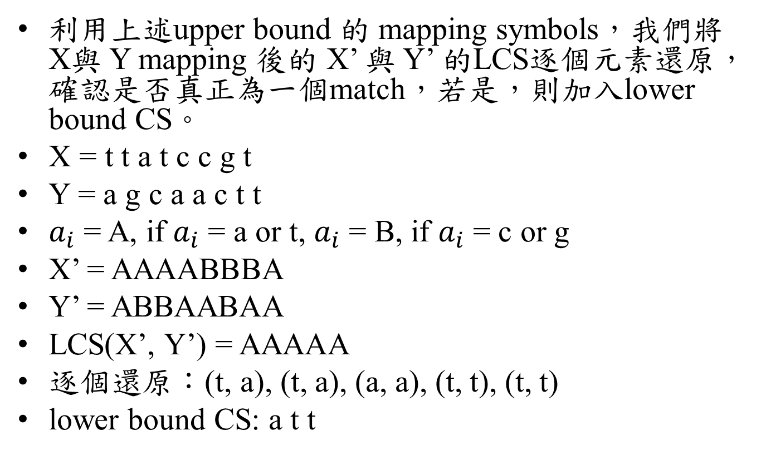
From an Upper Bound to a Lower Bound: the Mapping Technique
利用上述upper bound 的 mapping symbols，我們將 X與 Y mapping 後的 X’ 與 Y’ 的LCS逐個元素還原，確認是否真正為一個match，若是，則加入lower bound CS。
X = t t a t c c g t
Y = a g c a a c t t
$a_{i}$ = A, if $a_{i}$ = a or t, $a_{i}$ = B, if $a_{i}$ = c or g
X’ = AAAABBBA
Y’ = ABBAABAA
LCS(X’, Y’) = AAAAA
逐個還原：(t, a), (t, a), (a, a), (t, t), (t, t)
lower bound CS: a t t

Slide 25
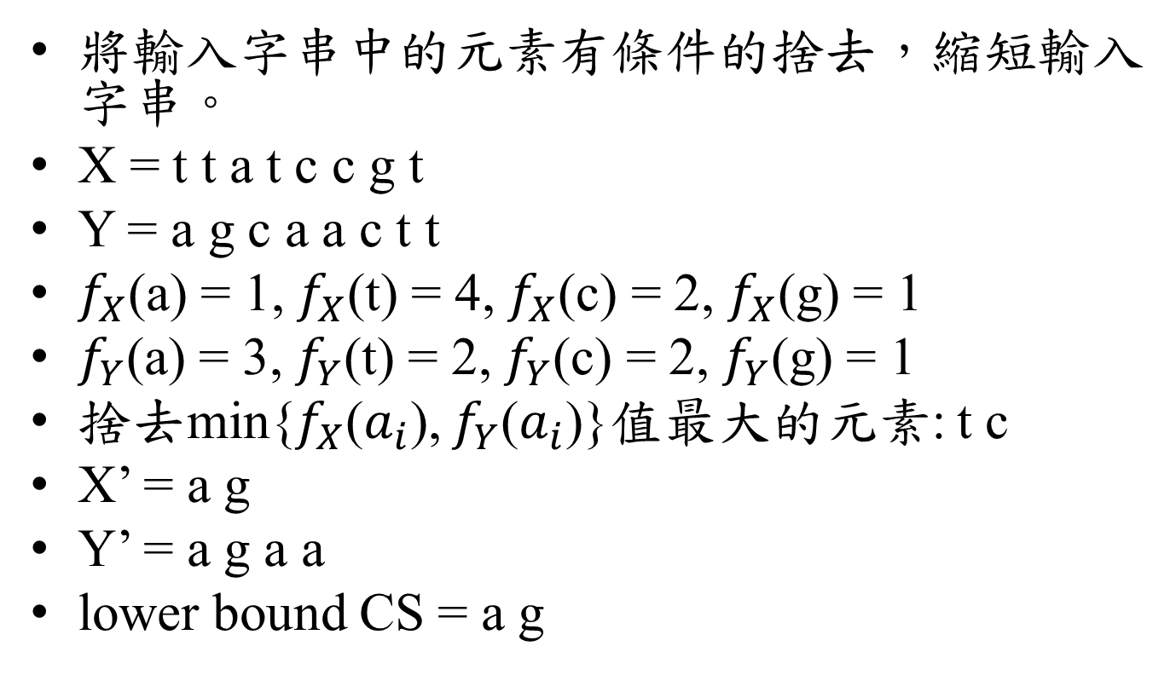
Reducing the lengths of the input strings
將輸入字串中的元素有條件的捨去，縮短輸入字串。
X = t t a t c c g t
Y = a g c a a c t t
$f_{X}$(a) = 1, $f_{X}$(t) = 4, $f_{X}$(c) = 2, $f_{X}$(g) = 1
$f_{Y}$(a) = 3, $f_{Y}$(t) = 2, $f_{Y}$(c) = 2, $f_{Y}$(g) = 1
捨去min{$f_{X}$($a_{i}$), $f_{Y}$($a_{i}$)}值最大的元素: t c
X’ = a g
Y’ = a g a a
lower bound CS = a g

Slide 26
An Approach Used in Biosequence Comparison
給定長度q，將Y中符合長度q的substring找出，利用這些substring，檢查X中的common substring，從輸入字串中間選擇最長的common substring，將其加入lower bound中，繼續檢查其起點與(0, 0)產生的左上矩形，與其中點和(m, n)產生的右下矩形中的common substring，而矩形外的則不檢查。

Slide 27
An Approach Used in Biosequence Comparison
X = t t a t c c g t
Y = a g c a a c t t
令 q = 1
Lower bound = c
X Y | t | t | a | t | c | c | g | t
a |  |  | *
g |  |  |  |  |  |  | *
c |  |  |  |  | * | *
a |  |  | *
a |  |  | *
c |  |  |  |  | * | *
t | * | * |  | * |  |  |  | *
t | * | * |  | * |  |  |  | *

Slide 28
An Approach Used in Biosequence Comparison
X = t t a t c c g t
Y = a g c a a c t t
令 q = 1
Lower bound = c
X Y | t | t | a | t | c | c | g | t
a |  |  | *
g |  |  |  |  |  |  | *
c |  |  |  |  | * | *
a |  |  | *
a |  |  | *
c |  |  |  |  | * | *
t | * | * |  | * |  |  |  | *
t | * | * |  | * |  |  |  | *

Slide 29
An Approach Used in Biosequence Comparison
X = t t a t c c g t
Y = a g c a a c t t
令 q = 1
Lower bound = c
X Y | t | t | a | t | c | c | g | t
a |  |  | *
g |  |  |  |  |  |  | *
c |  |  |  |  | * | *
a |  |  | *
a |  |  | *
c |  |  |  |  | * | *
t | * | * |  | * |  |  |  | *
t | * | * |  | * |  |  |  | *

Slide 30
An Approach Used in Biosequence Comparison
X = t t a t c c g t
Y = a g c a a c t t
令 q = 1
Lower bound = a c t
X Y | t | t | a | t | c | c | g | t
a |  |  | *
g |  |  |  |  |  |  | *
c |  |  |  |  | * | *
a |  |  | *
a |  |  | *
c |  |  |  |  | * | *
t | * | * |  | * |  |  |  | *
t | * | * |  | * |  |  |  | *

Slide 31
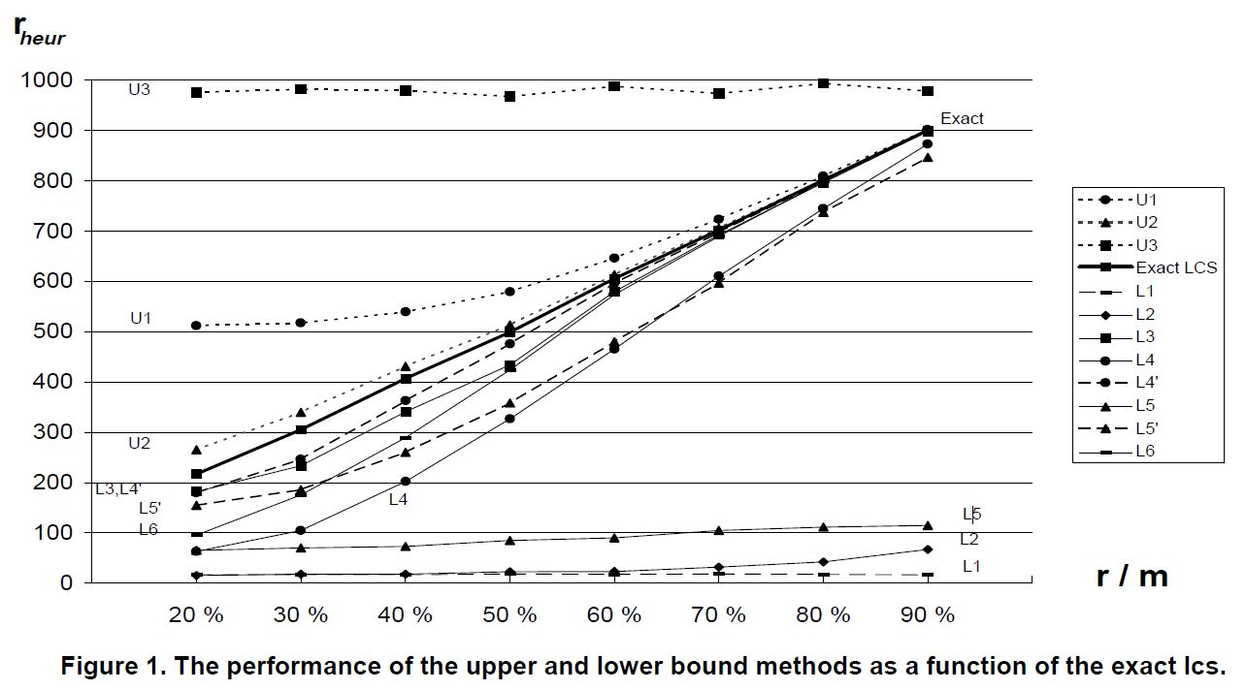
Performance

Slide 32
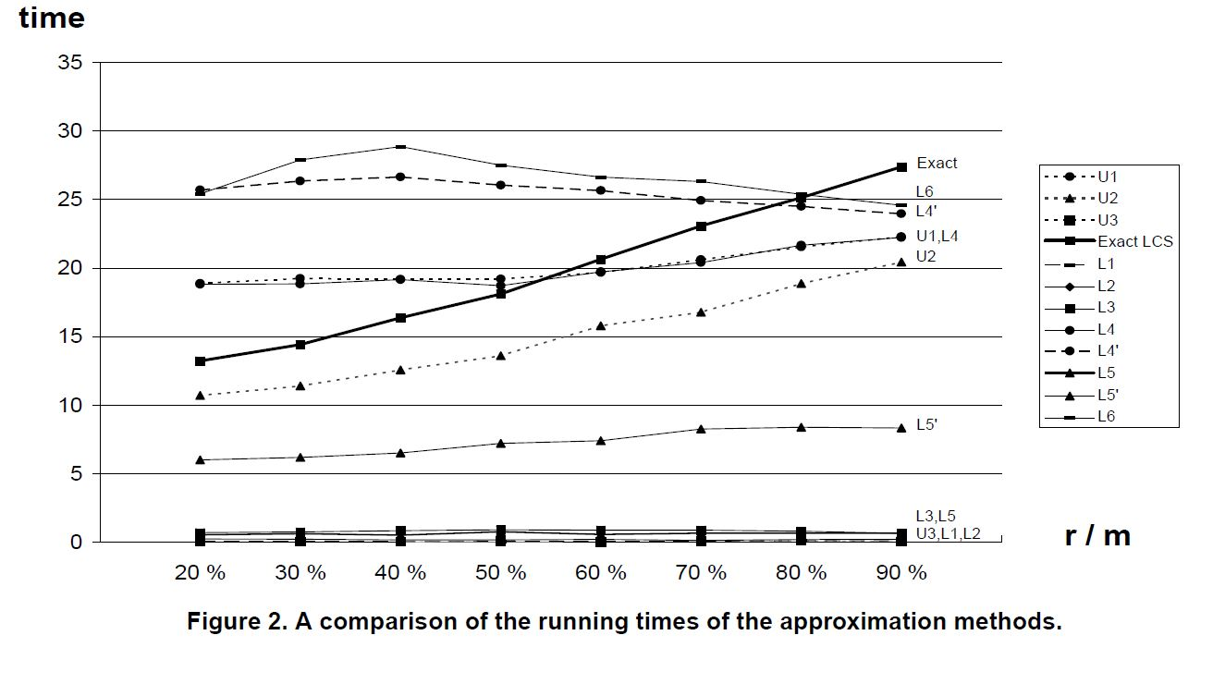
Time

