Slide 1
Parallel Computation for the All-Pairs Suffix-Prefix Problem
Felipe A. Louza, Simon Gog, Leandro Zanotto, Guido Araujo,
and Guilherme P. Telles
23rd International Symposium, SPIRE 2016, Beppu, Japan, October 18-20, pp. 122-132, 2016.
Presenter: Kuo-Feng Huang
Date: 2019/01/08

Slide 2
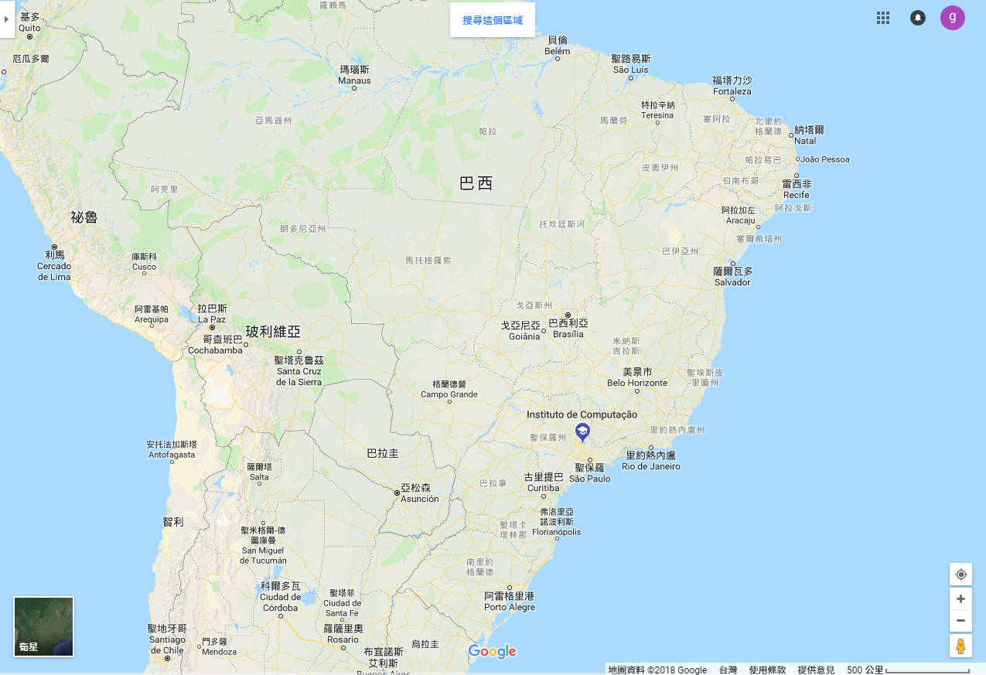
Institute of Computing, University of Campinas, Campinas, SP, Brazil

Slide 3
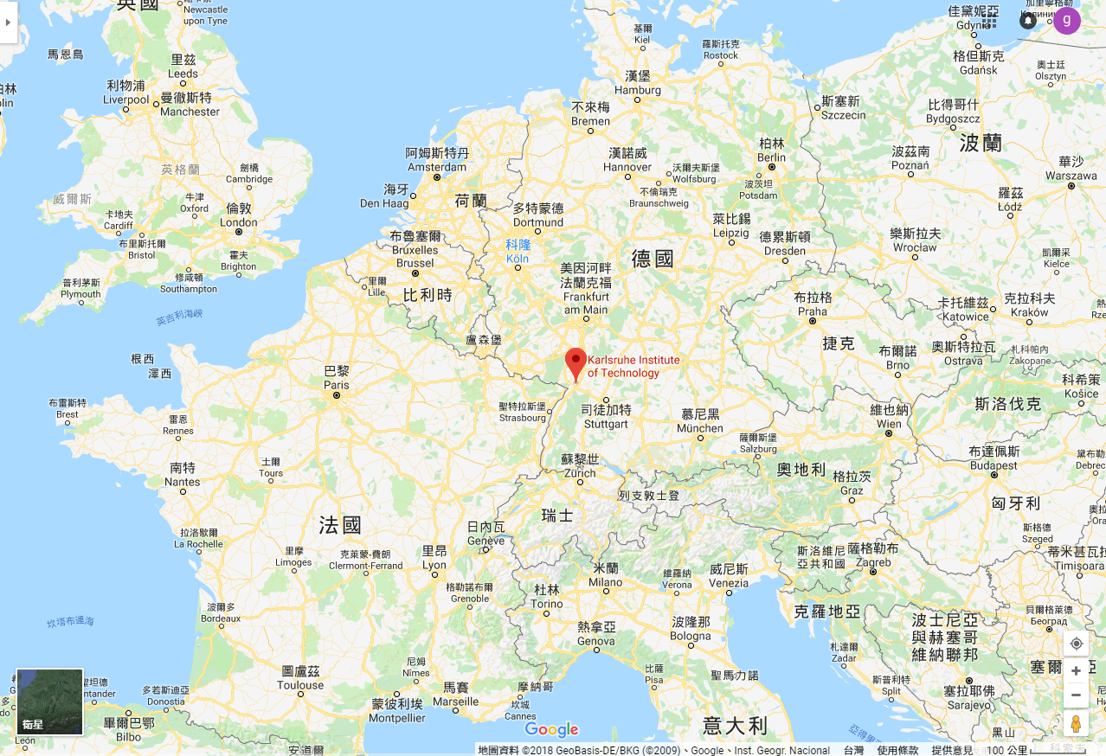
Institute of Theoretical Informatics, Karlsruhe Institute of Technology, Germany

Slide 4
Abstract
We show how to parallelize the optimal algorithm proposed by Tustumi et al. [19] to solve the all-pairs suffix-prefix matching problem for general alphabets. We compared our parallel algorithm with SOF [17], a practical solution for DNA sequences that exhibits good time and space performance in multithreading environments. The experimental results showed that our parallel algorithm achieves a consistent speedup when compared with the sequential algorithm, and it is competitive with SOF when the minimum overlap length is small.

Slide 5
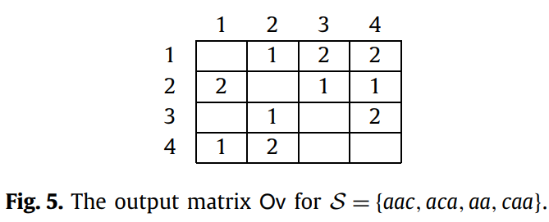
All longest suffix–prefix matches
aac
aca
aa
caa
aac
aca
aa
caa

Slide 6
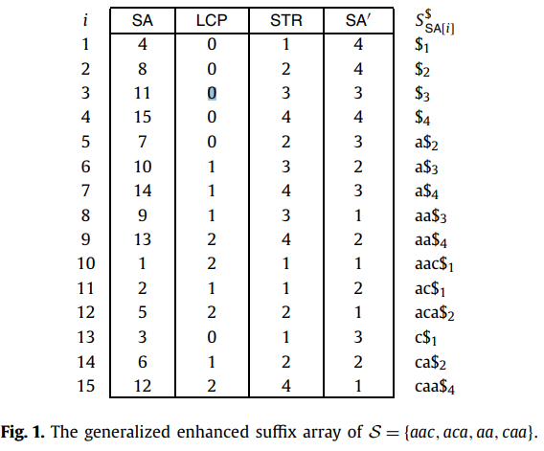
The generalized enhanced suffix array (GESA)
S= aac$₁aca$₂aa$₃caa$₄
P={8,10,12,15}

Slide 7
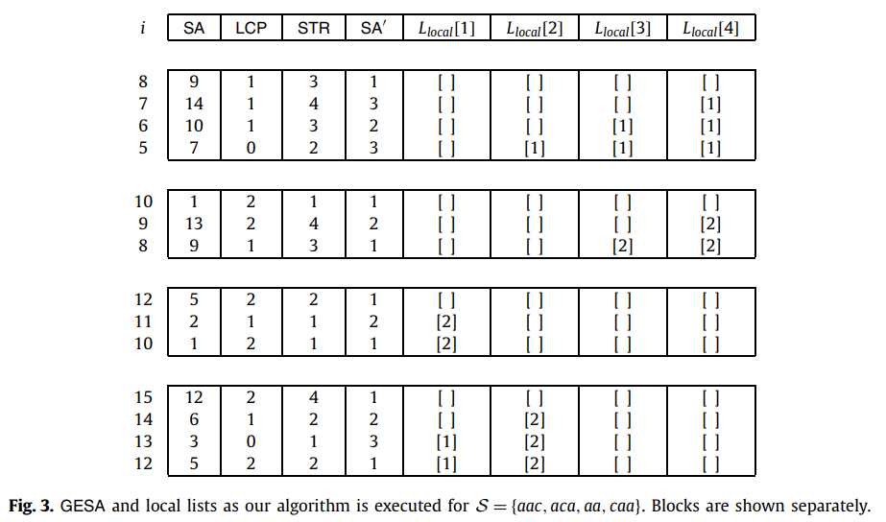
GESA and local lists
aa$₃
L= ∞ aa
L=1 |a|=1
L=1 |a|=1
L=1 |a|=1
a$₄
a$₃
a$₂
aac$₁
L= ∞ aac
L=2 |aa|=2
L=2 |aa|=2
aa$₄
aa$₃
aca$₂
L= ∞ aca
L=2 |ac|=2
L=1 |aac|=3
ac$₁
aac$₁
caa$₄
L= ∞ caa
L=2 |ca|=2
L=1 |c|=1
L=0 |aca|=3
ca$₂
c$₁
aca$₂

Slide 8
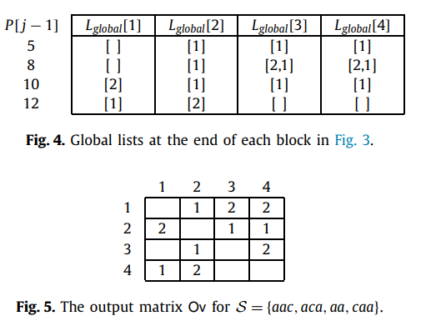
Output
0 | 1 | 1 | 1
 |  | 2 | 2
2
1 | 2
3
1
2
4

Slide 9
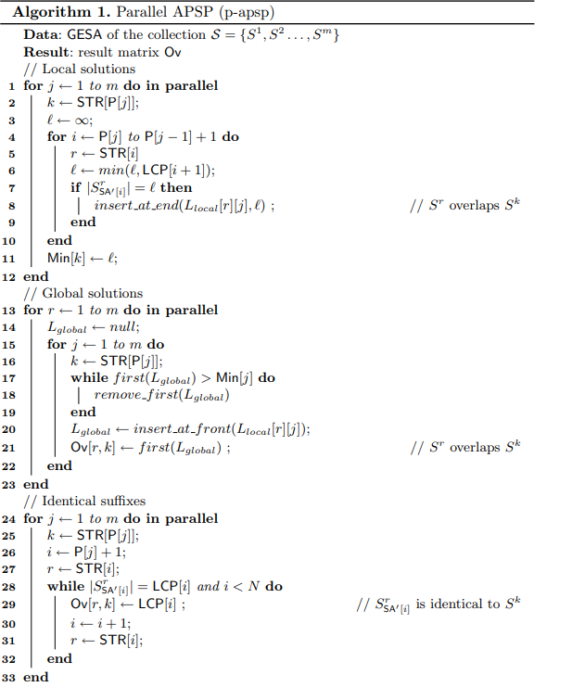
Algorithm
Time: O(N+m²)
O(N+m²/t)

Slide 10
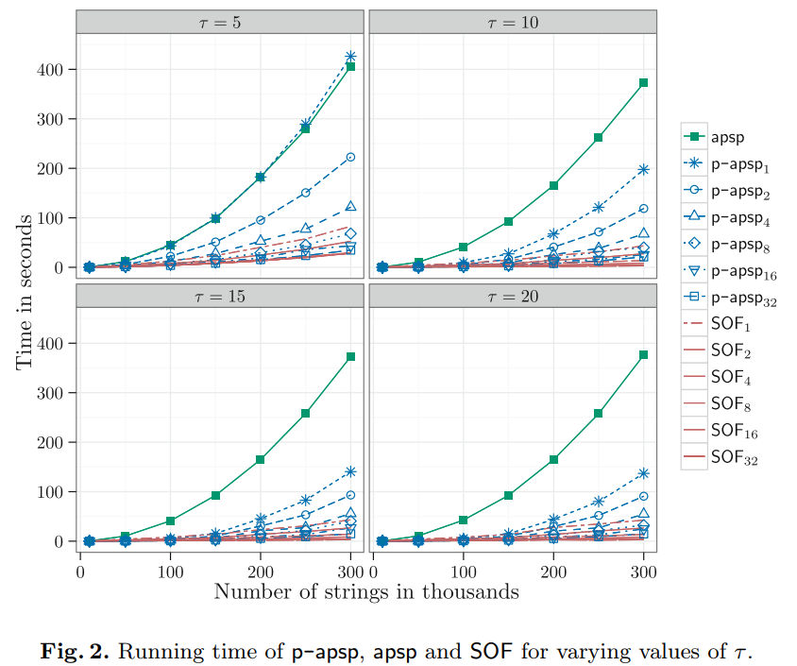
Experimental results

Slide 11
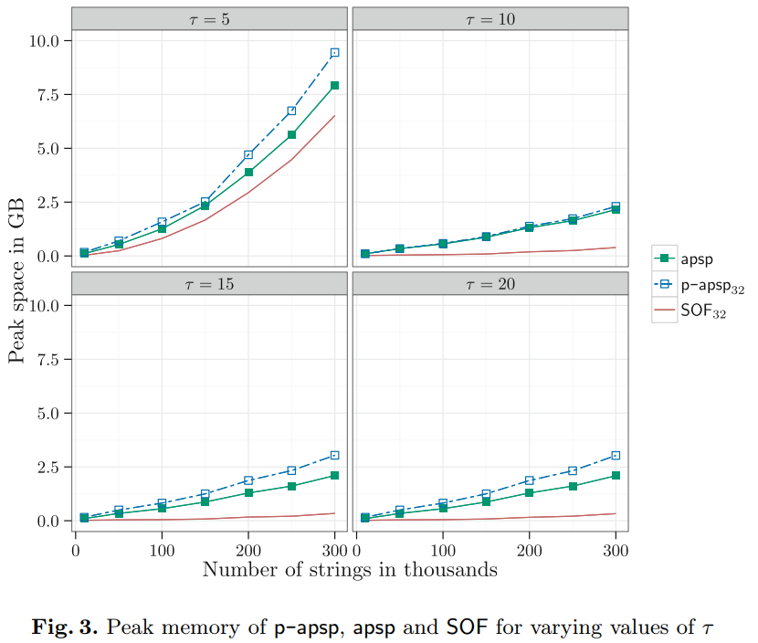
Experimental results

