Slide 1
A Multi-Objective Deep Reinforcement Learning Approach for Stock Index Futures’s Intraday Trading
Weiyu Si, Jinke Li, Ruonan Rao , Peng Ding
2017 10th International Symposium on Computational Intelligence and Design, Hangzhou, China, Pages 431–436
Presenter : Feng-Yang Tsai
Date: 2018.1.8
Notes:
https://www.google.com.tw/maps/place/Shanghai+Jiaotong+University/@31.2010056,121.4306523,17z/data=!3m1!4b1!4m5!3m4!1s0x35b265386b226333:0x39a5f5781d8a1dc7!8m2!3d31.201001!4d121.432841?hl=zh-TW&authuser=0
丁鵬
饒若楠
李金科
思維宇

Slide 2
Abstract(1/2)
Modern artiﬁcial intelligence has been widely discussed to practice in automated ﬁnancial asserts trading. Automated intraday trading means that the agent can react to the market conditions automatically, while simultaneously make the right decisions. Besides, the proﬁts will be made within a day considering transaction cost charged by the brokerage company. In this paper, we introduce a multi-objective deep reinforcement learning approach for intraday ﬁnancial signal representation and trading. We design the deep neural networks to automatically discover the dynamic market features, then a reinforcement learning method implemented by a special kind of recurrent neural network (LSTM) is applied to make continuous trading decisions.

Slide 3
Abstract(2/2)
In terms of balancing the proﬁt and risk, we implement a multi-objective structure which includes two objectives with different weights. We conduct experiments on stock index futures data, and our analysis and experiments not only offer insights into ﬁnancial market features mining, but also provide a straightforward and reliable method to make proﬁts, which sheds light on its wide application on automated ﬁnancial trading.

Slide 4
Reinforcement learning:
1.Actor-based
A recurrent reinforcement learning (RRL) model designed to implement risk control, cost-sensitive trading strategies that use the Sharp ratio as an objective function.
2.Critic-based
These value function methods, such as TD-learning , Q-learning and Sarsa , are often used to solve discrete space optimization problems.

Slide 5


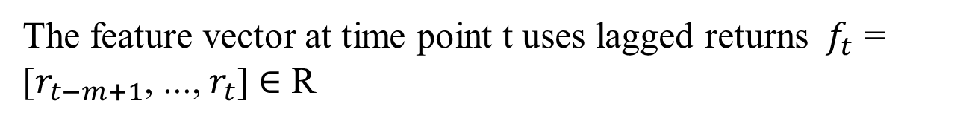
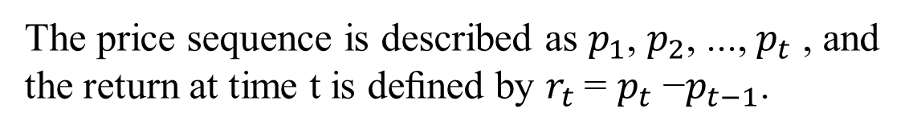
represents the trading decision {long, neutral, short} token at time t.
represents the feature vector of the current market condition at time t.
The price sequence is described as $p_{1}$, $p_{2}$, ..., $p_{t}$ , and the return at time t is deﬁned by $r_{t}$= $p_{t}$ −$p_{t−1}$.
The feature vector at time point t uses lagged returns $f_{t}$ = [$r_{t−m+1}$, ..., $r_{t}$] ∈ R
Notes:
在RRL中，時間t的動作不僅取決於時間t的當前市場狀況，而且還依賴於時間t-1的先前動作，因為頻繁變化的交易位置將帶來大的交易成本。

Slide 6
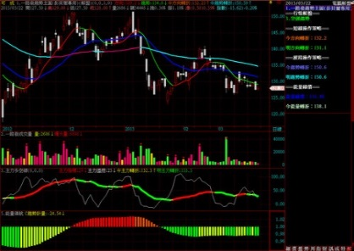

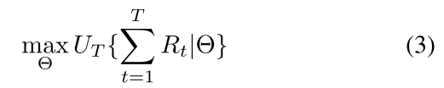

RNN
long
0.7
…
neutral
0.2
Probability of taking the action
…
short
0.1
data
At ∈ {1, 0, −1} represents the trading decision {long, neutral, short}
Notes:
夏普比率定義為在第1, 2, ..., T,期間獲得的收益的平均收益與標準差的比率
第一個項目是根據時間t-1的決策$A_{t−1}$獲得的利潤或損失，第二個項目是在時間t改變交易頭寸時的交易成本。
最直接的RRL目標是在1,2，......，T期間最大化累積獎勵。整個T訓練期間的累積獎勵可以定義為

Slide 7
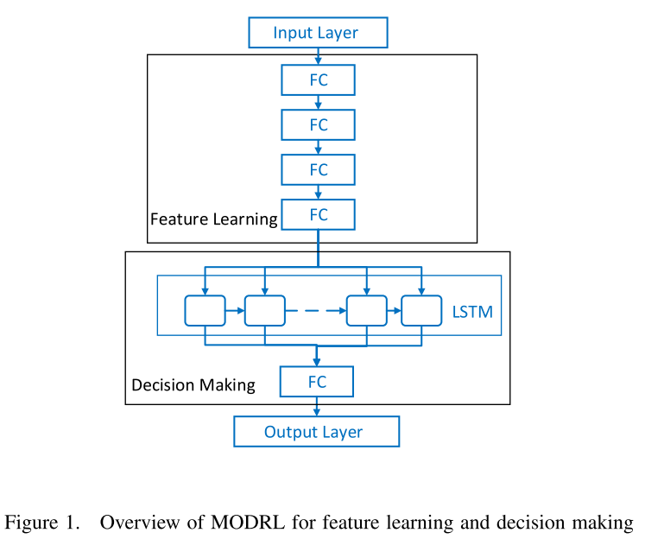
Multi-Objective Deep Reinforcement Learning:

Slide 8
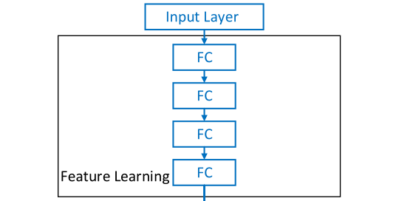
We use multiple fully-connected hidden layers (FC) to extract hidden features.
After learning the hidden features, we implement a special kind of recurrent neural network to make decisions.
Notes:
LSTM將交易操作保留在內存中以生成連續操作並降低交易成本。 而且，LSTM可以記住長時間步驟中的更多功能，以做出正確的決策。 然後，交易行為遵循以下等式：

Slide 9
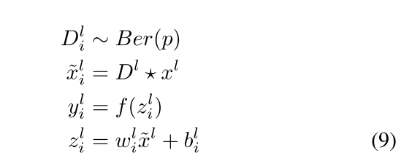
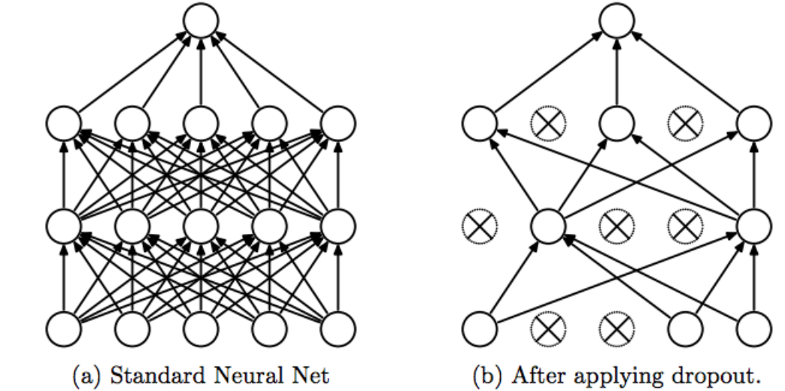
Dropout for Feature Learning:
Notes:
因為他不能成功的表達除了訓練數據以外的其他數據. 這就叫做過擬合. Overfitting.
還有一種專門用在神經網絡的正規化的方法, 叫作dropout. 在訓練的時候, 我們隨機忽略掉一些神經元和神經聯結, 是這個神經網絡變得”不完整”. 用一個不完整的神經網絡訓練一次.
到第二次再隨機忽略另一些, 變成另一個不完整的神經網絡. 有了這些隨機drop 掉的規則, 我們可以想像其實每次訓練的時候, 我們都讓每一次預測結果都不會依賴於其中某部分特定的神經元

Slide 10
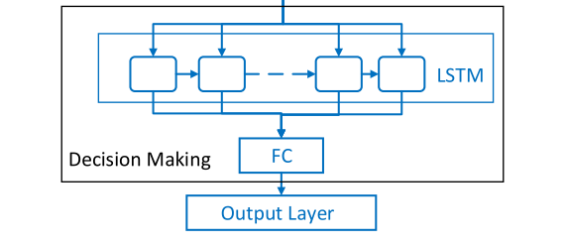
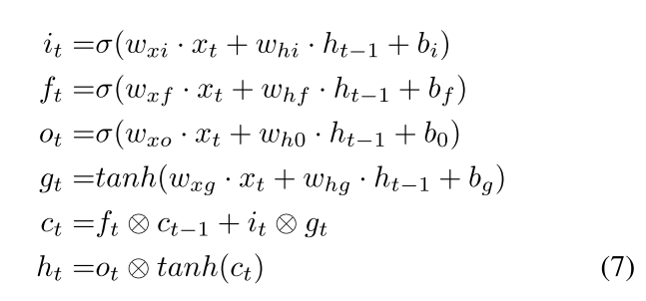

LSTM:

Slide 11
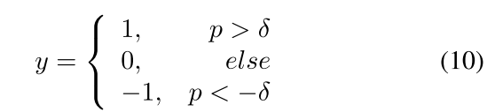

Slide 12
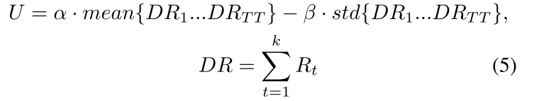
Multi-Objective Structure:
α, β is adjustable to give the system direction what kind of strategy the system will learn. In this paper, α = 1, β = 0.01 .
Notes:
其中k代表一天的時間，第一個項目是衡量平均每日利潤，第二個項目是描述波動率，這意味著波動率越小，交易期間的風險就越小。
雖然RL提供了一個很好的交易模型，但眾所周知，強大的特徵對於決策非常重要。 不良的特徵提取將直接影響交易系統。為了提取好的特徵，深度學習在圖像分類，語音識別和自然語言處理中表現良好。 深度學習是一種表示學習框架，其基礎設施被描述為多層神經網絡。 深度學習可以從大數據中學習強大的功能。 深度學習和強化學習相結合已成為一種快速發展的趨勢

Slide 13
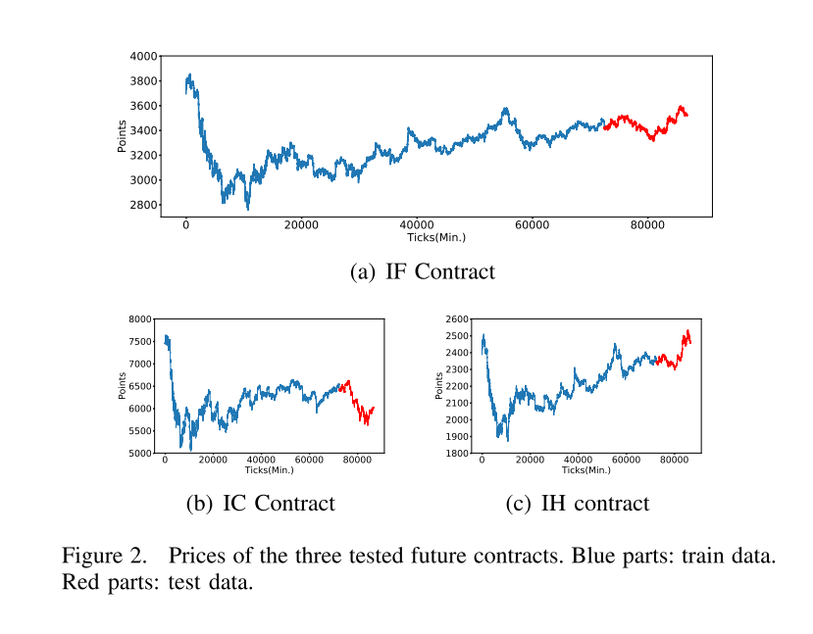
Experimental Result
Transaction cost is an important factor of intraday trading.
Notes:
we set TC = 1 .

Slide 14
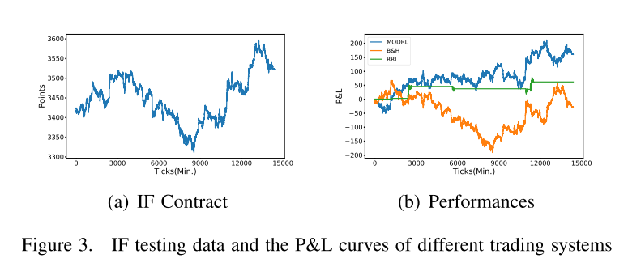
In Figure 3, MODRL outperforms RRL and B&H on total proﬁts. MODRL make proﬁts both on upward trend and downward trend. In most cases, RRL choose to do nothing, which may due to the volatility within a day when considering the transaction cost. B&H follows the trend ofclose price each day. B&H make proﬁts when the open price is lower than close price within a day.
Notes:
B＆H遵循每天收盤價的趨勢。 當開盤價低於一天內的收盤價時，B＆H會提供收益。

Slide 15
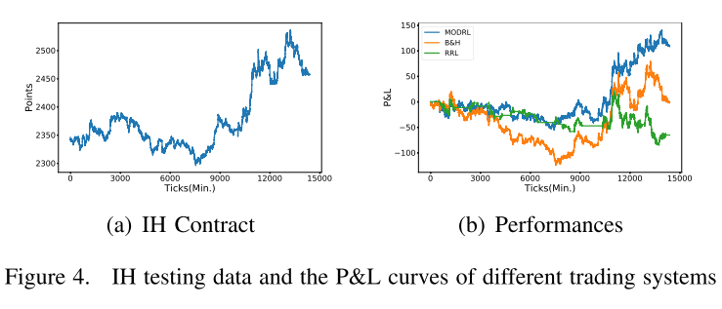
In Figure 4, it is obvious that when the trend is not obvious, RRL, MODRL and B&H do not make proﬁts, but in the latter, MODRL gains better performance than B&H and RRL. The RRL performs worse than B&H, which may be because RRL pay more transaction cost for changing positions.

Slide 16
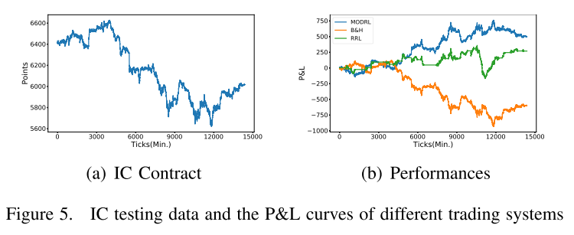
From Figure 5, MODRL and RRL achieve much more proﬁts during the trading period. MODRL are more stable to gain proﬁts, and the RRL ﬂuctuates during some periods. B&H has the same trend as the prices, and makes loss when the price is downward trend.

Slide 17
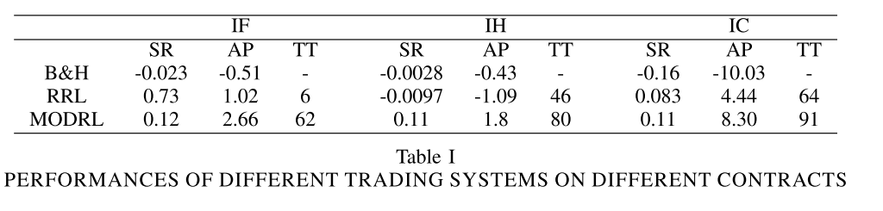
It can be observed from Table I that, for the intraday trading, MODRL can gain more average points each day than RRL, which means MODRL is possible to make proﬁts for intraday trading. As for Sharp Ratio, MODRL obtains the higher SR than RRL and B&H, except for IF contracts, because the total trading number of RRL is only 6. MODRL has the highest number of transactions and makes the highest proﬁts in these three trading systems.

