Slide 1
A generalized financial time series forecasting model based on automatic feature engineering using genetic algorithms and support vector machine
Norberto Ritzmann Júnior and Julio Cesar Nievola
arXiv:1809.06775, 18 Sept, 2018
Presenter: Cheng-Han Wu
Date:2019/1/8

Slide 2
Abstract
We propose the genetic algorithm for time window optimization, which is an embedded genetic algorithm (GA), to optimize the time window (TW) of the attributes using feature selection and support vector machine. This GA is evolved using the results of a trading simulation, and it determines the best TW for each technical indicator. An appropriate evaluation was conducted using a walk-forward trading simulation, and the trained model was verified to be generalizable for forecasting other stock data. The results show that using the GA to determine the TW can improve the rate of return, leading to better prediction models than those resulting from using the default TW.

Slide 3
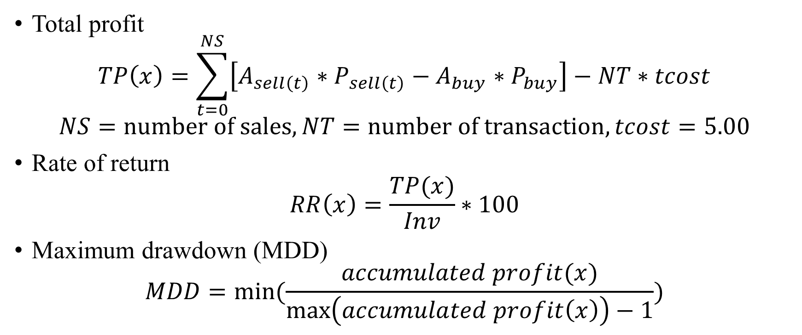
Evaluation
Total profit
$$TP\left(x\right)=\sum_{t=0}^{NS}{\left[A_{sell\left(t\right)}∗P_{sell\left(t\right)}−A_{buy}∗P_{buy}\right]−NT∗tcost}$$
$$NS=number of sales,NT=number of transaction, tcost=5.00$$
Rate of return
$$RR\left(x\right)=\frac{TP(x)}{Inv}∗100$$
Maximum drawdown (MDD)
$$MDD=min⁡(\frac{accumulated profit(x)}{\max\left(accumulated profit\left(x\right)\right)−1})$$
Notes:
三角形=WINDOW SIZE，<>

Slide 4
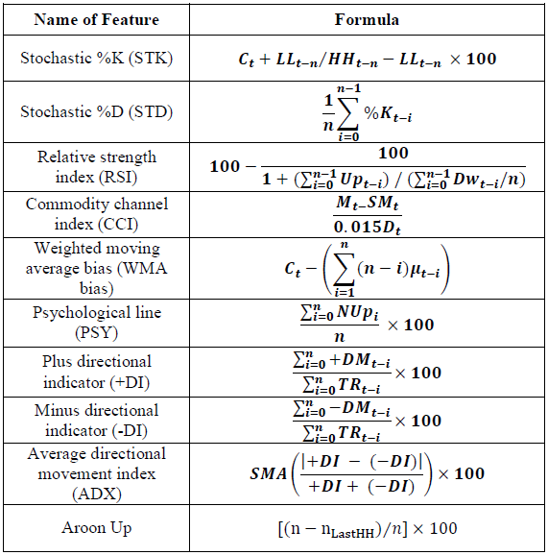
Data (2000/1/1~2004/12/31)
Microsoft (MSFT)
Nike (NKE)
Goldman Sacks 高盛(GS)
Intel (INTC)

Slide 5
Genetic algorithm
a
b
crossover
mutation
fitness good or bad?

Slide 6
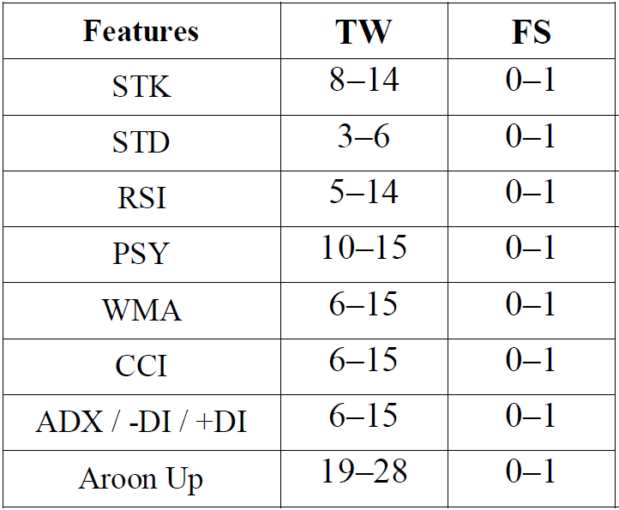

GATWO
Population : 30 chromosomes
Fitness function :
$GATWO\left(x\right)=max⁡(\frac{1}{n}\sum_{s=0}^{n}{RR_{s}})$
Mutation : 10%
Stop condition : 100 rounds

Slide 7
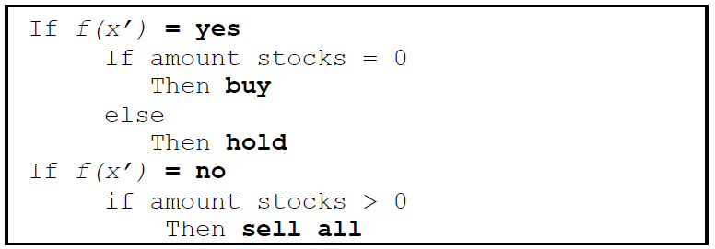

support vector machine (SVM)
Input vector $x_{i}∈R^{d} (i=1,2,…,N)$
z-score normalization : $x^{′}=\frac{(x−μ)}{σ}$
Label $y_{i}∈\{+1,−1\}$
$$f\left(x\right)=sgn(\sum_{i=1}^{N}{y_{i}a_{i}∙k\left(x_{j},x_{i}\right)+b})$$
Notes:
三角形=WINDOW SIZE，<>

Slide 8
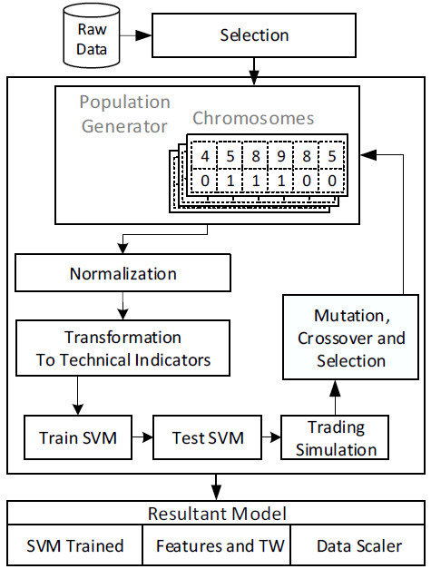
GATWO train & test

Slide 9
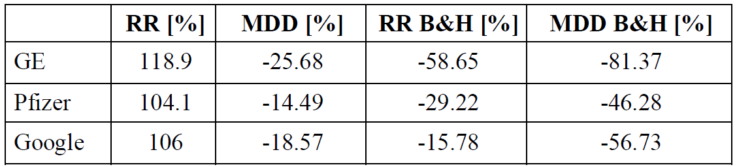
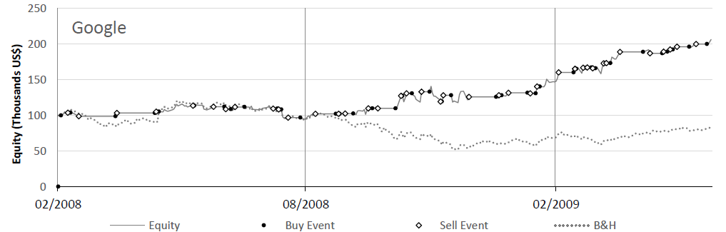
Stress testing
GE(奇異), Pfizer(輝瑞), and Google: 2008/2/1~2009/5/31
Notes:
三角形=WINDOW SIZE，<>

Slide 10
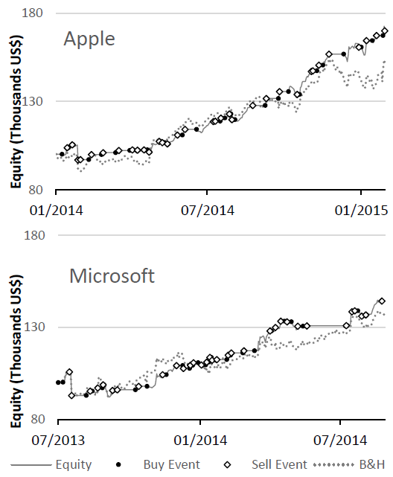
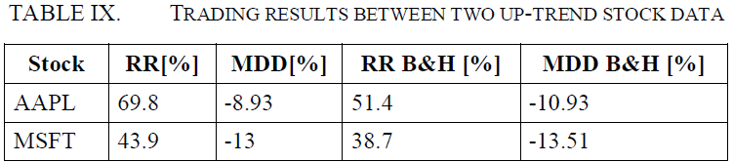
Up-trend testing
Apple (AAPL): 2014/1/1~2015/1/31
Microsoft stock(MSFT): 2013/7/1~2014/8/31
Notes:
三角形=WINDOW SIZE，<>

Slide 11
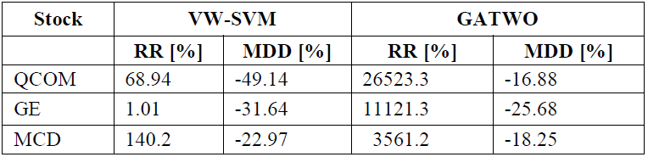
Comparison
QCOM(高通), GE(奇異), and MCD(麥當勞): 2003/1/1~2013/10/21
Notes:
三角形=WINDOW SIZE，<>

