Slide 1
Searching Gapped Palindromes Using Inverted Suffix Array
Shivika Gupta, Rajesh Prasad and Sunita Yadav
Dept. of Computer Science Ajay Kumar Garg Engineering College
Dept. of Computer Science Yobe State University
Dept. of Computer Science Ajay Kumar Garg Engineering College
2015 IEEE International Conference on Computational Intelligence & Communication Technology,
Ghaziabad, India, pp. 186-191, 2015
Presenter: Ting-Wei Liang
Date:2019/01/15

Slide 2
Abstract
Palindrome pattern matching is a classical and well-studied problem in computer science. A palindrome is a string that reads the same forward and backward. Gapped palindrome is an interesting version of the palindrome which is defined as the one having a space between left and right palindromic arms of the string. In this paper, we develop efficient algorithms to detect two different classes of gapped palindromes: long armed and length constrained in a biological sequences by using inverted suffix array. The algorithms perform the computation in O(n) time. Also, we determine palindromic weights (number and size of gapped palindromes) in the input biological string.

Slide 3
Palindrome in DNA (Reverse Complement)
W = ACGT
W_{com} = TGCA
W_{com}^{rev} = ACGT = W^{T} = W
W is a palindrome(same as its reverse complement)

Slide 4
Gapped Palindrome
Gapped palindrome in a biological sequence is defined as follow:
gapped palindrome form : vuv^{T}
v : non-empty sequence of bases
v^{T}: reverse complement of v
u : (spacer) a sequence of bases
Ex:
GCATTTATGC
v u v^{T}

Slide 5
Long Armed and Length Constrained
gapped palindrome form : vuv^{T}
Longed Armed :
|u| ≤ |v|
Length Constrained :
MinGap ≤ |u| ≤ MaxGap
MinArm ≤ |v|

Slide 6
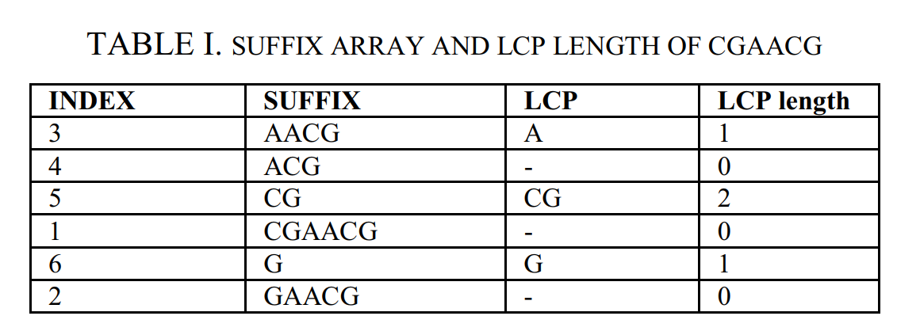
Suffix array(sort by lexical order)

Slide 7
Detect Gapped Palindrome Algorithm(Long Armed)
Fetch DNA sequence by sliding window iterator
If W = GCATTTATGC
Reverse complement
W^{T} = GCATAAATGC
Concatenation of # and $
W = GCATTTATGC#
W^{T} = GCATAAATGC$
3.Construct Inverted Suffix Array

Slide 8
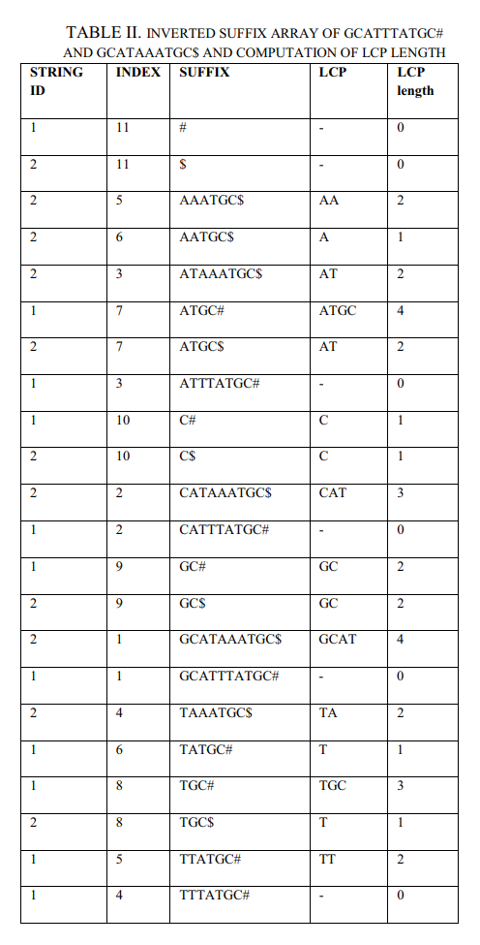
W = GCATTTATGC#
W^{T} = GCATAAATGC$
To verify the constraints of palindrome arm, the following condition should be satisfied:
W (i) = W (j) , i < j
W(i) = W[i - max LCP length… i - 1]^{T}
W(j) = W[j…j + max LCP length - 1]
Computing i :
i = 1
W(1) = W[1-4 … 1-1]^{T} = W[-3…0]^{T}
(not possible)
i increment by 1
…
W(5) = W[5-4 … 5-1]^{T} = W[1…4]^{T} , i = 5
Computing j:
W(7) = W[7 … 7+4-1] = W[7…10] , j = 7

Slide 9
W = GCATTTATGC#
W^{T} = GCATAAATGC$
i = 5, j = 7
W(i) = W[1…4]^{T} = TACG
W(j) = W[7…10] = ATGC
Verify complementarity:
W(i) = W(j)
TACG = ATGC
Verify spacer length constraints:
j – i ≤ Max LCP length
2 ≤ 4
Hence, we say the DNA sequence GCATTTATGC fetched by the sliding window iterator is long armed gapped palindrome.

Slide 10
Detect Gapped Palindrome Algorithm(Length Constrained)
Fetch DNA sequence by sliding window iterator
If W = GCATTTATGC
Reverse complement
W^{T} = GCATAAATGC
Concatenation of # and $
W = GCATTTATGC#
W^{T} = GCATAAATGC$
3.Construct Inverted Suffix Array

Slide 11
W = GCATTTATGC#
W^{T} = GCATAAATGC$
MinArm = 3, MinGap = 3 and MaxGap = 5
To verify the constraints of palindrome arm, the following condition should be satisfied:
W (i) = W (j) , i < j
W(i) = W[i - MinArm… i - 1]^{T}
W(j) = W[j…j + MinArm - 1]
Computing i :
i = 2
W(1) = W[2-3 … 2-1]^{T} = W[-1…1]^{T}
(not possible)
i increment by 1
…
W(4) = W[4-3 … 4-1]^{T} = W[1…3]^{T} , i = 4
Computing j:
W(8) = W[8 … 8+3-1] = W[8…10] , j = 8

Slide 12
W = GCATTTATGC#
W^{T} = GCATAAATGC$
MinArm = 3, MinGap = 3 and MaxGap = 5
i = 4, j = 8
W(i) = W[1…3]^{T} = ACG
W(j) = W[8…10] = TGC
Verify complementarity:
W(i) = W(j)
ACG = TGC
Verify spacer length constraints:
MinGap ≤ j – i ≤ MaxGap
3 ≤ 4 ≤ 5
Hence, we say the DNA sequence GCATTTATGC fetched by the sliding window iterator is length constrained gapped palindrome.

Slide 13
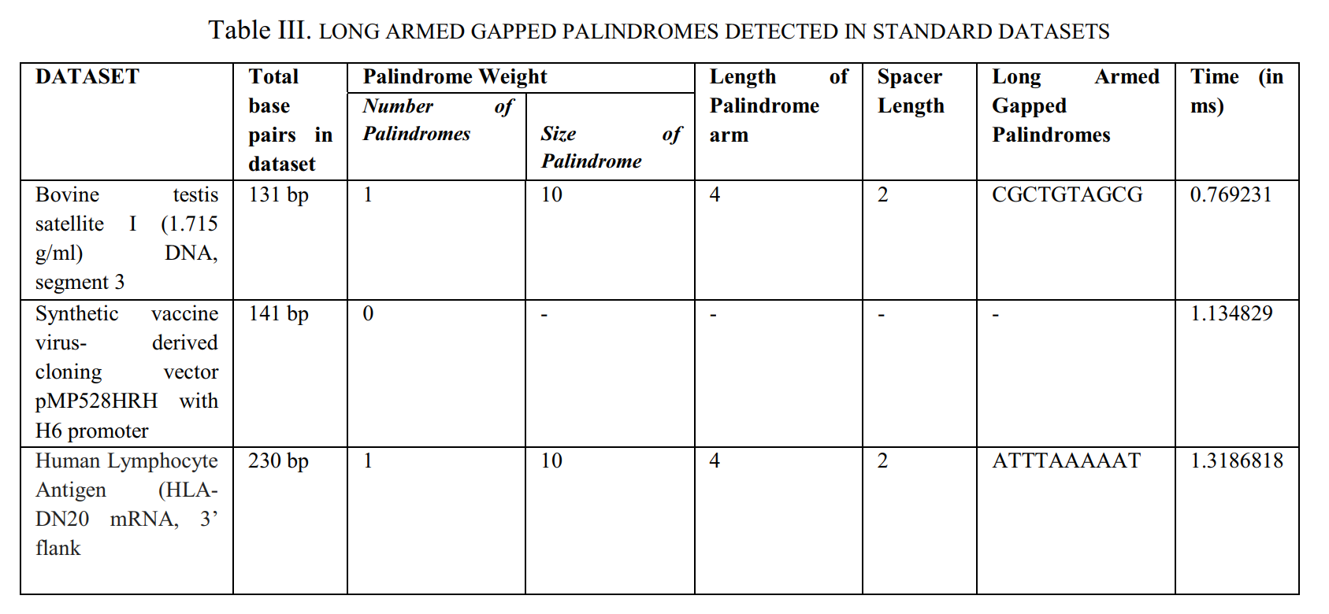
Tests

Slide 14
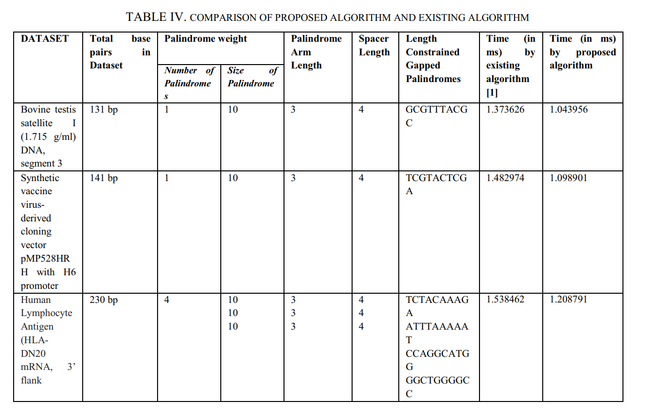
Tests

