Slide 1
Improvement of Dynamic Time Warping (DTW) Algorithm
Yuansheng Lou, Huanhuan Ao and Yuchao Dong
Proceeding of 14th International Symposium on Distributed Computing and Applications for Business Engineering and Science
Guiyang, China, 18-24 Aug. 2015
Presenter: Shan-Ru Liu
Date: 2019/01/15

Slide 2
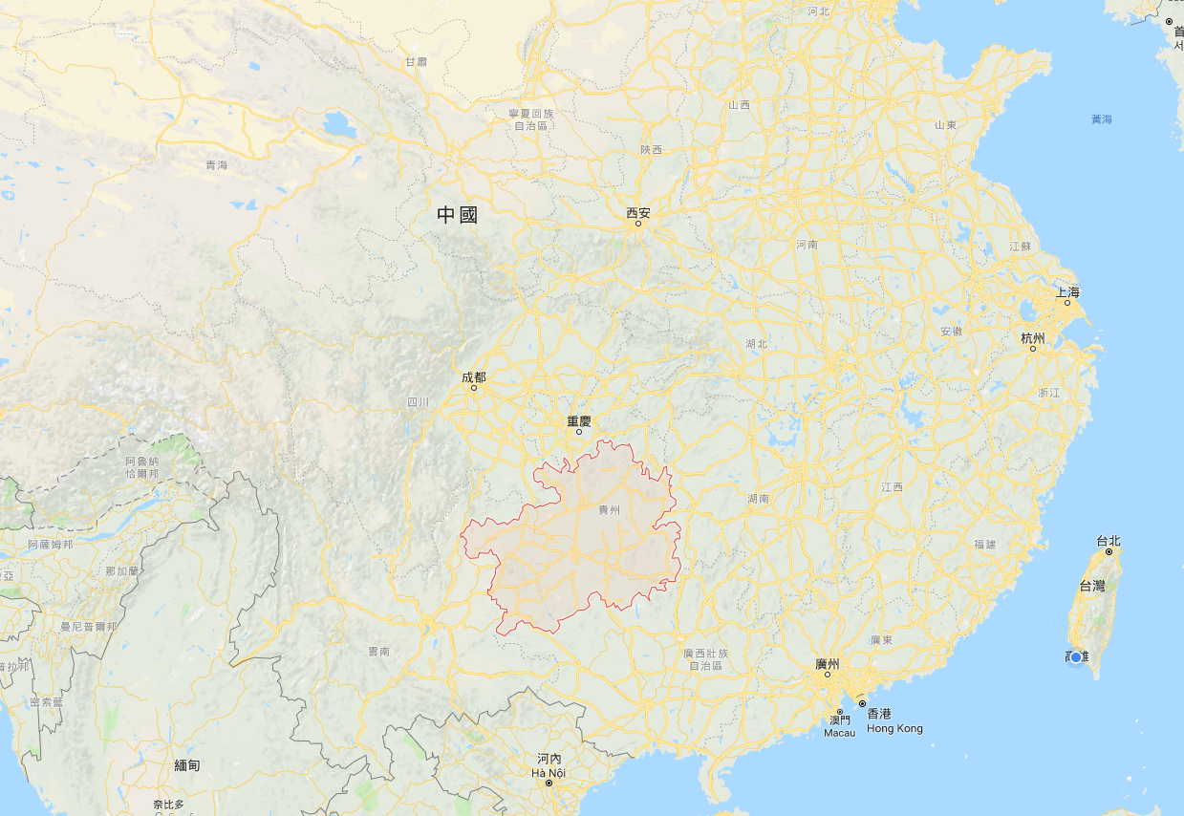
貴陽
簡稱筑，別稱林城

Slide 3
Abstract
Dynamic time warping algorithm is widely used in similar search of time series. However, large scales of route search in existing algorithms resulting in low operational efficiency. In order to improve the efficiency of dynamic time warping algorithm, this paper put forward an improved algorithm, which plans out a three rectangular area in the search area of the existing algorithms, search path won't arrive the points outside the rectangular area, thus further reduced the search range of regular path. To some extent, this algorithm reduces computation of original algorithm, thus improving the operational efficiency. The improvement is more pronounced when two time series are longer.

Slide 4
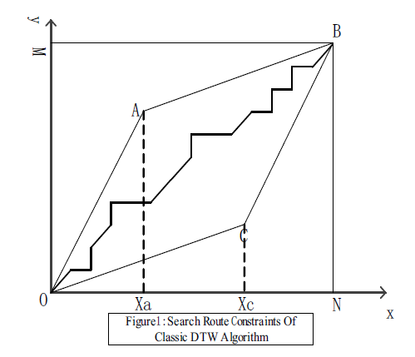
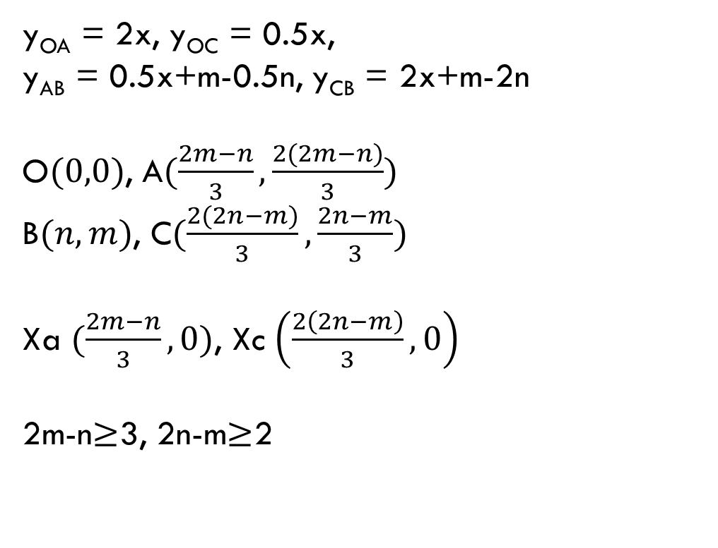
Classic DTW with Constraints
y_{OA} = 2x, y_{OC} = 0.5x,
y_{AB} = 0.5x+m-0.5n, y_{CB} = 2x+m-2n
O$(0,0)$, A$(\frac{2m−n}{3},\frac{2(2m−n)}{3})$
B$(n,m)$, C$(\frac{2(2n−m)}{3},\frac{2n−m}{3})$
Xa $(\frac{2m−n}{3},0)$, Xc $\left(\frac{2\left(2n−m\right)}{3},0\right)$
2m-n$≥$3, 2n-m$≥$2

Slide 5
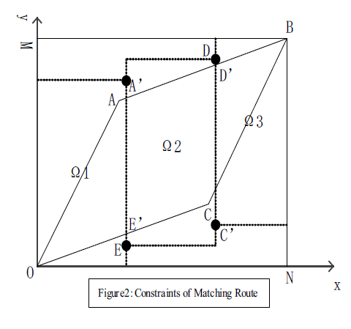
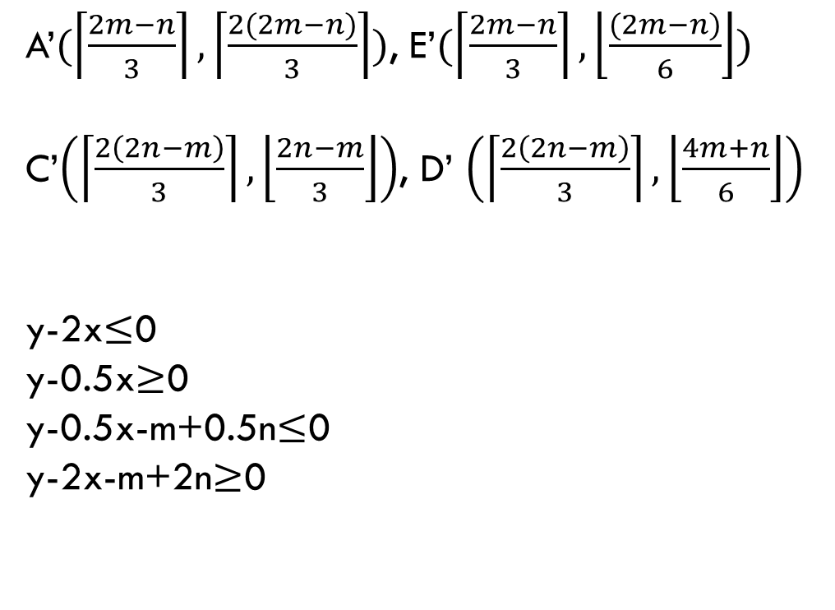
Improvement of DTW
A’$(\left\lceil \frac{2m−n}{3}\right\rceil ,\left\lceil \frac{2(2m−n)}{3}\right\rceil )$, E’$(\left\lceil \frac{2m−n}{3}\right\rceil ,\left\lfloor \frac{(2m−n)}{6}\right\rfloor )$
C’$\left(\left\lceil \frac{2\left(2n−m\right)}{3}\right\rceil ,\left\lfloor \frac{2n−m}{3}\right\rfloor \right)$, D’ $\left(\left\lceil \frac{2\left(2n−m\right)}{3}\right\rceil ,\left\lfloor \frac{4m+n}{6}\right\rfloor \right)$
y-2x$≤$0
y-0.5x$≥$0
y-0.5x-m+0.5n$≤$0
y-2x-m+2n$≥$0

Slide 6
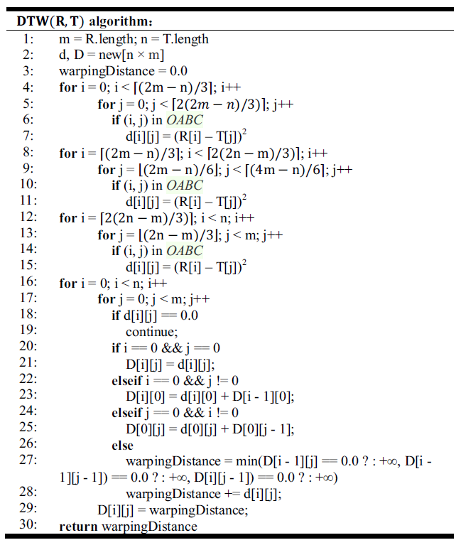
Algorithm

Slide 7
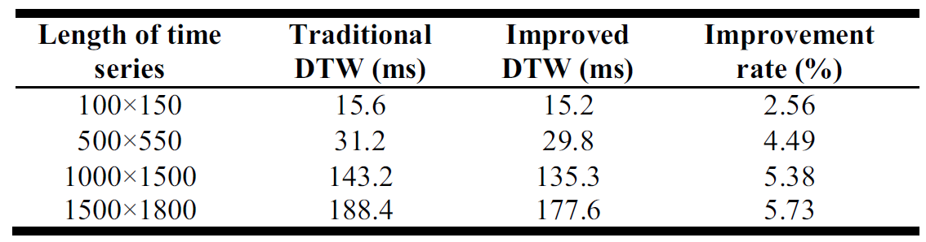
Result

