Slide 1
Food Image Segmentation for Dietary Assessment
Joachim Dehais, Marios Anthimopoulos, Stavroula Mougiakakou
MADiMa’16, Oct 16 2016, Amsterdam, Netherlands
Speaker: Du-Cheng Wu
Date: 2019.01.15
Notes:
Bern: https://goo.gl/Fnghq9
阿姆斯特丹 https://goo.gl/VEDFFT

Slide 2
Abstruct(1/2)
The prevalence of diet-related chronic diseases strongly impacts global health and health services. Currently, it takes training and strong personal involvement to manage or treat these diseases. One way to assist with dietary assessment is through computer vision systems that can recognize foods and their portion sizes from images and output the corresponding nutritional information. When multiple food items may exist, a food segmentation stage should also be applied before recognition. In this study, we propose a method to detect and segment the food of already detected dishes in an image. The method combines region growing/merging techniques with a deep CNN-based food border detection.

Slide 3
Abstruct(2/2)
A semi-automatic version of the method is also presented that improves the result with minimal user input. The proposed methods are trained and tested on non-overlapping subsets of a food image database including 821 images, taken under challenging conditions and annotated manually. The automatic and semi-automatic dish segmentation methods reached average accuracies of 88% and 92%, respectively, in roughly 0.5 seconds per image.

Slide 4
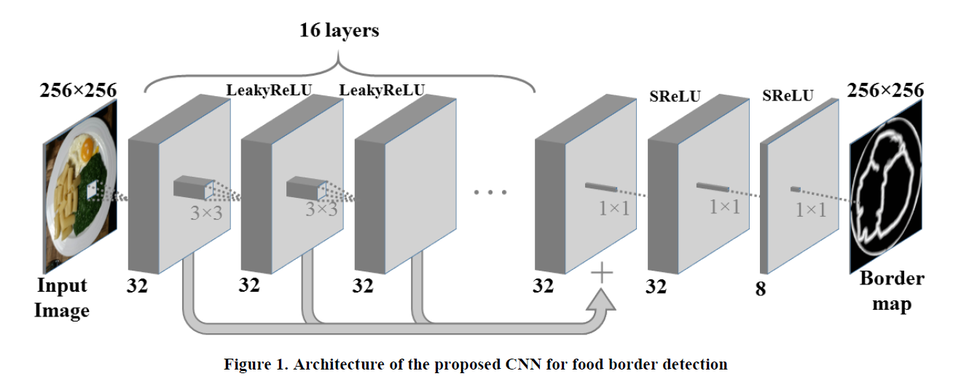
Border Map Generation
16 convolutional layers each have 32 kernels of size 3×3.
Summed and passed through layers with 32, 8 and 1 kernels of size 1×1

Slide 5
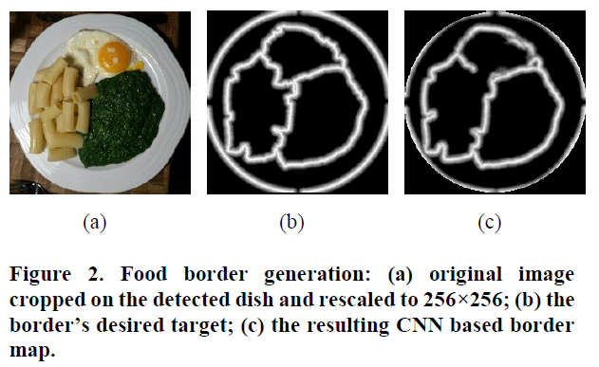
Border Map Generation
Border pixels have the value one
Pixels which are more than 8 pixels away from border are zero
The rest of the pixels have values between one and zero

Slide 6
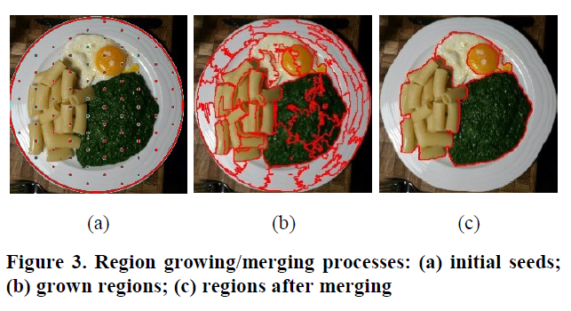




Region Growing/Merging
The CIELab based color distance proposed in reference[22]
The border magnitudes of point to be added and its closest point in the region as defined in the CNN-based map
Geometric distance from the region’s seed
Average border magnitude of pixel p and its closest pixel in R
The geometric distance between p and seed point of R

Slide 7




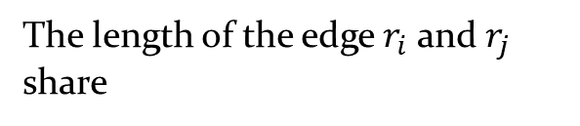
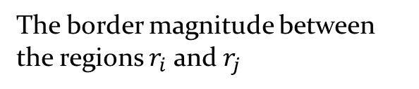
Region Growing/Merging
The border magnitude between the regions $r_{i}$ and $r_{j}$
The length of the edge $r_{i}$ and $r_{j}$ share

Slide 8
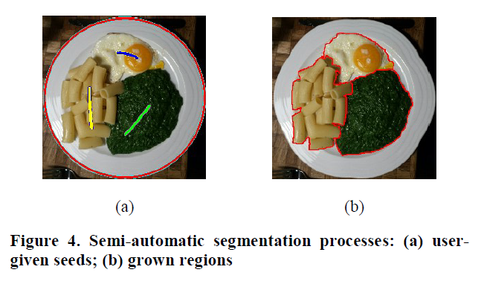
Region Growing/Merging

Slide 9

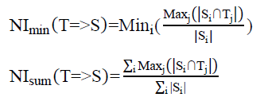

Data and Experiment Setup
Experiment consists of 821 meal images
70% for training set and 30% for test set
The result evaluates by using region-based metrics
Define two normalized directional indices worst and average segment

Slide 10
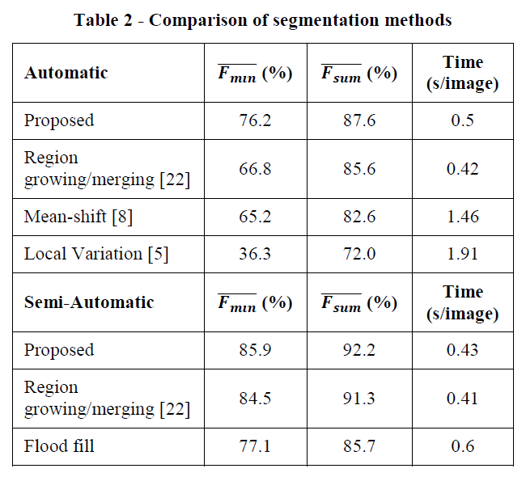
Results of Region/Merging

