Slide 1
Palindromic Decompositions with Gaps and Errors
Michal Adamczyk, Mai Alzamel, Panagiotis Charalampopoulos, Costas S. Iliopoulos, and Jakub Radoszewski Proceedings of 12th International Computer Science Symposium in Russia (CSR) Kazan, Russia, June 8-12, 2017 pp 48-61
Speaker: Kuan-Lin Lai
Date: Feb. 19, 2019

Slide 2
Abstract(1/2)
Identifying palindromes in sequences has been an interesting line of research in combinatorics on words and also in computational biology, after the discovery of the relation of palindromes in the DNA sequence with the HIV virus. Efficient algorithms for the factorization of sequences into palindromes and maximal palindromes have been devised in recent years. We extend these studies by allowing gaps in decompositions and errors in palindromes, and also imposing a lower bound to the length of acceptable palindromes.

Slide 3
Abstract(2/2)
We first present an algorithm for obtaining a palindromic decomposition of a string of length n with the minimal total gap length in time O(n log n · g) and space O(n · g), where g is the number of allowed gaps in the decomposition. We then consider a decomposition of the string in maximal δ-palindromes (i.e. palindromes with δ errors under the edit or Hamming distance) and g allowed gaps. We present an algorithm to obtain such a decomposition with the minimal total gap length in time O(n · (g + δ)) and space O(n · g).

Slide 4
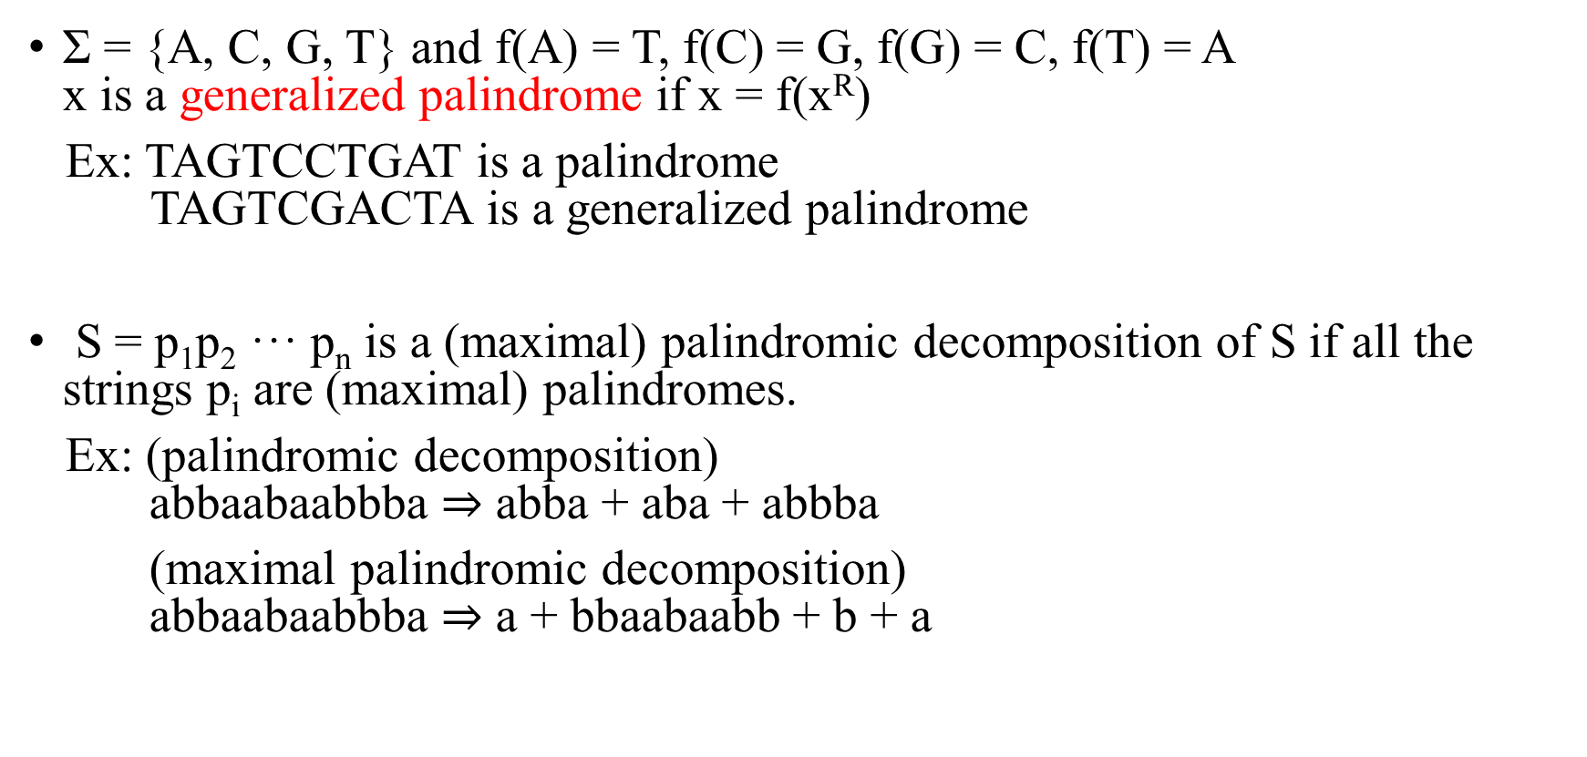
Notation and Terminology
Σ = {A, C, G, T} and f(A) = T, f(C) = G, f(G) = C, f(T) = A x is a generalized palindrome if x = f(x^{R})
Ex: TAGTCCTGAT is a palindrome TAGTCGACTA is a generalized palindrome
S = p₁p₂ ··· p_{n} is a (maximal) palindromic decomposition of S if all the strings p_{i} are (maximal) palindromes.
Ex: (palindromic decomposition) abbaabaabbba $⇒$ abba + aba + abbba
(maximal palindromic decomposition) abbaabaabbba $⇒$ a + bbaabaabb + b + a

Slide 5
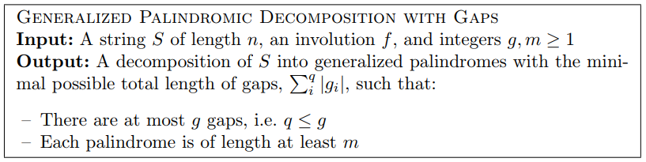
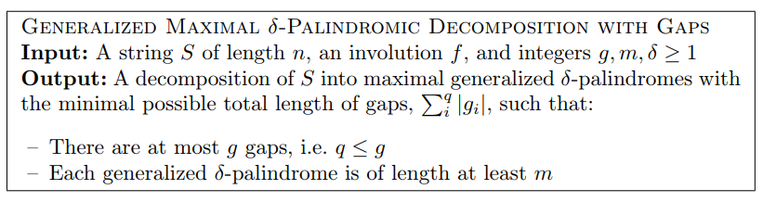
Computational problems

Slide 6
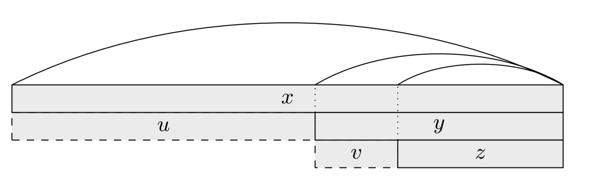

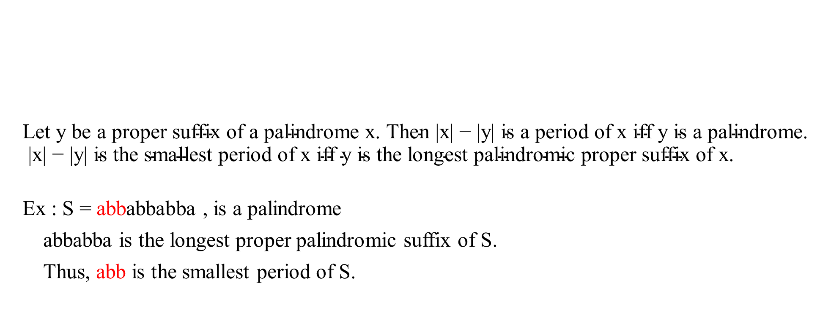
Period ($Δ$)
$$\text{Let} \text{y} \text{be} \text{a} \text{proper} \text{suffix} \text{of} \text{a} \text{palindrome} \text{x}\text{. }\text{Then}\text{ |}\text{x}\text{| − |}\text{y}\text{| }\text{is} \text{a} \text{period} \text{of} \text{x} \text{iff} \text{y} \text{is} \text{a} \text{palindrome}\text{. |}\text{x}\text{| − |}\text{y}\text{| }\text{is} \text{the} \text{smallest} \text{period} \text{of} \text{x} \text{iff} \text{y} \text{is} \text{the} \text{longest} \text{palindromic} \text{proper} \text{suffix} \text{of} \text{x}\text{.}$$
Ex : S = abbabbabba , is a palindrome
abbabba is the longest proper palindromic suffix of S.
Thus, abb is the smallest period of S.

Slide 7
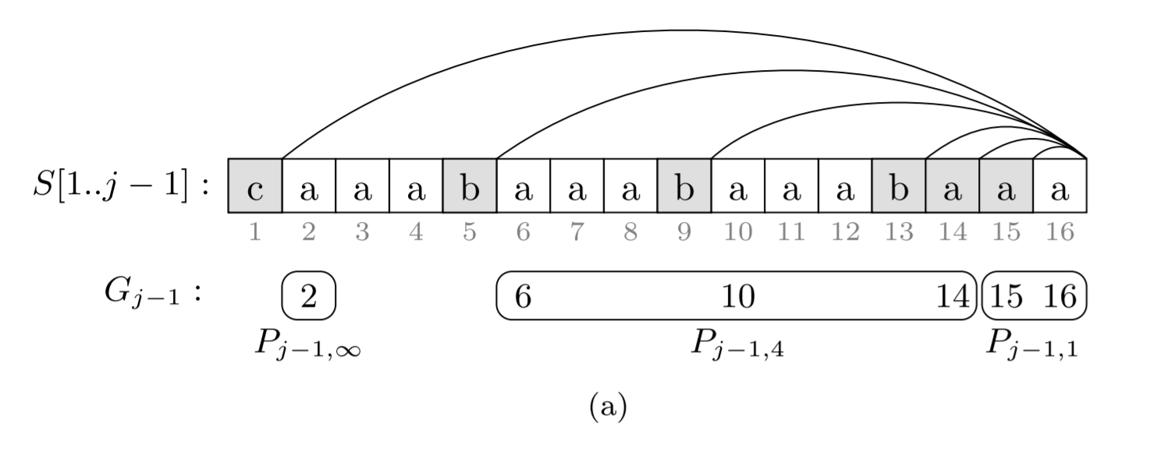

Grouping the suffix palindromes by periods
$P_{j−1,∞}=(2,∞,1)$
$P_{j−1,4} =(6,4,3)$
$P_{j−1,1} =(15,1,2)$

Slide 8
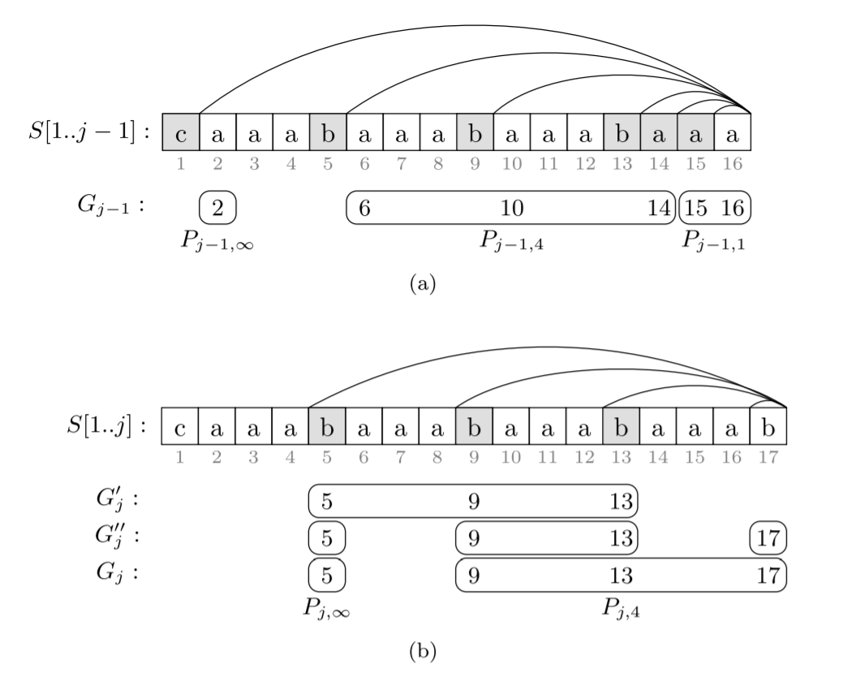

Update $G_{j}$

Slide 9

Modify triple depend on m (palindrome’s length)
If m = 4, $P_{j−1,∞}=(2,∞,1)$
$P_{j−1,4} =(6,4,3)$ $⇒$ $(6,4,1)$
$P_{j−1,1} =(15,1,2)$ $⇒$ $(15,1,0)$

Slide 10


DP formula
S = CAAAB, m=3, g = 2
P_{3,}$∞$ P_{3,1}
MG | 1 | 2 | 3 | 4 | 5
q \ S | C | A | A | A | B
0
1 | 1 | 2 | 3 | 1 | 5
2 | 1 | 2 | 3 | 1 | 2
MG’ | 1 | 2 | 3 | 4 | 5
q \ S | C | A | A | A | B
0 | 1 | 2 | 3 | 4 | 5
1 | 1 | 2 | 3 | 4 | 5
2 | 1 | 2 | 3 | 4 | 2

Slide 11
Computational problems

Slide 12
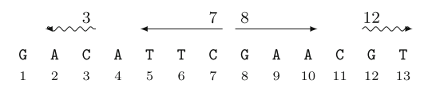
Longest Gapped Palindrome (LGPal) Queries
S = GACATTCGAACGT
LGPal(7,8)=3 LGPal(3,12) = 2

Slide 13
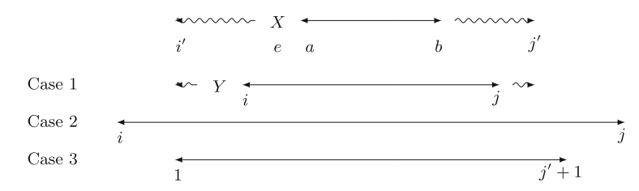

Computing Maximal Palindromes with Errors
deletion deletion substitution

Slide 14

Maximal Palindromic Decomposition with Gaps and Errors
Ex: m=5, δ=1, g=2
 |  |  |  |  |  | 0 |  | …
 |  |  |  | 5 | 1 | 0 | 1 | …
 |  |  |  | 5 | 1 | 0 | 1 | …

Slide 15
Open problem
Efficiently compute decompositions into palindromes that may contain errors and are not necessarily maximal.

