Slide 1
CNNpred CNN-based stock market prediction using several data sources
Ehsan Hoseinzade, Saman Haratizadeh
arXiv:1810.08923v1, Oct 21, 2018
Presenter: Cheng-Han Wu
Date:2019/2/19

Slide 2


Slide 3
Abstract(1/2)
Feature extraction from financial data is one of the most important problems in market prediction domain for which many approaches have been suggested. Among other modern tools, convolutional neural networks (CNN) have recently been applied for automatic feature selection and market prediction. However, in experiments reported so far, less attention has been paid to the correlation among different markets as a possible source of information for extracting features. In this paper, we suggest a CNN-based framework with specially designed CNNs, that can be applied on a collection of data from a variety of sources, including different markets, in order to extract features for predicting the future of those markets.

Slide 4
Abstract(2/2)
The suggested framework has been applied for predicting the next days direction of movement for the indices of S&P 500, NASDAQ, DJI, NYSE, and RUSSELL markets based on various sets of initial features. The evaluations show a significant improvement in predictions performance compared to the state of the art baseline algorithms.

Slide 5
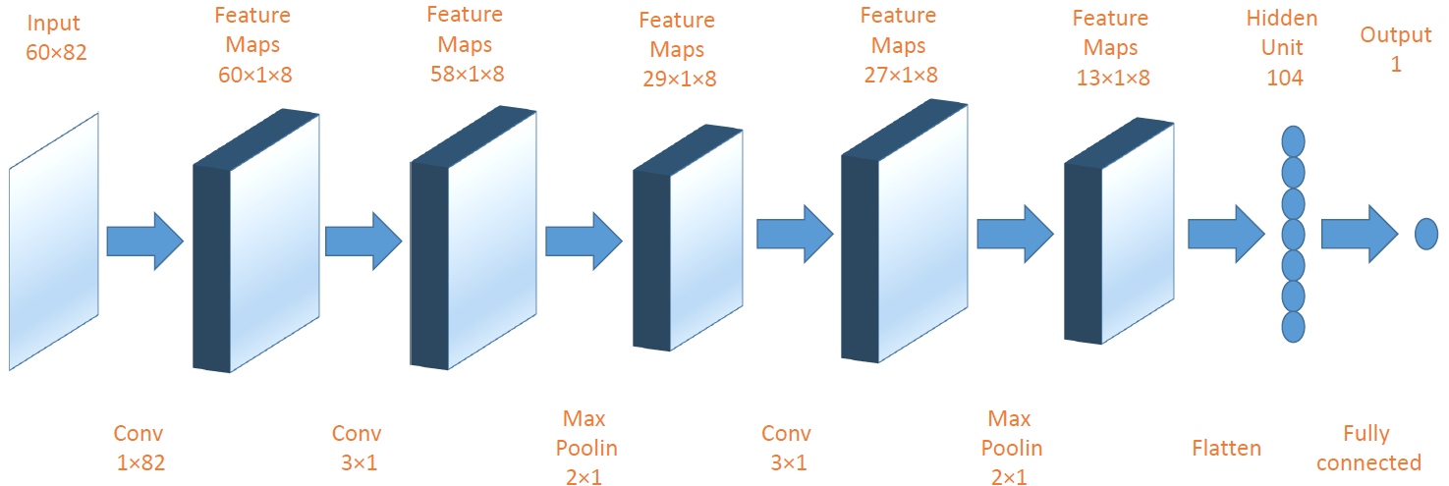
2D-CNNpred

Slide 6
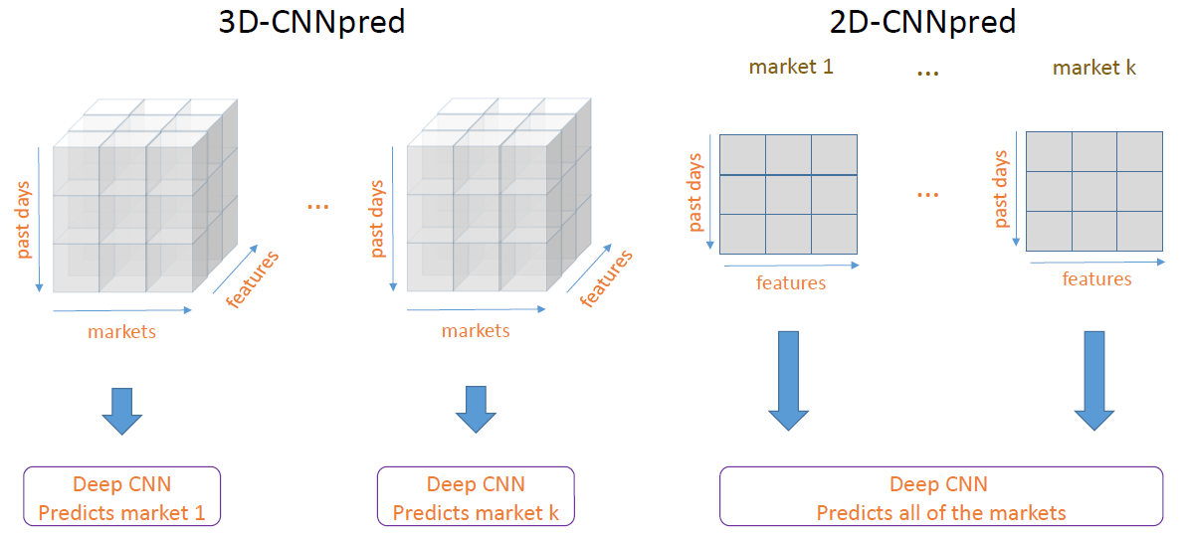
Difference of 2D-CNNpred and 3D-CNNpred

Slide 7
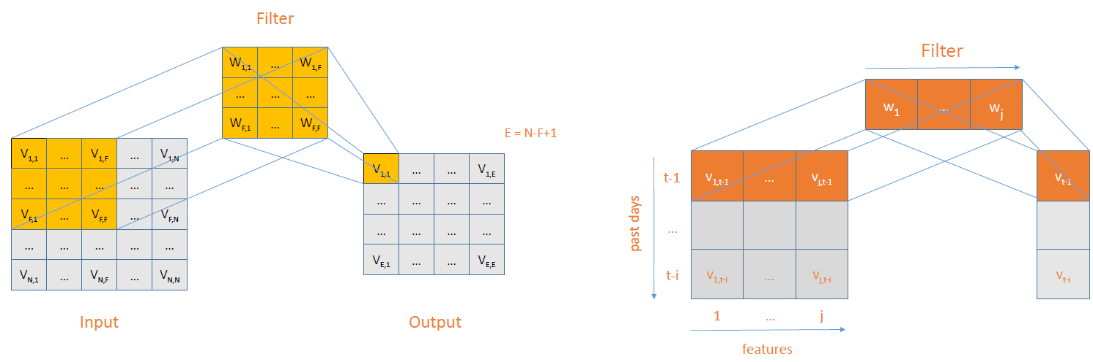
Difference of Filter

Slide 8
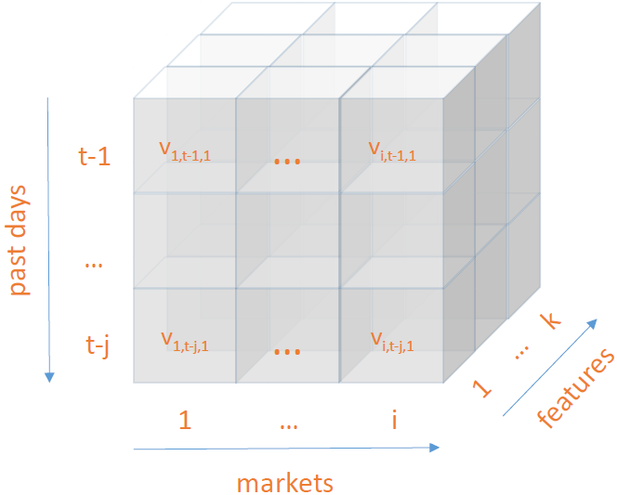
3D-Input

Slide 9
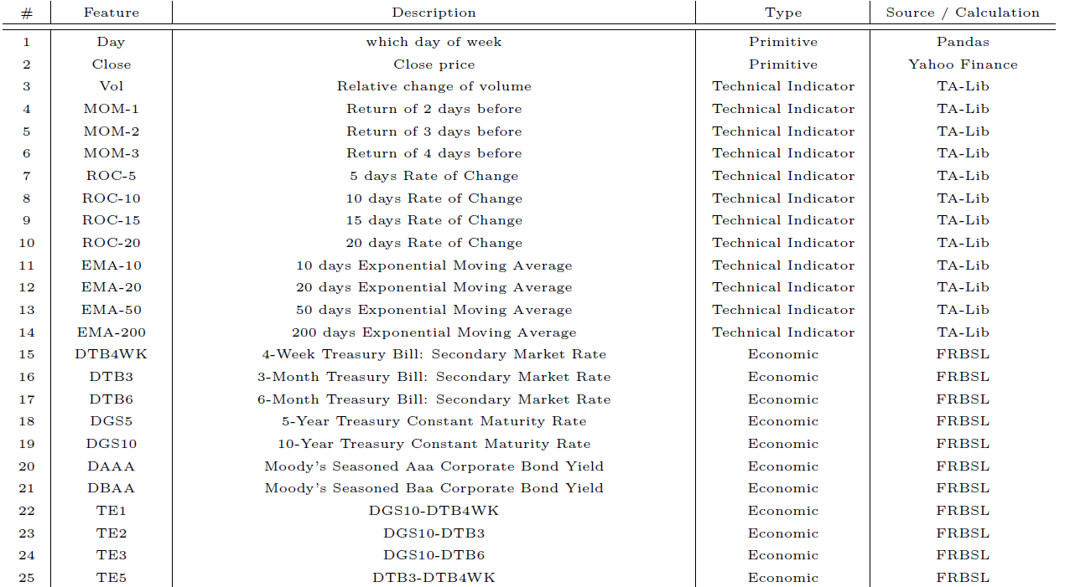
Features

Slide 10
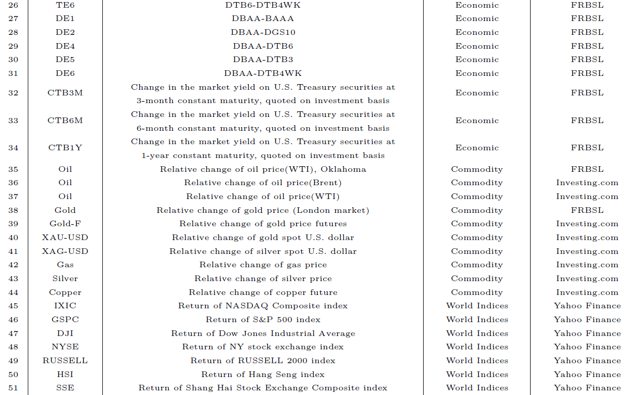

Slide 11
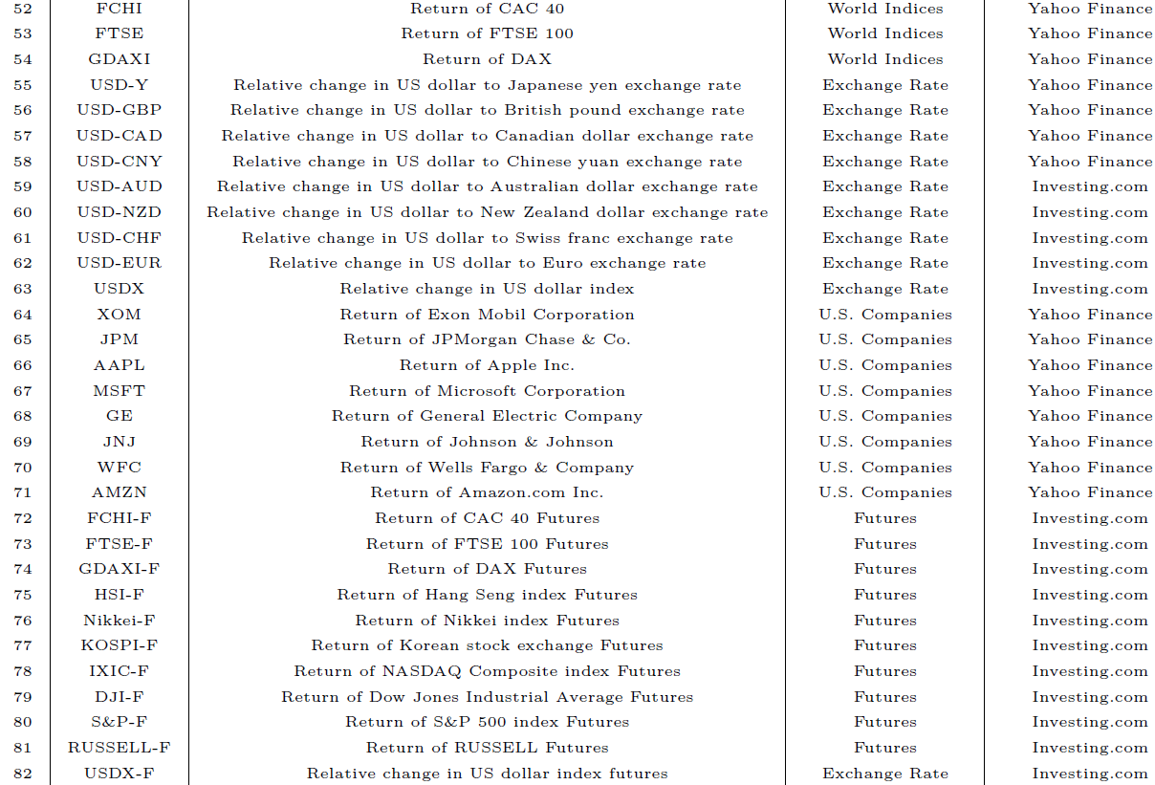

Slide 12
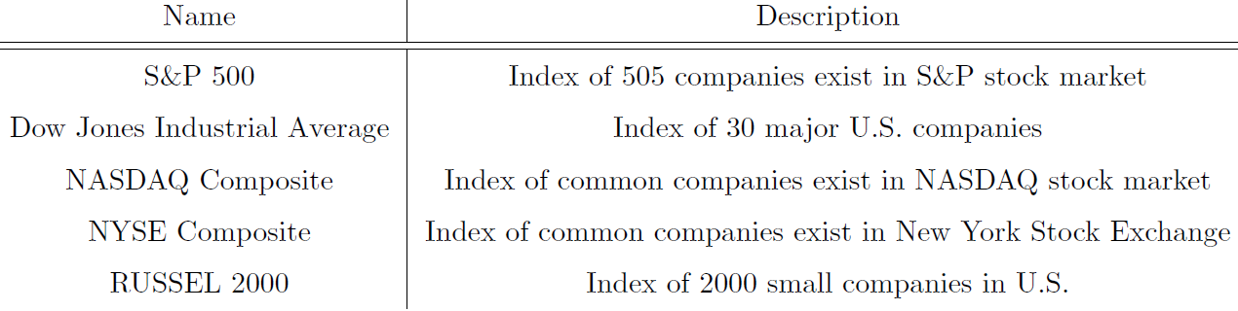
Markets
Jan 2010 to Nov 2017 (60% training, 20% validation, and 20% testing)

Slide 13
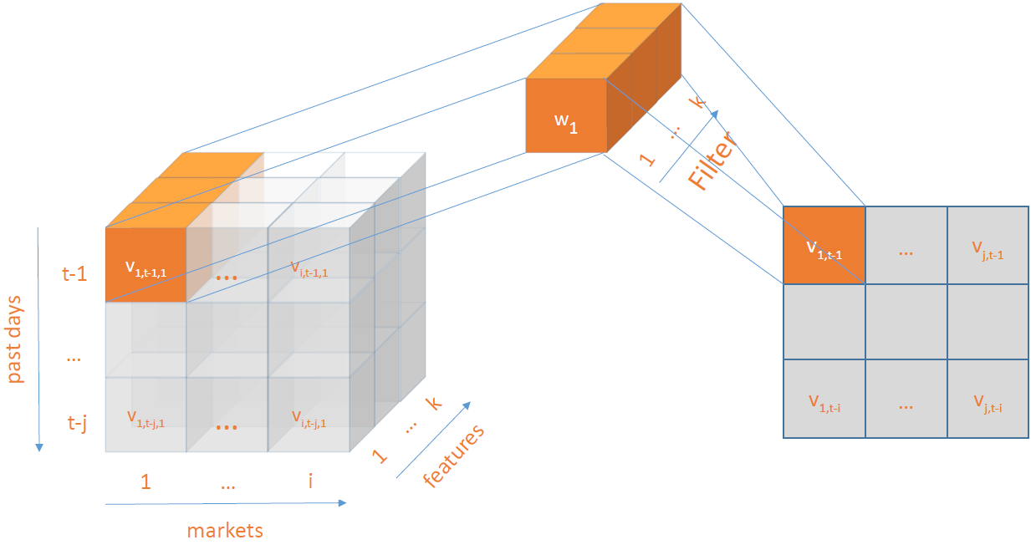
3D-Convolution
Notes:
三角形=WINDOW SIZE，<>

Slide 14
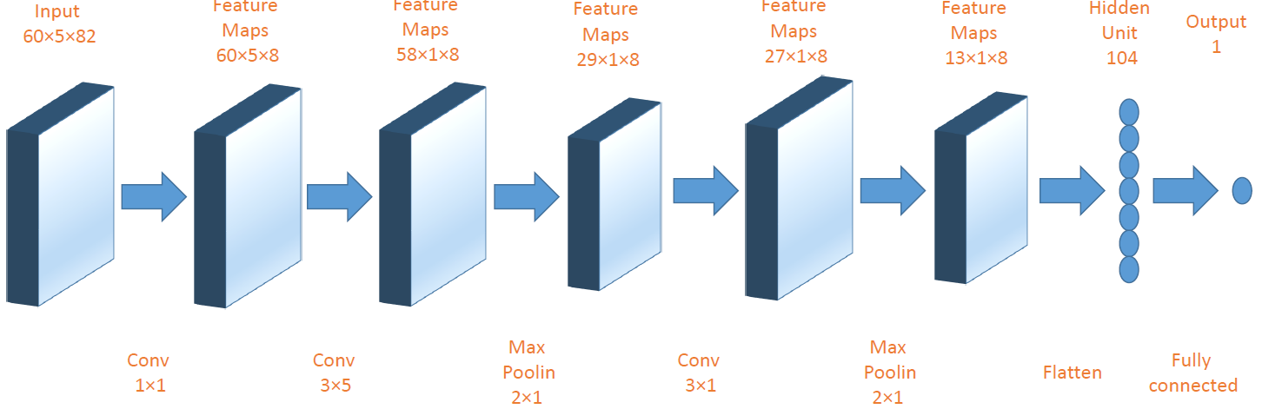
3D-CNNpred Model

Slide 15
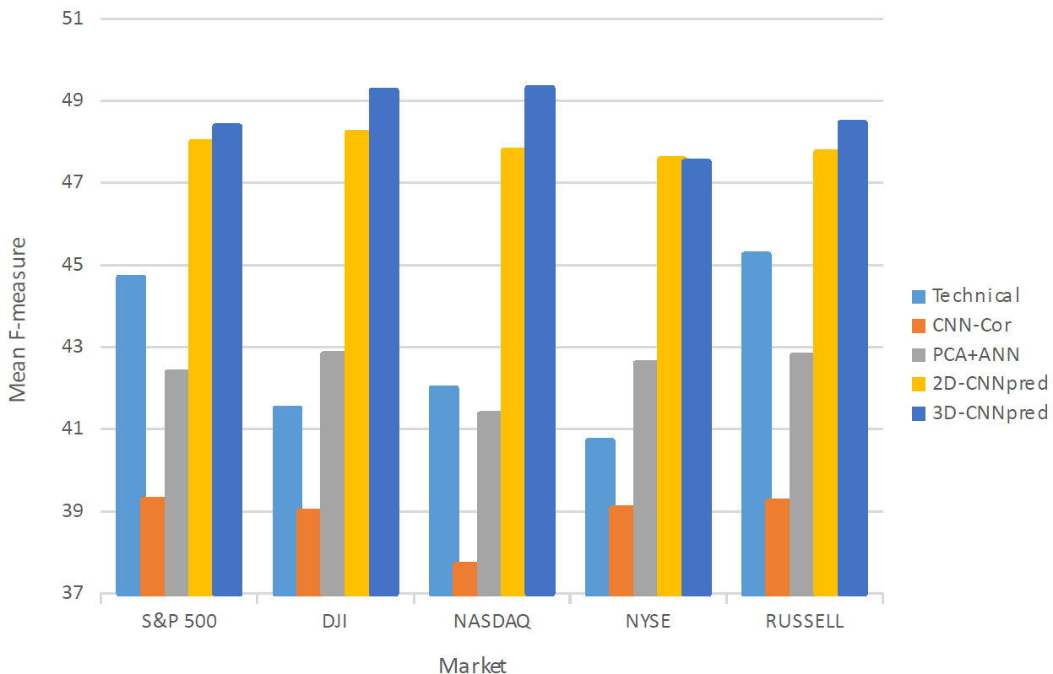
Experiment Result

