Slide 1
Longest Common Subsequence in at Least k Length Order-Isomorphic Substrings
Yohei Ueki, Diptarama, Masatoshi Kurihara, Yoshiaki Matsuoka, Kazuyuki Narisawa, Ryo Yoshinaka, Hideo Bannai, Shunsuke Inenaga, Ayumi Shinohara
43rd International Conference: Theory and Practice of Computer Science
Limerick, Ireland, January 16-20, 2017, pp.363-374
Presenter: Du-Cheng Wu
Date: Feb. 19, 2019
Notes:
https://www.google.com/maps/place/%E6%84%9B%E7%88%BE%E8%98%AD%E5%88%A9%E9%BB%98%E9%87%8C%E5%85%8B/@52.6451383,-8.8014936,10.46z/data=!4m5!3m4!1s0x485b5c611f545113:0xa00c7a997317330!8m2!3d52.6638367!4d-8.6267343

Slide 2
Abstract
We consider the longest common subsequence (LCS) problem with the restriction that the common subsequence is required to consist of at least k length substrings. First, we show an O(mn) time algorithm for the problem which gives a better worst-case running time than existing algorithms, where m and n are lengths of the input strings. Furthermore, we mainly consider the LCS in at least k length order-isomorphic substrings problem. We show that the problem can also be solved in O(mn) worst-case time by an easy-to-implement algorithm.

Slide 3

Longest Common Subsequence at least k substrings
X = ATTCGTATCG
Y = ATTGCTATGC
${LCS}_{2}$ = ATTA, ATAT, TTTA, TTAT = 4
${LCS}_{2+}$ = ATTTAT = 6

Slide 4
Order-isomorphism
X = (32, 40, 4, 16, 27)
Y = (28, 32, 12, 20, 25)
4 5 1 2 3
X ≈ Y

Slide 5

op-${LCS}_{k+}$
X = (14, 84, 82, 31, 74, 68, 87, 11, 20, 32)
Y = (21, 64, 2, 83, 73, 51, 5, 29, 7, 71)
$X⟨1,+3⟩≈Y⟨3,+3⟩$and $X⟨4,+4⟩≈Y⟨7,+4⟩$
Length = 7

Slide 6
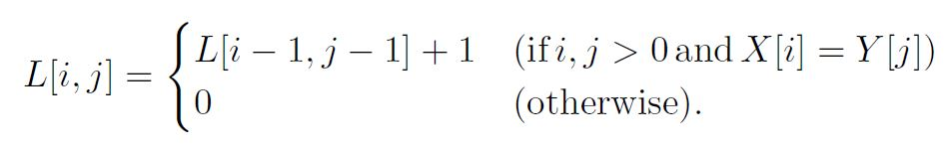
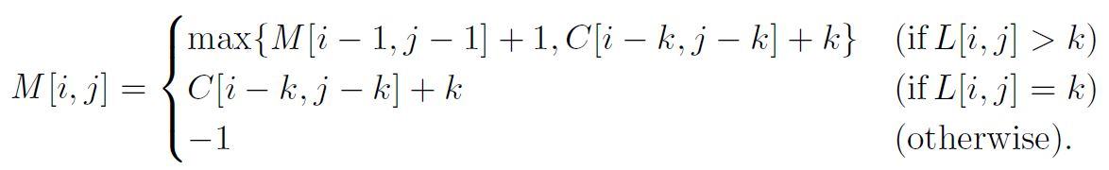
$${LCS}_{k+}$$
$C\left[i,j\right]=max (\{C\left[i,j−1\right],C[i−1,j]\}∪M[i,j])$ and C[i,j]=0 otherwise

Slide 7
$${LCS}_{k+}$$
X = abcdef
Y = abcbcdef
k = 3
 | 0 | a | b | c | b | c | d | e | f
0 | 0 | 0 | 0 | 0 | 0 | 0 | 0 | 0 | 0
a | 0 | 1 | 0 | 0 | 0 | 0 | 0 | 0 | 0
b | 0 | 0 | 2 | 0 | 1 | 0 | 0 | 0 | 0
c | 0 | 0 | 0 | 3 | 0 | 2 | 0 | 0 | 0
d | 0 | 0 | 0 | 0 | 0 | 0 | 3 | 0 | 0
e | 0 | 0 | 0 | 0 | 0 | 0 | 0 | 4 | 0
f | 0 | 0 | 0 | 0 | 0 | 0 | 0 | 0 | 5
 | 0 | a | b | c | b | c | d | e | f
0 | 0 | 0 | 0 | 0 | 0 | 0 | 0 | 0 | 0
a | 0 | 0 | 0 | 0 | 0 | 0 | 0 | 0 | 0
b | 0 | 0 | 0 | 0 | 0 | 0 | 0 | 0 | 0
c | 0 | 0 | 0 | 3 | 3 | 3 | 3 | 3 | 3
d | 0 | 0 | 0 | 3 | 3 | 3 | 3 | 3 | 3
e | 0 | 0 | 0 | 3 | 3 | 3 | 3 | 4 | 4
f | 0 | 0 | 0 | 3 | 3 | 3 | 3 | 4 | 6
 | 0 | a | b | c | b | c | d | e | f
0 | -1 | -1 | -1 | -1 | -1 | -1 | -1 | -1 | -1
a | -1 | -1 | -1 | -1 | -1 | -1 | -1 | -1 | -1
b | -1 | -1 | -1 | -1 | -1 | -1 | -1 | -1 | -1
c | -1 | -1 | -1 | 3 | -1 | -1 | -1 | -1 | -1
d | -1 | -1 | -1 | -1 | -1 | -1 | 3 | -1 | -1
e | -1 | -1 | -1 | -1 | -1 | -1 | -1 | 4 | -1
f | -1 | -1 | -1 | -1 | -1 | -1 | -1 | -1 | 6
Table L
Table C
Table M

Slide 8
op-${LCS}_{k+}$
X = (32, 40, 4, 16, 27, 41)
Y = (28, 32, 12, 20, 25, 26)
 | 28 | 32 | 12 | 20 | 25 | 26
32 | 1
40 |  | 2
4 |  |  | 3
16 |  |  |  | 4
27 |  |  |  |  | 5
41 |  |  |  |  |  | 4

Slide 9
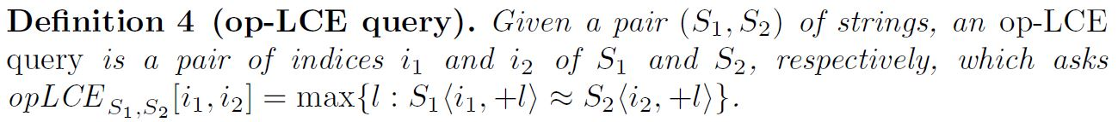

op-LCE

Slide 10
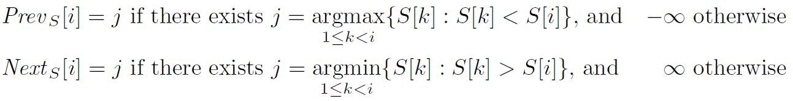
Z-table

Slide 11
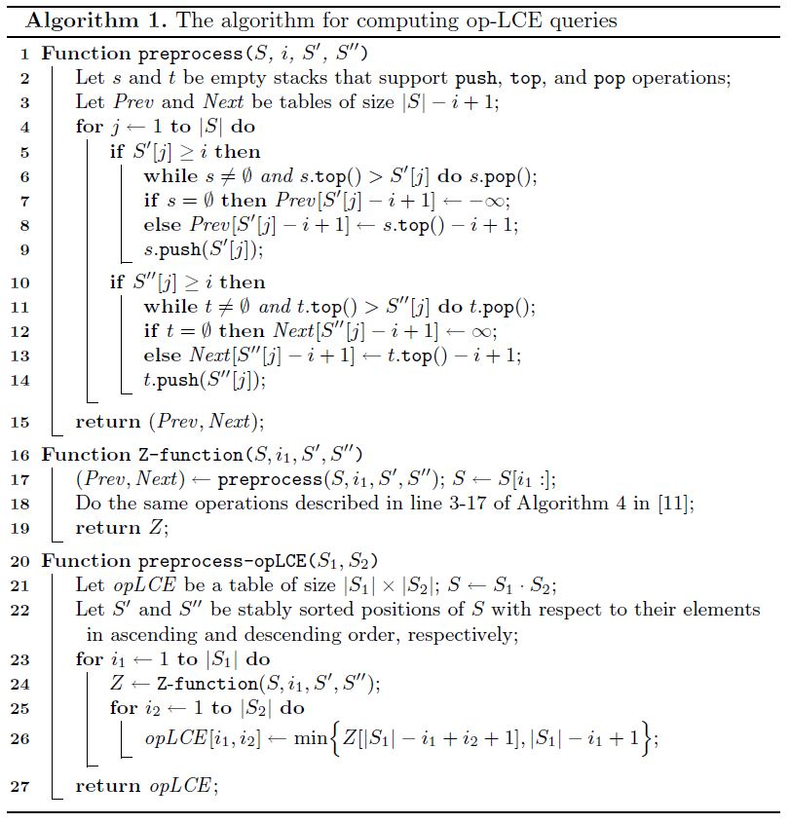
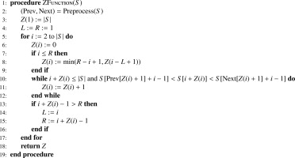
op-LCE algorithm

Slide 12
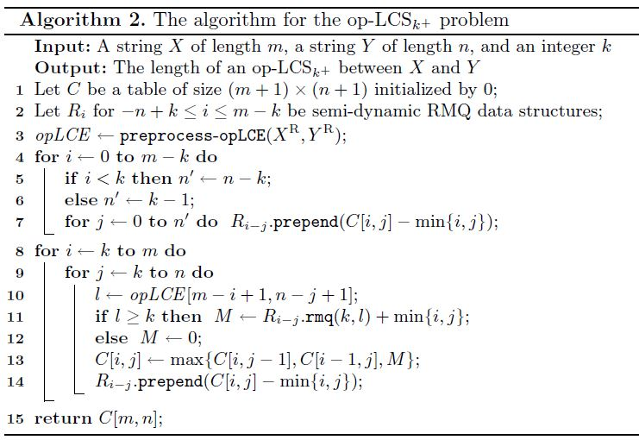
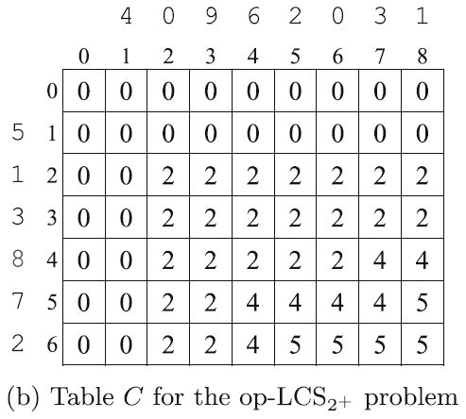
op-${LCS}_{k+}$ algorithm

Slide 13
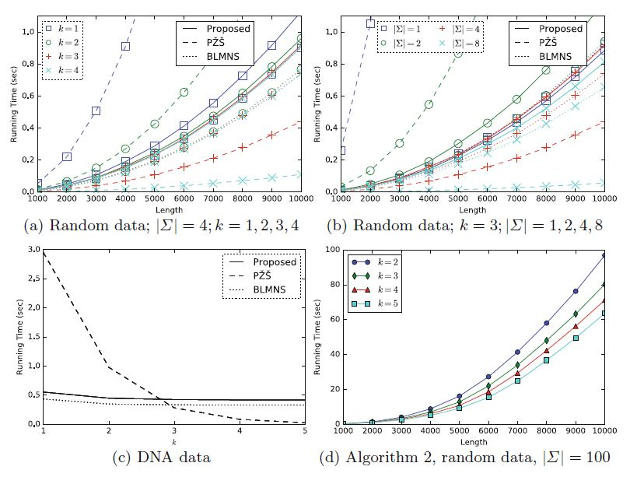
Experimental Results
Proposed O(mn)
BLMNS O(kmn)
PZS O(mn log(mn))

