Slide 1
Longest Property-Preserved Common Factor
Lorraine A.K Ayad, Giulia Bernardini, Roberto Grossi,
Costas S. Iliopoulos, Nadia Pisanti,
Solon P. Pissis, and Giovanna Rosone
Proceedings of International Symposium
on String Processing and Information Retrieval,
2018, Lima, Peru. , <hal-01921603>
Presenter: Ting-Wei Liang
Date: 2019/02/26

Slide 2
Abstract (1/2)
In this paper we introduce a new family of string processing problems. We are given two or more strings and we are asked to compute a factor common to all strings that preserves a specific property and has maximal length. Here we consider three fundamental string properties: square-free factors, periodic factors, and palindromic factors under three different settings, one per property. In the first setting, we are given a string x and we are asked to construct a data structure over x answering the following type of on-line queries: given string y, find a longest square-free factor common to x and y.

Slide 3
Abstract (2/2)
In the second setting, we are given k strings and an integer 1 < k’ ≤ k and we are asked to find a longest periodic factor common to at least k’ strings. In the third setting, we are given two strings and we are asked to find a longest palindromic factor common to the two strings. We present linear-time solutions for all settings. We anticipate that our paradigm can be extended to other string properties or settings.

Slide 4
Square-Free-Preserved
A string “uu” is called a square. A square-free string is a string that does not contain a square factor.
e.g.
S = baba , is a square string
T = abca , is a square-free string

Slide 5
Periodic-Preserved
S = ababbabba
runs (maximal length periods) of S :
S[1,4] = abab
S[2,9] = babbabba
S[4,5] = bb
S[7,8] = bb

Slide 6
Palindromic-Preserved
S = ababaa
Palindromic factor of S :
S[1,3] = aba
S[2,4] = bab
S[1,5] = ababa
S[3,5] = aba
S[5,6] = aa

Slide 7
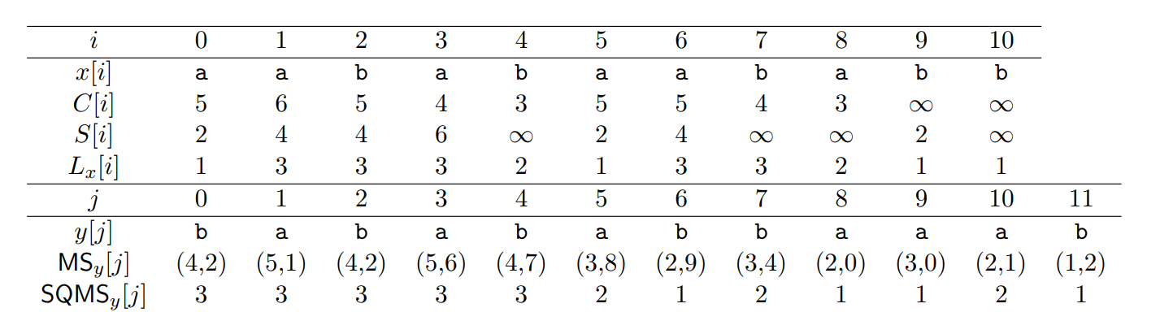
Square-Free-Preserved Matching Stastistics

Slide 8
Square-Free-Preserved Matching Stastistics

Slide 9
Square-Free-Preserved Matching Stastistics

Slide 10
Square-Free-Preserved Matching Stastistics

Slide 11
Square-Free-Preserved Matching Stastistics

Slide 12
Square-Free-Preserved Matching Stastistics

Slide 13
Square-Free-Preserved Matching Stastistics

Slide 14
Longest Periodic-Preserved Common Factor
X = ababbabba
Y = ababaab
Z = babbaa
k = 3, 1 < k’ ≤ k
LPCF₂ (X,Y,Z) = abab

Slide 15
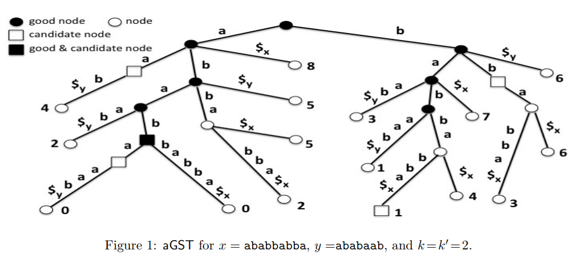
Longest Periodic-Preserved Common Factor

Slide 16
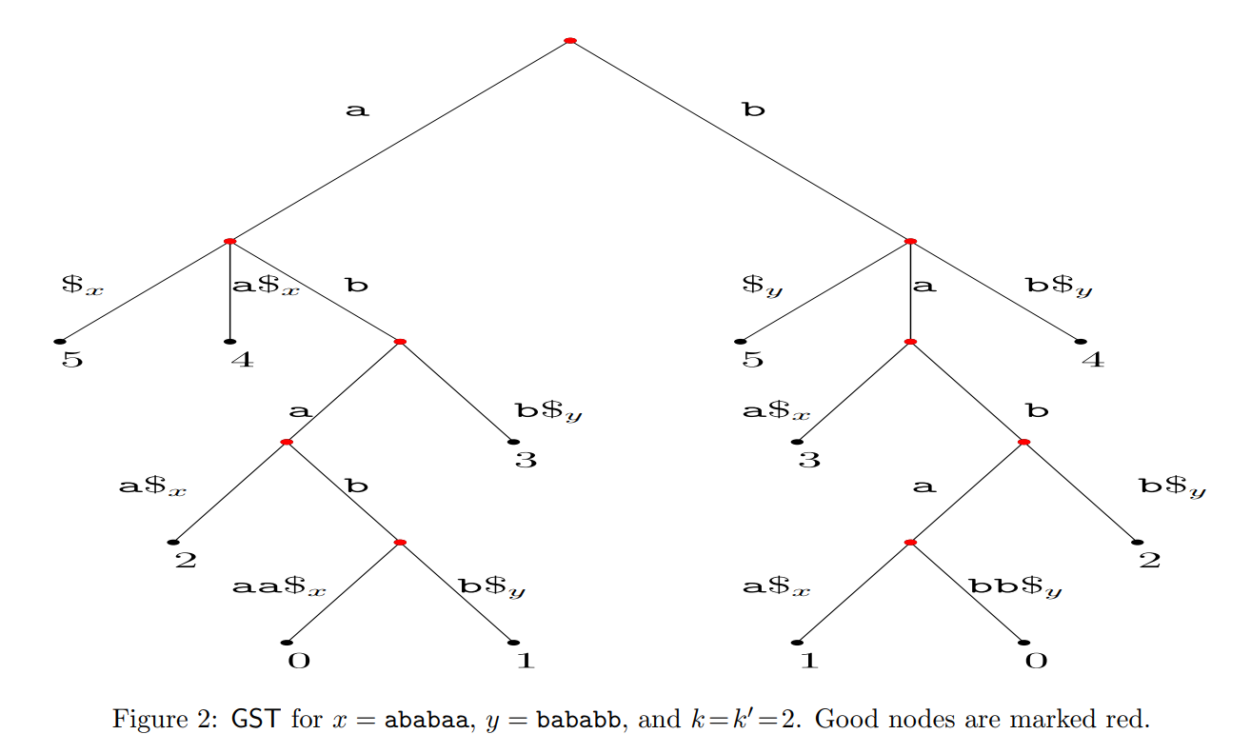
Longest Periodic-Preserved Common Factor

Slide 17
Longest Palindromic-Preserved Common Factor
X = ababaa
Y = bababb
LPALCP(X,Y) = aba or bab
X maximal palindromes Y maximal palindromes
a, b,
aba, bab,
ababa, babab,
aba, bab
a, b,
a b

