Slide 1
Variable Selection and Model Prediction Based on Lasso, Adaptive Lasso and Elastic Net
Lei Fan(范雷), Qun Li(李群), Shuai Chen(陳帥), Zhouli Zhu(朱周立)
4th International Conference on Computer Science and Network Technology (ICCSNT),2015, Pages 579 - 583, Harbin, China
Speaker: Jheng-Yan Lyu
Date: Feb. 26, 2019

Slide 2
Abstract (1/2)
Statistics and modeling is gaining more and more attention as the time for big data is coming. Variable choosing plays a significant role during modeling. The traditional methods like OLS and ridge regression could not satisfy interpretability and prediction accuracy at the same time. Tibshirani. R prompted Lasso and the new method could not only solve the above problem but also decrease the complexity of calculation. The paper aims to compare Lasso and adaptive lasso, elastic net. We do experiment on the classical case—diabetes patient data and choose model with AIC, BIC and cross validation to get the advantage and disadvantage of the above methods.

Slide 3
Abstract (2/2)
According to the result, we draw the conclusion that Lasso performances better in variable selection, however, the predictions are not as accurate as the other two methods. Adaptive Lasso selects less variables and gives a more accurant prediction value. Elastic net has a most interpretative model.

Slide 4

Ridge Regression
λ₁ = tuning parameter that controls the amount of shrinkage.
β_{j}= is a nonnegative regularization parameter
Using L2-norm loss function and shrinks regression coefficients equally towards zero.

Slide 5
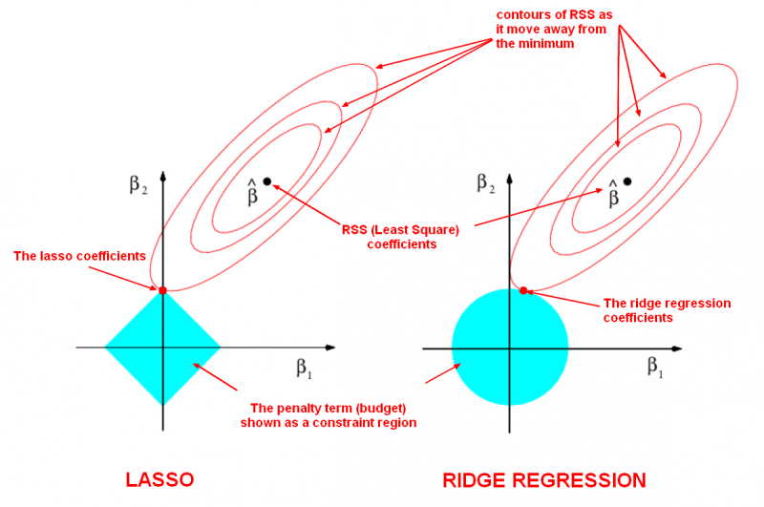

Slide 6
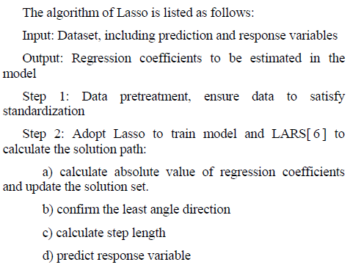

Lasso

Slide 7
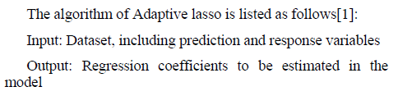
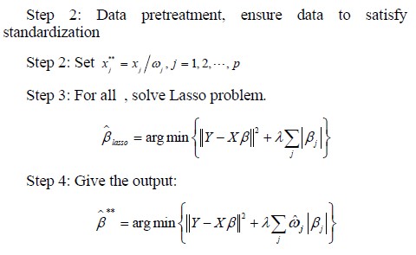

Adaptive Lasso
Oracle property
Consistency in variable selection
Asymptotic normality.

Slide 8
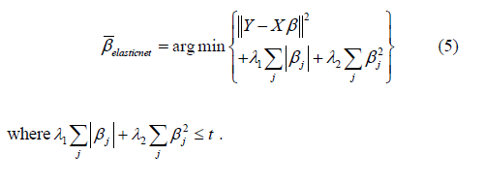
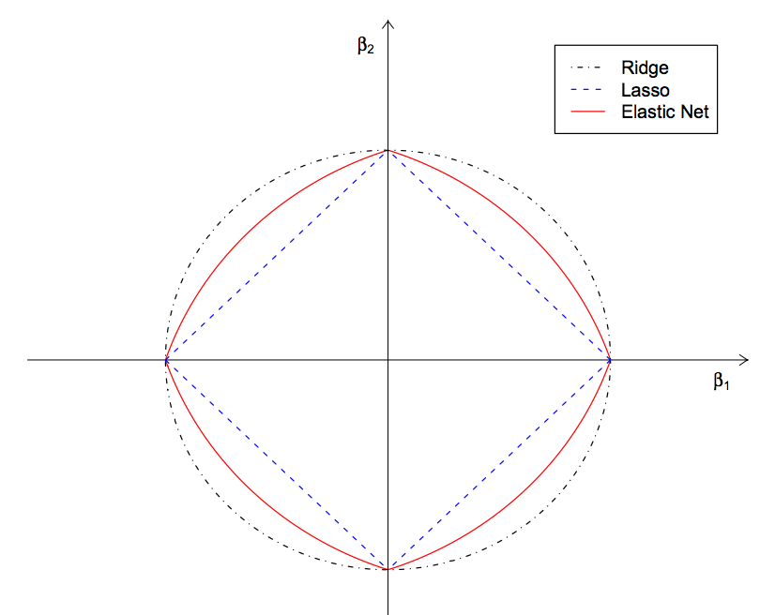
Elastic Net

Slide 9
Mode Selection Criterion
AIC(Akaike Information Criterion)
AIC = 2k - 2 ln(L)
k是模型參數個數，L是似然函數(likelihood fuction)。
提供權衡估計模型複雜度和擬合數據優良性的標準
從一組可供選擇的模型中選擇最佳模型時，通常選擇AIC最小的模型。
BIC(Bayes Information Criterion)
BIC = 2 ln(k) - 2 ln(L)
k是模型參數個數，L是似然函數。
BIC與AIC相似
訓練模型時，增加參數數量，也就是增加模型複雜度，會增大似然函數，但是也會導致過擬合現象，BIC的懲罰項比AIC的大，當樣本數量過多時，可有效防止模型精度過高造成的模型複雜度過高。
Cross Validation

Slide 10
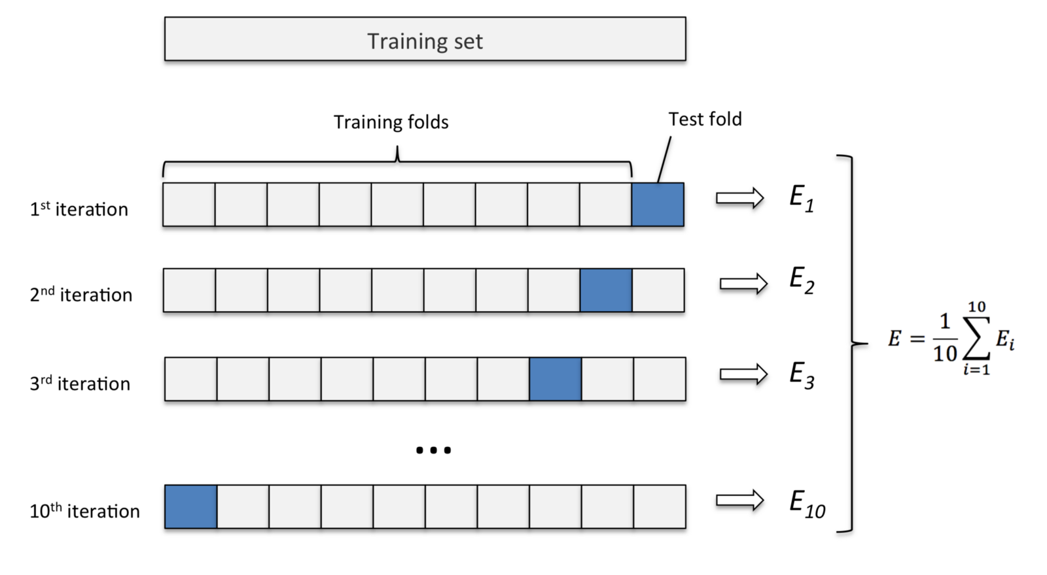
Mode Selection Criterion
Cross Validation

Slide 11
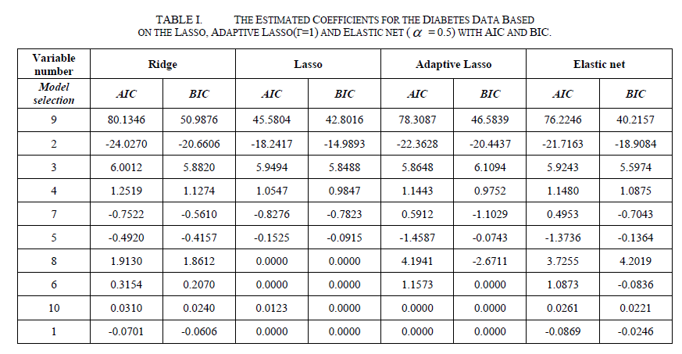
Case Analyze And Results

Slide 12
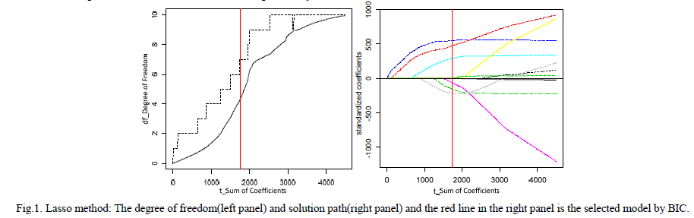
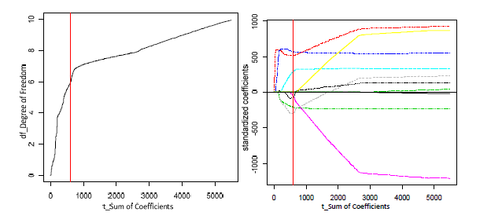
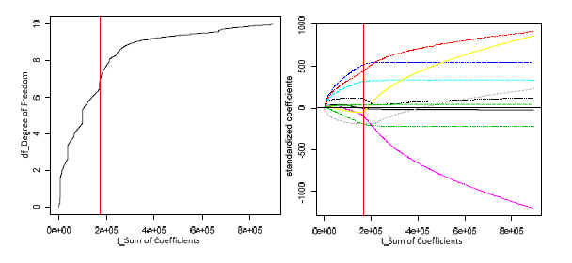
Variable Selection

Slide 13
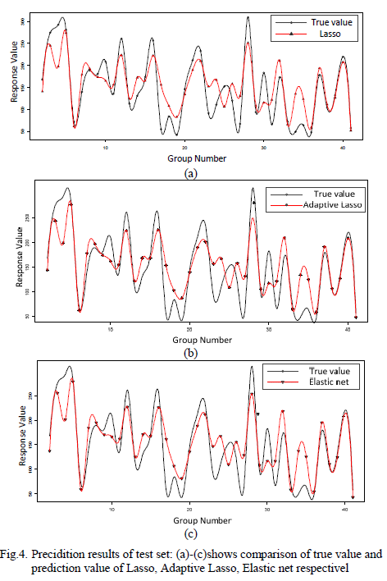
Model Prediction

Slide 14
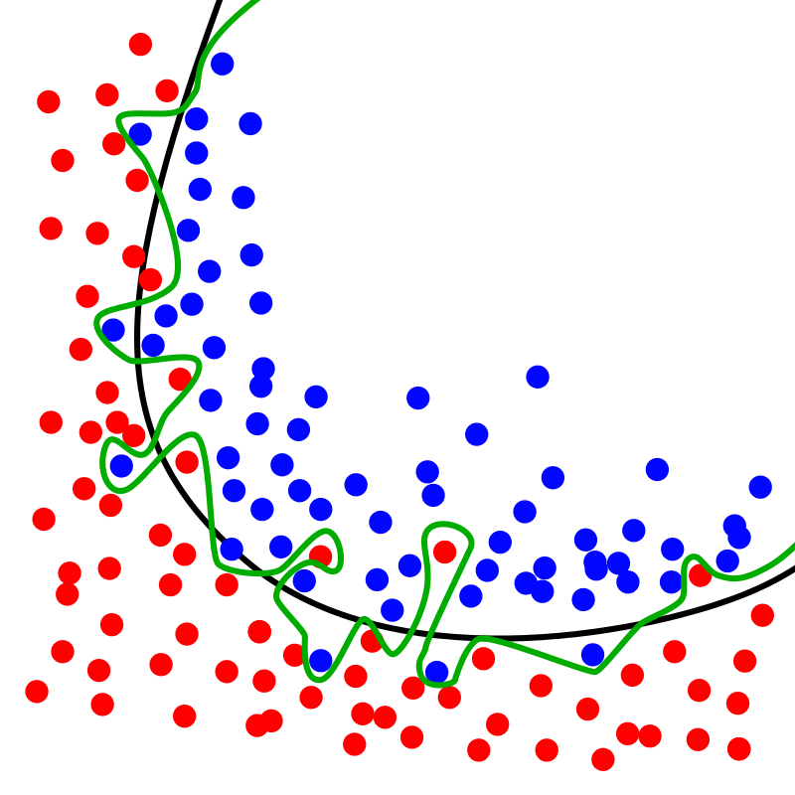
Overfitting
綠線代表過適模型，黑線代表正規化模型。雖然綠線完美的符合訓練資料，但太過依賴，並且與黑線相比，對於新的測試資料上具有更高的錯誤率。

