Slide 1
Prediction of Continuous B-cell Epitopes Using Long Short Term Memory Networks
Bin Cheng, Ling-yun Liu, Zhao-hui Qi ,
and Hong-guang Yang
2018 IEEE 6th International Conference on Bioinformatics and Computational Biology (ICBCB 2018), March 12–14, 2018, Chengdu, China.
Presenter : Feng-Yang Tsai
Date:Feb. 26, 2019.
Notes:
https://www.google.com.tw/maps/place/%E4%B8%AD%E5%9C%8B%E6%B2%B3%E5%8C%97%E7%9C%81%E7%9F%B3%E5%AE%B6%E5%BA%84%E5%B8%82%E6%A1%A5%E8%A5%BF%E5%8C%BA%E5%8F%8B%E8%B0%8A%E5%8D%97%E5%A4%A7%E8%A1%9746%E5%8F%B7(%E7%9C%81%E7%A7%91%E5%AD%A6%E9%99%A2%E4%BA%94%E5%8F%B7%E6%A5%BC%E5%9B%9B%E5%B1%82)+%E9%82%AE%E6%94%BF%E7%BC%96%E7%A0%81:+050041/@37.9900199,114.3673398,10.87z/data=!4m5!3m4!1s0x35e6df21cfdafe31:0xe3be1e8ff4b48563!8m2!3d38.033228!4d114.452201?hl=zh-TW&authuser=0
https://www.google.com.tw/maps/search/%E7%9F%B3%E5%AE%B6%E8%8E%8A%E9%90%B5%E9%81%93%E5%A4%A7%E5%AD%B8/@38.0626234,114.4565233,11.9z?hl=zh-TW&authuser=0
https://www.google.com.tw/maps/place/Tibet+Hotel+Chengdu/@30.6797797,104.0655234,15.27z/data=!4m5!3m4!1s0x36efdaea8ff1a9b5:0xf5123b05b5e27da3!8m2!3d30.682234!4d104.072169?hl=zh-TW&authuser=0

Slide 2
Abstract(1/2)
B-cell epitopes play a vital role in the epitope-based vaccine design. The accumulation of epitope sample data makes it possible to predict epitopes using machine learning methods. Compared with the experimental tests, the computational methods are faster and more economic. Several machine learning computational methods have been applied to improve the accuracy of epitope predictions. These methods have been improved several times in the epitope prediction has made some achievements, but there are also deficiencies. The commonly used propensity scale methods for the prediction are physicochemical properties of amino acid sequences. It is difficult to get a good classification result

Slide 3
Abstract(2/2)
in the network training using only the physicochemical properties of the sample sequence. In this study, we have developed a novel method for predicting continuous B-cell epitope. We adopted the Long Short Term Memory network and relevance of amino acids pair feature scale. Long Short Term Memory network can make up for the lack of recurrent artificial neural network algorithm, which is very suitable for epitope prediction. We have been adopted the performance of Long Short Term Memory network and the relevance of amino acids pair feature scale in three aspects, and achieved a certain result.
Notes:
人體的免疫機制可概分為先天性免疫與後天性免疫兩種。先天性免疫是指人類與生俱來的免疫細胞，如自然殺手細胞、巨噬細胞等，可以廣泛地識別外來的入侵物質，迅速與它反應並消滅它，這種免疫防衛反應快但不持久。而後天性免疫反應較慢，但其免疫細胞可以專一性地識別特定的入侵病原物質（免疫學上稱為抗原，通常由蛋白質所構成），同時對於交手過的抗原會有記憶，當相同的致病物質再次侵犯時，便會快速大量增生，加強打擊病原體的效果。 抗原蛋白質與抗體結合的部位稱為Ｂ細胞抗原決定位，每個抗原蛋白質可能含有一個或多個抗原決定位，也就是可被一種或多種抗體所辨識。根據抗原的結構，抗原決定位又分為線形抗原決定位及非線形抗原決定位（也稱為構形抗原決定位）。線形抗原決定位是指，抗原蛋白質以一級結構上一段連續的胺基酸序列與抗體結合。倘若抗體與抗原蛋白質結合時，同時接觸到立體摺疊的抗原蛋白質表面上的多個三級結構，形成一個複合立體結構，這種情況下與抗體接觸的抗原部位，則稱作非線形抗原決定位。 若能事先預測較可能誘發抗體生成並與之結合的抗原決定位的位置，就可以協助疫苗或者抗體的開發，能在疾病爆發時，給予患者立即的防護。因此，快速且準確地找出病原蛋白質的抗原決定位就顯得格外重要。

Slide 4
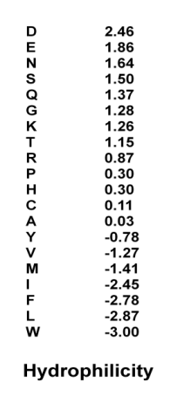
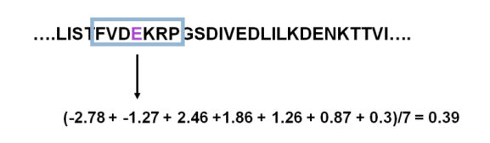
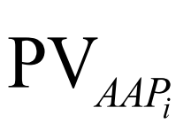
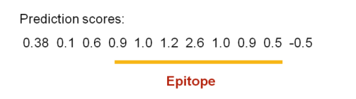
Propensity Scale Method:
Notes:
，可以知道使用單一性質無法準確地預測出可能的B細胞表頂但是如果使
用多項指標來找出可能的B細胞表頂，又不易確認出確切的邊界，因而產生過多的預測
結果。 為了改善以性質指標的方式預測的準確度提出了一些改善的方式，

Slide 5
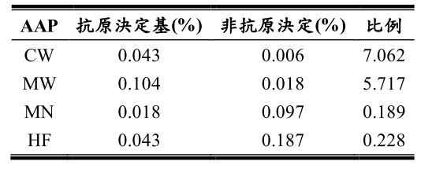
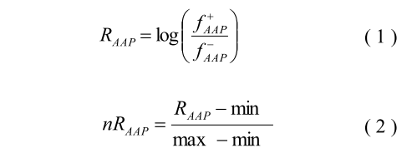
AAP Scale Approaches:
0.84
0.75
Notes:
這種方法是基於
假設抗原決定位對應的蛋白質序列通常含有大量的帶電荷性和極性以及親水性殘基。其
後，其他幾個傾向量表陸續被提出對於預測線性B細胞表頂，包括：親水性、易曲性、
轉位、以及溶液的可接近性質[29-32]為了改善以性質指標的方式預測的準確度提出了一些改善的方式，例如：提出根據
序列傾向的指標使用AAP指標[37]

Slide 6
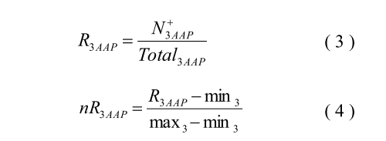
AAP Scale Approaches:
MCTGSFKLEK:
8 AAPs: MCT, CTG, TGS, GSF, SFK, FKL, KLE, and LEK.

Slide 7

RAAP Feature Scale:
The relevance of amino acids pair (RAAP) which is a novel feature scale.
MCTGSFKLEK:
8 AAPs: MCT, CTG, TGS, GSF, SFK, FKL, KLE, and LEK.

Slide 8
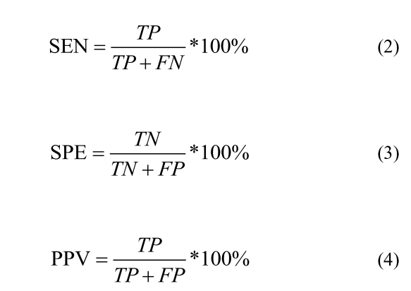
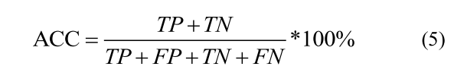
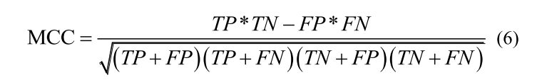
Evaluation Parameters:
PPV:
Positive Predictive Value
MCC:
Matthews Correlation Coefficient

Slide 9
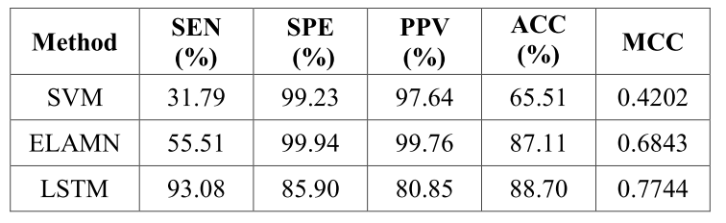
Results:
The performance of three methods developed on hydrophilicity of amino acids using our dataset.

Slide 10
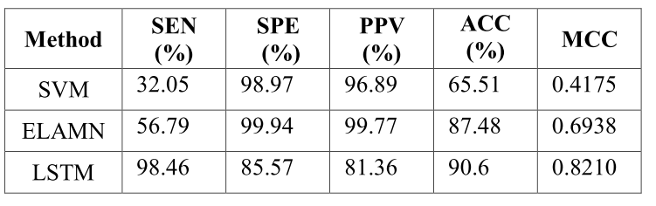
Results:
The performance of three methods developed on combination of two characters of amino acids using our dataset.

Slide 11
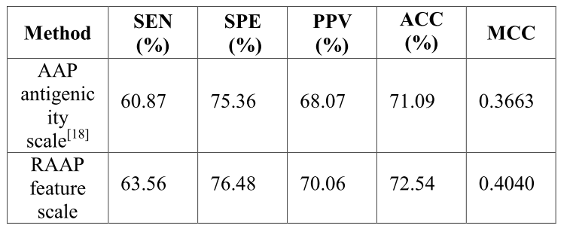
Results:
The performance of SVM methods using AAP antigenicity scale and RAAP feature scale on our dataset

