Slide 1
Computing Nonoverlapping Inversion Distance Between Two Strings in Linear Average Time
XIAODONG WANG (王晓东) and LEI WANG Journal of Computational Biology Vol. 26, No. 3, 2019 pp 193-201
Speaker: Kuan-Lin Lai
Date: Mar. 20, 2019

Slide 2
Abstract(1/2)
Biological events like inversions are not automatically detected by the usual alignment algorithms. Alignment with inversions does not have a known polynomial time algorithm and Scho¨niger and Waterman introduced a simplification of the alignment problem with nonoverlapping inversions, where all regions will not be allowed to overlap. They presented an O(n⁶) algorithm to compute nonoverlapping inversion distance between two strings of length n. The time and space complexities were improved to O(n³) and O(n²) later by Cho, Vellozo, and Ta.

Slide 3
Abstract(2/2)
In this article, a linear space and linear average time algorithm to compute the inversion distance between two strings of the same length is presented. The recursive formula for this purpose is new to the best of our knowledge. The space costs of the algorithms to solve the same problem are quadratic in the literature, and thus our original algorithm is the first linear space and linear average time algorithm to solve the inversion distance problem.

Slide 4
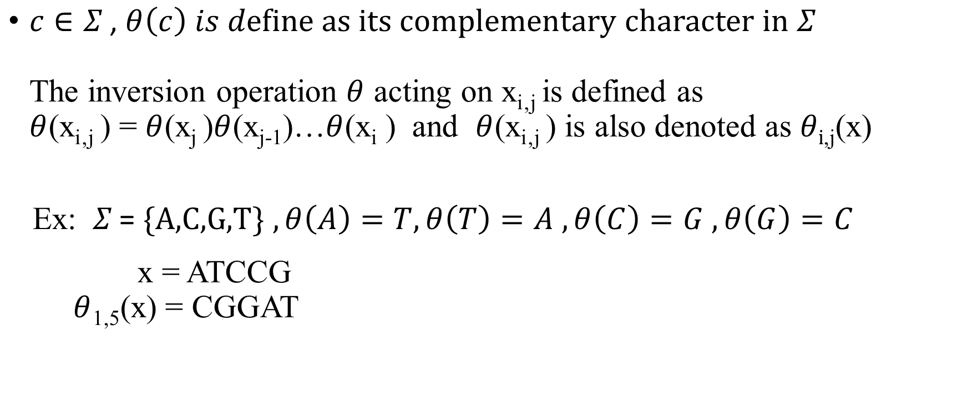
Preliminaries
$c∈Σ \text{,} θ\left(c\right) is d\text{efine} \text{as} \text{its} \text{complementary} \text{character} \text{in} Σ$ The inversion operation $θ$ acting on x_{i‚j} is defined as $θ$(x_{i‚j} ) = $θ$(x_{j} )$θ$(x_{j-1})…$θ$(x_{i} ) and $θ$(x_{i‚j} ) is also denoted as $θi$_{,j}(x)
Ex: $Σ \text{= }\text{\{}\text{A}\text{,}\text{C}\text{,}\text{G}\text{,}\text{T}\text{\}} ,θ\left(A\right)=T,θ\left(T\right)=A$ $,θ\left(C\right)=G$ $,θ\left(G\right)=C$ x = ATCCG $θ$_{1,5}(x) = CGGAT

Slide 5


Preliminaries
$id(x,y)$ : inversion distance
$Θ$ : feasible inversion operation set
$ID(x,y)$ : optimal inversion operation set if $\left|Θ\right|=id\left(x,y\right)$
$ξ\left(i\right)=\left\{ j \right.| 1≤j≤i , θ_{j,i}\text{(}\text{x}\text{) = }\left.y_{j,i}\right\}$
Ex: x = T A G G A C T C y = T C T G A G A G
$$ξ\left(3\right)=\left\{2\right\} ,ξ\left(6\right)=\left\{6\right\} ,ξ\left(7\right)=\left\{7\right\} , ξ\left(8\right)=\left\{6,8\right\} \\ Θ :\left\{θ\text{2,3}\text{(}\text{x}\text{)},θ\text{6,6}\text{(}\text{x}\text{)},θ\text{7,7}\text{(}\text{x}\text{)},θ\text{8,8}\text{(}\text{x}\text{)}\right\}, \left\{θ\text{2,2}\text{(}\text{x}\text{)},θ\text{6,8}\text{(}\text{x}\text{)}\right\} \\ id\left(x,y\right)=2 \\ ID\left(x,y\right)=\left\{θ\text{2,2}\text{(}\text{x}\text{)},θ\text{6,8}\text{(}\text{x}\text{)}\right\}$$

Slide 6
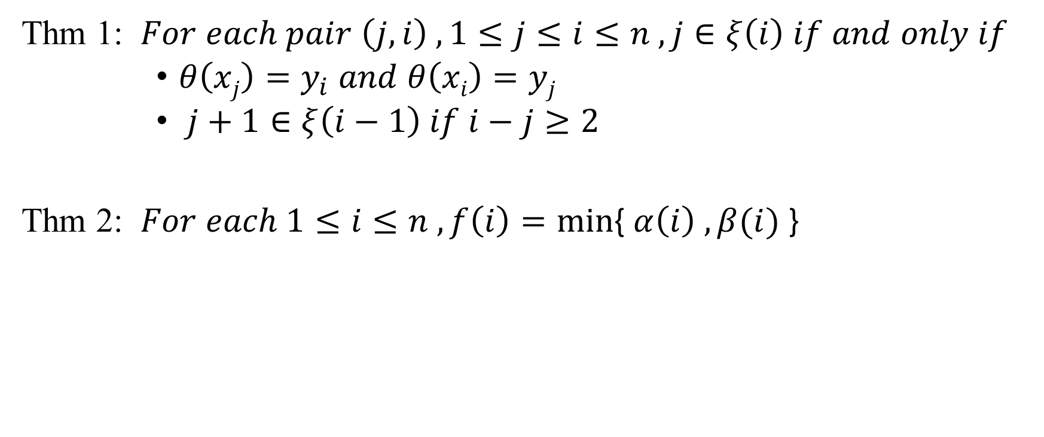
Theorem
Thm 1: $For each pair \left(j,i\right) , 1≤j≤i≤n , j∈ξ\left(i\right) if and only if$
$θ\left(xj\right)=y_{i} and θ\left(xi\right)=yj$
$j+1∈ξ\left(i−1\right) if i−j≥2$
Thm 2: $For each 1≤i≤n , f\left(i\right)=min${ $α\left(i\right) , β(i)$ }

Slide 7
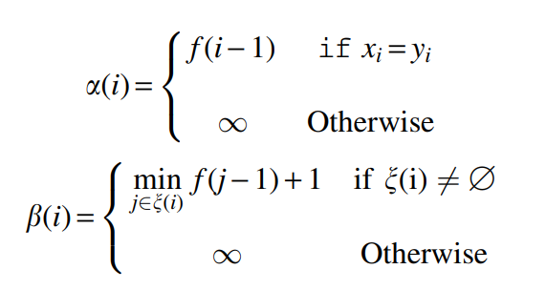

Theorem 2
$f\left(i\right)=id\left(x_{1,i} , y_{1,i}\right).$
Goal: $f\left(n\right)=id(x,y)$

Slide 8
Theorem
Thm 1: $For each pair \left(j,i\right) , 1≤j≤i≤n , j∈ξ\left(i\right) if and only if$
$θ\left(xj\right)=y_{i} and θ\left(xi\right)=yj$
$j+1∈ξ\left(i−1\right) if i−j≥2$
Thm 2: $For each 1≤i≤n , f\left(i\right)=min${ $α\left(i\right) , β(i)$ }

Slide 9

Algorithm
Ex: x = T A G G A C T C y = T C T G A G A G
f = (0, $∞$, 1, 1, 1, 2, 3, 2)
t = (0, 0 , 2, 0, 0, 6, 7, 6)
Queue 0 0 0 8
1 | 2 | 3 | … | 6 | 7 | 8
0 | 0 | 2 |  | 6 | 7 | 6
 |  | 0 |  | 0 | 0 | 8
 |  |  |  |  |  | 0

Slide 10
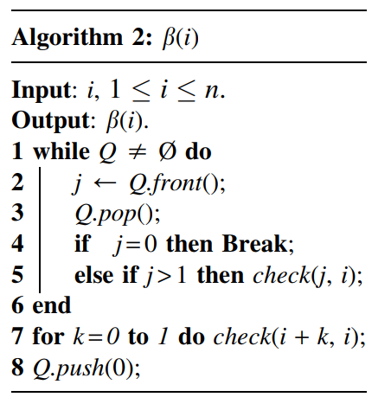
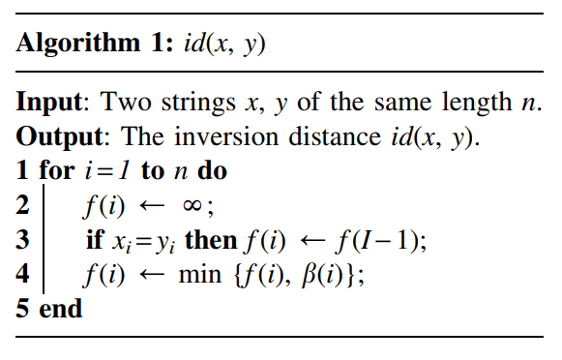

Slide 11
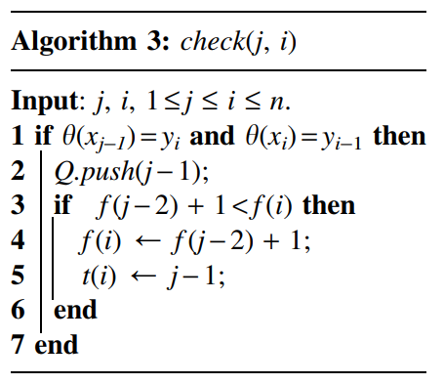
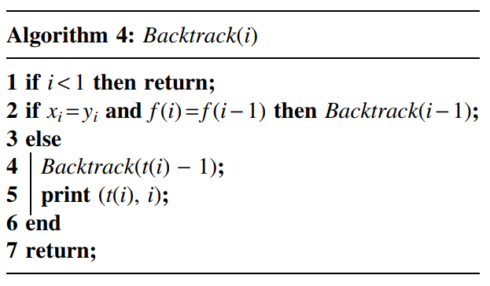

Slide 12
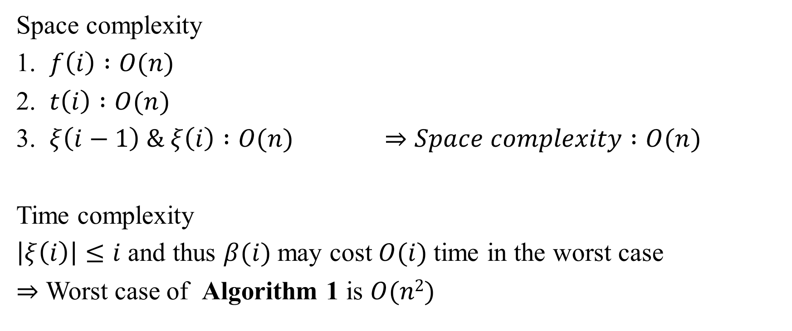
Time and Space complexity
Space complexity
1. $f\left(i\right) :O(n)$
2. $t\left(i\right) :O(n)$
3. $ξ\left(i−1\right) \& ξ\left(i\right) :O(n)$ $⇒Space complexity :O(n)$
Time complexity
$\left|ξ\left(i\right)\right|≤i$ and thus $β(i)$ may cost$O(i)$time in the worst case
$⇒$ Worst case of Algorithm 1 is $O(n2)$

Slide 13
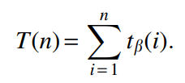
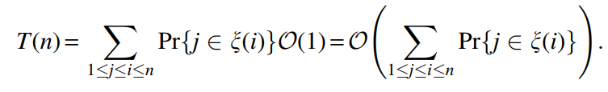

Time complexity in the average case
Time cost to compute $β(i)$ :
$∀j∈ξ\left(i\right)$, it cost $O\left(1\right)$ in the computation of $β(i)$

Slide 14
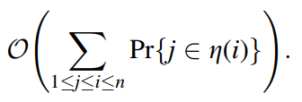

Time complexity in the average case
Let inversion of x be denoted as $z=θ\left(x_{n}\right)θ\left(x_{n−1}\right)…θ(x_{1})$
For each pair $(j,i)$
So, $T(n)$ is bounded above by

Slide 15
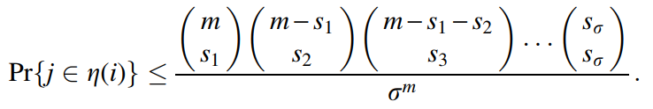
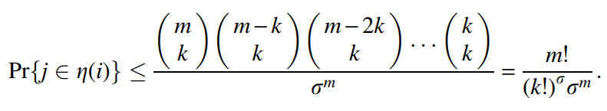
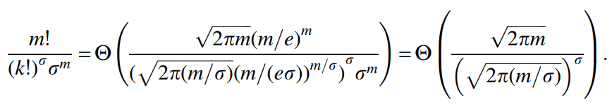

Time complexity in the average case
$m=i−j+1, s_{t}=g_{y}\left(j,i,t\right), k=\left\lfloor \frac{m}{σ}\right\rfloor , σ is alphabet size$

Slide 16

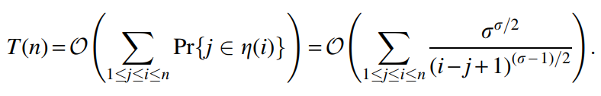
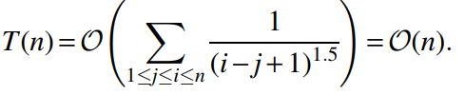
Time complexity in the average case

