Slide 1
A deep learning-based multi-model ensemble method for cancer prediction
Yawen Xiao, Jun Wu, Zongli Lin, and
Xiaodong Zhao
Computer Methods and Programs in Biomedicine 153 (2018) 1–9
Presenter : Feng-Yang Tsai
Date:Mar. 20, 2019.
Notes:
https://www.google.com/maps/place/%E7%B6%AD%E5%90%89%E5%B0%BC%E4%BA%9E%E5%A4%A7%E5%AD%B8/@36.8267898,-76.6091282,7.58z/data=!4m5!3m4!1s0x0:0x405108c2cc8b5846!8m2!3d38.0335529!4d-78.5079772

Slide 2
Abstract(1/2)
Cancer is a complex worldwide health problem associated with high mortality. With the rapid development of the high-throughput sequencing technology and the application of various machine learning methods that have emerged in recent years, progress in cancer prediction has been increasingly made based on gene expression, providing insight into effective and accurate treatment decision making. Thus, developing machine learning methods, which can successfully distinguish cancer patients from healthy persons, is of great current interest. However, among the classiﬁcation methods applied to cancer prediction so far, no one method outperforms all the others. In this paper, we demonstrate a new strategy, which applies

Slide 3
Abstract(2/2)
deep learning to an ensemble approach that incorporates multiple different machine learning models. We supply informative gene data selected by differential gene expression analysis to ﬁve different classiﬁcation models. Then, a deep learning method is employed to ensemble the outputs of the ﬁve classiﬁers. By taking full advantage of different classiﬁers, the proposed deep learning-based multi-model ensemble method is shown to be accurate and effective for cancer prediction.

Slide 4
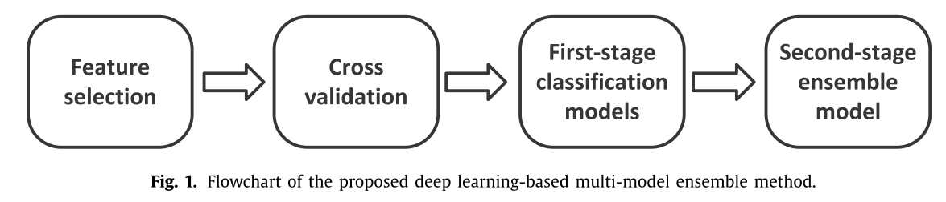
Multi-model ensemble method :

Slide 5
Feature selection :
TCGA(The Cancer Genome Atlas：人類癌症基因組圖譜
Lung Adenocarcinoma (LUAD)
Stomach Adenocarcinoma (STAD)
Breast Invasive Carcinoma (BRCA)
In this paper, we employ the DESeq method to select informative genes for the downstream classiﬁcation.
p=0<0.01
Notes:
差異信息矩陣，其中包括差異倍數(log fold change)，差異顯著程度(adjusted p-value)

Slide 6

男生身高資料{170,175,178,180}
女生身高資料{160,165,168,150}
虛無假設(H0): 平均數(男生身高)= 平均數(女生身高) 對立假設(H1): 平均數(男生身高)≠平均數(女生身高)
平均數(女生身高)= 148.2253 平均數(男生身高)= 179.8867 標準差(女生身高)= 8.6371 標準差(男生身高)= 8.5540
Notes:
準確率為 0.91，即 91%（總共 100 個樣本中有 91 個預測正確）。這表示我們的腫瘤分類器在識別惡性腫瘤方面表現得非常出色，對吧？
實際上，只要我們仔細分析一下正類別和負類別，就可以更好地了解我們模型的效果。
在 100 個腫瘤樣本中，91 個為良性（90 個 TN 和 1 個 FP），9 個為惡性（1 個 TP 和 8 個 FN）。
在 91 個良性腫瘤中，該模型將 90 個正確識別為良性。這很好。不過，在 9 個惡性腫瘤中，該模型僅將 1 個正確識別為惡性。這是多麽可怕的結果！9 個惡性腫瘤中有 8 個未被診斷出來！
雖然 91% 的準確率可能乍一看還不錯，但如果另一個腫瘤分類器模型總是預測良性，那麽這個模型使用我們的樣本進行預測也會實現相同的準確率（100 個中有 91 個預測正確）。換言之，我們的模型與那些沒有預測能力來區分惡性腫瘤和良性腫瘤的模型差不多。
當您使用分類不平衡的數據集（比如正類別標簽和負類別標簽的數量之間存在明顯差異）時，單單準確率一項並不能反映全面情況。

Slide 7

平均數(女生身高)=169.6028 平均數(男生身高)=174.1443 標準差(女生身高)= 32.1374 標準差(男生身高)= 30.8397
因為p=0<0.05，我們必須拒絕「虛無假設(H0):平均數(男生身高)=平均數(女生身高)」，所以範例1結論是「男生跟女生身高是有統計上顯著差異的」。
因為p=0.3092>0.05，我們不能拒絕「虛無假設(H0):平均數(男生身高)=平均數(女生身高)」，所以範例2結論是「男生跟女生身高是有統計上沒有顯著差異的」。

Slide 8
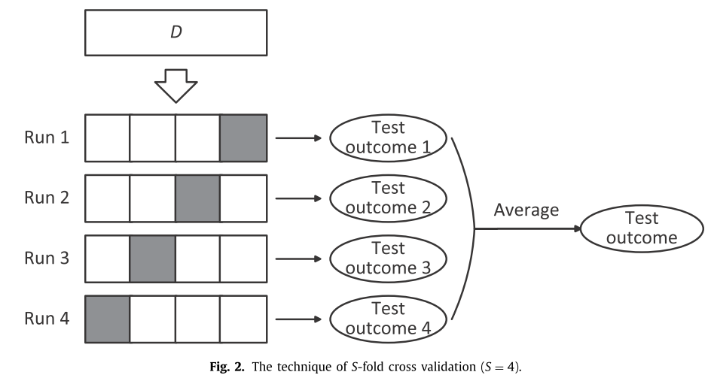
Cross validation :

Slide 9
Classiﬁcation methods :
GBDT:GB（Gradient Boosting）
26
20
3
6
3
2
1
1

Slide 10
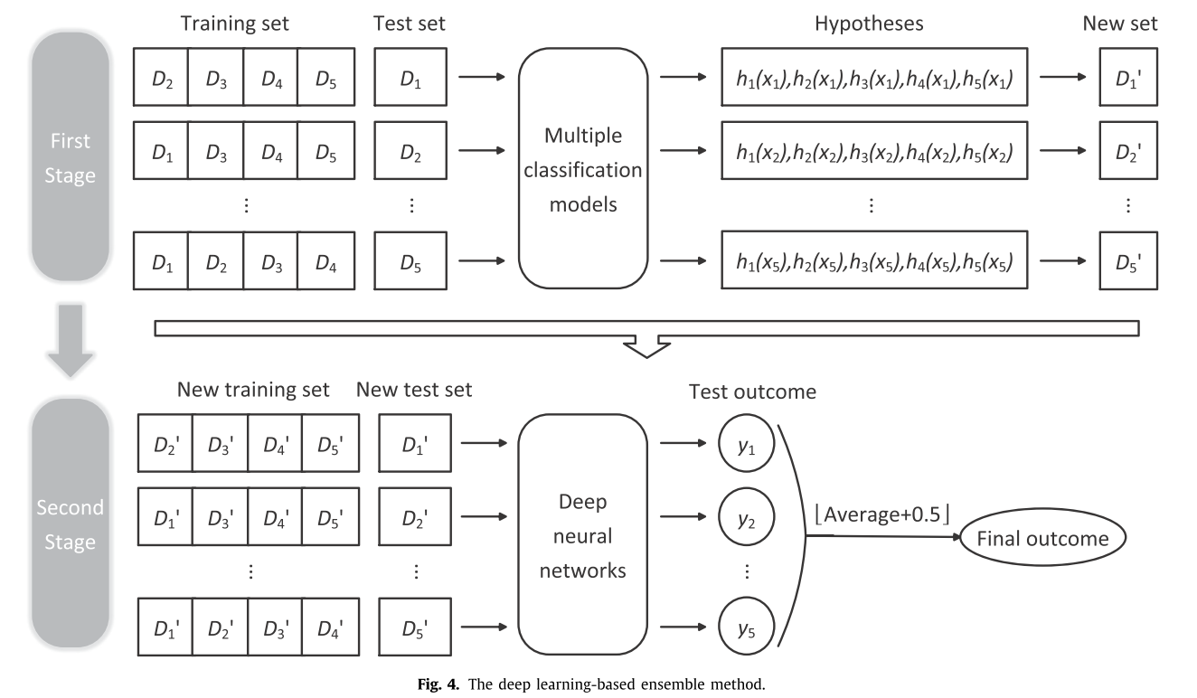
Multi-model ensemble based on deep learning :

Slide 11
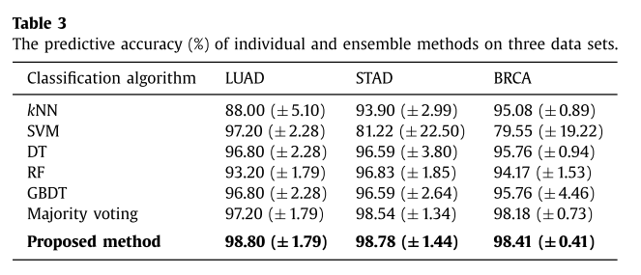
Result :

