Slide 1
The Longest Almost Wave Subsequence Problem
Shin-Cheng Lin, Kuo-Si Huang and Chang-Biau Yang
CMCT2023
Presenter: Wen-Yu Chang
Date: Nov. 14, 2023
Notes:
組合數學與計算理論研討會

Slide 2
Abstract(1/2)
In this paper, we first define a new longest almost wave subsequence (LaWS) problem by combining the longest almost increasing subsequence (LaIS) problem (Elmasry, 2010) and the longest wave subsequence (LWS) problem (Chen and
Yang, 2020). The three problems are all generalized variants of the longest increasing subsequence (LIS) problem.

Slide 3
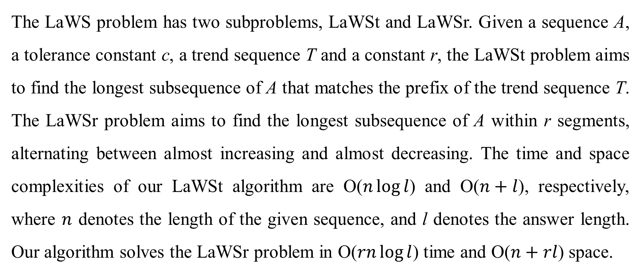
Abstract(2/2)
The LaWS problem has two subproblems, LaWSt and LaWSr. Given a sequence A, a tolerance constant c, a trend sequence T and a constant r, the LaWSt problem aims to find the longest subsequence of A that matches the prefix of the trend sequence T. The LaWSr problem aims to find the longest subsequence of A within r segments, alternating between almost increasing and almost decreasing. The time and space complexities of our LaWSt algorithm are O($n\log{l}$) and O($n+l$), respectively, where $n$ denotes the length of the given sequence, and l denotes the answer length. Our algorithm solves the LaWSr problem in O($rn\log{l}$) time and O($n+rl$) space.

Slide 4
Longest Almost Wave Subsequence with Trend (LaWSt)
$$A=\left\langle 2, 13, 1, 5, 4, 3, 6,14, 15, 14, 16, 15, 17\right\rangle$$
$$T=\left\langle 0, 1, 1, 1, 0, 0, 0, 0, 1, 1, 1, 1, 1\right\rangle$$
$$c=3$$
The LaWSt sequence is $\left\langle 2, 1, 5, 14, 15, 14, 16, 15, 17\right\rangle$

Slide 5
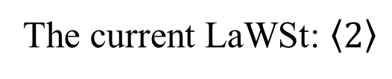
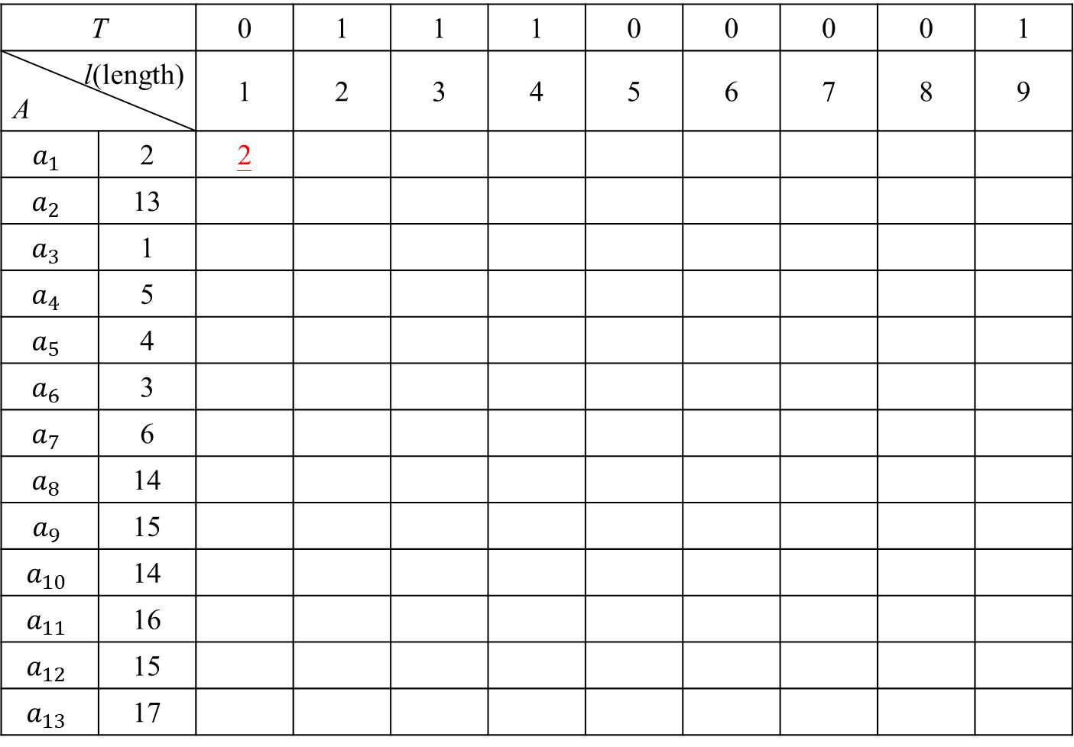
LaWSt
T |  | 0 | 1 | 1 | 1 | 0 | 0 | 0 | 0 | 1
l(length) A |  | 1 | 2 | 3 | 4 | 5 | 6 | 7 | 8 | 9
$$a_{1}$$ | 2 | 2
$$a_{2}$$ | 13
$$a_{3}$$ | 1
$$a_{4}$$ | 5
$$a_{5}$$ | 4
$$a_{6}$$ | 3
$$a_{7}$$ | 6
$$a_{8}$$ | 14
$$a_{9}$$ | 15
$$a_{10}$$ | 14
$$a_{11}$$ | 16
$$a_{12}$$ | 15
$$a_{13}$$ | 17
$$c=3$$
The current LaWSt: $\left\langle 2\right\rangle$

Slide 6
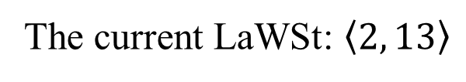
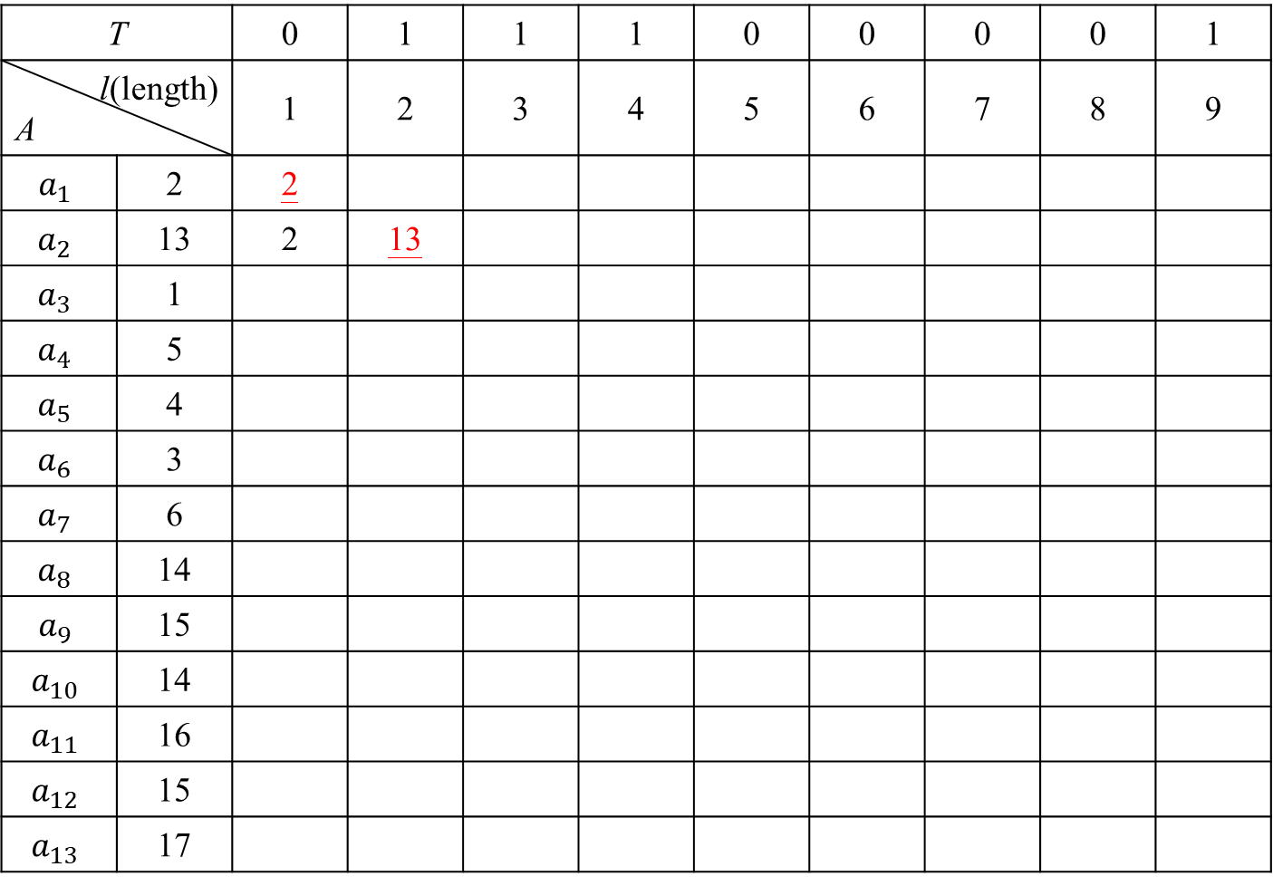
LaWSt
T |  | 0 | 1 | 1 | 1 | 0 | 0 | 0 | 0 | 1
l(length) A |  | 1 | 2 | 3 | 4 | 5 | 6 | 7 | 8 | 9
$$a_{1}$$ | 2 | 2
$$a_{2}$$ | 13 | 2 | 13
$$a_{3}$$ | 1
$$a_{4}$$ | 5
$$a_{5}$$ | 4
$$a_{6}$$ | 3
$$a_{7}$$ | 6
$$a_{8}$$ | 14
$$a_{9}$$ | 15
$$a_{10}$$ | 14
$$a_{11}$$ | 16
$$a_{12}$$ | 15
$$a_{13}$$ | 17
$$c=3$$
The current LaWSt: $\left\langle 2, 13\right\rangle$

Slide 7
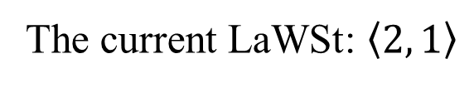
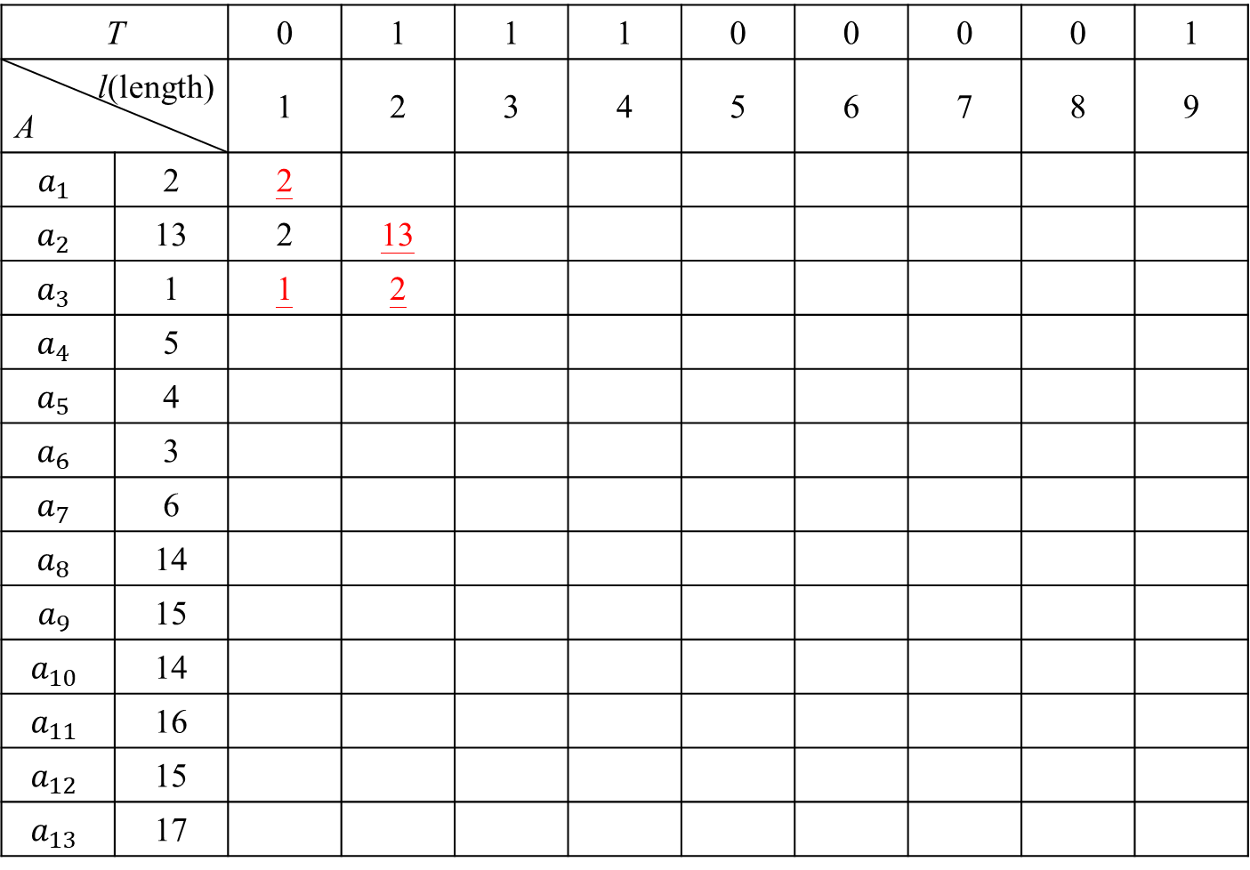
LaWSt
T |  | 0 | 1 | 1 | 1 | 0 | 0 | 0 | 0 | 1
l(length) A |  | 1 | 2 | 3 | 4 | 5 | 6 | 7 | 8 | 9
$$a_{1}$$ | 2 | 2
$$a_{2}$$ | 13 | 2 | 13
$$a_{3}$$ | 1 | 1 | 2
$$a_{4}$$ | 5
$$a_{5}$$ | 4
$$a_{6}$$ | 3
$$a_{7}$$ | 6
$$a_{8}$$ | 14
$$a_{9}$$ | 15
$$a_{10}$$ | 14
$$a_{11}$$ | 16
$$a_{12}$$ | 15
$$a_{13}$$ | 17
$$c=3$$
$$13−c=10>1$$
$$2−c=−1<1$$
The current LaWSt: $\left\langle 2, 1\right\rangle$

Slide 8
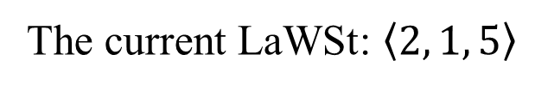
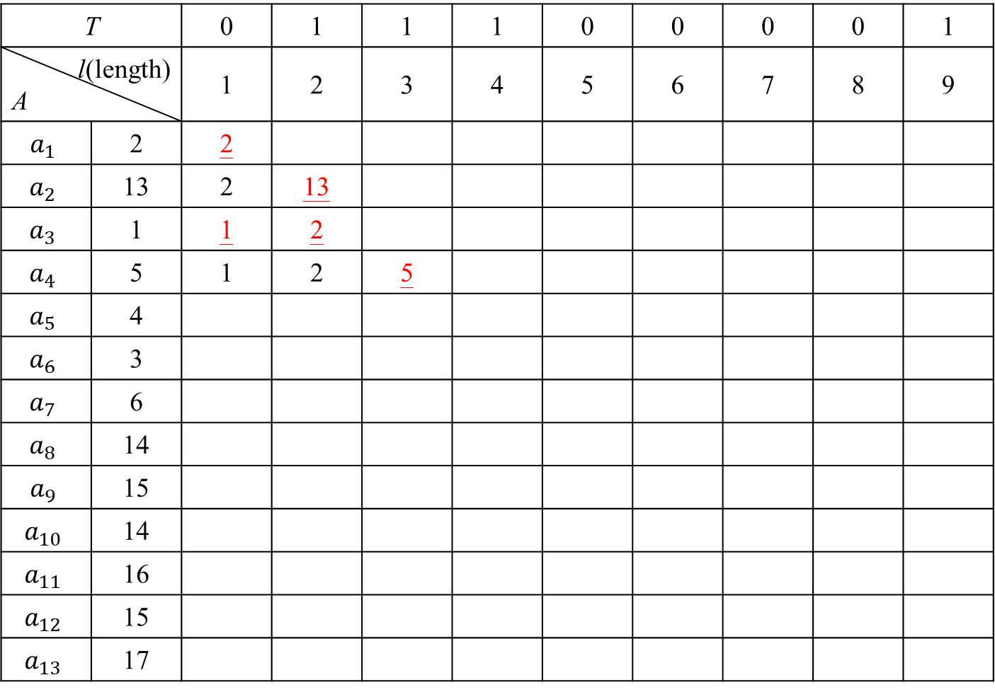
LaWSt
T |  | 0 | 1 | 1 | 1 | 0 | 0 | 0 | 0 | 1
l(length) A |  | 1 | 2 | 3 | 4 | 5 | 6 | 7 | 8 | 9
$$a_{1}$$ | 2 | 2
$$a_{2}$$ | 13 | 2 | 13
$$a_{3}$$ | 1 | 1 | 2
$$a_{4}$$ | 5 | 1 | 2 | 5
$$a_{5}$$ | 4
$$a_{6}$$ | 3
$$a_{7}$$ | 6
$$a_{8}$$ | 14
$$a_{9}$$ | 15
$$a_{10}$$ | 14
$$a_{11}$$ | 16
$$a_{12}$$ | 15
$$a_{13}$$ | 17
$$c=3$$
The current LaWSt: $\left\langle 2, 1, 5\right\rangle$

Slide 9
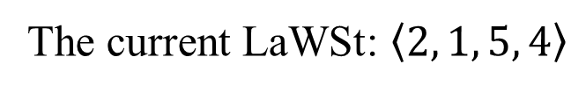
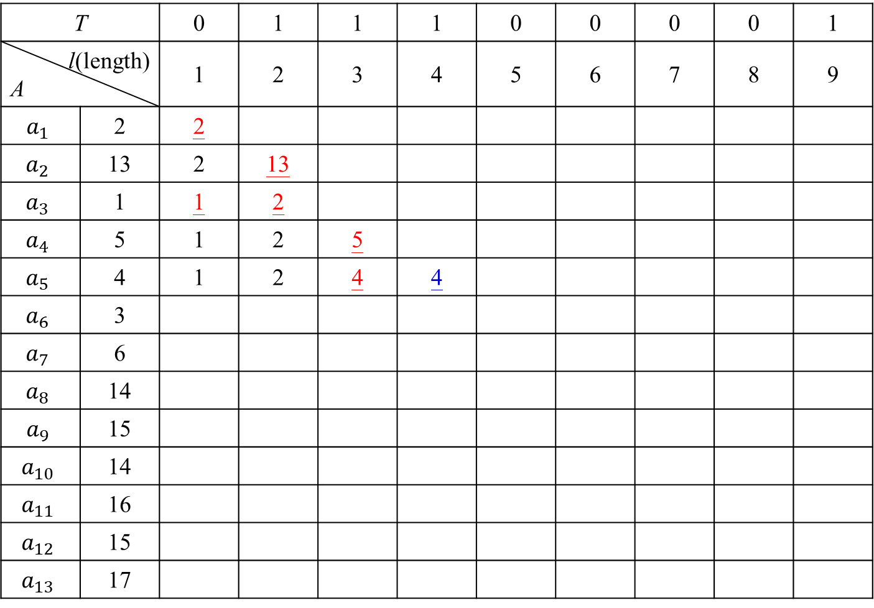
LaWSt
T |  | 0 | 1 | 1 | 1 | 0 | 0 | 0 | 0 | 1
l(length) A |  | 1 | 2 | 3 | 4 | 5 | 6 | 7 | 8 | 9
$$a_{1}$$ | 2 | 2
$$a_{2}$$ | 13 | 2 | 13
$$a_{3}$$ | 1 | 1 | 2
$$a_{4}$$ | 5 | 1 | 2 | 5
$$a_{5}$$ | 4 | 1 | 2 | 4 | 4
$$a_{6}$$ | 3
$$a_{7}$$ | 6
$$a_{8}$$ | 14
$$a_{9}$$ | 15
$$a_{10}$$ | 14
$$a_{11}$$ | 16
$$a_{12}$$ | 15
$$a_{13}$$ | 17
$$c=3$$
$$5−c=2<4$$
The current LaWSt: $\left\langle 2, 1, 5, 4\right\rangle$

Slide 10
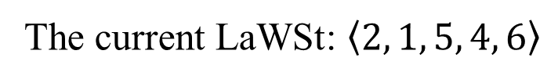
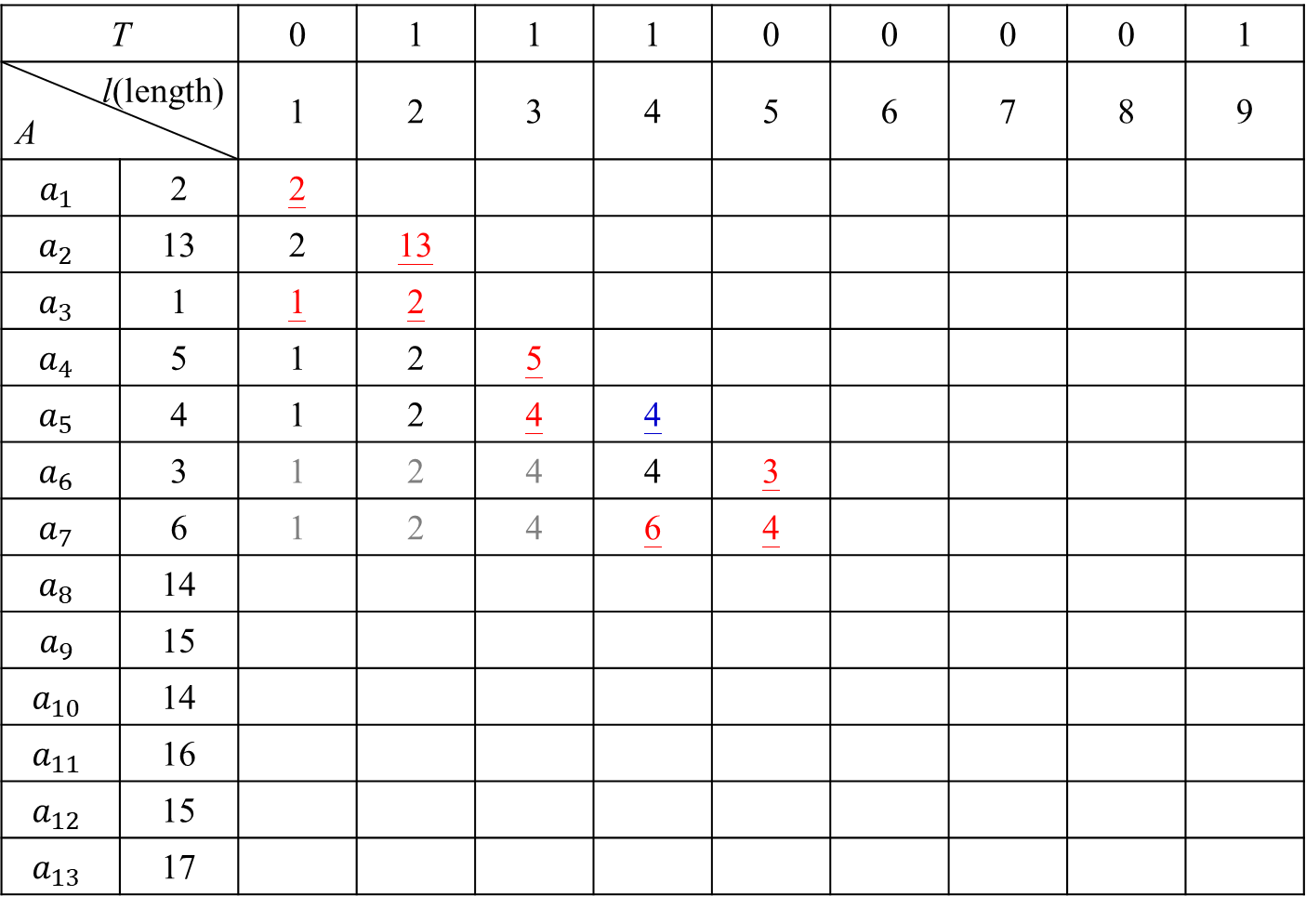
LaWSt
T |  | 0 | 1 | 1 | 1 | 0 | 0 | 0 | 0 | 1
l(length) A |  | 1 | 2 | 3 | 4 | 5 | 6 | 7 | 8 | 9
$$a_{1}$$ | 2 | 2
$$a_{2}$$ | 13 | 2 | 13
$$a_{3}$$ | 1 | 1 | 2
$$a_{4}$$ | 5 | 1 | 2 | 5
$$a_{5}$$ | 4 | 1 | 2 | 4 | 4
$$a_{6}$$ | 3 | 1 | 2 | 4 | 4 | 3
$$a_{7}$$ | 6 | 1 | 2 | 4 | 6 | 4
$$a_{8}$$ | 14
$$a_{9}$$ | 15
$$a_{10}$$ | 14
$$a_{11}$$ | 16
$$a_{12}$$ | 15
$$a_{13}$$ | 17
$$c=3$$
$$3+c=6=6$$
$$4+c=7>6$$
The current LaWSt: $\left\langle 2, 1, 5, 4, 6\right\rangle$

Slide 11
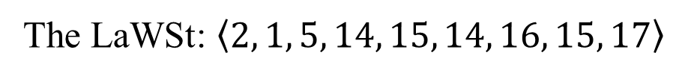
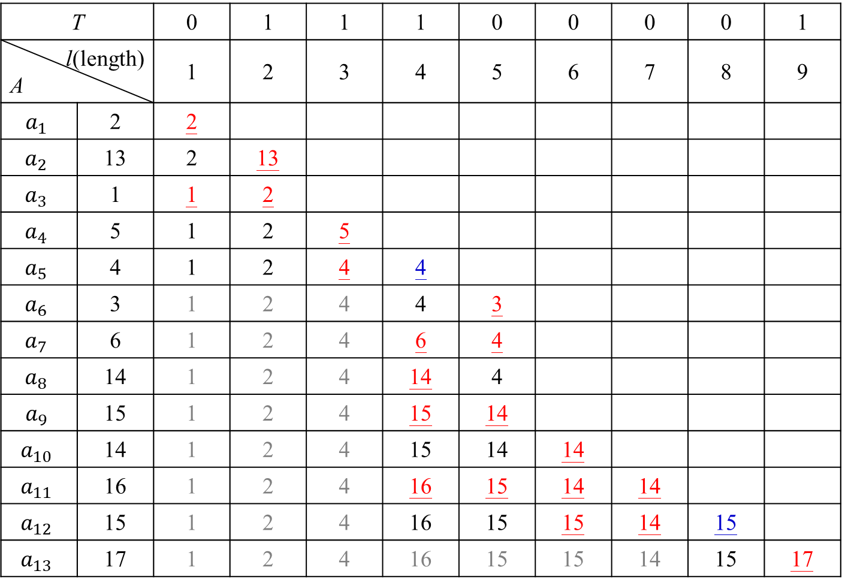
LaWSt
T |  | 0 | 1 | 1 | 1 | 0 | 0 | 0 | 0 | 1
l(length) A |  | 1 | 2 | 3 | 4 | 5 | 6 | 7 | 8 | 9
$$a_{1}$$ | 2 | 2
$$a_{2}$$ | 13 | 2 | 13
$$a_{3}$$ | 1 | 1 | 2
$$a_{4}$$ | 5 | 1 | 2 | 5
$$a_{5}$$ | 4 | 1 | 2 | 4 | 4
$$a_{6}$$ | 3 | 1 | 2 | 4 | 4 | 3
$$a_{7}$$ | 6 | 1 | 2 | 4 | 6 | 4
$$a_{8}$$ | 14 | 1 | 2 | 4 | 14 | 4
$$a_{9}$$ | 15 | 1 | 2 | 4 | 15 | 14
$$a_{10}$$ | 14 | 1 | 2 | 4 | 15 | 14 | 14
$$a_{11}$$ | 16 | 1 | 2 | 4 | 16 | 15 | 14 | 14
$$a_{12}$$ | 15 | 1 | 2 | 4 | 16 | 15 | 15 | 14 | 15
$$a_{13}$$ | 17 | 1 | 2 | 4 | 16 | 15 | 15 | 14 | 15 | 17
$$c=3$$
The LaWSt: $\left\langle 2, 1, 5, 14, 15, 14, 16, 15, 17\right\rangle$

Slide 12
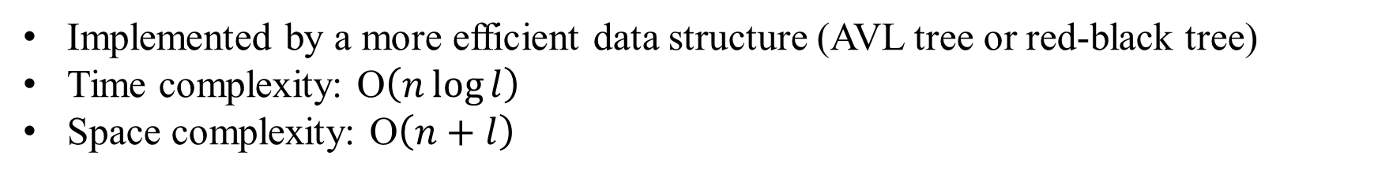
Time and Space Complexity
Implemented by a more efficient data structure (AVL tree or red-black tree)
Time complexity: O$\left(n\log{l}\right)$
Space complexity: O$\left(n+l\right)$

Slide 13
Longest Almost Wave Subsequence with r Segments (LaWSr)
$$A=\left\langle 9, 12, 11, 17, 10, 12, 9, 5, 11, 16\right\rangle$$
$$r=3$$
$$c=3$$
The LaWSr sequence is $\left\langle 9, 12, 11, 17, 10, 12, 9, 5, 11, 16\right\rangle$

Slide 14

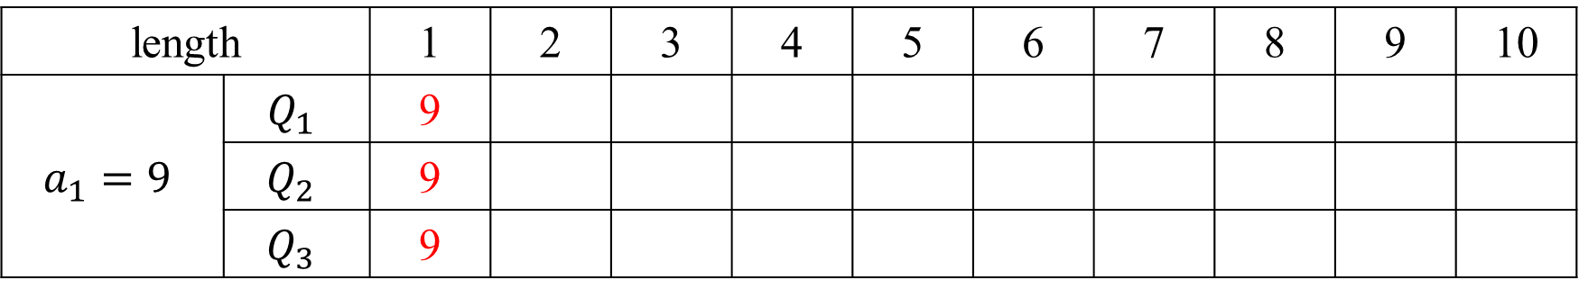
LaWSr
$$c=3$$
length |  | 1 | 2 | 3 | 4 | 5 | 6 | 7 | 8 | 9 | 10
$$a_{1}=9$$ | $$Q_{1}$$ | 9
 | $$Q_{2}$$ | 9
 | $$Q_{3}$$ | 9
$$\left\langle 9\right\rangle$$

Slide 15
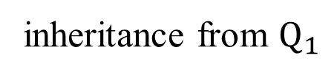
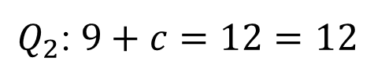

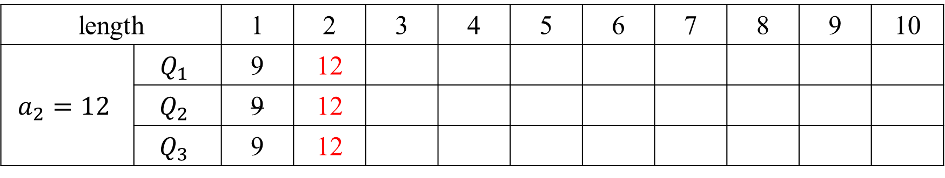
LaWSr
$$c=3$$
length |  | 1 | 2 | 3 | 4 | 5 | 6 | 7 | 8 | 9 | 10
$$a_{2}=12$$ | $$Q_{1}$$ | 9 | 12
 | $$Q_{2}$$ | 9 | 12
 | $$Q_{3}$$ | 9 | 12
$$\left\langle 9, 12\right\rangle$$
$Q_{2}$: $9+c=12=12$
inheritance from $Q_{1}$

Slide 16
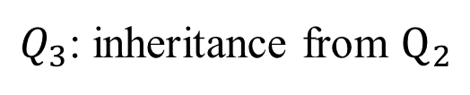

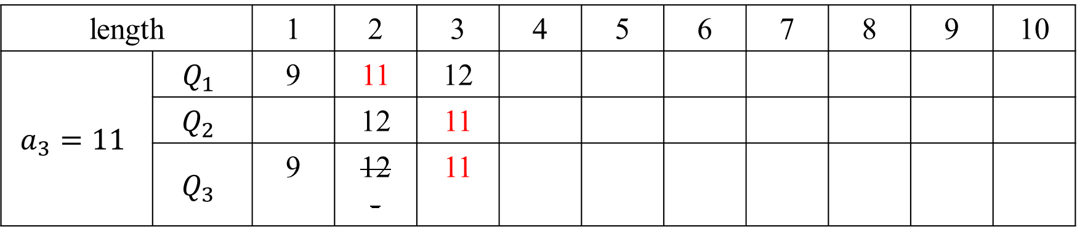
LaWSr
$$c=3$$
length |  | 1 | 2 | 3 | 4 | 5 | 6 | 7 | 8 | 9 | 10
$$a_{3}=11$$ | $$Q_{1}$$ | 9 | 11 | 12
 | $$Q_{2}$$ |  | 12 | 11
 | $$Q_{3}$$ | 9 | 12 - | 11
$$\left\langle 9, 12, 11\right\rangle$$
$Q_{3}$: inheritance from $Q_{2}$

Slide 17
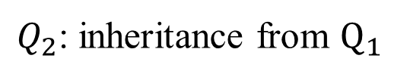

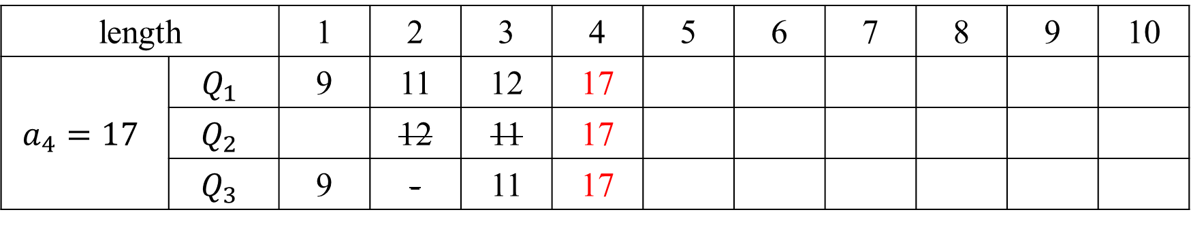
LaWSr
$$c=3$$
length |  | 1 | 2 | 3 | 4 | 5 | 6 | 7 | 8 | 9 | 10
$$a_{4}=17$$ | $$Q_{1}$$ | 9 | 11 | 12 | 17
 | $$Q_{2}$$ |  | 12 | 11 | 17
 | $$Q_{3}$$ | 9 | - | 11 | 17
$$\left\langle 9, 12, 11, 17\right\rangle$$
$Q_{2}$: inheritance from $Q_{1}$

Slide 18
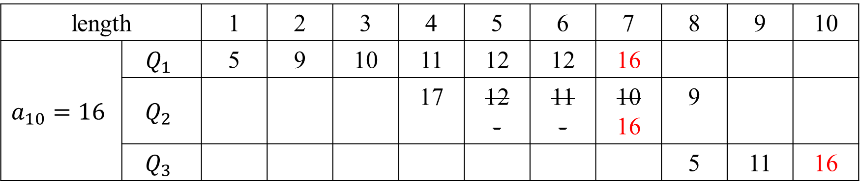
LaWSr
$$c=3$$
length |  | 1 | 2 | 3 | 4 | 5 | 6 | 7 | 8 | 9 | 10
$$a_{10}=16$$ | $$Q_{1}$$ | 5 | 9 | 10 | 11 | 12 | 12 | 16
 | $$Q_{2}$$ |  |  |  | 17 | 12 - | 11 - | 10 16 | 9
 | $$Q_{3}$$ |  |  |  |  |  |  |  | 5 | 11 | 16
⟨9, 12, 11, 17, 10, 12, 9, 5, 11, 16⟩

Slide 19
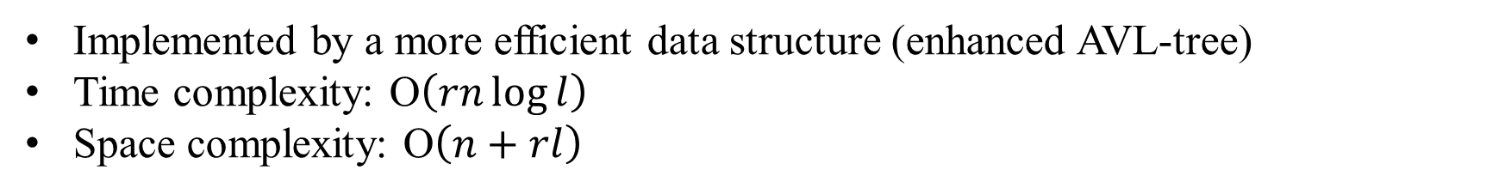
Time and Space Complexity
Implemented by a more efficient data structure (enhanced AVL-tree)
Time complexity: O$\left(rn\log{l}\right)$
Space complexity: O$\left(n+rl\right)$

