Slide 1
An Improved Algorithm with Azimuth Clustering for Detecting Turning Regions on GPS Trajectories
Kuo-Si Huang, and Yu-Chen Lin, Chang-Biau Yang, Ho-Chun Lin, Yung-Hsing Peng and Szu-Hsuan Wang.
Presenter: Yu-Chen Lin
Date: Nov. 14, 2023

Slide 2
Abstract
According to the latest report released by the Ministry of Agriculture (MOA) of Taiwan, the number of agriculture machinery in Taiwan exceeds 200,000. To keep track of these machinery, there are some research units making their efforts in devising GPS for agricultural application. Recently, Peng et al. proposed the turning region detection (TRD) problem for the GPS data obtained in the tea industry, which can be used to measure the working efficiency of agricultural machinery. To solve the TRD problem, Peng et al. tried to devise a linear time algorithm, which is easy to implement. However, the accuracy of their algorithm is far from expectation, which calls for further improvement. By adopting the concept of azimuth clustering, in this paper we propose a new algorithm for solving the TRD problem, which achieves better accuracy. The experimental results show that our new algorithm has an average accuracy 85%, which is better than the average accuracy 70% achieved with the previous algorithm. In addition, the proposed algorithm is not difficult to implement and is suitable for providing derivative services and analysis to agricultural managers in the future.

Slide 3
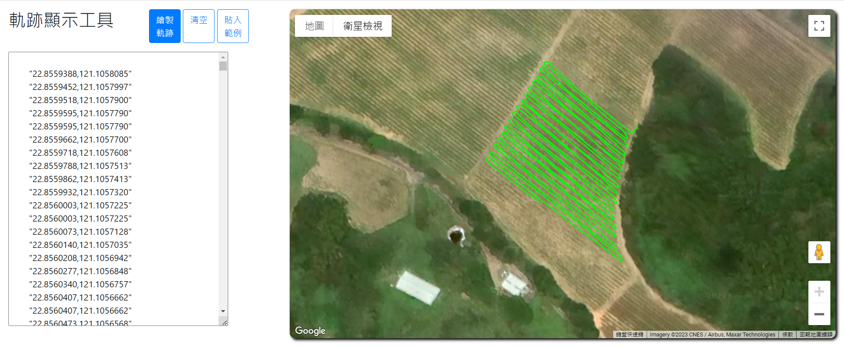
GPS Trajectories

Slide 4
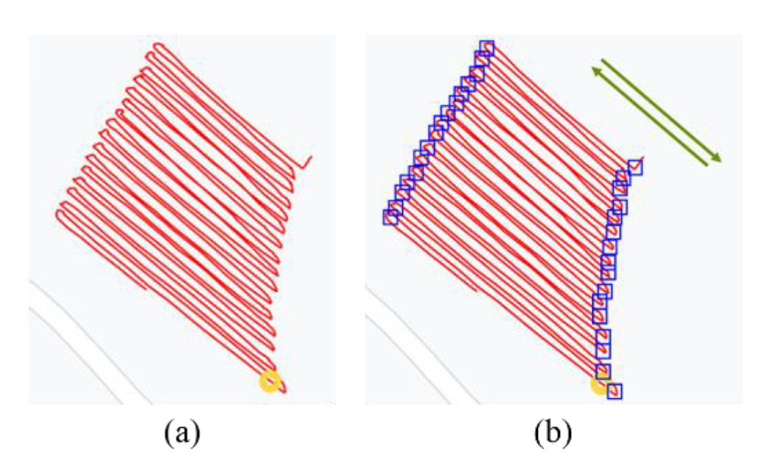
Turning Region Detection

Slide 5
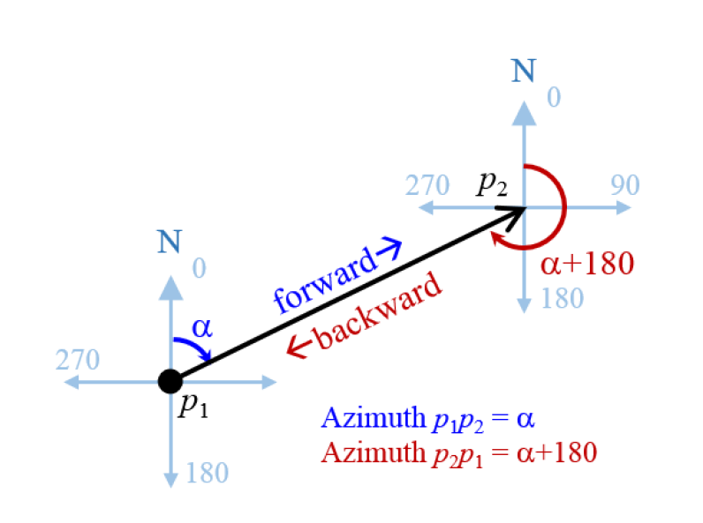
Azimuth

Slide 6

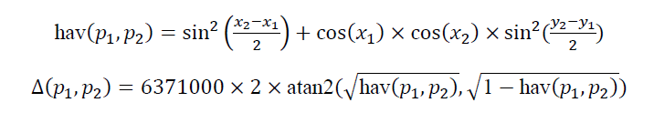
Working Direction and Displacement

Slide 7
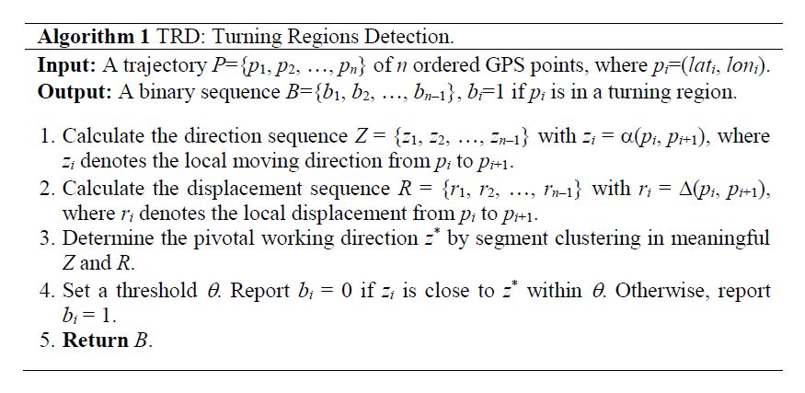
TRD Algorithm

Slide 8
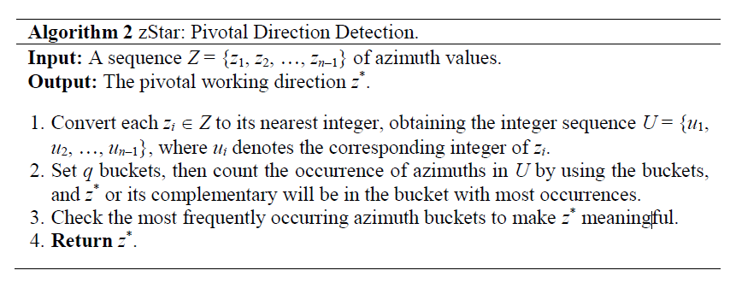
Pivotal Direction Detection

Slide 9
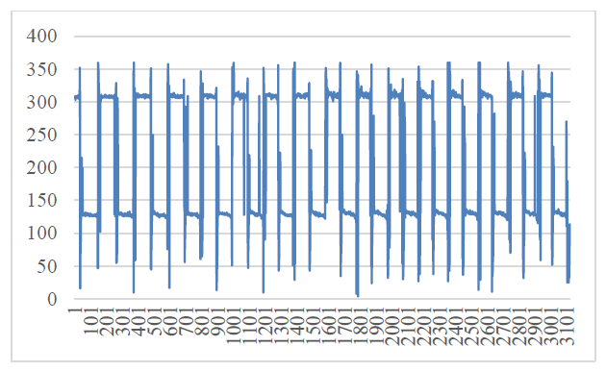
Visualization from Trajectory to Azimuth

Slide 10
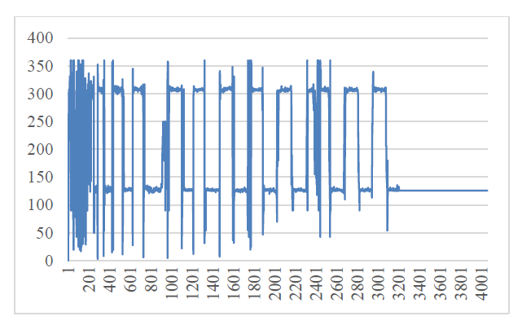
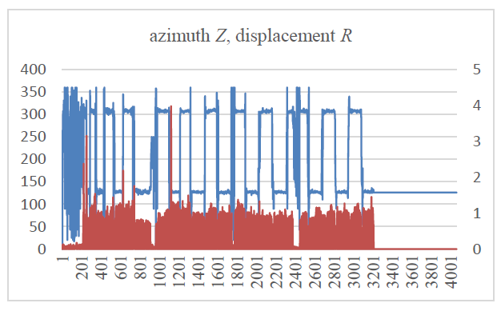
Visualization from Trajectory to Azimuth with Displacement

Slide 11
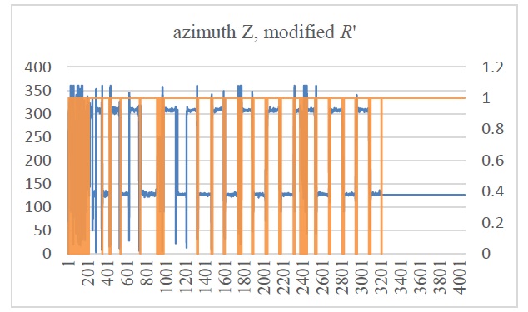

Slide 12

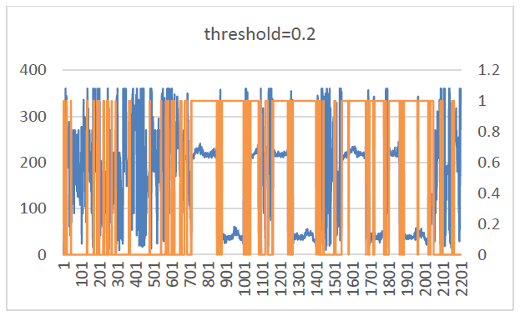
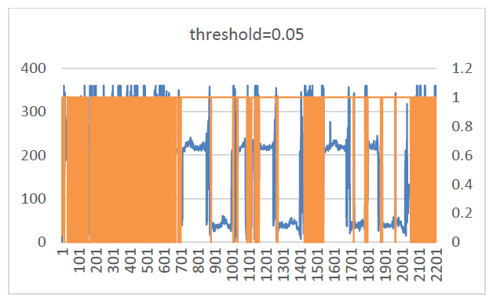

Slide 13
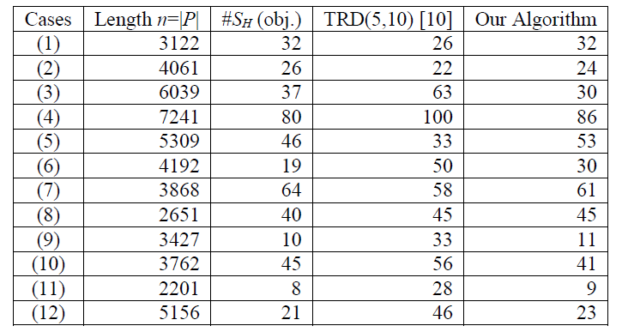
Experimental Results

Slide 14
Conclusion
The proposed algorithm take consideration of the azimuth and displacement from the original trajectory.
It has an average accuracy 85%, which is better than the average accuracy 70% achieved with previous algorithm.

