Slide 1
An Ensemble-Based Incremental Learning Approach to Data Fusion
Devi Parikh and Robi Polikar
IEEE TRANSACTIONS ON SYSTEMS, MAN, AND CYBERNETICS—PART B: CYBERNETICS, VOL. 37,
NO. 2, APRIL 2007

Slide 2
Abstract
This paper introduces Learn++, an ensemble[合唱] of classifiers based algorithm originally developed for incremental learning, and now adapted for information/data fusion applications. Recognizing the conceptual similarity between incremental learning and data fusion, Learn++ follows an alternative approach to data fusion, i.e., sequentially generating an ensemble of classifiers that specifically seek the most discriminating information from each data set.

Slide 3
Abstract
It was observed that Learn++ based data fusion consistently outperforms a similarly configured ensemble classifier trained on any of the individual data sources across several applications. Furthermore, even if the classifiers trained on individual data sources are fine tuned for the given problem, Learn++ can still achieve a statistically significant improvement by combining them, if the additional data sets carry complementary information.

Slide 4
Abstract
The algorithm can also identify—albeit indirectly—those data sets that do not carry such additional information. Finally, it was shown that the algorithm can consecutively learn both the supplementary novel information coming from additional data of the same source, and the complementary information coming from new data sources without requiring access to any of the previously seen data.

Slide 5
Approaches for classifier combination
Fusion
  Each ensemble member is supposed to have knowledge of the whole feature space.
Selection
  Each ensemble member is supposed to know well a part of the feature space.

Slide 6
Approaches for classifier combination
Recommendations for training
  If a single training set is used with a nontrainable combiner (eg. majority vote), make sure the base classifiers are not overtrained.
  If a single training set is used with a trainable combiner (eg. weighted majority vote), leave the base classifiers undertrained. (weak classifier ⇒ Adaboost)

Slide 7
Ensemble classifiers
Assume we have three independent but weak (better than randomly guessing) classifiers, each achieves a classification rate of 60%. The final output is obtained by a majority voting scheme.
The probability to make mistakes is:
  0.6*0.4*0.4 = 9.6%
  0.4*0.6*0.4 = 9.6%
  0.4*0.4*0.6 = 9.6%
  0.4*0.4*0.4 = 6.4%
The overall classification rate is: 1-3*9.6%-6.4% = 64.8%.
The analysis about majority vote can be obtained from
Ofer Matan, On Voting Ensembles of Classifiers, In Proceedings of AAAI-96 workshop on Integrating Multiple Learned Models

Slide 8
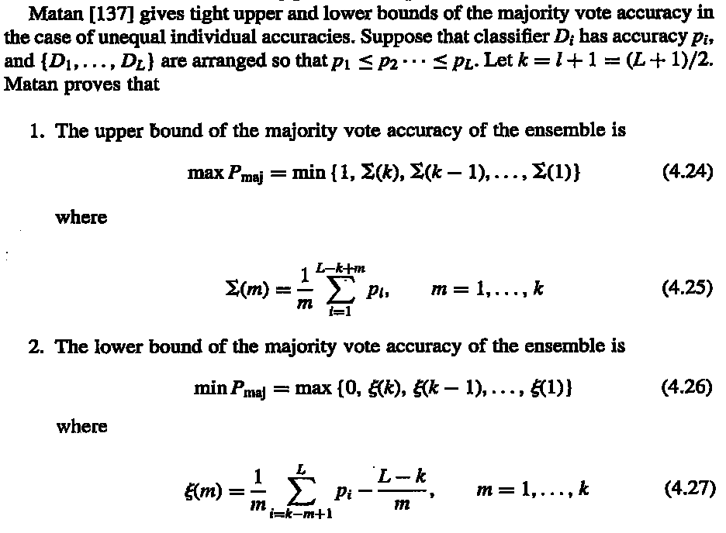
Error limit of majority vote

Slide 9
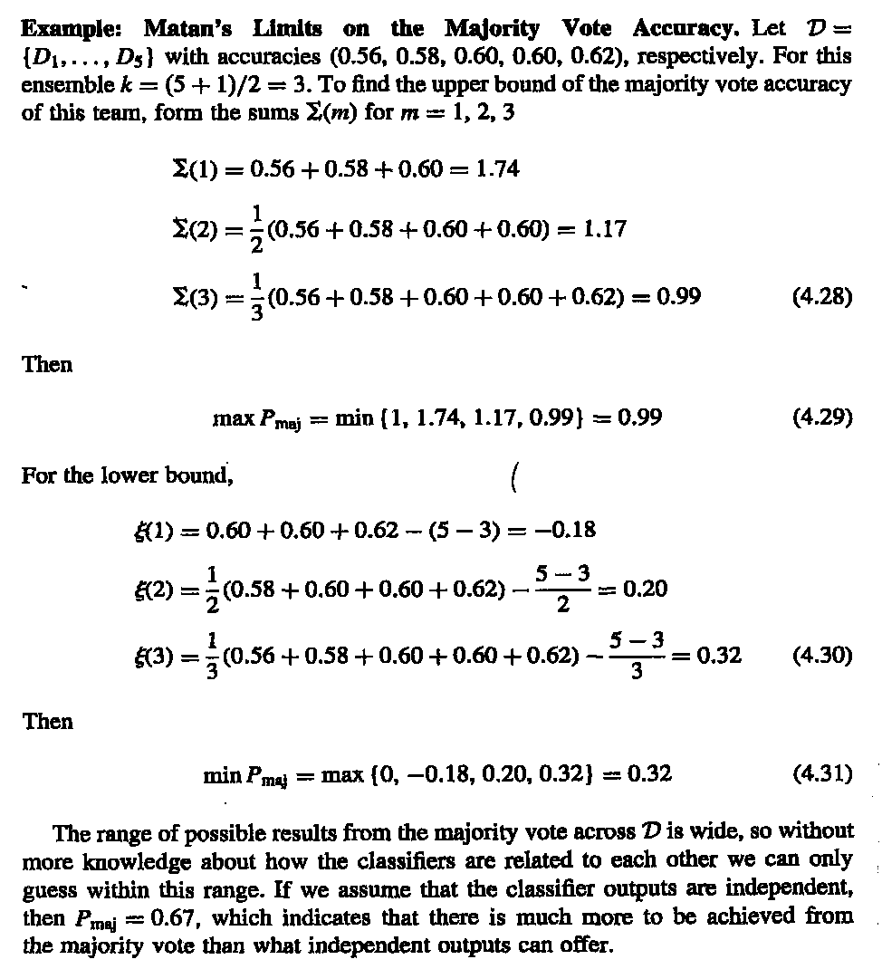
Error limit of majority vote

Slide 10
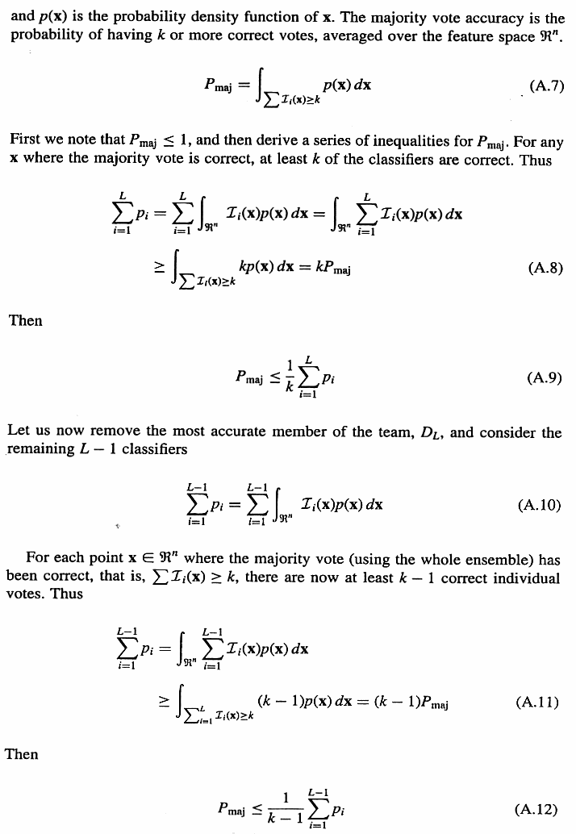
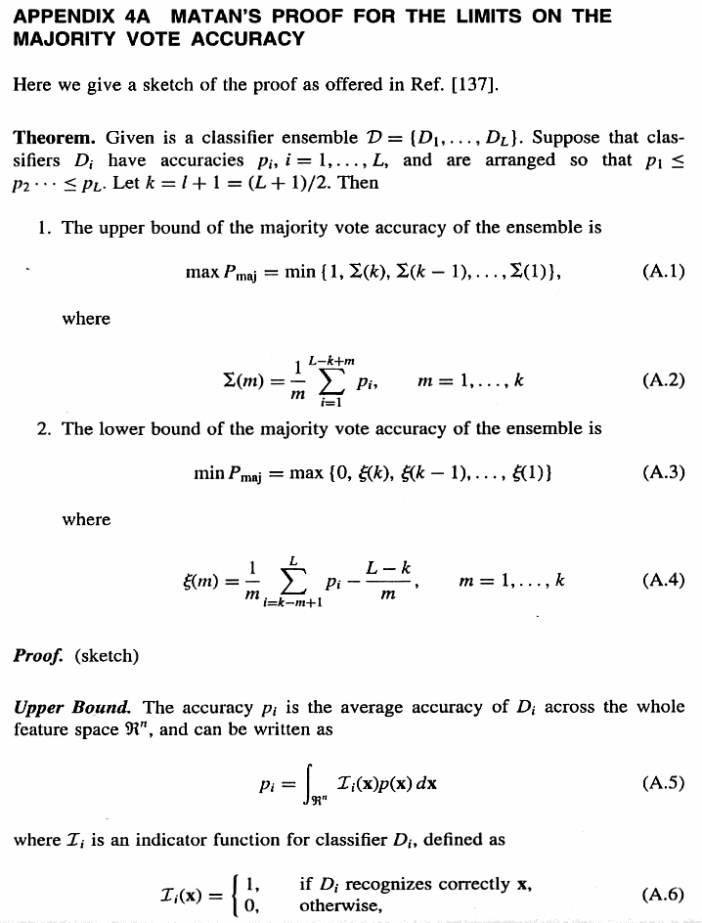
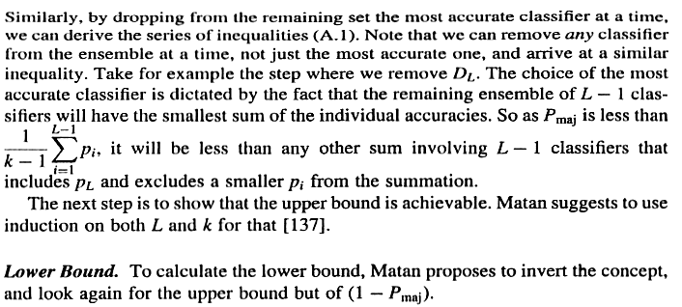

Slide 11
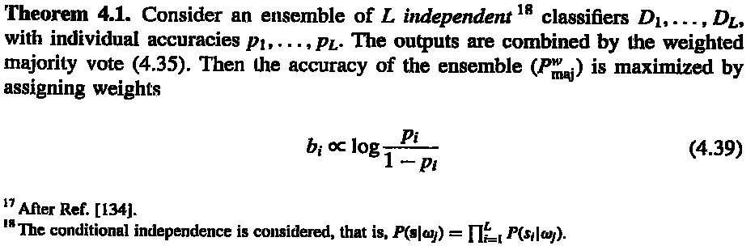
Why αm = log((1-e)/e) ?
Notes:
x <- cbind(rep(seq(0,10,.2),each=51),rep(seq(0,10,.2),51))
cl <- apply(x,1,function(x) if((x[1]-x[2])>=0) "C1" else "C2")
col <- rep("blue",dim(x)[1])
col[which(cl=="C1")] <- "red"
plot(x,type='p',xlab="x1",ylab="x2",col=col,main="Original data")
x<-data.frame(x1=x[,1],x2=x[,2],class=cl)
ad <- adaboost.M1(class~.,x,mfinal=10)
for(i in 1:length(ad$trees)){
pred <- predict(ad$trees[[i]],x,type="class")
col <- rep("blue",dim(x)[1])
col[which(pred=="C1")] <- "red"
str <- sprintf("Classifier %i output, error: %f, weight: %f",
i,sum(pred!=x[,3])/dim(x)[1],ad$weights[i])
print(str)
x11()
plot(x[,1:2],type='p',xlab="x1",ylab="x2",col=col,main=str)
}
pred <- predict(ad,x)$class
col <- rep("blue",dim(x)[1])
col[which(pred=="C1")] <- "red"
str <- sprintf("Classifier 1~%i output, error: %f",
length(ad$trees),sum(pred!=x[,3])/dim(x)[1])
print(str)
x11()
plot(x[,1:2],type='p',xlab="x1",ylab="x2",col=col,main=str)

Slide 12
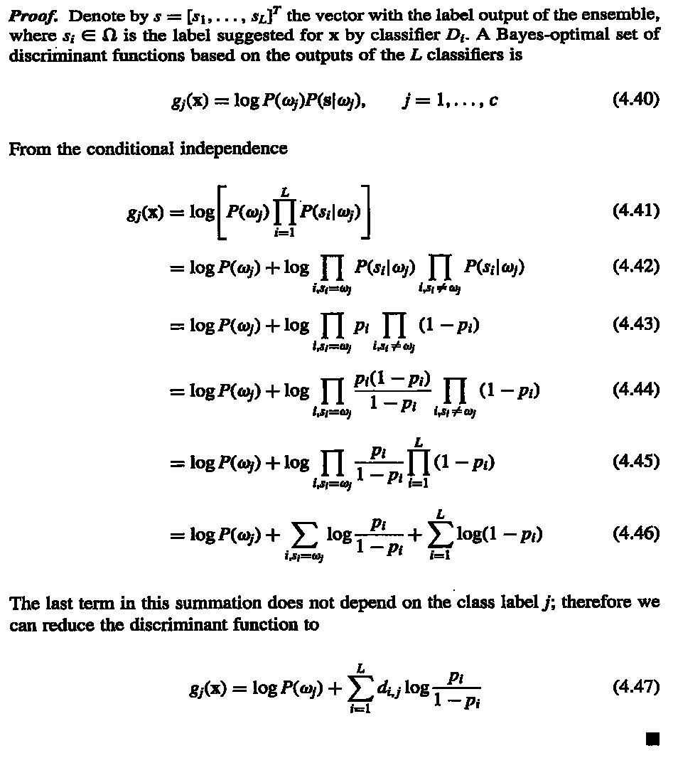

Slide 13
Example
125特徵(CSHVPZ)，訓練資料311筆分四類，CSHVPZ各用訓練25隱藏神經元神經網路，驗證正確率分別為：0.84、0.87、0.61、0.58、0.59及0.59。，因此，分類器權重為：1.65、1.93、0.45、0.30、0.36及0.34。
測試資料383筆，正確率分別為：0.68、0.77、0.66、0.63、0.60及0.62。
合併後測試正確率為0.81。
http://ranger.uta.edu/~chqding/protein/

Slide 14
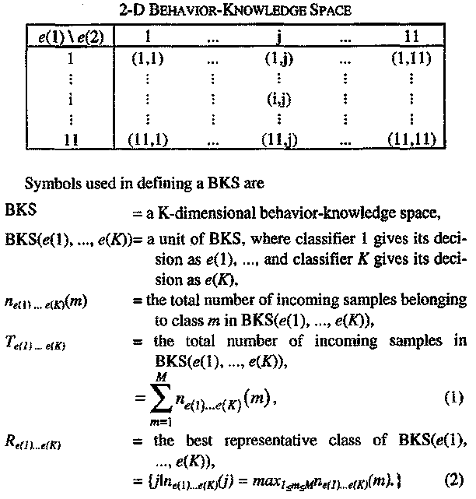
Behavior knowledge space (BKS)
IEEE TRANSACTIONS ON PATERN ANALYSIS AND MACHINE INTELLIGENCE, VOL. 17, NO. 1, JANUARY 1995

Slide 15
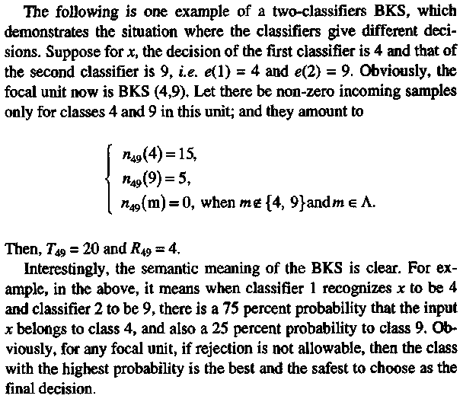
Behavior knowledge space (BKS)
IEEE TRANSACTIONS ON PATERN ANALYSIS AND MACHINE INTELLIGENCE, VOL. 17, NO. 1, JANUARY 1995

Slide 16
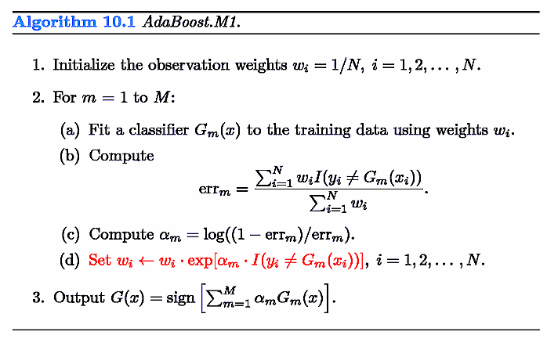
Adaboost
觀察某一訓練資料在adaboost訓練時出現狀況
第一輪0個，第一輪錯
第二輪2個，第二輪錯
第三輪6個，第三輪錯
第四輪11個，第四輪對
第五輪4個，第五輪錯
第六輪6個，第六輪錯
第七輪10個，第七輪對
第八輪8個，第八輪對
第九輪3個，第九輪錯
About the reason to set αm, see the following pages.
Notes:
x <- cbind(rep(seq(0,10,.2),each=51),rep(seq(0,10,.2),51))
cl <- apply(x,1,function(x) if((x[1]-x[2])>=0) "C1" else "C2")
col <- rep("blue",dim(x)[1])
col[which(cl=="C1")] <- "red"
plot(x,type='p',xlab="x1",ylab="x2",col=col,main="Original data")
x<-data.frame(x1=x[,1],x2=x[,2],class=cl)
ad <- adaboost.M1(class~.,x,mfinal=10)
for(i in 1:length(ad$trees)){
pred <- predict(ad$trees[[i]],x,type="class")
col <- rep("blue",dim(x)[1])
col[which(pred=="C1")] <- "red"
str <- sprintf("Classifier %i output, error: %f, weight: %f",
i,sum(pred!=x[,3])/dim(x)[1],ad$weights[i])
print(str)
x11()
plot(x[,1:2],type='p',xlab="x1",ylab="x2",col=col,main=str)
}
pred <- predict(ad,x)$class
col <- rep("blue",dim(x)[1])
col[which(pred=="C1")] <- "red"
str <- sprintf("Classifier 1~%i output, error: %f",
length(ad$trees),sum(pred!=x[,3])/dim(x)[1])
print(str)
x11()
plot(x[,1:2],type='p',xlab="x1",ylab="x2",col=col,main=str)

Slide 17
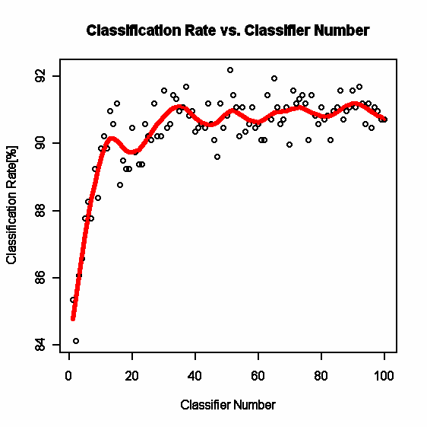
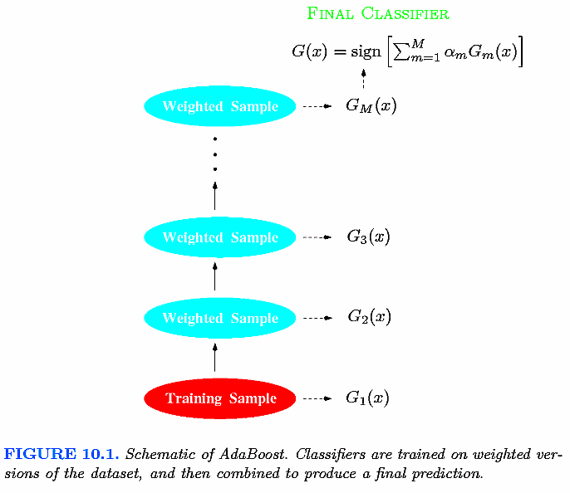
Adaboost

Slide 18
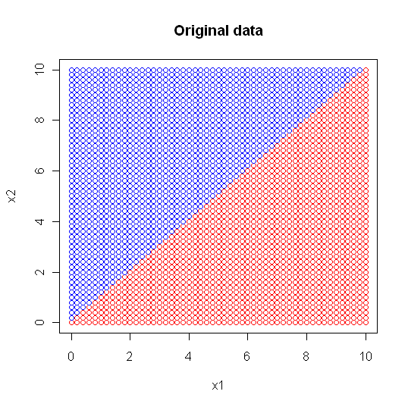
Adaboost
"Classifier 1 output, error: 0.132257, weight: 0.940575"
"Classifier 2 output, error: 0.217993, weight: 0.638700"
"Classifier 3 output, error: 0.129950, weight: 0.950700"
"Classifier 4 output, error: 0.129950, weight: 0.950700"
"Classifier 5 output, error: 0.190311, weight: 0.723994"
"Classifier 6 output, error: 0.259516, weight: 0.524244"
"Classifier 7 output, error: 0.348328, weight: 0.313199"
"Classifier 8 output, error: 0.328335, weight: 0.357862"
"Classifier 9 output, error: 0.384083, weight: 0.236127"
"Classifier 10 output, error: 0.209919, weight: 0.662706"
Notes:
[1] "Classifier 1 output, error: 0.132257, weight: 0.940575"
[1] "Classifier 2 output, error: 0.217993, weight: 0.638700"
[1] "Classifier 3 output, error: 0.129950, weight: 0.950700"
[1] "Classifier 4 output, error: 0.129950, weight: 0.950700"
[1] "Classifier 5 output, error: 0.190311, weight: 0.723994"
[1] "Classifier 6 output, error: 0.259516, weight: 0.524244"
[1] "Classifier 7 output, error: 0.348328, weight: 0.313199"
[1] "Classifier 8 output, error: 0.328335, weight: 0.357862"
[1] "Classifier 9 output, error: 0.384083, weight: 0.236127"
[1] "Classifier 10 output, error: 0.209919, weight: 0.662706"

Slide 19
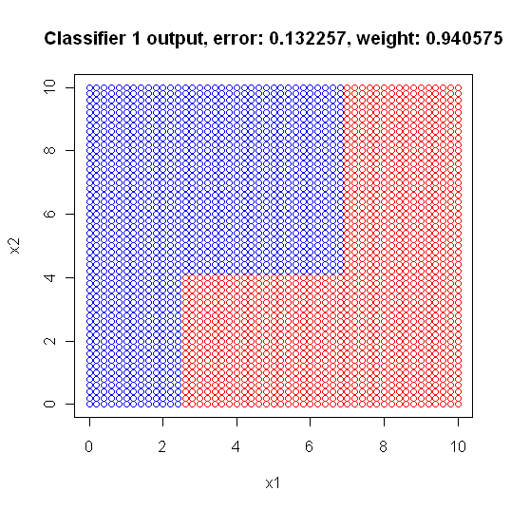
Adaboost
1) root 2601 1300 C1 (0.50019223 0.49980777)
2) x2< 4.1 1041 187 C1 (0.82036503 0.17963497)
4) x1>=2.5 801 30 C1 (0.96254682 0.03745318) *
5) x1< 2.5 240 83 C2 (0.34583333 0.65416667) *
3) x2>=4.1 1560 447 C2 (0.28653846 0.71346154)
6) x1>=6.9 495 130 C1 (0.73737374 0.26262626) *
7) x1< 6.9 1065 82 C2 (0.07699531 0.92300469) *
"

Slide 20
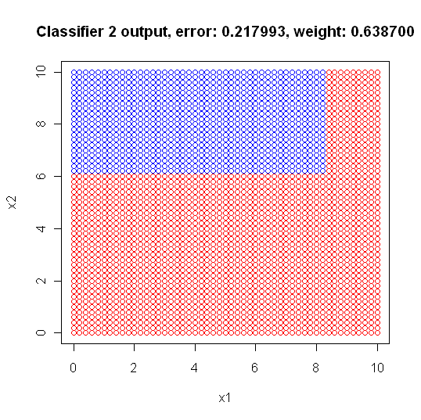
Adaboost
1) root 2601 1276 C1 (0.50941945 0.49058055)
2) x2< 6.1 1557 405 C1 (0.73988439 0.26011561) *
3) x2>=6.1 1044 173 C2 (0.16570881 0.83429119)
6) x1>=8.3 188 75 C1 (0.60106383 0.39893617) *
7) x1< 8.3 856 60 C2 (0.07009346 0.92990654) *

Slide 21
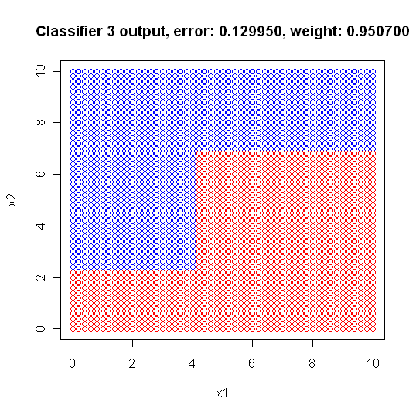
Adaboost
1) root 2601 1181 C2 (0.45405613 0.54594387)
2) x1>=4.1 1461 516 C1 (0.64681725 0.35318275)
4) x2< 6.9 936 83 C1 (0.91132479 0.08867521) *
5) x2>=6.9 525 92 C2 (0.17523810 0.82476190) *
3) x1< 4.1 1140 236 C2 (0.20701754 0.79298246)
6) x2< 2.3 286 81 C1 (0.71678322 0.28321678) *
7) x2>=2.3 854 31 C2 (0.03629977 0.96370023) *

Slide 22
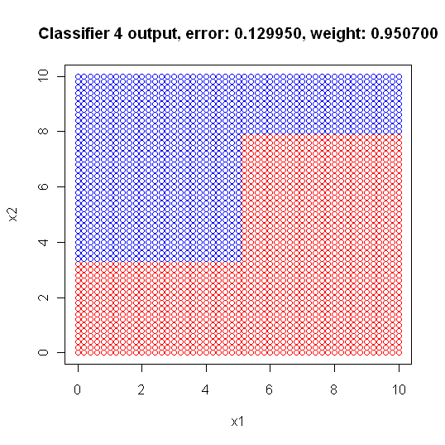
Adaboost
1) root 2601 1185 C2 (0.45559400 0.54440600)
2) x1>=5.1 1207 359 C1 (0.70256835 0.29743165)
4) x2< 7.9 840 97 C1 (0.88452381 0.11547619) *
5) x2>=7.9 367 105 C2 (0.28610354 0.71389646) *
3) x1< 5.1 1394 337 C2 (0.24175036 0.75824964)
6) x2< 3.3 557 254 C1 (0.54398564 0.45601436) *
7) x2>=3.3 837 34 C2 (0.04062127 0.95937873) *

Slide 23
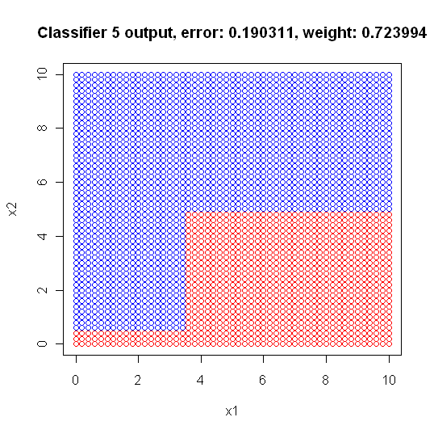
Adaboost
1) root 2601 1085 C2 (0.41714725 0.58285275)
2) x1>=3.5 1518 574 C1 (0.62187088 0.37812912)
4) x2< 4.9 496 26 C1 (0.94758065 0.05241935) *
5) x2>=4.9 1022 474 C2 (0.46379648 0.53620352) *
3) x1< 3.5 1083 141 C2 (0.13019391 0.86980609)
6) x2< 0.5 68 21 C1 (0.69117647 0.30882353) *
7) x2>=0.5 1015 94 C2 (0.09261084 0.90738916) *

Slide 24
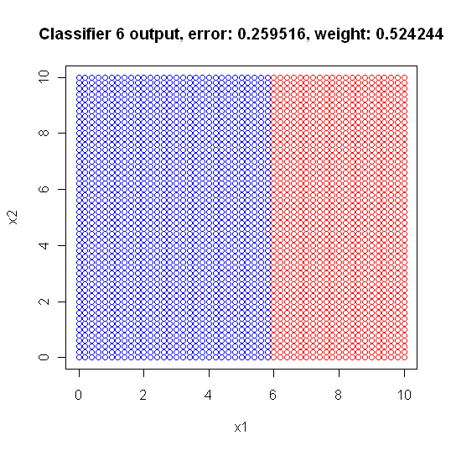
Adaboost
1) root 2601 1268 C1 (0.5124952 0.4875048)
2) x1>=5.9 1105 206 C1 (0.8135747 0.1864253) *
3) x1< 5.9 1496 434 C2 (0.2901070 0.7098930) *

Slide 25
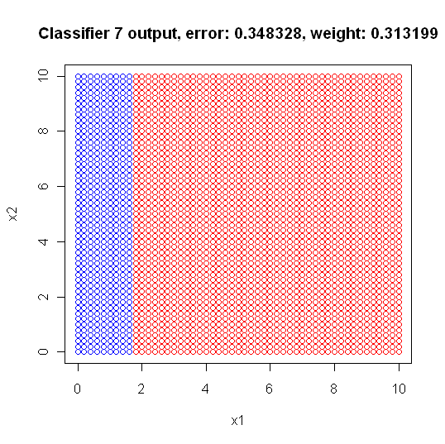
Adaboost
1) root 2601 1240 C1 (0.5232603 0.4767397)
2) x1>=1.7 2067 787 C1 (0.6192550 0.3807450) *
3) x1< 1.7 534 81 C2 (0.1516854 0.8483146) *

Slide 26
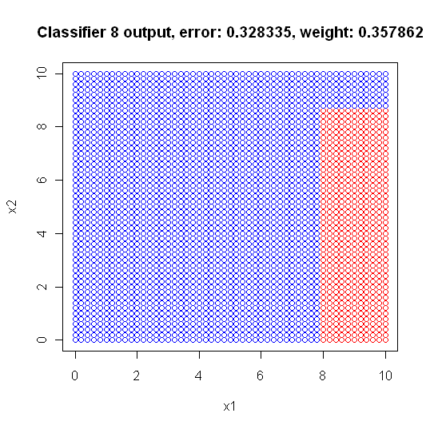
Adaboost
1) root 2601 1254 C2 (0.48212226 0.51787774)
2) x1>=7.9 619 141 C1 (0.77221325 0.22778675)
4) x2< 8.7 391 13 C1 (0.96675192 0.03324808) *
5) x2>=8.7 228 100 C2 (0.43859649 0.56140351) *
3) x1< 7.9 1982 776 C2 (0.39152371 0.60847629) *

Slide 27
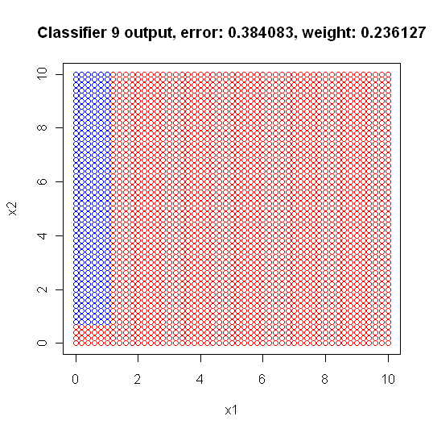
Adaboost
1) root 2601 1144 C1 (0.56016917 0.43983083)
2) x1>=1.1 2296 892 C1 (0.61149826 0.38850174) *
3) x1< 1.1 305 53 C2 (0.17377049 0.82622951)
6) x2< 0.7 63 23 C1 (0.63492063 0.36507937) *
7) x2>=0.7 242 13 C2 (0.05371901 0.94628099) *

Slide 28
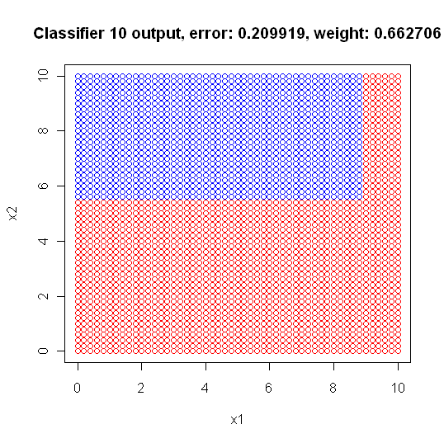
Adaboost
1) root 2601 1253 C1 (0.5182622 0.4817378)
2) x1>=8.9 335 35 C1 (0.8955224 0.1044776) *
3) x1< 8.9 2266 1048 C2 (0.4624890 0.5375110)
6) x2< 5.5 1302 503 C1 (0.6136713 0.3863287) *
7) x2>=5.5 964 249 C2 (0.2582988 0.7417012) *

Slide 29
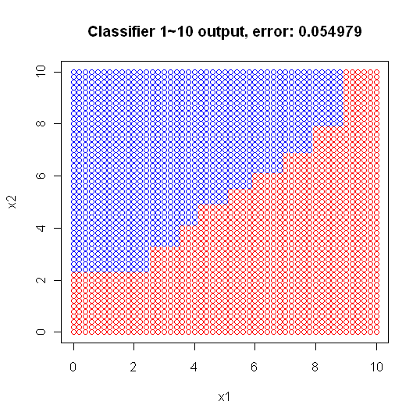
Adaboost - how to classify
input (6.6,6.6)
Classifier 1 output C2, weight: 0.940575
Classifier 2 output C2, weight: 0.638700
Classifier 3 output C1, weight: 0.950700
Classifier 4 output C1, weight: 0.950700
Classifier 5 output C2, weight: 0.723994
Classifier 6 output C1, weight: 0.524244
Classifier 7 output C1, weight: 0.313199
Classifier 8 output C2, weight: 0.357862
Classifier 9 output C1, weight: 0.236127
Classifier 10 output C2, weight: 0.662706
---------------------------------------------
C2:0.940575+0.638700+0.723994+0.357862+0.662706
=3.323837
C1:0.950700+0.950700+0.524244+0.313199+0.236127
2.97497
➔C2

Slide 30
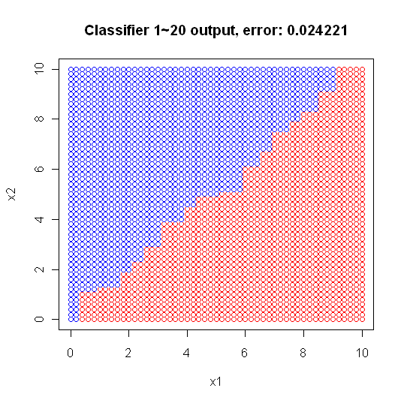
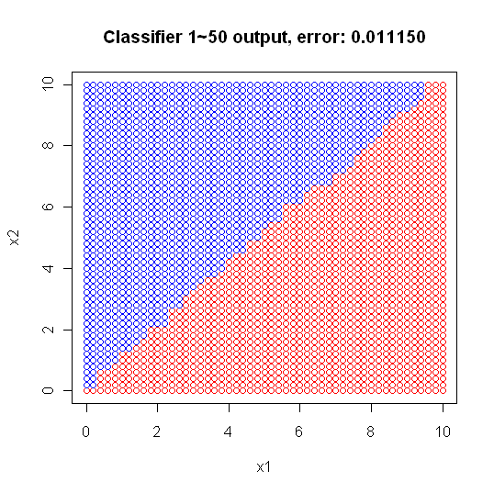
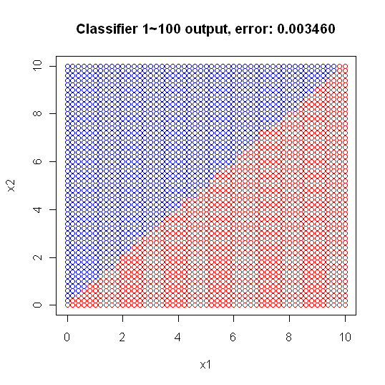
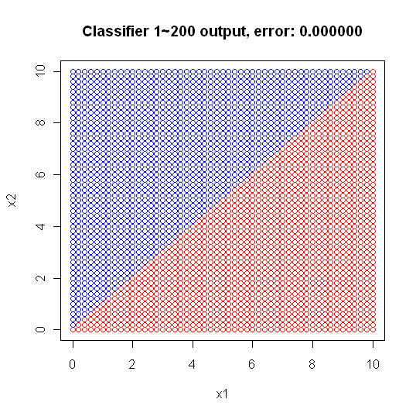
Adaboost

Slide 31
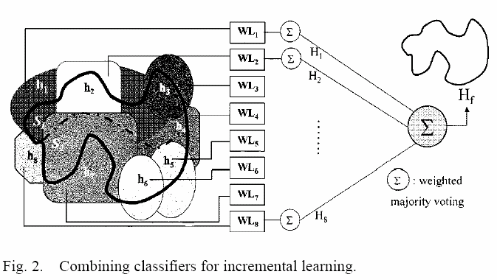
Learn++ architecture

Slide 32


Performance
Given total T composite hypotheses (or weak classifiers) and Et the t'th composite hypothesis Ht
The error bound is (its proof is in the paper)
If Et<0.5, then (Et(1-Et))^{½}<0.5 and 2*(Et(1-Et))^{½}<1. When T→∞, E→0.

Slide 33
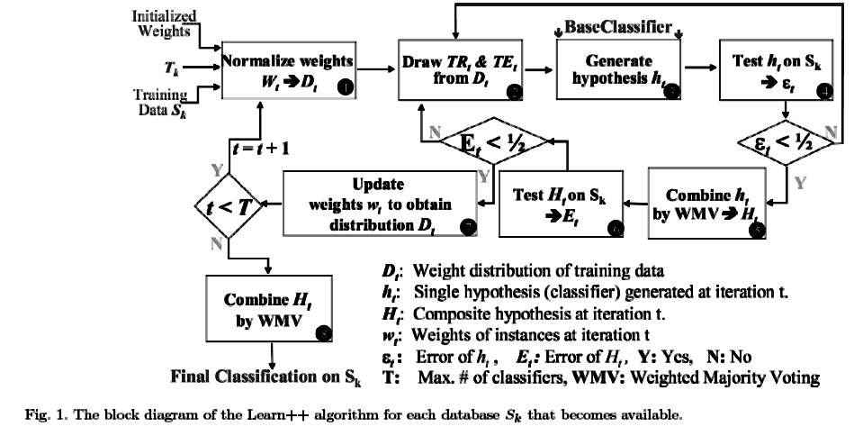
Learn++ algorithm

Slide 34
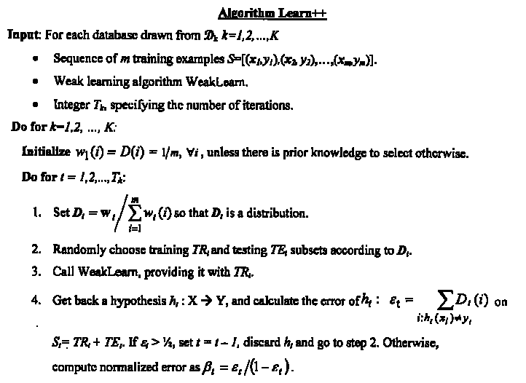
Learn++ algorithm
x為sample，y為類別
共計K個composite classifiers學習K個資料庫
初始化每一sample權重
每個composite classifier計Tk個weak classifiers
正規化每一sample權重，並根據sample權重決定被納入訓練之機率
3.訓練weak classifiers，如果其分類正確率小於50%則捨棄

Slide 35
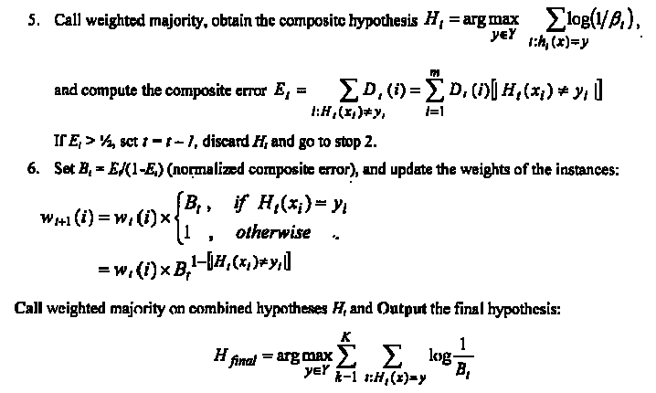
Learn++ algorithm
如果composite classifiers分類正確率小於50%則捨棄
更新每一sample的權重，如果在此iteration被分錯，則權重增加，反之則減少。權重越高到下一iteration被再拿來訓練機會越高
在面對未知sample時，各composite classifiers每一票權重係由訓練時分類正確率高低決定(上式應為log(1/β_{t}))

Slide 36
Step 3-4: Decide weights of weak classifiers
Call WeakLearn to train a weak classifier.
Can be any training algorithm such as neural networks or decision trees.
Calculate the error rate ε_{t} of each t'th weak classifier. Discard classifier with ε_{t}>0.5.
Compute normalized error for t‘th weak classifier β_{t}=ε_{t}/(1-ε_{t}). Assign its weighted majority as log(1/β_{t}) = log((1-ε_{t})/ε_{t}) = log(correct/wrong). [正確率越高，投票時權重越大]

Slide 37
Step 5 : Decide weights of composite classifiers
Calculate the error rate E_{t} of each t'th composite classifier. Discard classifier with E_{t}>0.5.
Compute normalized error for t‘th composite classifier B_{t}=E_{t}/(1-E_{t}). Assign its weighted majority as log(1/B_{t}) = log((1-E_{t})/E_{t}) = log(correct/wrong). [正確率越高，投票時權重越大]

Slide 38
Difference between Learn++ & Adaboost
AdaBoost updates its weight distribution based on the decision of previously generated “hypothesis”.
Learn++ updates its distribution based on the decision of the current “ensemble” through the composite hypothesis. This procedure forces Learn++ to focus on instances that have not been properly learned by the “ensemble”.
Learn++會加重學習在複合分類器判錯的資料，而AdaBoost會加重學習在上一個分類器判錯的資料

Slide 39
Information / Data fusion
Data fusion is the process of putting together information obtained from many heterogeneous sensors, on many platforms, into a single composite picture of the environment.
Information integration (II) is the merging of information from disparate sources with differing conceptual, contextual and typographical representations. It is used in data mining and consolidation of data from unstructured or semi-structured resources.

Slide 40
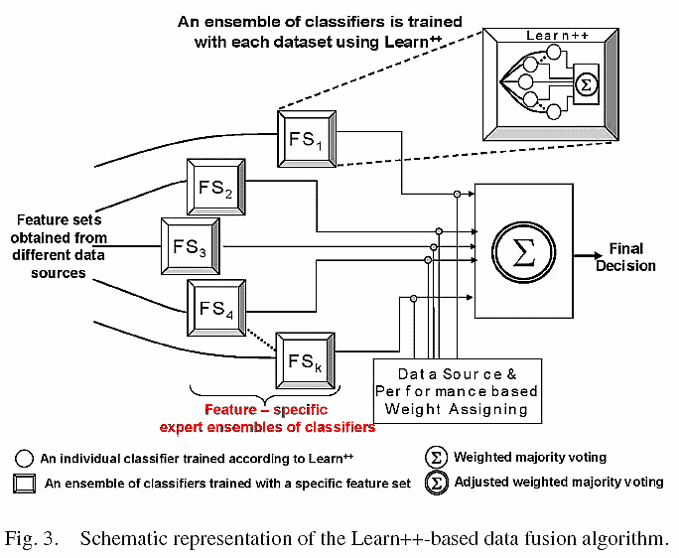

Slide 41
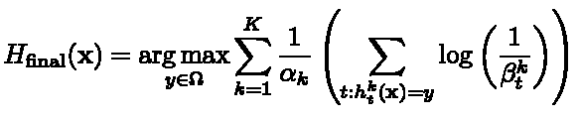


Learn++-based Data Fusion
Classifiers (ensembles) are combined through weighted majority voting.
Voting weights
在面對未知sample要投票給第k類時，各classifiers (含大與小分類器)每一票權重係由訓練時分類正確率高低決定

Slide 42
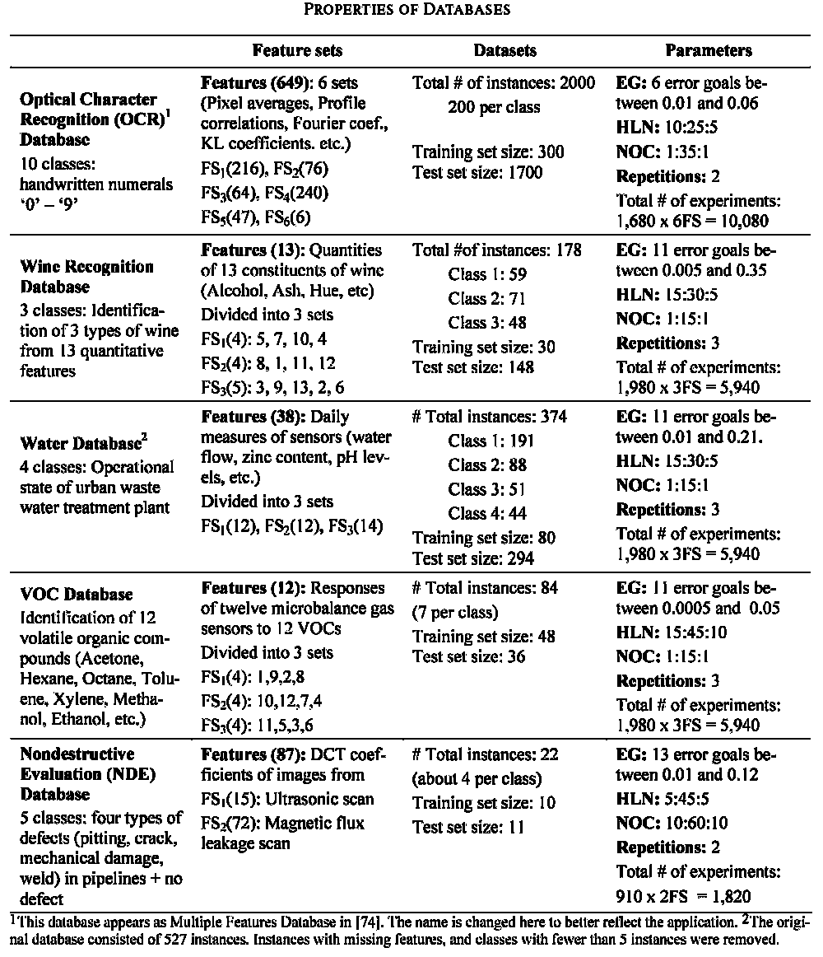
Experiments - Datasets

Slide 43
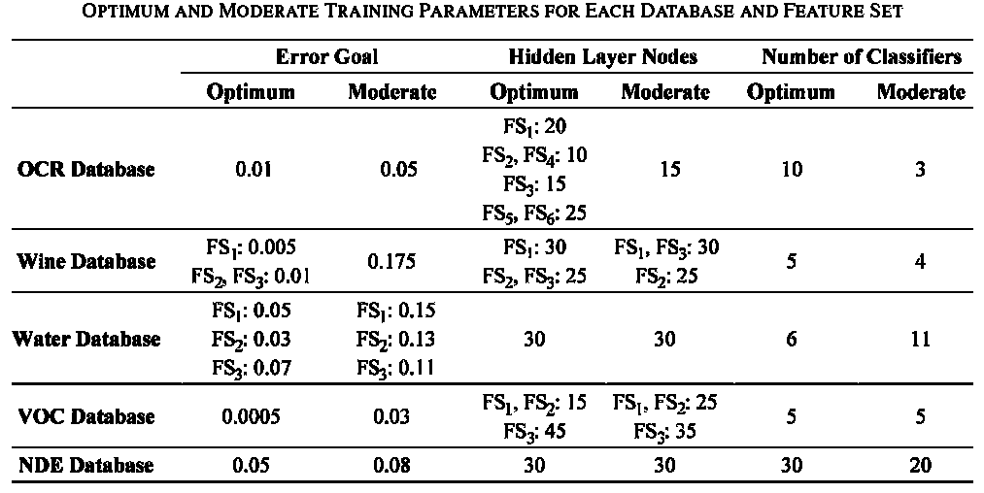
Deciding optimum / moderate parameters
`

Slide 44
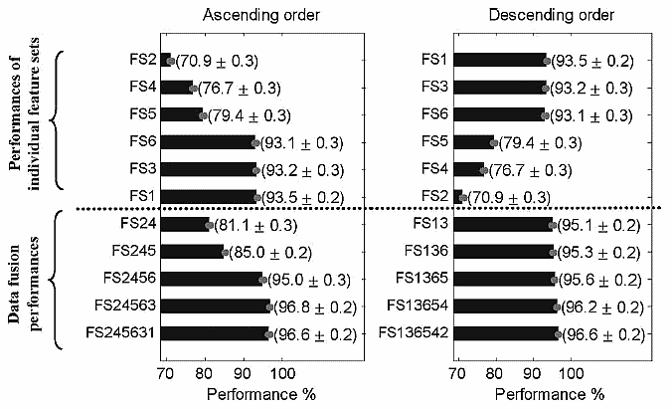
OCR fusion experiment
50 trials
Learn++ uses a linear combination scheme, and thus is independent of the order in which the classifiers are combined.

Slide 45
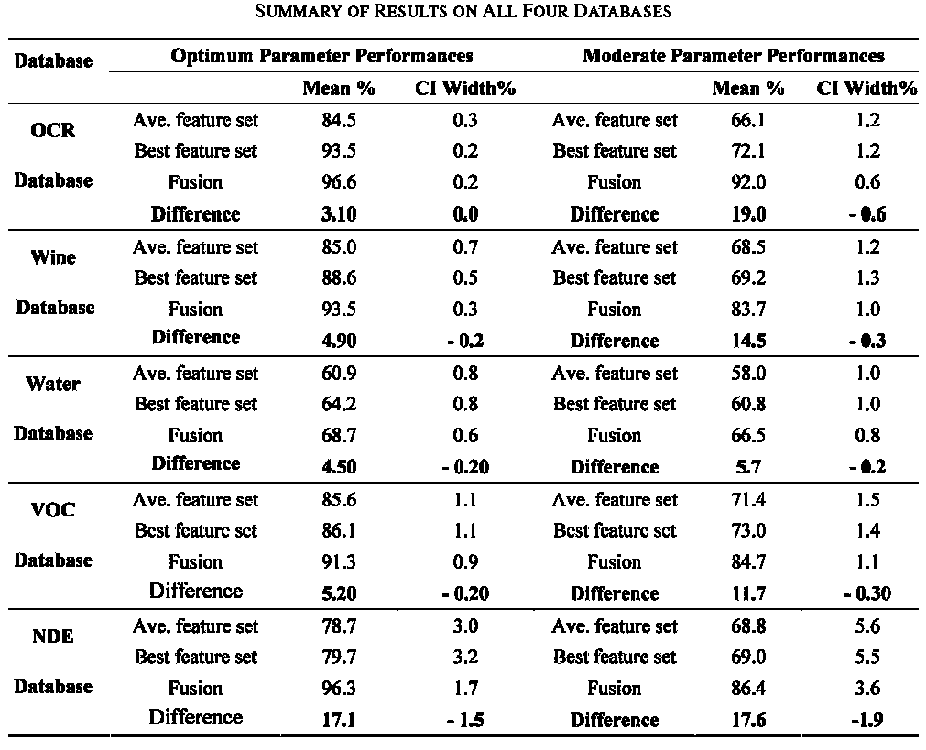
Summary for data fusion
The data fusion performance is consistently better than the performance of classifiers trained with even the best of the individual feature sets.
CI (confidence interval) widths are always lower for data fusion as the addition of irrelevant features would have less of an impact on Learn++ due to performances of larger number of classifiers being averaged.(see next)

Slide 46
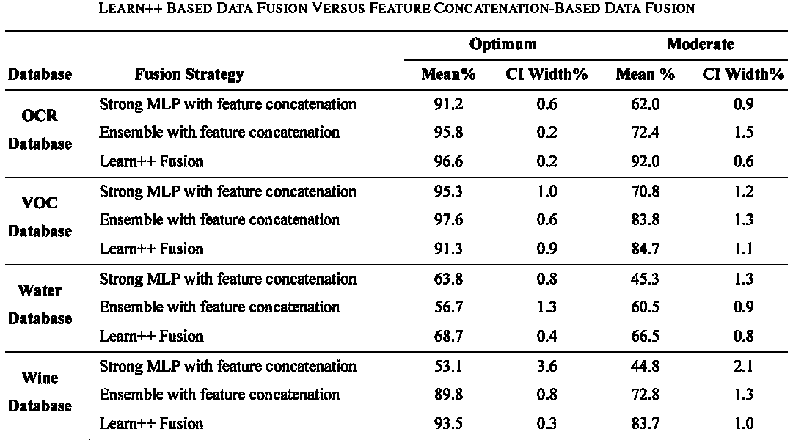
Data fusion vs. feature concatenation
Conventional Adaboost

Slide 47
Conclusion
Learn++ can identify feature sets that are redundant and carry no additional information.
The feature sets can be combined in any order without affecting the final performance.
Learn++ based data fusion often outperforms classification systems, whether an ensemble (conventional adaboost) or a single (strong) classifier.

