Slide 1
Flows in Networks
Presenter: Chu-Kai Liu
Date: May. 6, 2009

Slide 2
Abstract
Finding the shortest path in G from u to v passing through w corresponds to finding a minimum cost flow of volume two from w to t in N. This can be done with two iterations of the augmentation step of the Ford–Fulkerson maximum flow algorithm or equivalently two shortest path computations and hence gives an O(n²) algorithm[1].
[1] J. Bang-Jensen, G. Gutin, Digraphs: Theory, Algorithms and Applications, Springer, London, 2001.

Slide 3
Ford–Fulkerson algorithm(1/3)
Computes the maximum flow in a flow network.
Algorithm: As long as there is a path from the source(start node) to the sink(end node), with available capacity on all edges in the path, we send flow along one of these paths. Then we find another path, and so on. A path with available capacity is called an augmenting path.

Slide 4

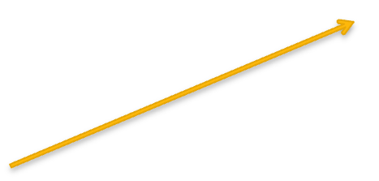



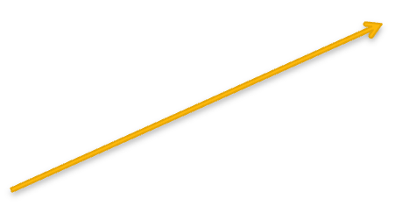



Ford–Fulkerson algorithm(2/3)
Example: augmenting path & max flow
16
12/16
s
1
7+4/13
13
4/13
10
12
12/12
2
3
9
12+7/20
7/20
7+4/14
20
14
4/14
7/7
7
4
t
4
4/4
Max flow = 23

Slide 5
Ford–Fulkerson algorithm(3/3)
Complexity: When the capacities are integers, the runtime is bounded by O( m*f ).
This is because each augmenting path can be found in O(m) time and increases the flow by an integer amount which is at least 1.

Slide 6
Minimum cost flow (1/3)
Finding the cheapest possible way of sending a certain amount of flow through a flow network.
The cycle canceling algorithm time complexity O(nm²CU).
U denote the maximum capacity of N.
C denote the maximum numerical value among all costs of N.

Slide 7
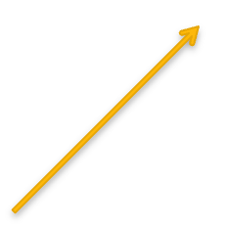
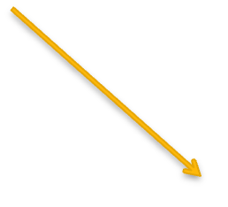

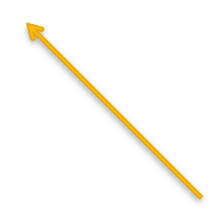
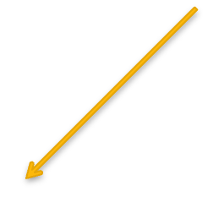
Minimum cost flow (2/3)
Example:
2
(4, 4, 2)
(2, 2, 2)
1
(6, 5, 1)
3
(3, 3, 2)
(3, 2, 3)
4

Slide 8
Minimum cost flow (3/3)
Example:
2
(4, 2, 2)
(2, 0, 2)
1
(6, 5, 1)
3
(3, 1, 2)
(3, 0, 3)
4

Slide 9
An O(n²) algorithm
Where is the O(n²)?

Slide 10
Unit capacity network(1/2)
A unit capacity network, all arcs have capacity equal to one.
The Ford-Fulkerson algorithm will find a maximum (s, t)-flow in time O(nm).

Slide 11
Unit capacity network(2/2)
Assign a capacity of ∞ to all the arcs and to the vertices t and w, and one to every other vertex. Give the arcs joined to t zero cost and give each other arc cost equal to the length in G.
Because the statement “one to every other vertex”, the time complexity O(n²)?

