Slide 1
LOMETS: A local meta-threading-server for protein structure prediction
Sitao Wu and Yang Zhang
Nucleic Acids Research, 2007, Vol. 35, No. 10 Speaker: Chun-Jen Chen
Date: May 19, 2009

Slide 2
Abstract
We developed LOMETS, a local threading meta-server, for quick and automated predictions of protein tertiary structures and spatial constraints. Nine state-of-the-art threading programs are installed and run in a local computer cluster, which ensure the quick generation of initial threading alignments compared with traditional remote-server- based meta-servers. Consensus models are generated from the top predictions of the component-threading servers, which are at least 7% more accurate than the best individual servers based on TM-score at a t-test significance level of 0.1%.
115/11/07

Slide 3
Abstract
Moreover, side-chain and C-alpha (Ca) contacts of 42 and 61% accuracy respectively, as well as long- and short-range distant maps, are automatically constructed from the threading alignments. These data can be easily used as constraints to guide the ab initio procedures such as TASSER for further protein tertiary structure modeling. The LOMETS server is freely available to the academic community at http://zhang.bioinformatics.ku.edu/LOMETS.
115/11/07

Slide 4
Several drawbacks in the current meta-servers.
All the meta-servers take the initial threading inputs from remote computer servers installed in other laboratories.
To achieve the best performance, the meta-servers need to balance various cutoff parameters for the selection and combination of the final models.

Slide 5
LOMETS
all nine individual threading servers are installed locally. This will allow us to control and tune our meta-server algorithms in a consistent manner.
LOMETS server also provides the Ca and side-chain contact and distance map predictions These constraints can be used to guide the structure construction procedures such as MODELLER (10), ROSETTA (11) and TASSER (12) for generating protein tertiary models.

Slide 6
Component Threading Programs in LOMETS
FUGUE
HHSEARCH
PROSPECT2
SAM-T02
SPARKS2
SP3
PAINT, PPA-I and PPA-II.

Slide 7
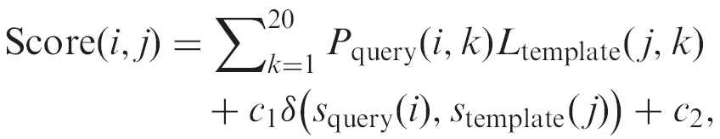
PPA-I.
a simple sequence Profile–Profile Alignment approach combined with secondary structure matches.
The alignment score between the ith residue of the query sequence and the jth residue of the template structure is defined as

Slide 8
P_{query}(i, k) is the frequency of the kth amino acid at the ith position of the query sequence in the PSIBLAST search
L_{template}( j, k) is the log-odds profile of template sequence in the PSI-BLAST search
S_{query}(i) is the secondary structure prediction from PSIPRED[23] for the ith residue of the query sequence
S_{template}( j) the secondary structure assignment by DSSP[24] for the jth residue of the template

Slide 9
δ(S_{query}(i),S_{template}( j)) equals to 1 if S_{query}(i) = S_{template}( j) and 0 otherwise.
The weight factor c₁ is an adjustable parameter for balancing the profile term and the secondary structure matches;
The shift constant c₂ is introduced to avoid the alignment of unrelated regions in the local alignment

Slide 10
PPA-I
The Needleman–Wunsch [20] dynamic programming algorithm is used to find the best match between query and template sequences.
A position-dependent gap penalty in the dynamic programming is employed: no gap is allowed inside the secondary structure regions;

Slide 11
PPA-II
PPA-II is also a profile–profile alignment algorithm. The only difference from PPA-I is that the sequence profiles in PPA-II are collected from SAM-T99 sequence alignments [26].

Slide 12
PAINT
PAINT is a PAirwise-Interaction-based Threading algorithm similar to RAPTOR [28].
There are five terms in PAINT’s energy function which account for environment fitness, residue mutation, secondary structure match, pair-wise interactions and gap penalty.

Slide 13
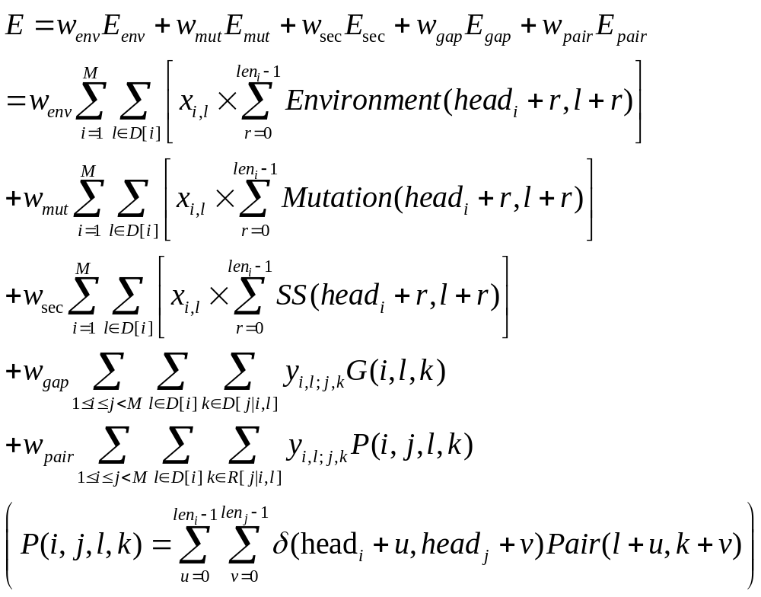

Slide 14
Threading Model selection
Models are taken by the order of:
  PPA-I, SP3, PPA-II, SPARKS, PROSPECT, FUGUE,HHSEARCH, PAINT and SAM-T02
The collection process proceeds and stops until 30 models have been reached.
During the collection, the templates of very short alignments, i.e. the number of aligned residues is less than a quarter of the query sequence length, are neglected.

Slide 15
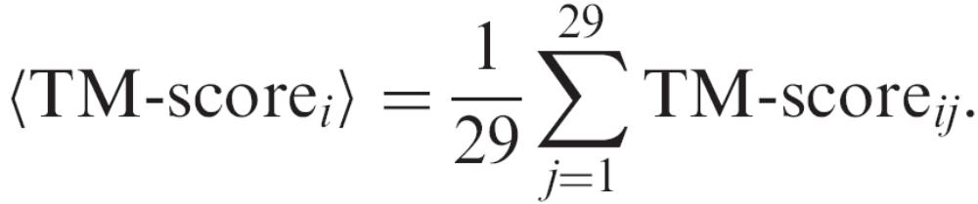
The consensus score of each (ith) of the 30 models is calculated by the average TM-score[29]:
Finally, the models are ranked based on TM-score_{ii}, i.e. the models with higher average TM-score to other models are ranked higher.

Slide 16
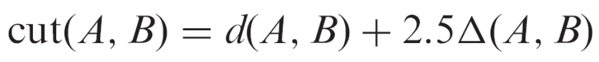
Spatial constraints
Side-chain contacts: A pair of side-chains is considered as contact if the distance between the centers of mass in the aligned templates is below an amino acid specific cutoff:
Here d(A, B) was obtained by calculating the average distance of side-chain centers of mass of the contacted residues A and B
Δ(A, B) is the SD of d(A, B).
http://zhang.bioinformatics.ku.edu/LOMETS/sidechain_contact.txt.

Slide 17

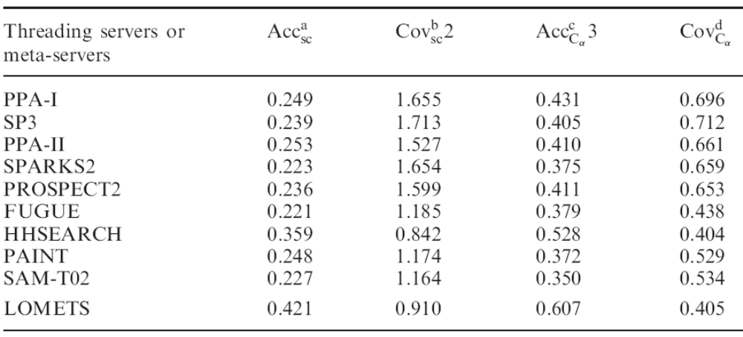
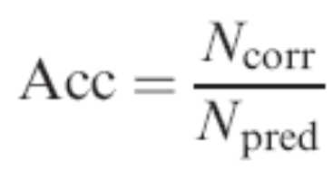
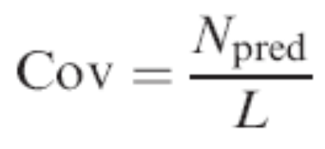
C-alpha contacts: A pair of C-alphas is considered as contact if the distance of Ca atoms is below 6

Slide 18
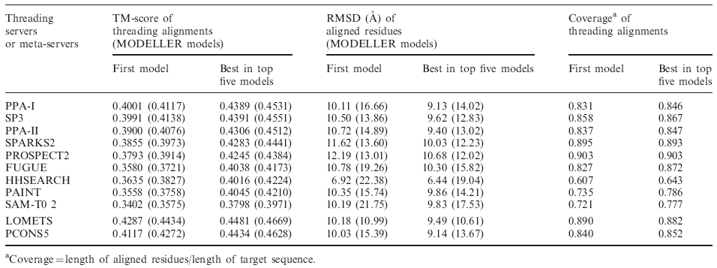
The higher TM-score of the LOMETS models demonstrates a better balance of RMSD (Columns 4 and 5) and alignment coverage (Columns 6 and 7) in comparison with that of the individual servers.
As a control, we also downloaded the PCONS5, the newest version of PCONS meta-server selection program by Wallner and Elofsson [34],

