Slide 1
Seeding strategies and recombination operators for solving the DNA fragment assembly problem
Gabriela Minetti, Enrique Alba, Gabriel Luque
Information Processing Letters 108 (2008) 94–100
Presenter: Chu-Kai Liu
Date: July 28, 2009

Slide 2
Abstract (1/3)
The fragment assembly problem consists in building the DNA sequence from several hundreds (or even, thousands) of fragments obtained by biologists in the laboratory. This is an important task in any genome project since the rest of the phases depend on the accuracy of the results of this stage. Therefore, accurate and efficient methods for handling this problem are needed.

Slide 3
Abstract (2/3)
Genetic Algorithms (GAs) have been proposed to solve this problem in the past but a detailed analysis of their components is needed if we aim to create a GA capable of working in industrial applications. In this paper, we take a first step in this direction, and focus on two components of the GA: the initialization of the population and the recombination operator. We propose several alternatives for each one and analyze the behavior of the different variants.

Slide 4
Abstract (3/3)
Results indicate that using a heuristically generated initial population and the Edge Recombination (ER) operator is the best approach for constructing accurate and efficient GAs to solve this problem.

Slide 5
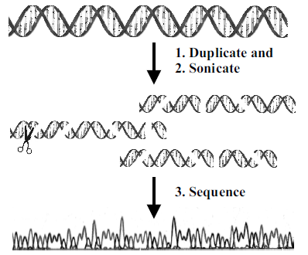
DNA fragment assembly(1/3)

Slide 6
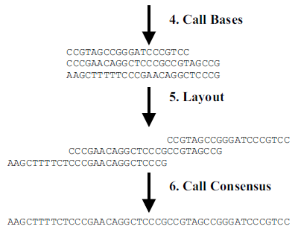
DNA fragment assembly(2/3)

Slide 7
DNA fragment assembly(3/3)
Example: a set of fragments { F1 = GTCAG, F2 = TCGGA, F3 = ATGTC, F4 = CGGATG }
F2 → TCGGA
F4 → CGGATG
F3 → ATGTC
F1 → GTCAG
Consensus → TCGGATGTCAG

Slide 8
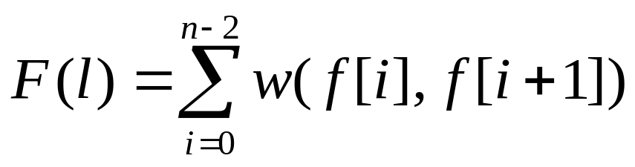
Solving the DNA fragment assembly problem with genetic algorithms
1. Solution representation: fragment IDs.
2. Fitness function:
3. Population initialization.
4. Recombination operators.
5. Mutation operator: randomly select.
6. Selection operators.
7. Stop criterion: 1000 generations.

Slide 9
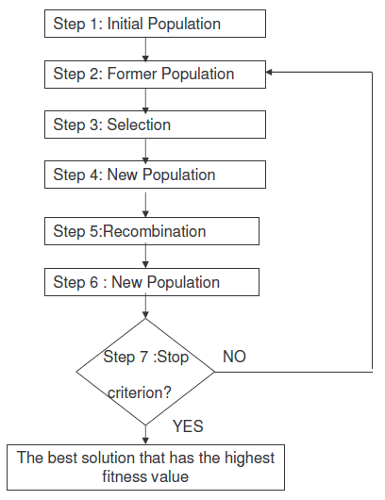
Operation of Genetic Algorithm

Slide 10
Population initialization
An initial population with a high diversity is important to explore the search space and to avoid local optimal solutions.
Three different seeding strategies to generate a single individual in the initial population:
  Random method.
  2-opt heuristic.
  Greedy approach.

Slide 11
2-opt heuristic
It randomly selects two non-adjacent fragments and inverts the subpermutation among them.
Example: a set of fragments { F1 = GTCAG, F2 = TCGGA, F3 = ATGTC, F4 = CGGATG }
F2 – F3 F1 – F4
F3 → ATGTC F4 → CGGATG
F2 → TCGGA F1 → GTCAG
Inverts:
F1 – F3 F2 – F4
F3 → ATGTC F2 → TCGGA
F1 → GTCAG F4 → CGGATG

Slide 12
Greedy approach
Example: a set of fragments { F1 = GTCAG, F2 = TCGGA, F3 = ATGTC, F4 = CGGATG }
TCGGA
CGGATG
ATGTC
GTCAG

Slide 13
Population initialization
Five different seeding strategies to generate the initial population:
  (1) GA.
  (2) GA2o50.
  (3) GA2o100.
  (4) GAG50.
  (5) GAG100.

Slide 14
Recombination operators
1. Cycle crossover (CX).
2. Edge recombination (ER).
3. Order crossover (OX).
4. Partial mapped crossover (PMX).

Slide 15
Cycle crossover
Parent 1:
1
2
3
4
5
6
7
8
9
Parent 2:
4
1
2
8
7
6
9
3
5
Temp offspring1:
1
2
3
4
8
Offspring1:
1
2
3
4
7
6
9
8
5
Offspring2:
4
1
2
8
5
6
7
3
9

Slide 16
Edge recombination
Parent 1:
1
2
3
5
6
4
Parent 2:
3
1
2
4
5
6
1: {2, 3, 4}
2: {1, 3, 4}
3: {1, 2, 5, 6}
4: {1, 2, 5, 6}
5: {3, 4, 6}
6: {3, 4, 5}
2: {3, 4}
3: {2, 5, 6}
4: {2, 5, 6}
5: {3, 4, 6}
6: {3, 4, 5}
3: {5, 6}
4: {5, 6}
5: {3, 4, 6}
6: {3, 4, 5}
3: {5, 6}
5: {3, 6}
6: {3, 5}
3: {5}
5: {3}
Offspring:
1
2
4
6
3
5

Slide 17
Order crossover
Parent 1:
2
1
4
3
7
6
9
8
5
Parent 2:
9
4
1
2
5
3
8
7
6
Temp offspring:
2
4
3
7
8
Order in parent 2:
9
4
1
2
5
3
8
7
6
Offspring:
2
9
4
3
7
1
5
8
6

Slide 18
Partial mapped crossover(1/2)
1. Select the substring
Parent 1:
2
1
4
3
7
6
9
8
5
Parent 2:
9
4
1
2
5
3
8
7
6
2. Exchange substrings
Proto-offspring 1:
2
1
1
2
5
3
9
8
5
Proto-offspring 2:
9
4
4
3
7
6
8
7
6

Slide 19
Partial mapped crossover(2/2)
3. Mapping substring
1 ↔ 4
2 ↔ 3 ↔ 6
5 ↔ 7
4. Legalize the offspring
Offspring 1:
6
4
1
2
5
3
9
8
7
Offspring 2:
9
1
4
3
7
6
8
5
2

Slide 20
Selection operators
This technique randomly selects two individuals and finally chooses the best one.

Slide 21
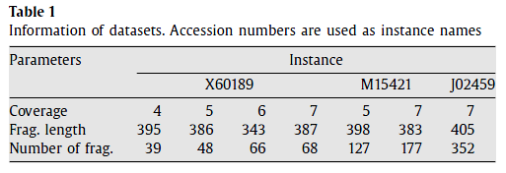
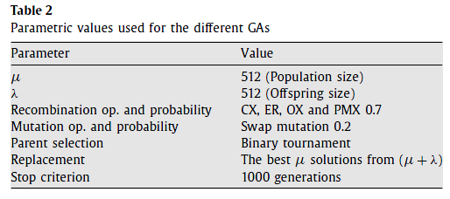
Experimental results(1/5)
3,835
10,089
20k

Slide 22
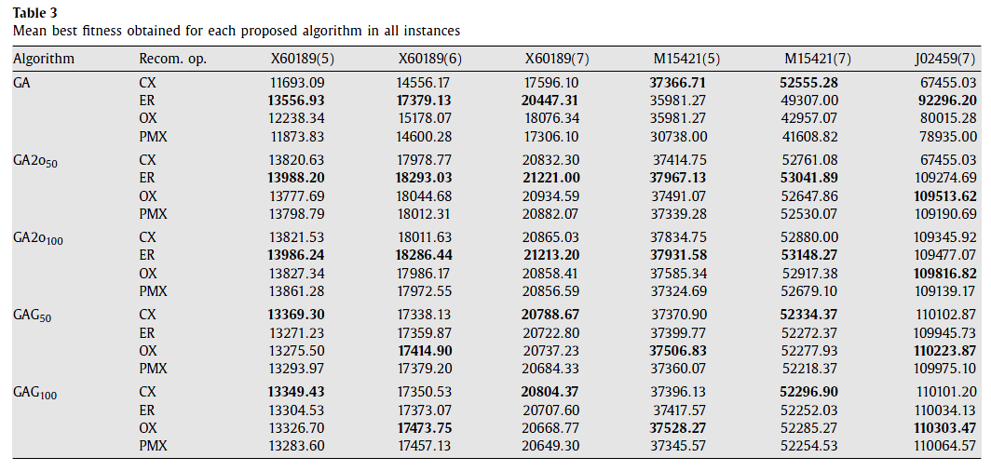
Experimental results(2/5)

Slide 23
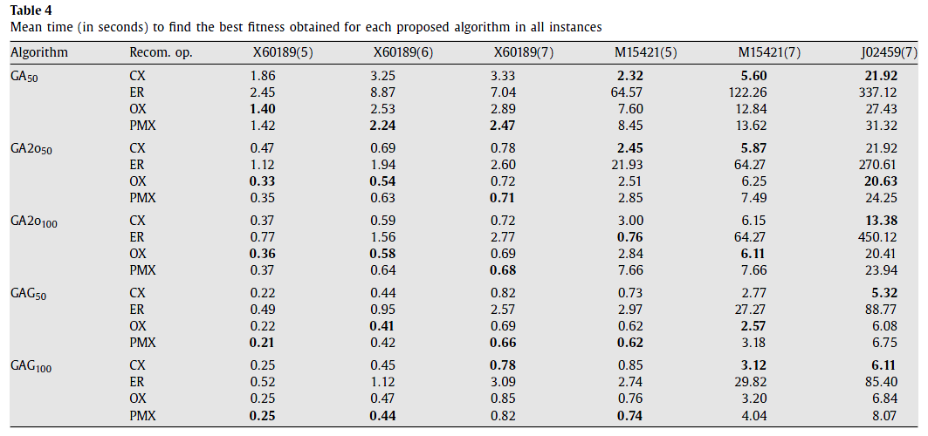
Experimental results(3/5)

Slide 24
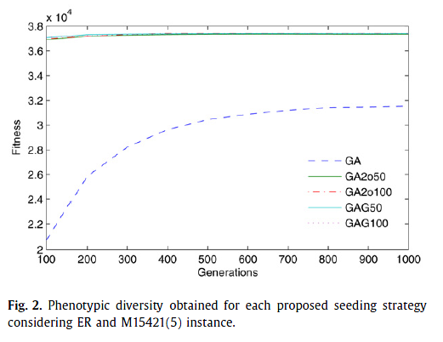
Experimental results(4/5)

Slide 25
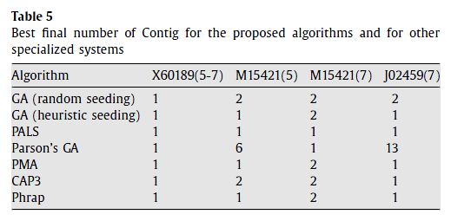
Experimental results(5/5)

