Slide 1
Faster sorting algorithms discovered using deep reinforcement learning
Daniel J. Mankowitz, Andrea Michi, Anton Zhernov, Marco Gelmi, Marco Selvi, Cosmin Paduraru, Edouard Leurent, Shariq Iqbal, Jean-Baptiste Lespiau, Alex Ahern, Thomas Köppe, Kevin Millikin, Stephen Gaffney, Sophie Elster, Jackson Broshear, Chris Gamble, Kieran Milan, Robert Tung, Minjae Hwang, Taylan Cemgil, Mohammadamin Barekatain, Yujia Li, Amol Mandhane, Thomas Hubert, Julian Schrittwieser, Demis Hassabis, Pushmeet Kohli, Martin Riedmiller, Oriol Vinyals & David Silver
Nature, June, 2023
Presenter: Yu-Yen Chu
Date: June 13, 2023

Slide 2
Abstract
Fundamental algorithms such as sorting or hashing are used trillions of times on any given day. As demand for computation grows, it has become critical for these algorithms to be as performant as possible. Whereas remarkable progress has been achieved in the past, making further improvements on the efficiency of these routines has proved challenging for both human scientists and computational approaches. Here we show how artificial intelligence can go beyond the current state of the art by discovering hitherto unknown routines.

Slide 3
Abstract (Cont.)
To realize this, we formulated the task of finding a better sorting routine as a single-player game. We then trained a new deep reinforcement learning agent, AlphaDev, to play this game. AlphaDev discovered small sorting algorithms from scratch that outperformed previously known human benchmarks. These algorithms have been integrated into the LLVM standard C++ sort library. This change to this part of the sort library represents the replacement of a component with an algorithm that has been automatically discovered using reinforcement learning. We also present results in extra domains, showcasing the generality of the approach.

Slide 4
Problem Setup
Goal: optimize the length and latency of the assembly program of sorting.
AlphaDev is a model to play a game to achieve this goal.
Two kinds of sort
Fixed sort: only sort sequence with a fixed length.
Variable sort: sort sequence whose length is less than or equal to a number.

Slide 5
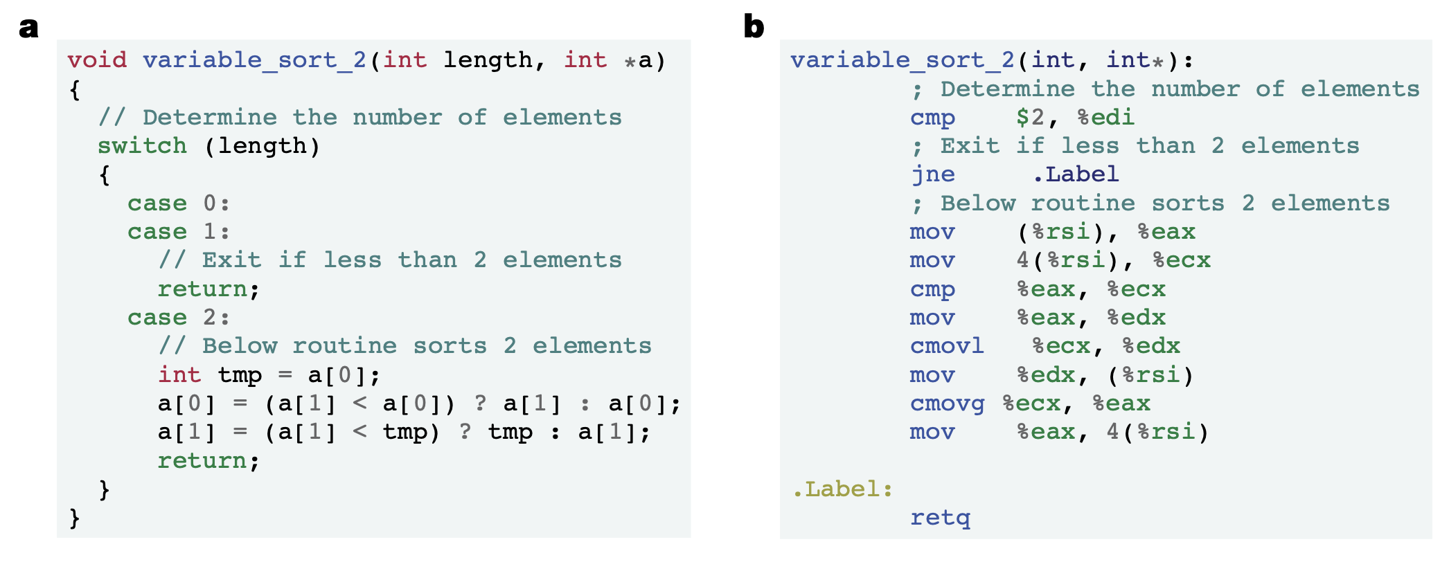
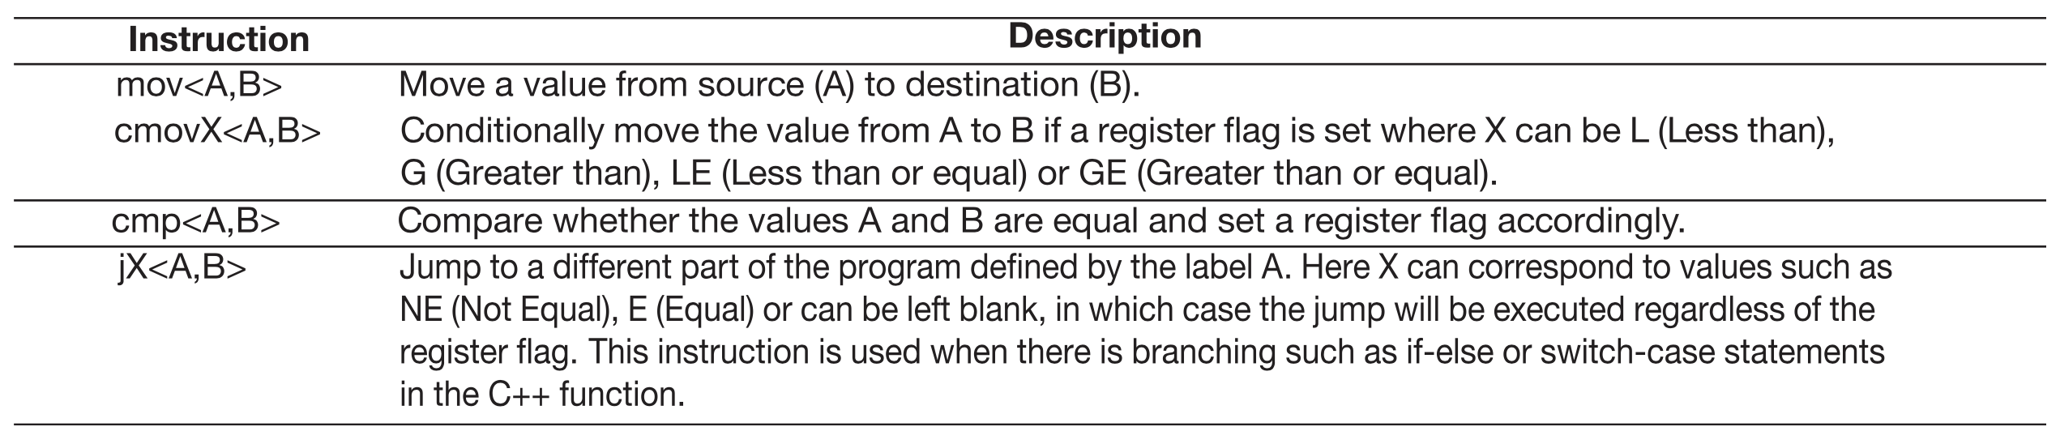
C++ program and Assembly program
C++ program
Assembly program

Slide 6
AlphaDev
Learning algorithm: Monte Carlo Tree Search with deep neural network.
Input: state S_{t}={P_{t}, S_{t}}
P_{t}: the representation of the algorithm structure, encoded by transformer encoder.
S_{t}: the dynamics of memory and registers, encoded by CPU state encoder.
Output:
Policy prediction: probability distribution over actions.
Value prediction: cumulative return from state S_{t}.
Action: one of the assembly instruction.
Reward: algorithm correctness and algorithm latency.

Slide 7
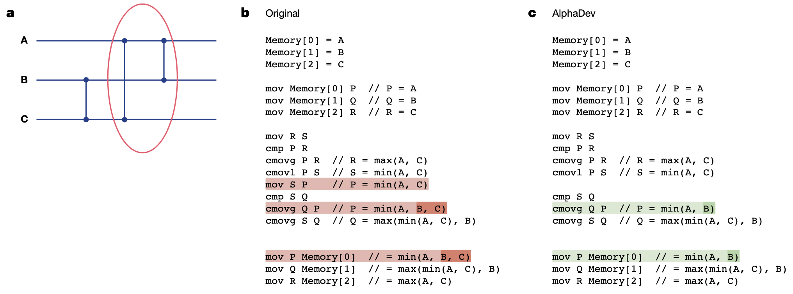
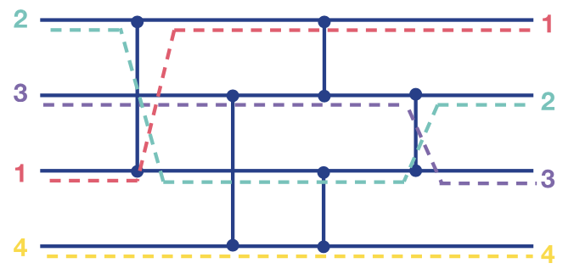

Fixed Sort with 3 elements
$$B≤C$$

Slide 8
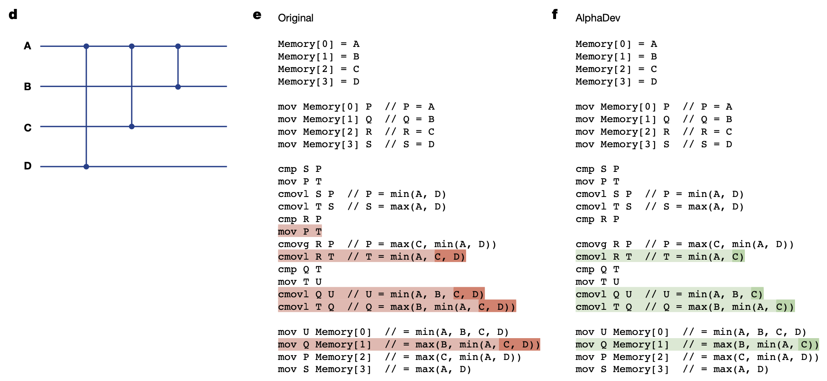

Fixed Sort with 4 elements
$$D≥min⁡(A,C)$$

Slide 9
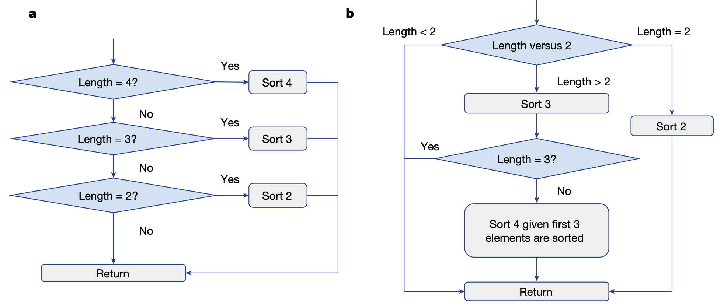
Variable Sort with 4 elements

Slide 10
Comparison with State-of-the-Art
State-of-the-Art: stochastic superoptimization approach.
Schkufza, E., Sharma, R. & Aiken, A., “Stochastic superoptimization”, ACM SIGPLAN Notices, 48, 305–315 (2013).
Use stochastic superoptimization approach as learning algorithm.
AlphaDev-S-CS (cold start): start with no program.
AlphaDev-S-WS (warm start): start with optimal sorting program.

Slide 11
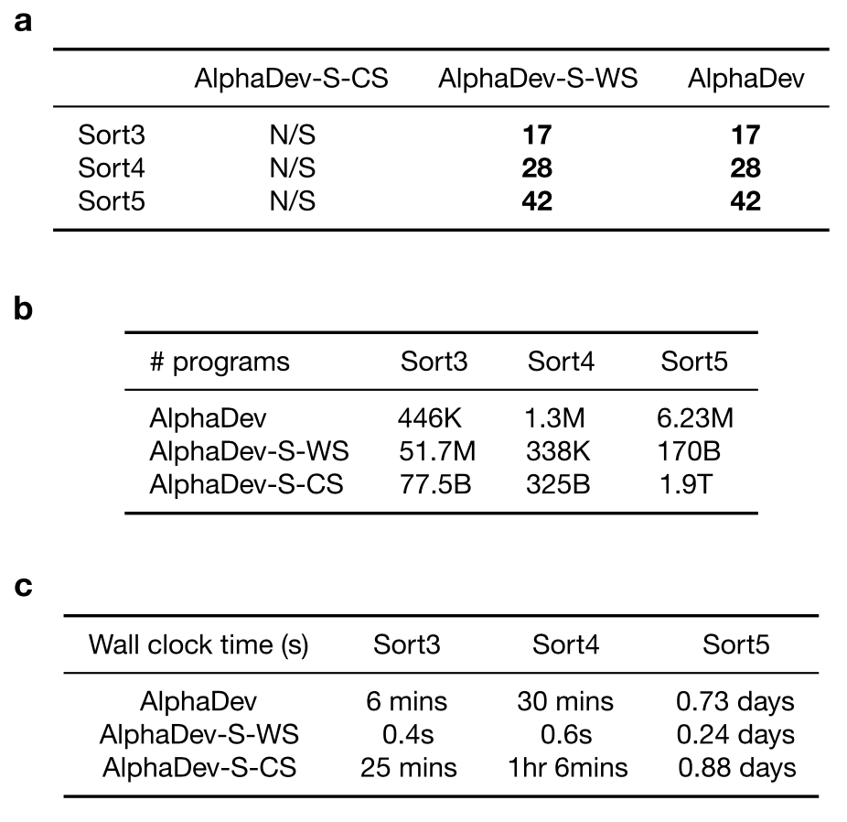
Comparison of Fixed Sort

Slide 12
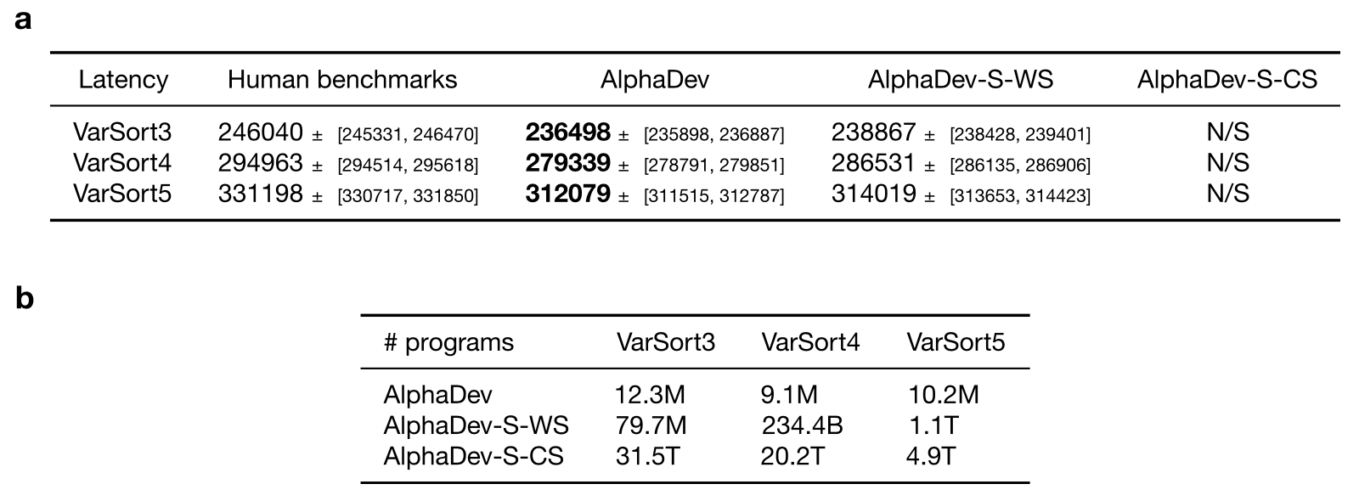
Comparison of Variable Sort
5th percentile among 100 machines’ latencies

Slide 13
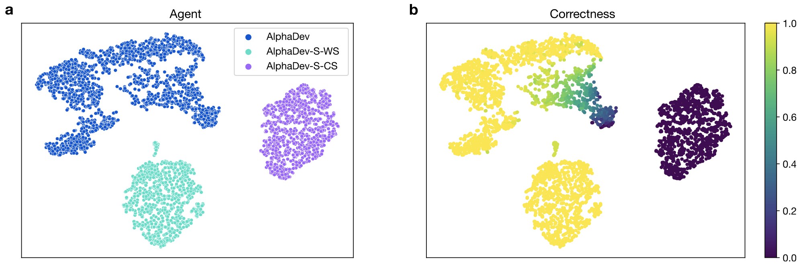
Exploration Hypothesis
two-dimensional t-stochastic neighbor embedding (t-SNE)

Slide 14
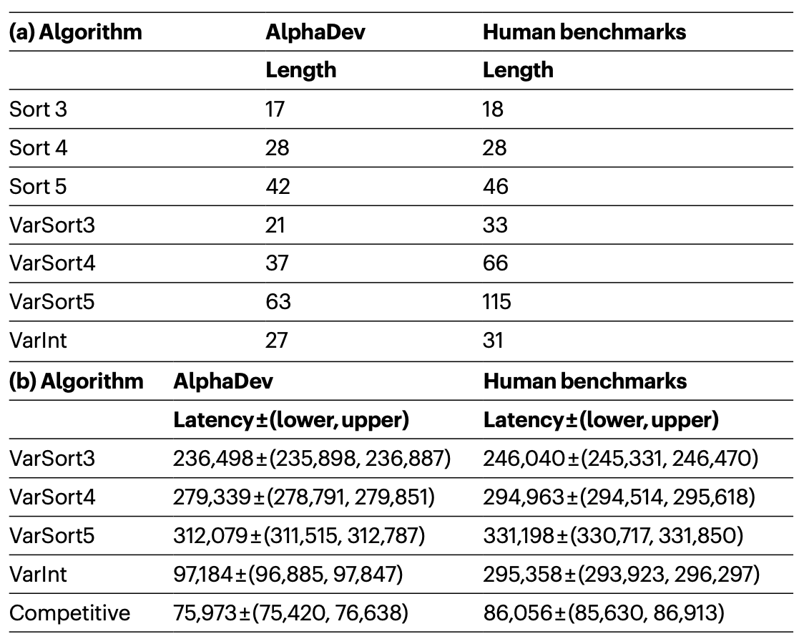
Comparison with Human Benchmark

Slide 15
Conclusion
Sort 3, Sort 4, and Sort 5 have been included in LLVM libc++ standard sorting library.
futurework of AlphaDev
Optimize the number of collisions of hash function.
Optimize the number of logic components of complicated functions.

