Slide 1
Cartesian Tree Matching and Indexing
Sung Gwan Park, Amihood Amir, Gad M. Landau, Kunsoo Park,
arXiv:1905.08974v1 [cs.DS] 22 May 2019
Presenter: Wen-Wen Liao
Date: June 13, 2023

Slide 2
Abstract
We introduce a new metric of match, called Cartesian tree matching, which means that two strings
match if they have the same Cartesian trees. Based on Cartesian tree matching, we define single
pattern matching for a text of length n and a pattern of length m, and multiple pattern matching
for a text of length n and k patterns of total length m. We present an O(n + m) time algorithm for
single pattern matching, and an O((n + m)log k) deterministic time or O(n + m) randomized time
algorithm for multiple pattern matching. We also define an index data structure called Cartesian
suffix tree, and present an O(n) randomized time algorithm to build the Cartesian suffix tree. Our
efficient algorithms for Cartesian tree matching use a representation of the Cartesian tree, called the
parent-distance representation.

Slide 3
Cartesian Tree Matching
𝑇 = (41, 36, 15, 8, 41, 23, 28, 16, 26, 22, 56, 29, 12, 61)
P = (6, 2, 5, 1, 4, 3, 7)
CT(T[5..11]) = CT(P[1..7])
1
16
2
3
23
22
6
5
7
4
41
28
26
56

Slide 4
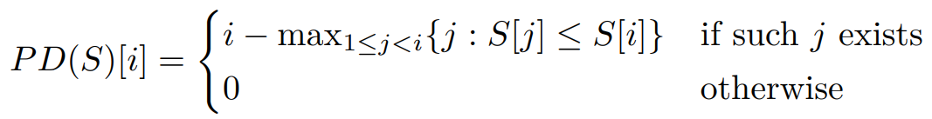
Single Pattern Matching
Parent-distance representation: 表示每個節點與其父節點之間的距離
S1 = (6, 2, 5, 1, 4, 3, 7), S2 = (41, 23, 28, 16, 26, 22, 56)
PD(S1) =(0, 0, 1, 0, 1, 2, 1), PD(S2) = (0, 0, 1, 0, 1, 2, 1)
=>Two strings S1 and S2 have the same Cartesian trees if and only if S1 and S2 have the same parent-distance representations.

Slide 5
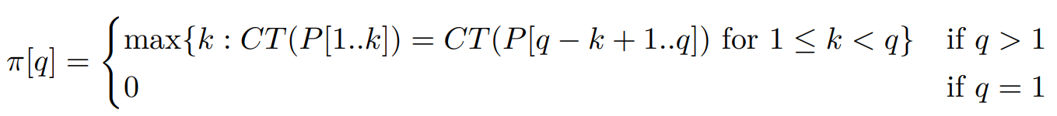
Single Pattern Matching
Failure function (π):當前字符和某個模式的某個字符不匹配，則可以跳到另一個節點，繼續匹配
P = (5, 7, 4, 6, 1, 3, 2)
π = (0, 1, 1, 2, 3, 4, 1)
CT(P[1..3]) = CT(P[3..5]) = (0, 1, 0)
CT(P[1..4]) = CT(P[3..6]) = (0, 1, 0, 1)

Slide 6
Single Pattern Matching
Time complexity:
O(n)(text search→KMP algorithm) + O(m)(failure function)
➔ linear time

Slide 7
Multiple Pattern Matching
Multiple pattern Cartesian tree matching: 在一個text中匹配多個pattern，並且每個pattern都是一棵Cartesian tree
P1 = (4, 2, 3, 1, 5), P2 = (3, 1, 4, 2), P3 = (1, 2, 3, 5, 4)
PD(P1) = (0, 0, 1, 0, 1), PD(P2) = (0, 0, 1, 2), PD(P3) = (0, 1, 1, 1, 2)

Slide 8
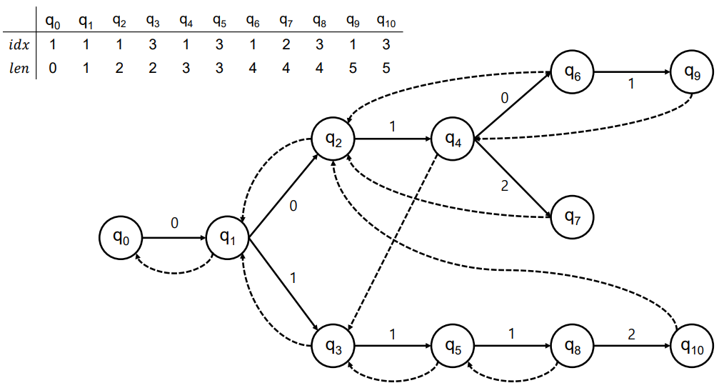
Multiple Pattern Matching
Aho-Corasick automaton: 所有pattern構建成一棵Trie樹，然後在Trie樹上構建一個有限狀態自動機，並且使用failure function和output function來實現匹配
P1 = (4, 2, 3, 1, 5), P2 = (3, 1, 4, 2), P3 = (1, 2, 3, 5, 4)
PD(P1) = (0, 0, 1, 0, 1), PD(P2) = (0, 0, 1, 2), PD(P3) = (0, 1, 1, 1, 2)

Slide 9
Multiple Pattern Matching
P1 = (4, 2, 3, 1, 5), P2 = (3, 1, 4, 2), P3 = (1, 2, 3, 5, 4)
PD(P1) = (0, 0, 1, 0, 1), PD(P2) = (0, 0, 1, 2), PD(P3) = (0, 1, 1, 1, 2)
Failure function: use BFS
idx[q9] = 1 and len[q9] = 5
→P1[1..5]
Failure function: q4
→PD(P1[1..3]) = PD(P1[4..5]) = 1
idx[q7] = 2 and len[q7] = 4
→P2[1..4]
Failure function: q2
→PD(P2[1..2]) = PD(P2[3..4]) = 0

Slide 10
Multiple Pattern Matching
Time complexity:
O((n + m)log k) → using a binary search tree
O(n + m)→ using a hash

Slide 11
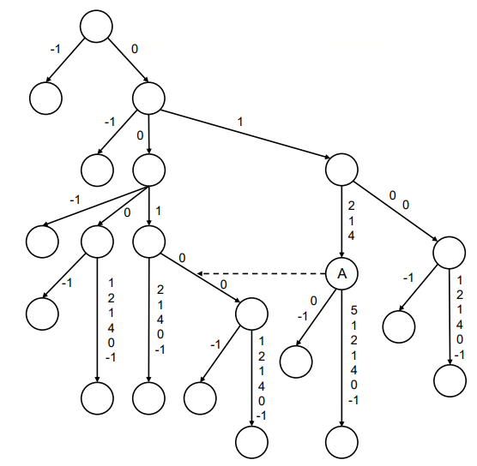
Cartesian Suffix Tree
給定一個字符串T[1..n]，T的Cartesian suffix tree是使用對於每個1 ≤ i ≤ n（其中特殊字符−1連接到PD(T[i..n])的末尾）和字符串（−1）構建的壓縮字典樹
用來判斷兩個suffix是否有相同的prefix
T = (2, 7, 5, 6, 4, 3, 11, 9, 10, 8, 1)
PD(T) = (0, 1, 2, 1, 4, 5, 1, 2, 1, 4, 0)
PD(T[1..5]) = PD(T[6..10]) = (0, 1, 2, 1, 4)
Notes:
它可以用來判斷兩個後綴是否有相同的前綴。如果兩個後綴的 parent-distance representation 相同，那麼它們的前綴就是相同的。

Slide 12
Cartesian Suffix Tree
後綴集合是一組n個字符串s1，s2，...，sn，其中si的長度為n+ 1−i。
對於任意不同的字符串si和sj，si不應該是sj的前綴。
對於任意的i和j，如果si和sj有長度為l的共同前綴，則si+1和sj+1的共同前綴長度至少為l − 1。
Notes:
1. Cartesian suffix tree 的每個節點都代表了原始字符串的一個後綴，而且這些後綴的長度都是不同的。
2. 它保證了每個節點都代表了一個唯一的後綴，並且這些後綴之間沒有重疊或包含關係。
3. 它保證了在構建 Cartesian suffix tree 的過程中，每次插入一個新的後綴時，都可以利用前一個後綴的信息來更新 Cartesian suffix tree。

Slide 13
Conclusion
Single pattern matching
O(n+m)
Multiple pattern matching
O((n+m)log k) deterministic time
O(n+m) randomized time
Cartesian suffix tree
O(n) randomized time

