Slide 1
Neural Networks and the Estimation of Hands Strength in Contract Bridge
K. Mossakowski and J. Mańdziuk
In Artificial Intelligence and Soft Computing–ICAISC
8th International Conference, Zakopane, Poland, June 25-29, 2006.
Presenter: Yun-An Chen
Date: July 23, 2023

Slide 2
Abstract(1/2)
This paper is focused on a Double Dummy Bridge Problem (DDBP) which consists in answering the question of how many tricks are to be taken by a pair of players assuming perfect play of all four sides with all cards being revealed. Several experiments are also presented in a variant of DDBP in which the information about to whom of the two players in a given pair a particular card belongs to is hidden. In contrast to our previous works, which were devoted to no trump contracts, here we concentrate on suit contracts.

Slide 3
Abstract(2/2)
Several interesting conclusions are drawn from comparison of weight patterns of networks trained on no trump contracts only vs. those trained exclusively on suit contracts. The ultimate goal of this research is to construct a computer program playing the game of contract bridge using neural networks and other CI techniques with the basic assumption of using zero-human-knowledge approach and to learn purely on examples.

Slide 4
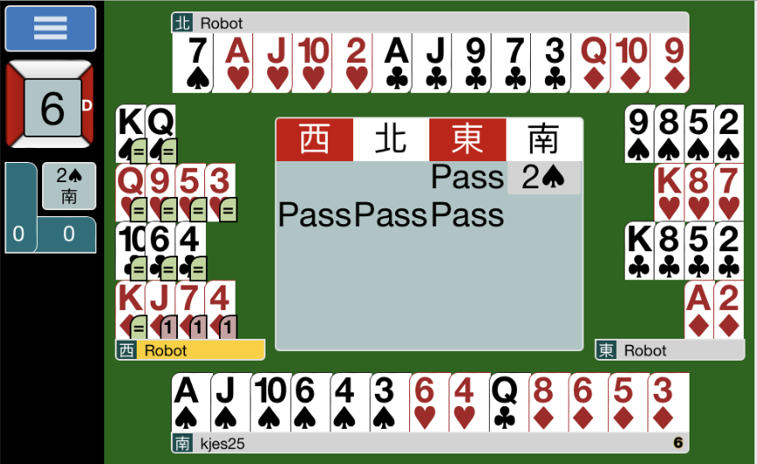
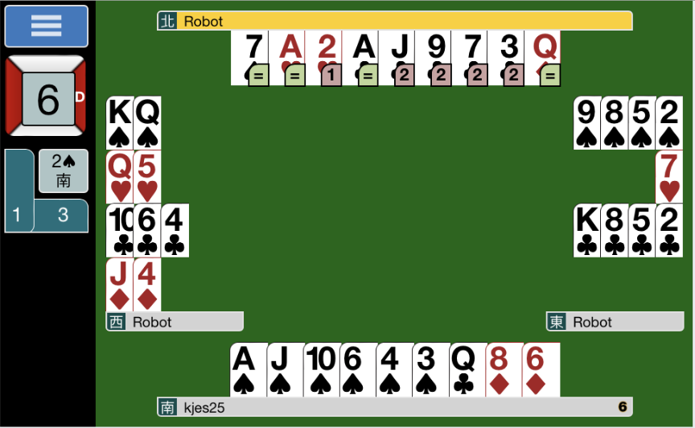
Double dummy bridge problem (DDBP)

Slide 5
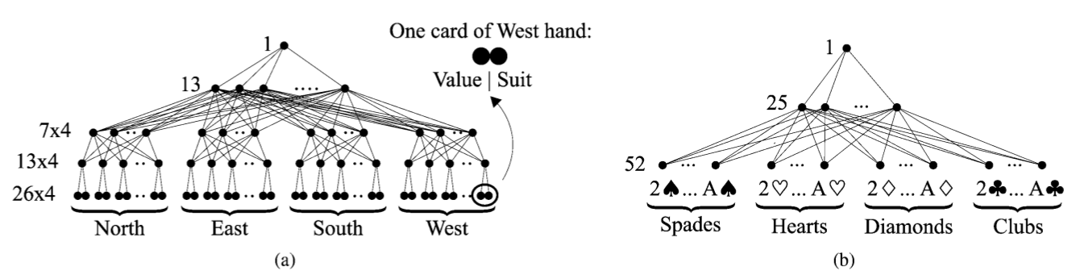
Trained Networks
Value: the rank of a card was transformed using a uniform linear transformation to the range [0.1, 0.9].
Suit: 0.3 for spade, 0.5 for heart, 0.7 for diamond, 0.9 for club.
N : 1.0, S : 0.8, W: -1.0 and E : -0.8

Slide 6
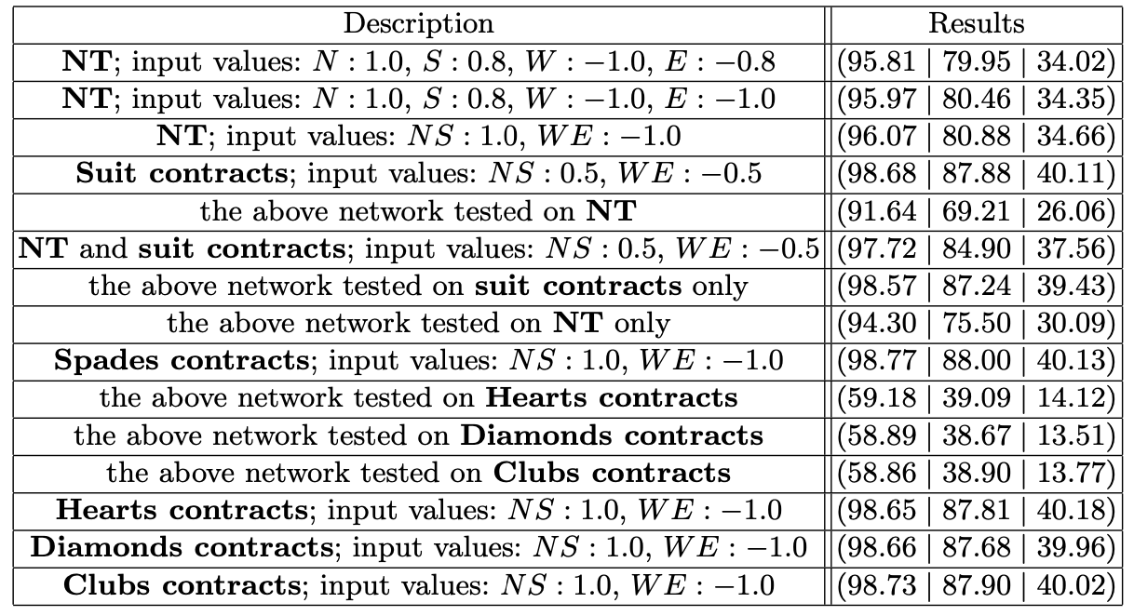
No trump contract

Slide 7
Hiding Opponents’ Cards in NT contracts
N : 1.0, S : 0.8, W: -1.0 and E : -0.8 (original)
Results with architecture (52-25-1) were (95.81 | 79.95 | 34.02)
For hands’ description: N : 1.0, S : 0.8, W and E : -1.0
Results were slightly improved: (95.97 | 80.46 | 34.35).
For hands’ description: N and S : 1.0, W and E : -1.0
Results were slightly improved: (96.07 | 80.88 | 34.66).

Slide 8
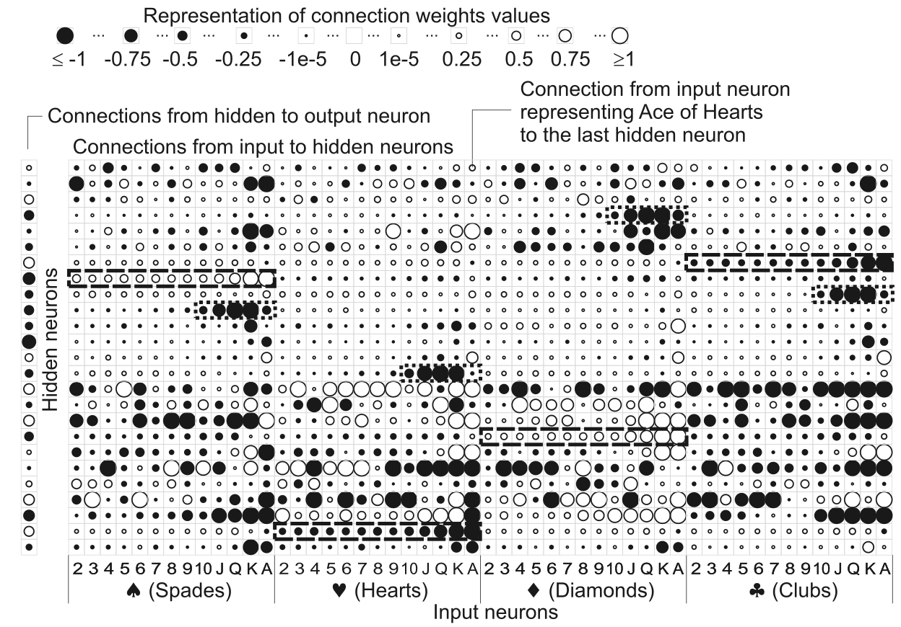
No trump contract analysis
Some hidden neurons focused on suits.
The presence of four hidden neurons each specialized in five cards from one suit.

Slide 9
Suit contract
Training data: 400000 deals from GIB Library.
Testing data: 100000 deals from GIB Library.

Slide 10
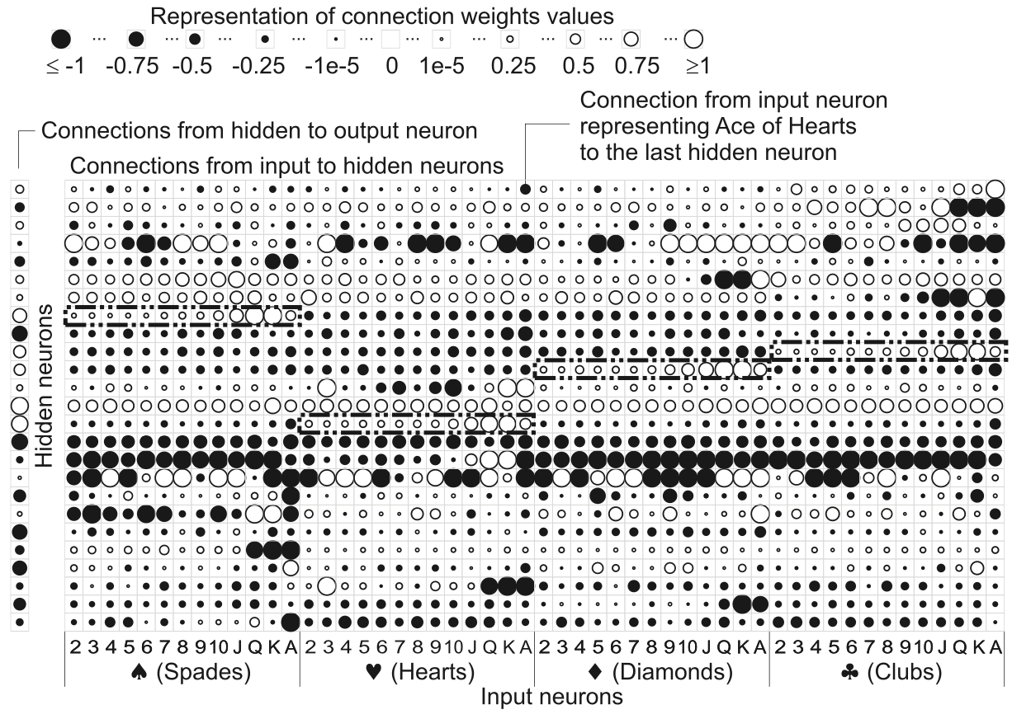
Suit contract

Slide 11
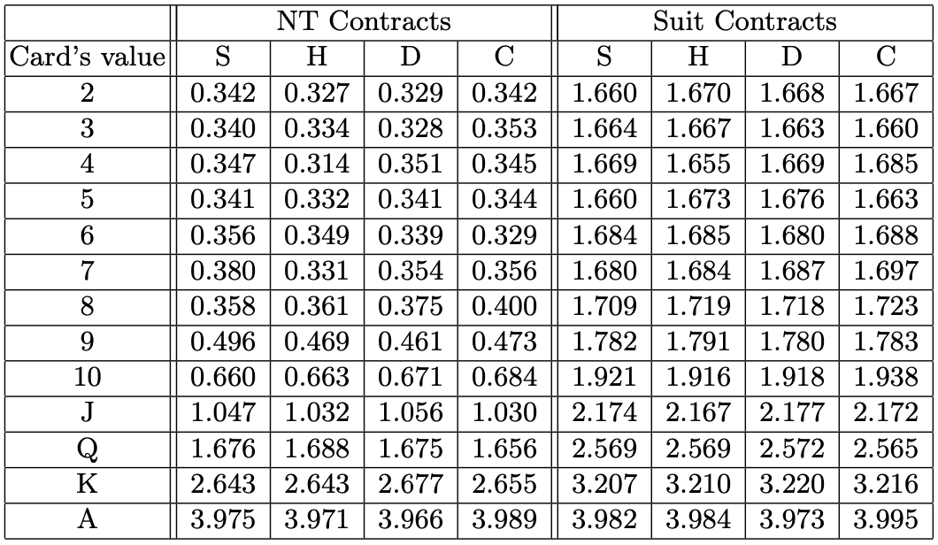
Suit contract

Slide 12
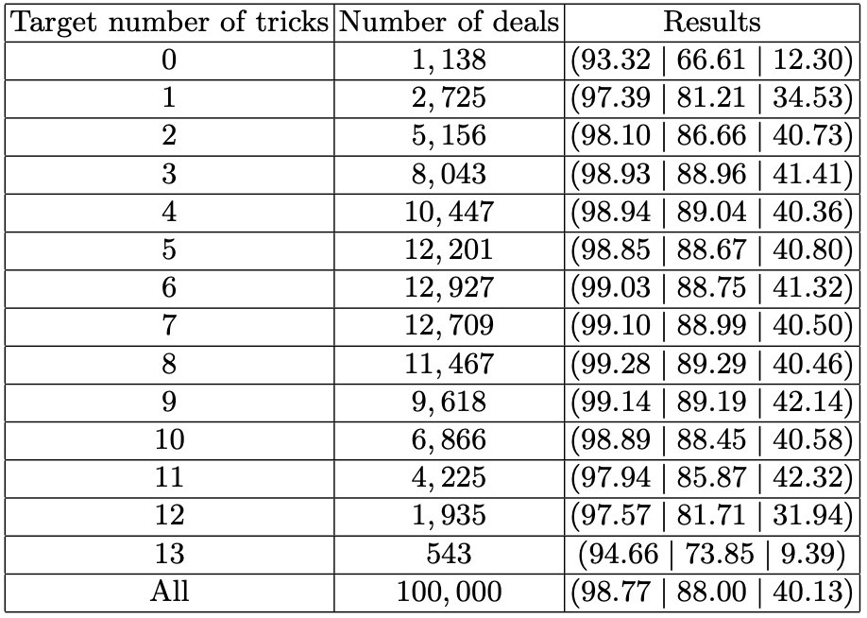
Results - The Target Number of Tricks

Slide 13
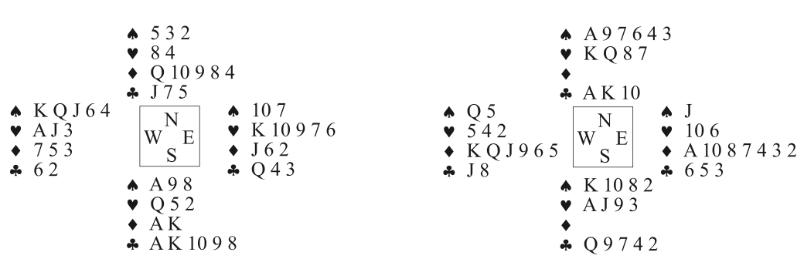
Results - Sample deals
(a) No trump contract
(b) Suit contract (spade)
Network estimated 7 or 8 tricks
Network estimated 12 tricks

Slide 14
Conclusions
It is advisable to train neural networks separately for no trump contracts and suit ones.
The networks connection weights’ values can be explained based on human experience in the game of bridge.

