Slide 1
Computing a Longest Common Almost-Increasing Subsequence of Two Sequences
Toan Thang Ta, Yi-Kung Shieh, Chin Lung Lu,
Theoretical Computer Science, 2021, pp. 44–51
Presenter: Wen-Wen Liao
Date: July 25, 2023

Slide 2
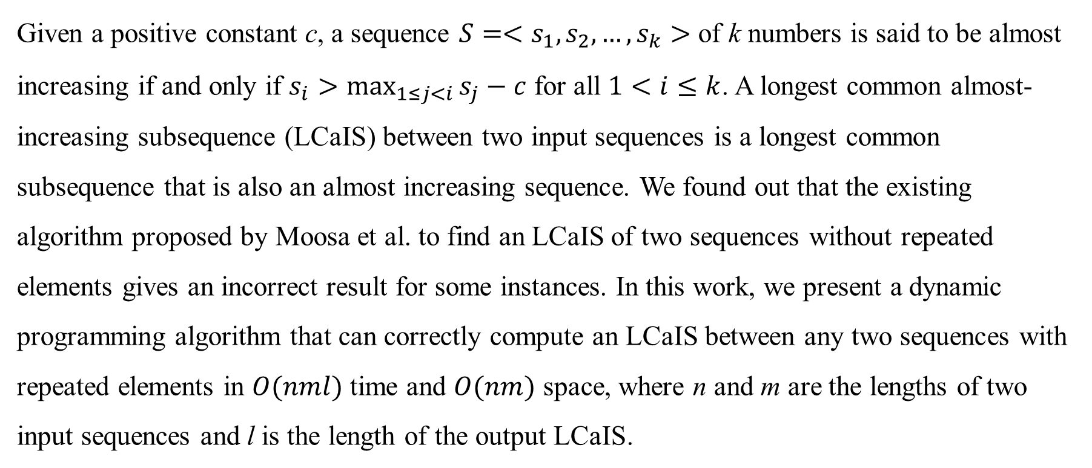
Abstract
Given a positive constant c, a sequence $S=<s_{1},s_{2}, …,s_{k}>$ of k numbers is said to be almost increasing if and only if $s_{i}>\max_{1≤j<i}{s_{j}−c}$ for all $1<i≤k$. A longest common almost-increasing subsequence (LCaIS) between two input sequences is a longest common subsequence that is also an almost increasing sequence. We found out that the existing algorithm proposed by Moosa et al. to find an LCaIS of two sequences without repeated elements gives an incorrect result for some instances. In this work, we present a dynamic programming algorithm that can correctly compute an LCaIS between any two sequences with repeated elements in $O(nml)$ time and $O(nm)$ space, where n and m are the lengths of two input sequences and l is the length of the output LCaIS.

Slide 3

Longest Common almost Increasing Subsequence (LCaLS)
$A=\text{<}\text{3, 2, 1, 3, 2}\text{>}$
$B=\text{<}\text{1, 3, 3, 2}\text{>}$
c = 2
LCaIS = <3, 3, 2>

Slide 4
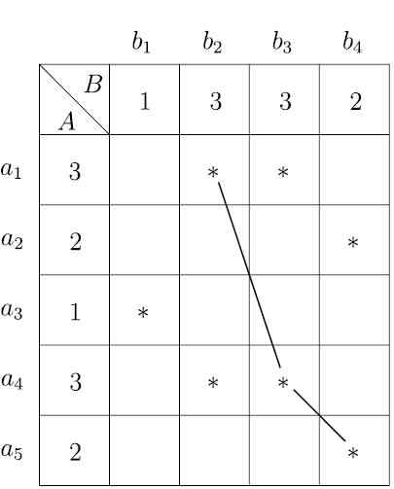

Dynamic programming algorithm
$A=\text{<}\text{3, 2, 1, 3, 2}\text{>}$
$B=\text{<}\text{1, 3, 3, 2}\text{>}$
c = 2
match

Slide 5
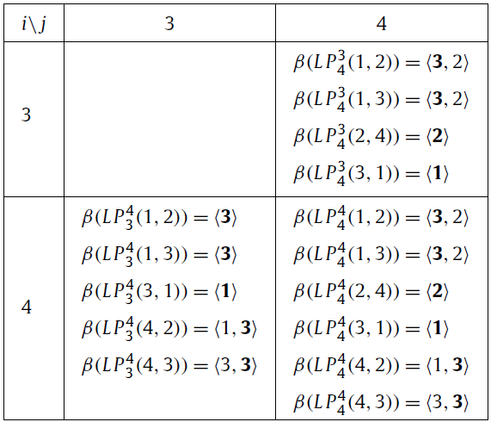

Dynamic programming algorithm
$A=\text{<}\text{3, 2, 1, }\text{3}\text{, 2}\text{>}$
$B=\text{<}\text{1, 3, 3, }\text{2}\text{>}$
c = 2
Mismatched
$L(i −1, j)∪L(i, j −1)$

Slide 6
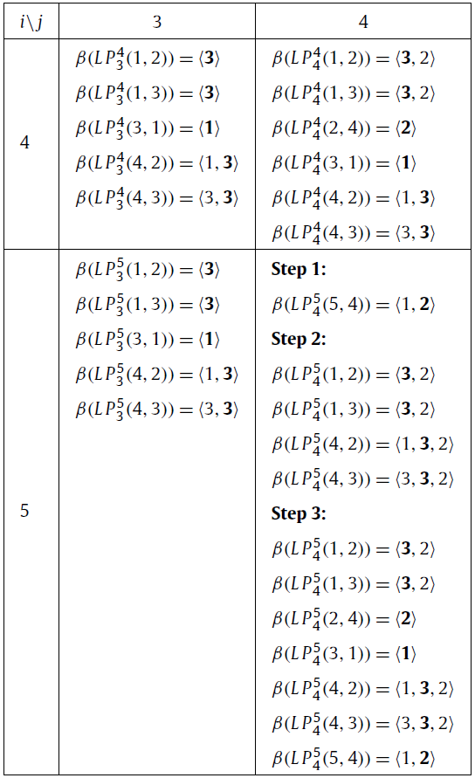

Dynamic programming algorithm
$A=\text{<}\text{3, 2, 1, }\text{3}\text{, }\text{2}\text{>}$
$B=\text{<}\text{1, 3, 3, }\text{2}\text{>}$
c = 2
Matched
Step 1: 在$L(i−1, j−1)$中，找到小於所
match到的值，將match到的值接在後面

Slide 7

Dynamic programming algorithm
$A=\text{<}\text{3, 2, 1, }\text{3}\text{, }\text{2}\text{>}$
$B=\text{<}\text{1, 3, 3, }\text{2}\text{>}$
c = 2
Matched
Step 2: 在$L(i−1, j−1)$中，找到小於所
match到的值加$c$，將match到的值接在後面

Slide 8

Dynamic programming algorithm
$A=\text{<}\text{3, 2, 1, }\text{3}\text{, }\text{2}\text{>}$
$B=\text{<}\text{1, 3, 3, }\text{2}\text{>}$
c = 2
Matched
Step 3: $L(i−1, j)∪L(i, j−1)$

Slide 9
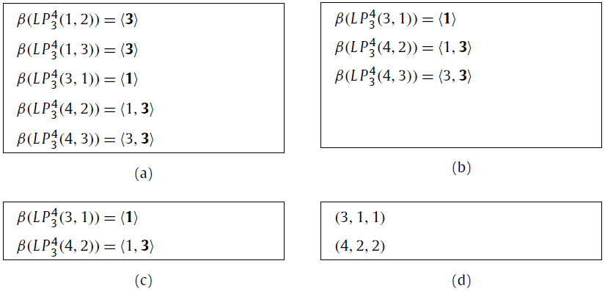
Simplified
原始L(4, 3)
刪掉dominated的路徑
刪掉redundant的路徑
簡化後的L(4, 3)

Slide 10
Simplified
原始L(4, 3)
刪掉dominated的路徑
刪掉redundant的路徑
簡化後的L(4, 3)

Slide 11
Simplified
原始L(4, 3)
刪掉dominated的路徑
刪掉redundant的路徑
簡化後的L(4, 3)→ 3-tuple
長度
最大值所在的index

Slide 12

Conclusion
Time complexity: $O\left(nml\right)$
n and m are the lengths of two sequences, and l is the length of LCaIS

