Slide 1
The Prediction of the Most Suitable Contract in Non-competitive Bridge Bidding
Ying-Yu Lin, Chang-Biau Yang, and Kuo-Si Huang
Department of Computer Science and Engineering
National Sun Yat-sen University, Kaohsiung, Taiwan
報告人：朱宥諺

Slide 2
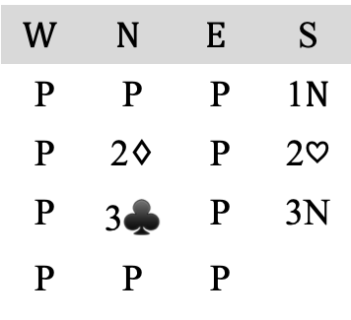
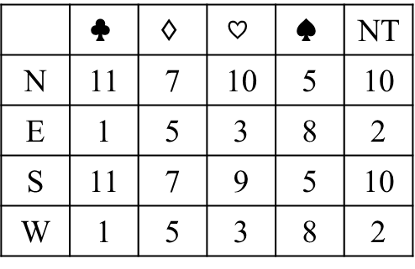
Contract Bridge
 | — 98632 K5 AQT987
QT764 Q5 JT876 K | N W E S | A932 KJT7 42 643
 | KJ85 A4 AQ93 J52
$$W$$ | $$N$$ | $$E$$ | S
P | P | P | 1$N$
P | 2$♢$ | P | 2$♡$
P | 3$♣$ | P | 3N
P | P | P
 | $$♣$$ | $$♢$$ | $$♡$$ | $$♠$$ | NT
N | 11 | 7 | 10 | 5 | 10
E | 1 | 5 | 3 | 8 | 2
S | 11 | 7 | 9 | 5 | 10
W | 1 | 5 | 3 | 8 | 2

Slide 3
Bridge Score Calculation
contract | made | non-vulnerable | vulnerable | contract | made | non-vulnerable | vulnerable | contract | made | non-vulnerable | vulnerable
1m | +0 | 70 | 70 | 1M | +0 | 80 | 80 | 1NT | +0 | 90 | 90
 | +1 | 90 | 90 |  | +1 | 110 | 110 |  | +1 | 120 | 120
2m | +0 | 90 | 90 | 2M | +0 | 110 | 110 | 2NT | +0 | 120 | 120
 | +1 | 110 | 110 |  | +1 | 140 | 140 |  | +1 | 150 | 150
3m | +0 | 110 | 110 | 3M | +0 | 140 | 140 | 3NT | +0 | 400 | 600
 | +1 | 130 | 130 |  | +1 | 170 | 170 |  | +1 | 430 | 630
4m | +0 | 130 | 130 | 4M | +0 | 420 | 620 | 4NT | +0 | 430 | 630
 | +1 | 150 | 150 |  | +1 | 450 | 650 |  | +1 | 460 | 660
5m | +0 | 400 | 600 | 5M | +0 | 450 | 650 | 5NT | +0 | 460 | 660
 | +1 | 420 | 620 |  | +1 | 480 | 680 |  | +1 | 490 | 690
6m | +0 | 920 | 1370 | 6M | +0 | 980 | 1430 | 6NT | +0 | 990 | 1440
 | +1 | 940 | 1390 |  | +1 | 1010 | 1460 |  | +1 | 1020 | 1470
7m | +0 | 1440 | 2140 | 7M | +0 | 1510 | 2210 | 7NT | +0 | 1520 | 2220
contract | made | non-vulnerable | vulnerable | contract | made | non-vulnerable | vulnerable | contract | made | non-vulnerable | vulnerable
1m | +0 | 70 | 70 | 1M | +0 | 80 | 80 | 1NT | +0 | 90 | 90
 | +1 | 90 | 90 |  | +1 | 110 | 110 |  | +1 | 120 | 120
2m | +0 | 90 | 90 | 2M | +0 | 110 | 110 | 2NT | +0 | 120 | 120
 | +1 | 110 | 110 |  | +1 | 140 | 140 |  | +1 | 150 | 150
3m | +0 | 110 | 110 | 3M | +0 | 140 | 140 | 3NT | +0 | 400 | 600
 | +1 | 130 | 130 |  | +1 | 170 | 170 |  | +1 | 430 | 630
4m | +0 | 130 | 130 | 4M | +0 | 420 | 620 | 4NT | +0 | 430 | 630
 | +1 | 150 | 150 |  | +1 | 450 | 650 |  | +1 | 460 | 660
5m | +0 | 400 | 600 | 5M | +0 | 450 | 650 | 5NT | +0 | 460 | 660
 | +1 | 420 | 620 |  | +1 | 480 | 680 |  | +1 | 490 | 690
6m | +0 | 920 | 1370 | 6M | +0 | 980 | 1430 | 6NT | +0 | 990 | 1440
 | +1 | 940 | 1390 |  | +1 | 1010 | 1460 |  | +1 | 1020 | 1470
7m | +0 | 1440 | 2140 | 7M | +0 | 1510 | 2210 | 7NT | +0 | 1520 | 2220

Slide 4
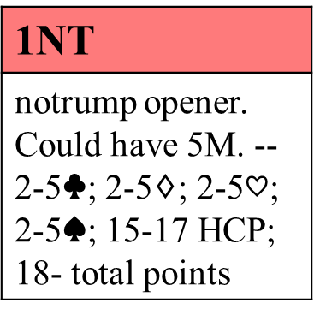
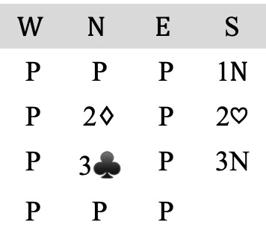
Hidden Messages in Bidding
 | — 98632 K5 AQT987
QT764 Q5 JT876 K | N W E S | A932 KJT7 42 643
 | KJ85 A4 AQ93 J52
1NT
notrump opener. Could have 5M. -- 2-5$♣$; 2-5$♢$; 2-5$♡$; 2-5$♠$; 15-17 HCP; 18- total points
$$W$$ | $$N$$ | $$E$$ | S
P | P | P | 1$N$
P | 2$♢$ | P | 2$♡$
P | 3$♣$ | P | 3N
P | P | P

Slide 5
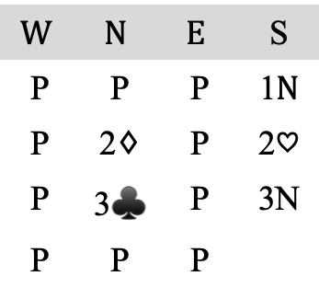
Goal of the Predictive Model
 | — 98632 K5 AQT987
QT764 Q5 JT876 K | N W E S | A932 KJT7 42 643
 | KJ85 A4 AQ93 J52
$$W$$ | $$N$$ | $$E$$ | S
P | P | P | 1$N$
P | 2$♢$ | P | 2$♡$
P | 3$♣$ | P | 3N
P | P | P
?

Slide 6
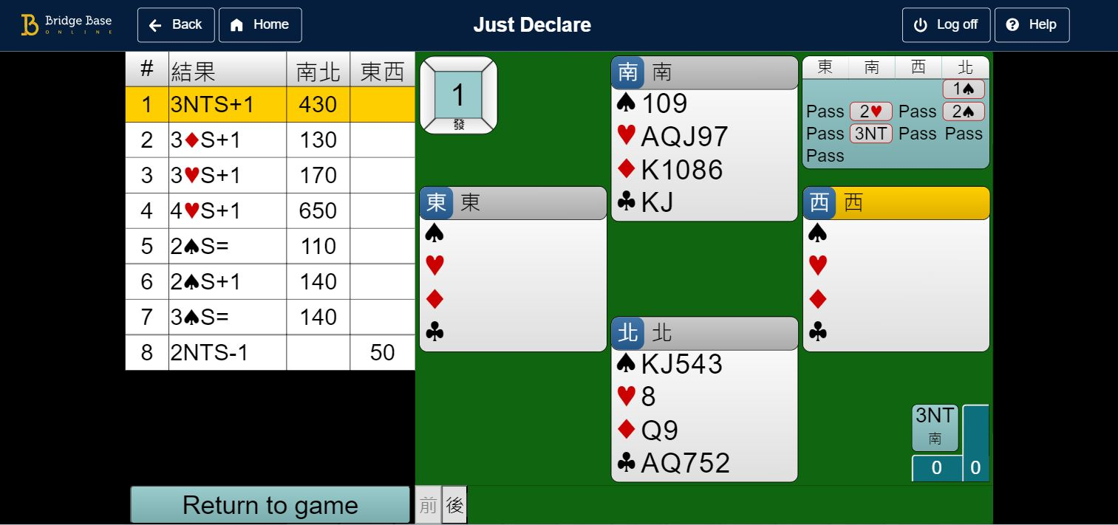
Dataset - BBO Solitaire’s “Just Declare”
The image is captured from Bridge Base Online https://www.bridgebase.com

Slide 7
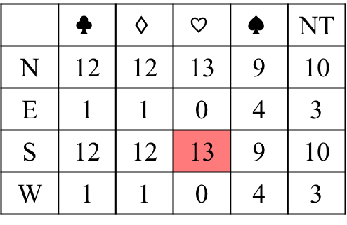
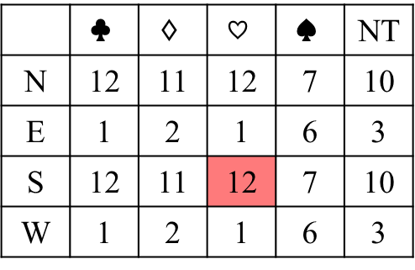
The Issue of Luck in Bridge
For a ﬁxed NS hand, shuﬄe 100 diﬀerent decks where the EW does not bid
 | — 7432 AKT642 AT7
A982 865 J95 543 | N W E S | KT765 J9 Q87 J82
 | QJ43 AKQT 3 KQ96
 | — 7432 AKT642 AT7
A9852 5 J987 543 | N W E S | KT76 J986 Q5 J82
 | QJ43 AKQT 3 KQ96
 | $$♣$$ | $$♢$$ | $$♡$$ | $$♠$$ | NT
N | 12 | 12 | 13 | 9 | 10
E | 1 | 1 | 0 | 4 | 3
S | 12 | 12 | 13 | 9 | 10
W | 1 | 1 | 0 | 4 | 3
 | $$♣$$ | $$♢$$ | $$♡$$ | $$♠$$ | NT
N | 12 | 11 | 12 | 7 | 10
E | 1 | 2 | 1 | 6 | 3
S | 12 | 11 | 12 | 7 | 10
W | 1 | 2 | 1 | 6 | 3

Slide 8

Which is the Best Contract?
 | 5C | 3D | 3H | 3S | 3N
Score | 600 | -200 | 140 | -400 | 630
Declarer | N | N | S | S | S
 | — 98632 K5 AQT987
QT764 Q5 JT876 K | N W E S | A932 KJT7 42 643
 | KJ85 A4 AQ93 J52
$$W$$ | $$N$$ | $$E$$ | S
P | P | P | 1$N$
P | 2$♢$ | P | 2$♡$
P | 3$♣$ | P | 3N
P | P | P
?
 | C | D | H | S | N
Partial | 2 | 0 | 1 | 0 | 0
Game | 51 | 2 | 13 | 0 | 36
Slam | 41 | 0 | 0 | 0 | 0
Grand | 0 | 0 | 0 | 0 | 0
 | $$♣$$ | $$♢$$ | $$♡$$ | $$♠$$ | NT
N | 11 | 7 | 10 | 5 | 10
E | 1 | 5 | 3 | 8 | 2
S | 11 | 7 | 9 | 5 | 10
W | 1 | 5 | 3 | 8 | 2

Slide 9
More than One Contracts are the Best
Choose the better one from the total counts of suits ﬁrst.
Select a superior game category based on the overall number of game categories.
First choose by suit order: major suit, no-trump, minor suit; and then by category order: grand slam, slam, game, partial game.
 | C | D | H | S | N
Partial | 0 | 3 | 3 | 0 | 0
Game | 0 | 44 | 47 | 0 | 11
Slam | 0 | 47 | 14 | 0 | 0
Grand | 0 | 0 | 0 | 0 | 0
 | C | D | H | S | N
Partial | 0 | 0 | 0 | 0 | 0
Game | 13 | 0 | 49 | 0 | 42
Slam | 7 | 0 | 49 | 0 | 27
Grand | 0 | 0 | 0 | 0 | 0
 | C | D | H | S | N
Partial | 0 | 0 | 0 | 0 | 0
Game | 0 | 100 | 0 | 0 | 100
Slam | 0 | 0 | 0 | 0 | 0
Grand | 0 | 0 | 0 | 0 | 0

Slide 10
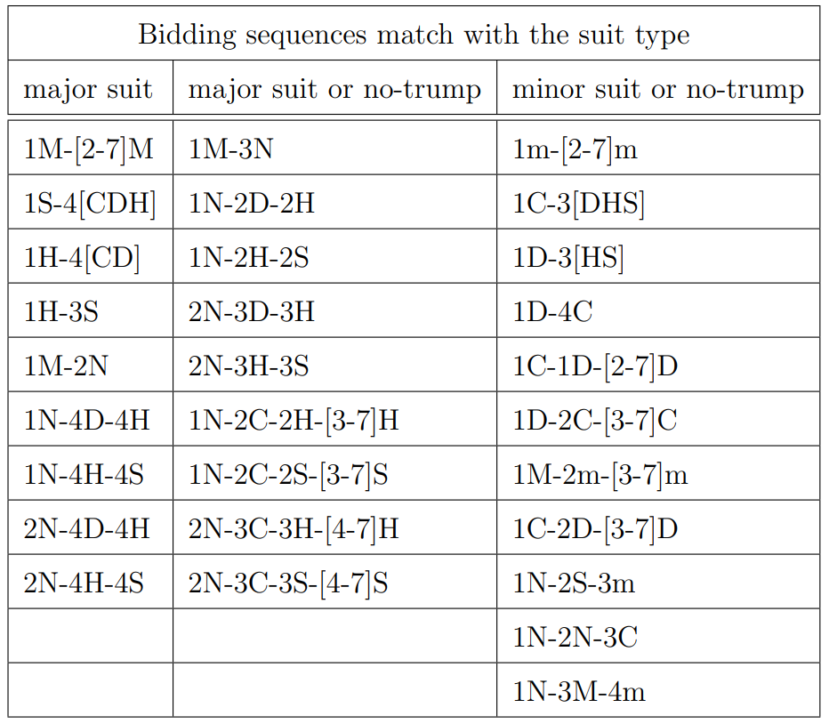
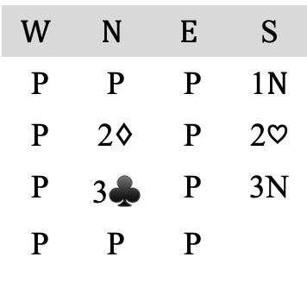
Which is the Most Suitable Contract?
$$W$$ | $$N$$ | $$E$$ | S
P | P | P | 1$N$
P | 2$♢$ | P | 2$♡$
P | 3$♣$ | P | 3N
P | P | P
 | C | D | H | S | N
Partial | 2 | 0 | 1 | 0 | 0
Game | 51 | 2 | 13 | 0 | 36
Slam | 41 | 0 | 0 | 0 | 0
Grand | 0 | 0 | 0 | 0 | 0

Slide 11
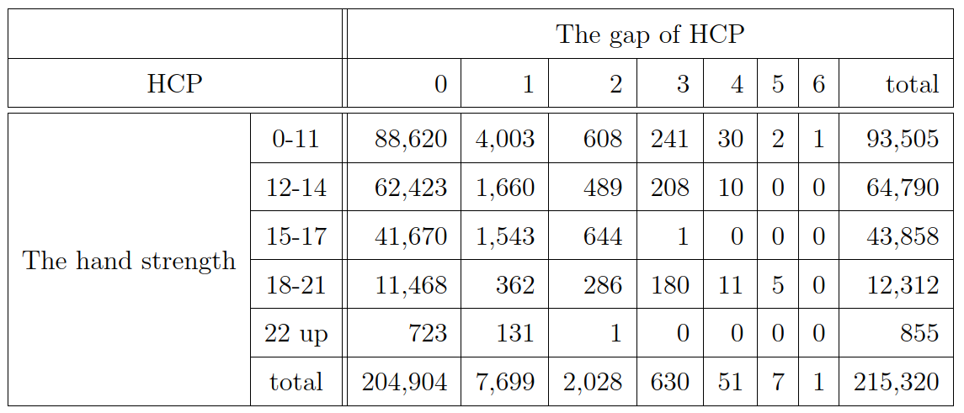
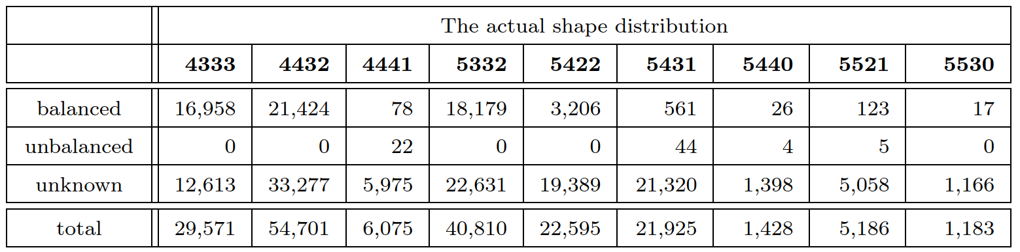
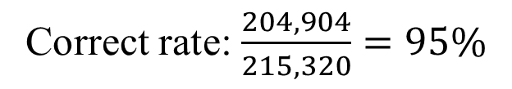
Dataset - BBO Solitaire’s “Just Declare”
Correct rate: $\frac{204,904}{215,320}=95\%$

Slide 12
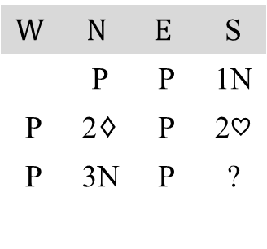
Data Labelling
HCP
A=4, K=3, Q=2, J=1
Balance
0:Balance, 4333/4432/5332/5422
3:Unbalance, Others
Stop
4:stopper,AQ/AK/AJT/KQJ/QJT9/
KJT9/A/KX/QJX/JT9X
3:partial-stop, K/QX/JXX/TXXX
2:unknown
1:no-stop, none of above
Vulnerability
NS nonvul, EW nonvul
NS vul, EW nonvul
NS nonvul, EW vul
NS vul, EW vul
 | T6 AT963 865 AQT
K94 KJ2 T43 KJ96 | N W E S | J732 85 K72 8752
 | AQ85 Q74 AQJ9 43
$$W$$ | $$N$$ | $$E$$ | S
 | P | P | 1N
P | 2$♢$ | P | 2$♡$
P | 3N | P | ?

Slide 13
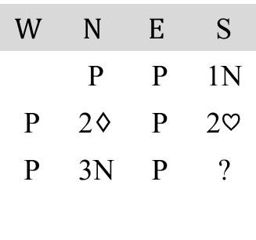
Input Representation
T6 AT963 865 AQT
N W E S
AQ85 Q74 AQJ9 43
$$W$$ | $$N$$ | $$E$$ | S
 | P | P | 1N
P | 2$♢$ | P | 2$♡$
P | 3N | P | ?
player_hcp_C/D/H/S | 0 |  |  |  |  |  |  | 7 |  |  |  |  |  | 2 |  |  |  |  |  | 6
total_hcp_lower/upper | 25 |  |  |  |  |  |  |  |  |  |  |  |  | 26
total_num_lower/upper | 2 |  |  | 4 |  |  |  | 4 |  |  | 6 |  |  | 8 |  |  | 8 |  |  | 4 |  |  |  | 7
player/partner_balance | 0 |  |  |  |  |  |  |  |  |  |  |  |  | 2
total_stop_C/D/H/S | 1 |  |  |  |  |  |  | 3 |  |  |  |  |  | 2 |  |  |  |  |  | 3
vulnerability | 4
bidding_history | P | C | D |  | H | S | N |  | C | D |  | H | S | N | C | D |  | H | S |  | N | C |  |  | N
 | 1 | 0 | 0 |  | 0 | 0 | 0 |  | 0 | 1 |  | 0 | 0 | 0 | 0 | 0 |  | 0 | 0 |  | 1 | 0 | … |  | 0
 | 0 | 0 | 0 |  | 0 | 0 | 1 |  | 0 | 0 |  | 1 | 0 | 0 | 0 | 0 |  | 0 | 0 |  | 0 | 0 | … |  | 0

Slide 14
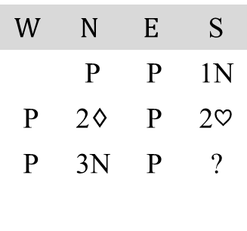
Two-stage Prediction with Random Forests
Stage 1: Predict the suit (or NT) that the board should choose.
Stage 2: Predict the game category (partial, game, slam, or grand slam).
Adjust the suit if it does not comply with the game rules.
 | T6 AT963 865 AQT
K94 KJ2 T43 KJ96 | N W E S | J732 85 K72 8752
 | AQ85 Q74 AQJ9 43
$$W$$ | $$N$$ | $$E$$ | S
 | P | P | 1N
P | 2$♢$ | P | 2$♡$
P | 3N | P | ?

Slide 15
Classify All Situations into Seven Indicators
Most Suitable: MS
Same Category: SC
Same Suit: SS
Same Category and Unacceptable Suit: SCU = SC \ (MS ∪ SCA)
Same Category and Acceptable Suit excluding Most Suitable: SCA = SC \ (MS ∪ SCU)
Same Suit excluding Most Suitable: SSE = SS \ MS
Others: O = U \ (SC ∪ SS)
 | C | D | H | S | N
Partial | 2 | 0 | 1 | 0 | 0
Game | 51 | 2 | 13 | 0 | 36
Slam | 41 | 0 | 0 | 0 | 0
Grand | 0 | 0 | 0 | 0 | 0

Slide 16
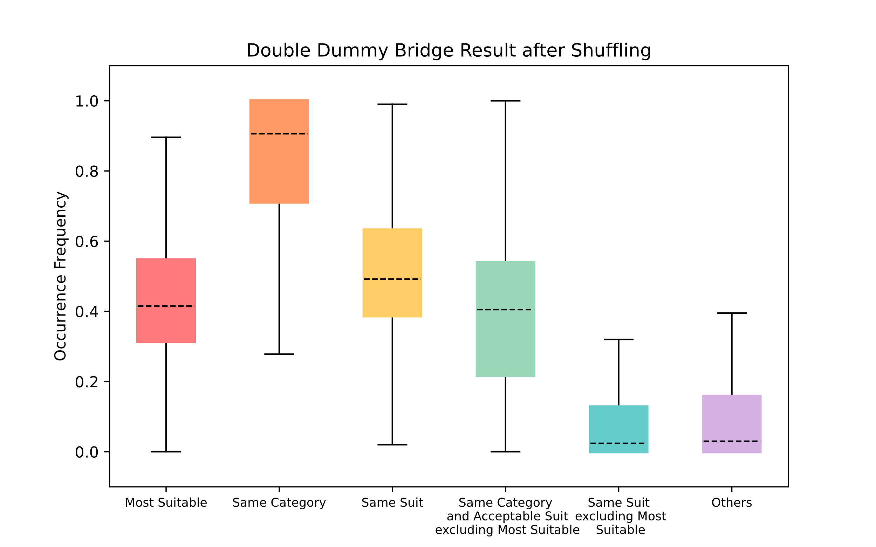
Proportions of Seven Indicators Becoming the Highest Score
 | C | D | H | S | N
Partial | 2 | 0 | 1 | 0 | 0
Game | 51 | 2 | 13 | 0 | 36
Slam | 41 | 0 | 0 | 0 | 0
Grand | 0 | 0 | 0 | 0 | 0
U = 146
MS = 36/146 = 0.247
SC = (51+2+13+36)/146 = 0.699
SS = 36/146 = 0.247
SCA = (51+2+13)/146 = 0.452
SSE = 0/146 = 0
O = (2+1+41)/146 = 0.301

Slide 17
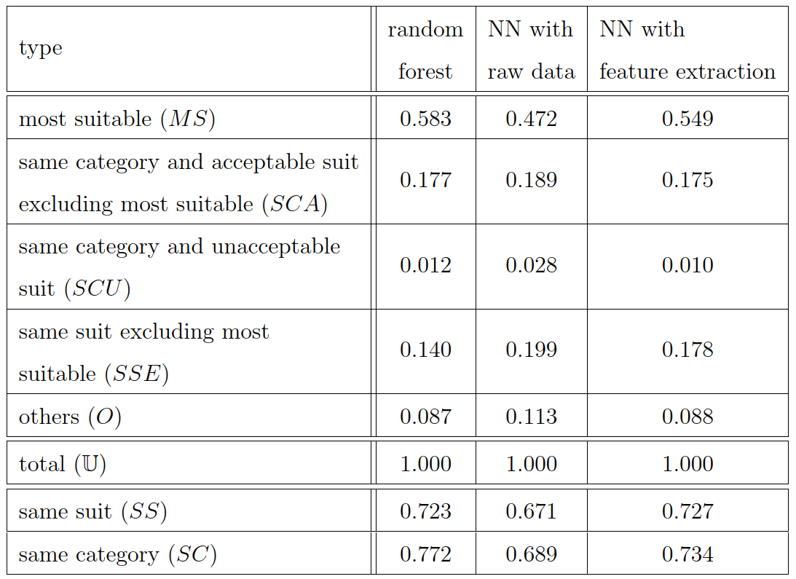
Random Forest Compared with NN Model(1/2)
Experiments are performed one time on the same training and testing sets

Slide 18
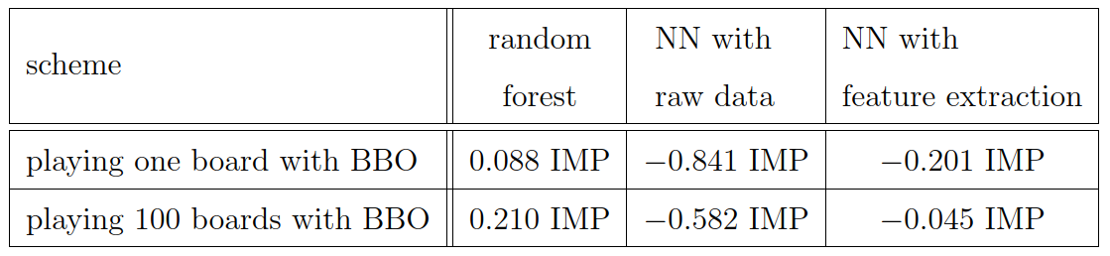
Random Forest Compared with NN Model(2/2)
Random Forest is better than NNs.
Feature extraction is helpful for predicting the ﬁnal contract.

Slide 19
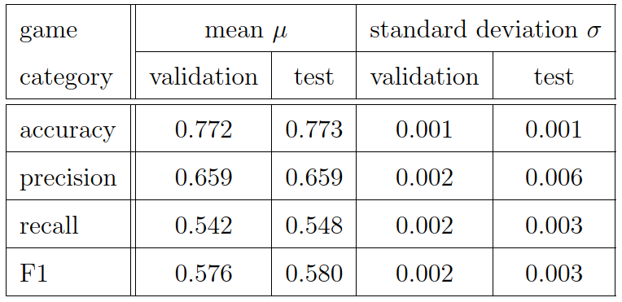
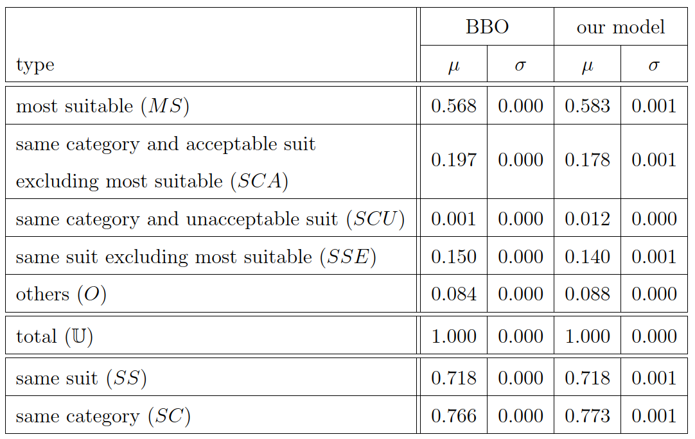
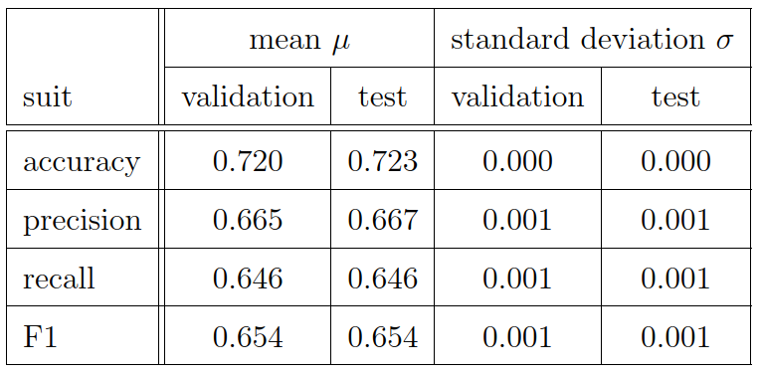
Experimental Result: Random Forests (1/2)
5-fold cross-validation experiments are performed ten times

Slide 20
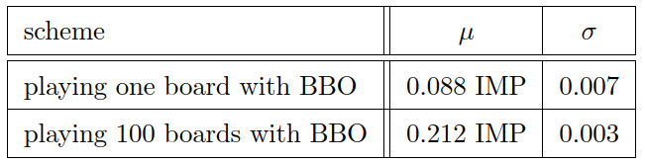
Experimental Result: Random Forests (2/2)

Slide 21
Conclusion
Propose the two-stage prediction with random forest models to predict the suit and game category.
Achieve an accuracy of 0.773 in prediction of the most suitable contract.
Achieve an average 0.212 IMP advantage over the BBO system in ten experiments.

Slide 22
Thanks for listening

